Slide 1
How to write a thesis
Disclaimer - read this first:
https://www.wu.ac.at/dpkm/topics/how-to-write-a-thesis/
how to get started, some Do's and Don'ts
… particularly in case I'm your supervisor ;-)
Axel Polleres
version: 2022-04-26

Slide 2
Some tips:
Your thesis is (typically) a monograph,* it shall have a clear structure and a running story that you tell throughout.
Your thesis is not a collection of excerpts of the literature, i.e.:
  it is ok to start with summarizing even copying text from papers you find as a part of your structured literature review BUT:
    Summarize what you UNDERSTOOD, not what you read.
  i.e. doing excerpts is not enough, but only a first step…
  … you rather should do a structured literature review.
* for PhD theses and Habilitation theses sometimes also cumulative theses (i.e. collections of own original works) are allowed, but that does not apply to Master or Bachelor theses.

Slide 3
Another word on literature References (especially important for the proposal)…
…. Again, do NEVER just summarize text and put the reference in the end!
References have two purposes only:
  Pointing to places where the reader finds more/deeper explanations than you provide in your written text
  Providing a source of where you took inspirations/your understanding for writing your own text from.
Implications:
Use only references you have read & understood
For each reference, your text should explain:
  why you used it
  why it is relevant for your thesis
Plus, you should be able to explain this for each reference in your own words, when I ask you ;-)

Slide 4
"Phases" of doing a thesis:
The second point of the last slide cannot be stressed enough…
  … write-up of your thesis should be considered a separate task/phase of your thesis project!
    it takes considerable time
    "mingling" this with the data/literature collection phase, i.e. collecting information and writing the thesis in one go is a common "recipe for failure"
Consider your thesis a project and plan it like a project!
    Example phases of a thesis project:
      research/literature collection phase - understand the problem
      Think of your contribution – what should be the (ideal) outcome?
      methodological familiarization phase: practice, familiarize yourself with needed technology (document what you learn here, this will be valuable for a "preliminaries section" in your thesis)
      design of your approach
      implementation phase
      evaluation phase (again, this may need a design phase for the evaluation, deciding on data to be used, how you want to analyze this data)
      write-up phase
        start from an empty document
        continue with a coherent structure
        write each section from scratch, drawing from the documentation and texts you produced in the earlier phases
        write the conclusions last, think about limitations and things you had to leave open in your work

Slide 5
What is your own contribution?
We expect an own contribution, in terms of e.g.
  Systematically structuring and comparing existing solutions on a problem:
    implement your own approach/artifact “design science”– and think about how to evaluate it
    reprocucability study (re-apply/re-implement/extend existing approches and compare your results to published ones
    define/appply criteria, systematically “slot” your research results into these criteria - qualitative comparison
    collect opinions of others (study/survey/interview-based)
    …
    i.e. it is not enough to summarize existing work sequentially “in your own words”.
    → The choice of contribution will determine your methodology! Not the other way around ;-)

Slide 6
The importance of reading:
Start reading now…
  Read a lot of scientific articles
  Look at other theses and how they are structured
Reading will help you
  Understanding how scientific work is best structured and presented → follow the examples, but find your own "mix".
  Read articles several times or iteratively
    1st time "skim"
      Start with getting the ideas, collecting articles,
      define which articles are in scope and which ones are "future work"
      which ones are relevant, which ones are not
    Read the in-scope articles in more detail
    Be ready to read more along the way
    Decide where you stop collecting more literature
I.e. reading and summarizing papers helps you to
  scope & understand
  the relevant literature
Tools you can use:
make a mindmap
categorize papers (post-its, labels, keywords)

Slide 7
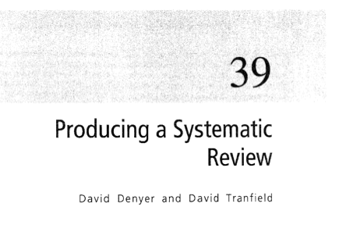
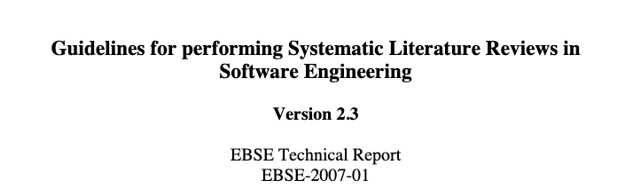

A structured literature review:
There are techniques for collecting and scoping literature in a structured manner:
A complete and well-done structured literature review may be
  a part of your work to scope related works
  worth a BSc or even an MSc thesis alone (exception),
  if done exhaustively and rigorously
First step: collect ALL references you come across in a BibTex database, and keep the bibtex entries tidy (always add authors, title, proper information how the source has been published, etc.)
https://www.cebma.org/wp-content/uploads/Denyer-Tranfield-Producing-a-Systematic-Review.pdf
https://www.elsevier.com/__data/promis_misc/525444systematicreviewsguide.pdf
https://twitter.com/moduloone/status/1449523528303198213

Slide 8
Some words on self-containedness …
What do you need to explain? What not?
Your thesis should be self-contained, in the sense that it is readable for your colleagues, or clear where they find the explanations they need.
I.e., someone who studied with you would be able to understand it, without having to read/redo your work, and could potentially continue your work.
  only write things you understood
    in a way that someone else can also understand them
  write down how you understood them, i.e. either
    explain them in your own words
    provide a reference, where there's a good explanation that helped you understand
  most importantly, don't copy or use terms and definitions you cannot explain.
  Read this:
  https://www.inc.com/glenn-leibowitz/the-single-reason-why-people-cant-write-according-.html

Slide 9
Scope & Management
  One of your main tasks in regular meetings with your supervisor is to manage the scope of your thesis!
  We will push potentially many ideas and suggestions to you how and where you can start and which particular aspects of your thesis topic you could investigate.
  It is your task to define a scoped topic out of these suggestions
  i.e., take the literature tips of your supervisor as starting points, but don't follow all routes at the same time --> it's up to you to define and argue the scope and to demonstrate that you have followed the literature deeply enough.

Slide 10
Scope & Management
  The other main tasks in regular meetings with your supervisor is to manage the progress of your thesis!
    Keep record of meetings (minutes) and send those to the supervisor
    Have a time plan & milestones and discuss it with your supervisor
    Agree on next meeting in the end of each meeting
    Agree on concrete things you plan to achieve until the next meeting
  Do not expect your supervisor to remember the details of your thesis/last meeting:
    i.e., start each meeting with a summary and status report and what was agreed in the last meeting!

Slide 11
Format:
In English (German *really* an exception only)
  English is the main language of our scientific discipline (and literature)
  most terminology doesn't translate well anyway to German
  makes your thesis more accessible internationally
Take care of proofreading and English language check, plan time for it
A bachelor thesis has a page limit of 40 pages text (not including cover, table of content, references, appendices).
A master thesis has a page limit of 80 pages text (not including cover, table of content, references, appendices).
A MBA thesis has a page limit of about 60 pages text and slightly different formatting guide by ExAc
If you have more material, think of moving parts to an appendix.
If you have less material, do NOT fill up pages, it is really NOT about pages.
If you want to write an academic thesis well: read a lot of scientific articles! start now!

Slide 12
How to write a good research paper/proposal/thesis?
Make your thesis an interesting read!
i.e., don't annoy the reviewer/reader ;-)

Slide 13
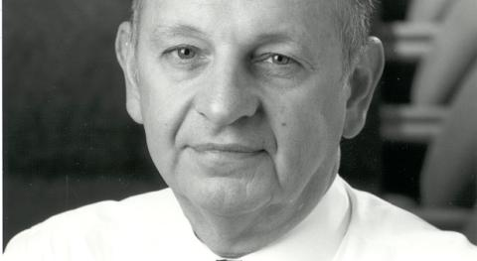
Heilmeier‘s catchism:
George H. Heilmeier, Director of DARPA (1975 – 1977)

Slide 14
Critical questions for ANY research project/paper/thesis:
paraphrasing:
What is the problem?
Why is it a problem?
Why should the reader care?
What's your solution/contribution?
Hint:thesis introduction section should answer those!
A set of questions credited to George Heilmeier that anyone proposing a research project or product development effort should be able to answer.¹
What are you trying to do? Articulate your objectives using absolutely no jargon.
How is it done today, and what are the limits of current practice?
What's new in your approach and why do you think it will be successful?
Who cares?
If you're successful, what difference will it make?
What are the risks and the payoffs?
How much will it cost?
How long will it take?
What are the midterm and final "exams" to check for success?
¹ G. Heilmeier, "Some Reflections on Innovation and Invention,"
Founders Award Lecture, National Academy of Engineering, Washington, D.C., Sept. 1992.

Slide 15
Structure:*
My own „default“ structure of a research paper (mainly suitable for the "case study" style):
0. Abstract
Introduction (Motivation)
Background
  Introduce background as necessary for the reader
  Often useful to add a „running example/scenario“
<Your proposed solution>
Evaluation
Related works
Future Work & Conclusions
References
(Appendices: proofs, details on experiments)
Variations of this scheme may apply, depending on your audience & purpose:
  Purpose: magazine article, vs. scientific journal vs. Seminar article vs. Diploma thesis)
  Audience: research community (Database vs. Economists), students vs. experienced researchers vs. Layman audience
  The main thing is : A thesis is a monography → Tell one coherent story
  Tell Your story: i.e. follow the structure in spirit, but adapt it to your needs, do not blindly use the same section headings!
*) For PMBA theses: see also Section 2.2 of the PMBA Thesis guide
Important:
DON'T USE THIS (or any other "generic" structure!!!
Your supervisor (and other readers) should already see from the content structure what you worked on!!!

Slide 16
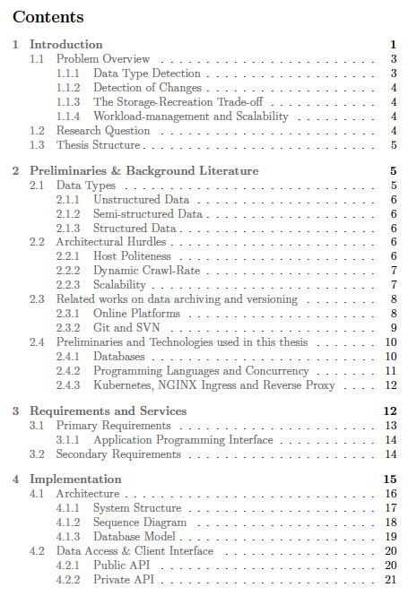
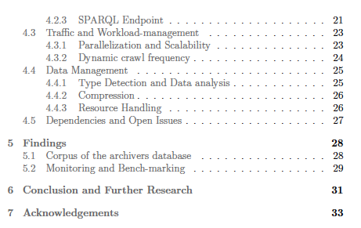
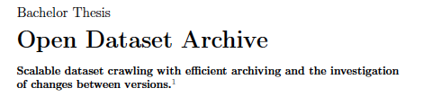
Structure: "award-winning" example" (TALENTA)

Slide 17
Some words on style:
use passive voice sparsely (rather use an inclusive "we")
don't state the obvious
Don't use subheadings directly after another heading
…

Slide 18

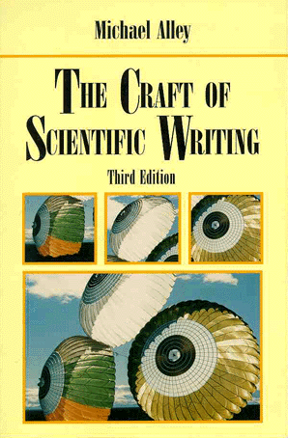
There are tons of books on Style...
... some examples from my shelf
If you look for good examples, take the base articles as a reference!

Slide 19
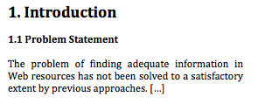
Some words on style
Most importantly: Don‘t annoy the reader/reviewer
  use a spell-checker ;-)
  avoid to repeat yourself
  explain the “big picture” before you jump into technical details
  avoid to state the obvious
  Avoid “Germanisms”, e.g.
    again: in English passive voice is less common than in German
    In English, often people avoid using ”I” in favor of a (reader-inclusive) “we”, even in single author papers!
  use proper citation
  be concise
  „If I had more time I would have written a shorter letter“ (Blaise Pascal? Mark Twain?)
  don‘t jump, follow a consistent line of arguments („roter Faden“)
  always try to consider the viewpoint of your reader/audience
Don't don't (i.e. avoid short forms like don't doesn't, can't …)
Use section structuring properly, e.g.

Slide 20
More bad examples 1/4:
  Avoid to state the obvious:
„This seminar paper was written for the course `Forschungsseminar Systemanalyse` in Summer term 2015“
... Not relevant. Look at accepted conference papers, nobody writes:
„This paper was written as a submission to the World Wide Web conference.“
i.e. the motivation/introduction section should explain what is the problem, not why you had to write the thesis. ;-)

Slide 21


More bad examples 2/4:
  use proper citation in the text, e.g. do not use citation as subject of a sentence:
  Better, e.g. :
  Dalvi et al. developed an approach called ``Web of concepts” [5] …
  or:
  The ``Web of concepts” approach [5] …
…
…
…

Slide 22
More bad examples 3/4:
  use of domain-specific terminology in your paper without explaining them, or giving a concrete reference where it is explained. E.g. if you write…
    "The k-means algorithm always finds a solution, which is not necessarily the optimal solution. Finding an optimal partitioning belongs to the class of NP-hard problems."
  … What do you mean by optimal? Can you define it? Can you expect the reader to know what NP-hardness means? Would you be able to explain it, if your supervisor asks you? If not:
    Read up on it!!!!
    Explain it in the preliminaries
  Better:
    Explain all relevant domain-specific terms in a leading "Background" or "Preliminaries section" and/or add a good reference (ATTENTION: only explain those terms relevant for your theses, finding the right balance between explaining too little and too much is an art ;-))

Slide 23
More bad examples 4/4:
  similarly, use of abbreviations without explaining them:
"We want to show which sub-question can be answered using SPARQL queries on the MAKG."
  Better:
    Explain each abbreviation at its first use in the thesis, provide references:
    "We want to show which sub-question can be answered using queries in the SPARQL query language [1] on the Microsoft Academic Knowledge Graph (MAKG).¹"
    ----
    ¹ available at http://ma-graph.org/, last acceessed 27.2.2021

Slide 24
Follow back to original References:
"We use PageRank [1], … "
Cite the original, e.g.
  don't cite Wikipedia for PageRank
    [1] Wikipedia "PageRank" . https://en.wikipedia.org/wiki/PageRank, last accessed 27.2.2021
  don't cite another paper that uses PageRank, e.g.
    [1] Ljosland, Mildrid. "Evaluation of Web search engines and the search for better ranking algorithms." SIGIR99 Workshop on Evaluation of Web retrieval. 1999.
  but cite the original reference:
    [1] Brin, S.; Page, L. (1998). "The anatomy of a large-scale hypertextual Web search engine" (PDF). Computer Networks and ISDN Systems. 30 (1–7): 107–117. doi:10.1016/S0169-7552(98)00110-X. ISSN 0169-7552.
General rule: cite webpages ONLY as a last resort (if there's no good textbook or academic paper explaining it), and, for Webpages, always add a "last accessed" date.
  Additionally, Check if URLs are indexed at the Web archive and if yes , ideally refer to the specific version you mean, e.g. the example from the last slide:
    https://web.archive.org/web/20201206004707/http://ma-graph.org/ refers to the last indexed version on the Web archive from 06 December 2020.

Slide 25
… I could go on forever here, but once again to conclude:
  learn from reading good papers!
  not only from their content, but also from their
    structure
    use of references
    explanations of related backgrounds
    style
  start reading and searching for literature now! ☺

Slide 26
Examples of good theses?
Some excellent theses that truly fullfilled or exceeded these expectations (at various levels, incl. 5 WU TALENTA awards!):
  http://polleres.net/supervised_theses/
  https://semantic-systems.org/student-thesis/
(Hint: unless you're a PhD student …
… of course you're NOT expected to do a CS PhD thesis ;-)))
To get equally great results:
plan & manage your thesis (and your supervisor ;-))

Slide 27
Further information
formatting
Why use LaTeX?
  the main tool used in scientific writing!
    Makes keeping of references really easy (using BibTex)!
    For our undergraduate thesis we actually provide a LaTeX thesis template it (which in case someone is interested, we could adapt):
    You can work using online tools, e.g. https://www.overleaf.com/ (many good tutorials on their page as well!
… again: find it here: https://www.wu.ac.at/dpkm/topics/how-to-write-a-thesis/

Slide 28
Code? Data?
If you produce code or data for your thesis, wherever possible:
  Be FAIR (cf. https://www.go-fair.org/fair-principles/ ):
    Findable
    Accessible
    Interoperable
    Reusable
  Apply-best practices:
    E.g.
    use a versioning tool/repository
    use a git repository (we can provide one at the institute)
    Add a licences for reuse (ideally an Open License!)
  i.e. make your work re-usable for other students who could build up on it!

Slide 29
A word on plagiarism…
ALL (no exceptions) inspirations you took from elsewhere should be referenced
We us e a plagiarism checker!
  reformulate and explain things you read elsewhere IN YOUR OWN WORDS
  any literal quotes have to be clearly marked as such (using quotes and italic)
Also figures and images need to be referenced!!!!
  I also use image search engines to check figures
Again: follow references to the original source! (cf. slide 20)

Slide 30
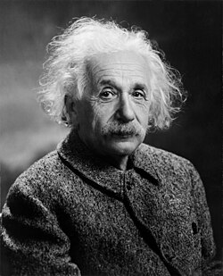
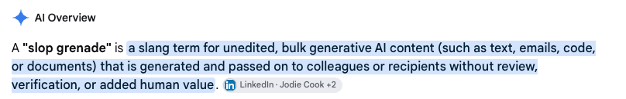
A word on plagiarism(?)… LLMS
Before asking an AI model for help, think twice:
”If you can't explain something simply,
you don't understand it well enough”
- Albert Einstein
A thesis (and its defense) shall first and foremost proof that YOU have understood the subject matter:
Implication: this is why we need to orally exam you about your thesis, ensure that you can explain it, and that you understand it.... to the level of every explaining and arguing any sentence and line of code you wrote. That's the very learning goal of a thesis.
No “Slop grenades”!
https://en.wikipedia.org/wiki/AI_slop
Interact with your supervisor, rather than with AI tools only!
p

Slide 31
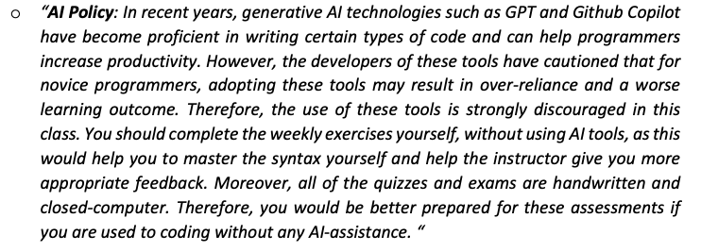
A word on plagiarism(?)… LLMS
Large-Language models like GPT, Claude, Gemini LLAMA, and friends
  are like “pocket calculators”
  but (still!) make mistakes (hallucination)
In general, we discourage their use for a thesis: you should learn how to write a good text/thesis yourself!
Agree about AI usage bounds with your supervisor as part of the proposal
Don’t take any output of an LLM into your thesis unreflected/unchecked
If you use an LLM, keep/provide a transcript of your interactions!
NEVER feed sensitive, personal, or copyrighted information into an LLM!
Be ALWAYS able to explain anything you write yourself!
Summarize your own contribution in your thesis, e.g. for a survey, how you structured the literature, which criteria you defined.
Sample guidline from a syllabus… apply analogously! ;-)
!
FAIR AI usage:
(1) keep track of all thesis related use in an obligatory
List of aids (Hilfsmittelverzeichnis).
(2) eparate use for your thesis from private use !!!
(keep separate chat/agent instruction logs)

Slide 32
Any additional questions?
In this order:
contact your supervisor!
  write a friendly reminder if you don’t get an answer within 2-3 days
backup (sometimes emails may get lost, just too many ☹):
  contact backoffice@ai.wu.ac.at

