Slide 1
BYOD Online Exam DMA

Slide 2
Please use/install the latest version of Chrome.
When you start the exam:
You will be asked to allow screen sharing when starting the exam.
On Mac OS, you might need to give permissions for screen sharing to Google Chrome upfront!

Slide 3
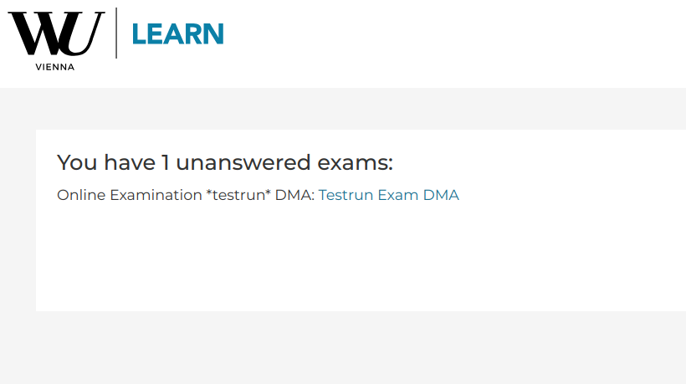
When you log into learn.wu.ac.at …
Go to : http://learn.wu.ac.at/exams/ and you will see something like this (click to start he correct exam,
On 27th NOT the testrun!):

Slide 4
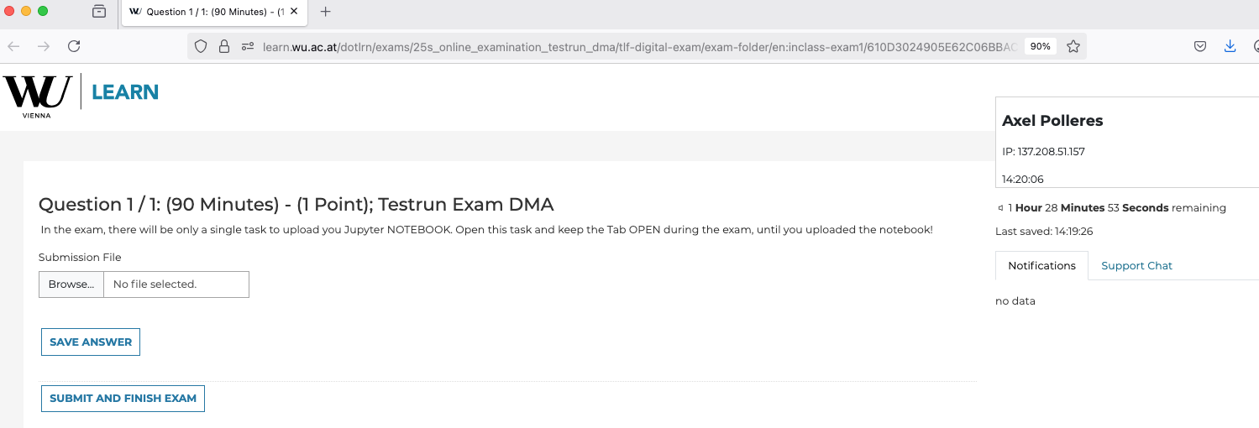
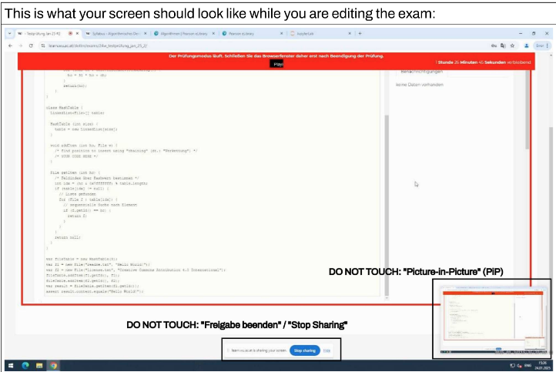
Finding your exam…
AFTER having started the online exam (KEEP THIS browser tab OPEN!)…
And also don’t close the PiP::
Now … in a new browser tab go to canvas.wu.ac.at (and log in)

Slide 5
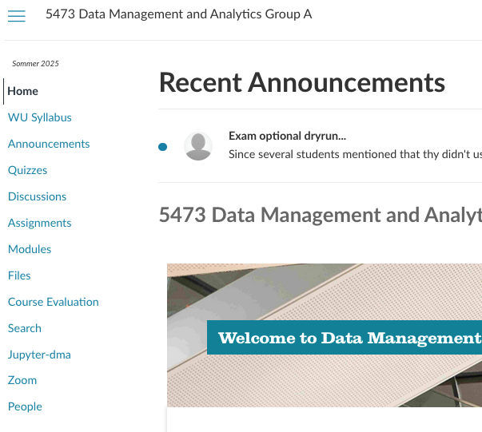
On canvas…
as usual, open your Jupyter environment from the course:

Slide 6
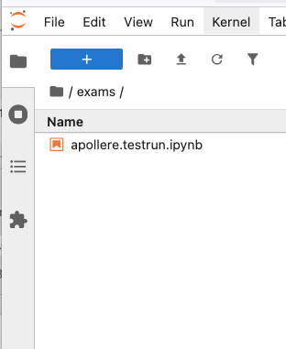
On Jupyter:
You will find your individual exams notebook called
  MATNR.ipynb and a
  MATNR.sql datafile
  in your exams folder:
  Start working…
  Save early, safe often!

Slide 7
Go to : http://learn.wu.ac.at/exams/
Exam Rules:
Choose a seat: Leave every 2nd row free
(start from 1st row) & 1 seat free in between, if possible (exceptions: row 1 and 3)
Do NOT use other browsers than Chrome
Do NOT close the exam browser TAB until you have downloaded and submitted your completed exam MATNR.ipynb file.
You are allowed to also open MS Teams, but not to communicate with other students during the exam.
Do not work on the notebook in another environment than our hosted jupyter environment.
Only open browser windows and tabs to allowed tools (see earlier announcment)
If you have questions, use the MS Teams channel (see Announcement on Canvas).
Strongly recommended: Wrap-up at around 11:50

