Slide 1
Knowledge Graphs – a key component in Bilateral AI
Axel Polleres

Slide 2
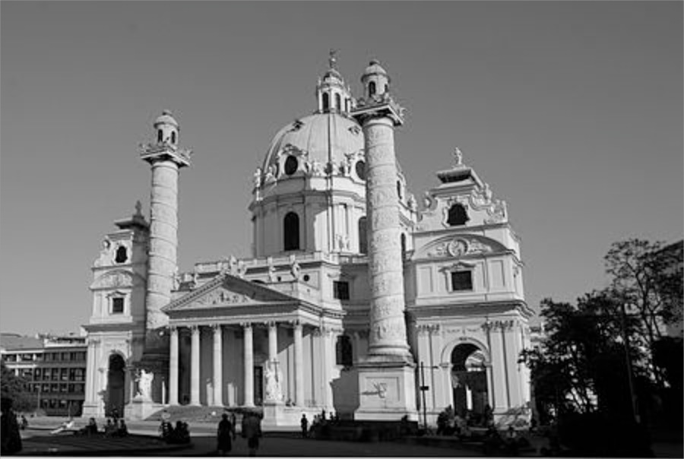
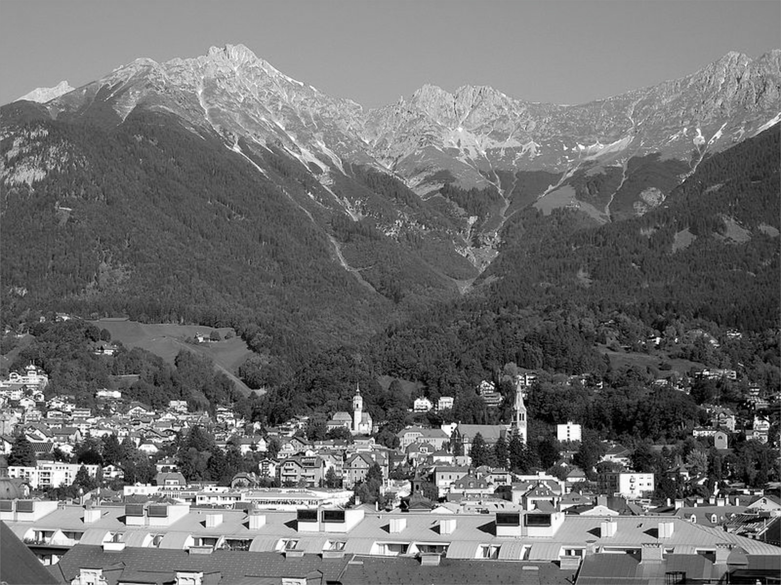




Great to be back!
Logic Programming, “Symbolic” Artificial Intelligence
Semantic Web, Knowledge Representation & Reasoning
Web Standard
Query Language (SPARQL)
Data Integration, Open Data
Knowledge Graphs
“Bilateral” AI
Linked Data
LLMs
2003
2005
2007
2011
2013
~2020
TU Vienna
Univ. Innsbruck
Univ. Rey Juan Carlos Madrid
DERI, NUI Galway, Ireland
Siemens AG Österreich
WU Vienna

Slide 3
Abstract:
The history of the Semantic Web and Knowledge Graphs is tightly interwoven with applications of different techniques and methods of AI, but also with the idea of Agents collaborating in a decentralised manner. In this talk I will give an overview of this history from predominant symbolic AI methods in the beginning towards the seeming dominance of GenAI and LLM approaches nowadays.
Yet, as we will see, the still open challenges call for Hybrid or - as we call them - “Bilateral” AI” approaches. In the course of of the talk, we will particularly focus on the central role of graph-based knowledge representation in Knowledge Graphs, which, as we argue, while having been influenced by both, neither can be viewed purely as (graph) databases nor as ontologies in a narrow sense. Lastly, we aim at giving an overview of ongoing trends and our current research in the Knowledge Graphs community with hopefully inspirations for potential collaborations.

Slide 4
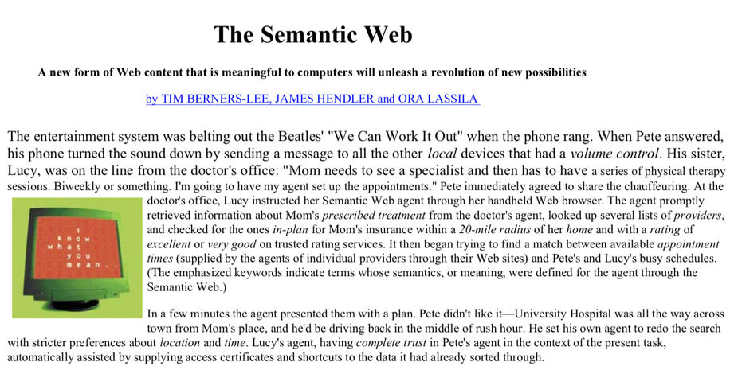
“[…] The agent promptly
retrieved information about Mom's prescribed treatment from the doctor's agent, looked up several lists of providers,
and checked for the ones in-plan for Mom's insurance within a 20-mile radius of her home and with a rating of excellent or very good on trusted rating services[…]”
Appointment detection in emails
Semantic Search
Ratings of products/services
"If HTML and the Web made all the online documents look like one huge book, RDF,
schema and inference languages will make all the data in the world look like one huge
database"
Tim Berners-Lee, Weaving the Web, 1999
Instead of its initial focus on agents the “Semantic Web”…
… has then mostly become the basis for the "Web of Data"…
… and its more recent focus on Open Knowledge Graphs…
" huge knowledge bases, also known as knowledge graphs, have been automatically constructed from web data, and have become a key asset for search engines and other use cases.
Gerhard Weikum, Knowledge Graphs 2021: A Data Odyssey, VDLB 2021

Slide 5
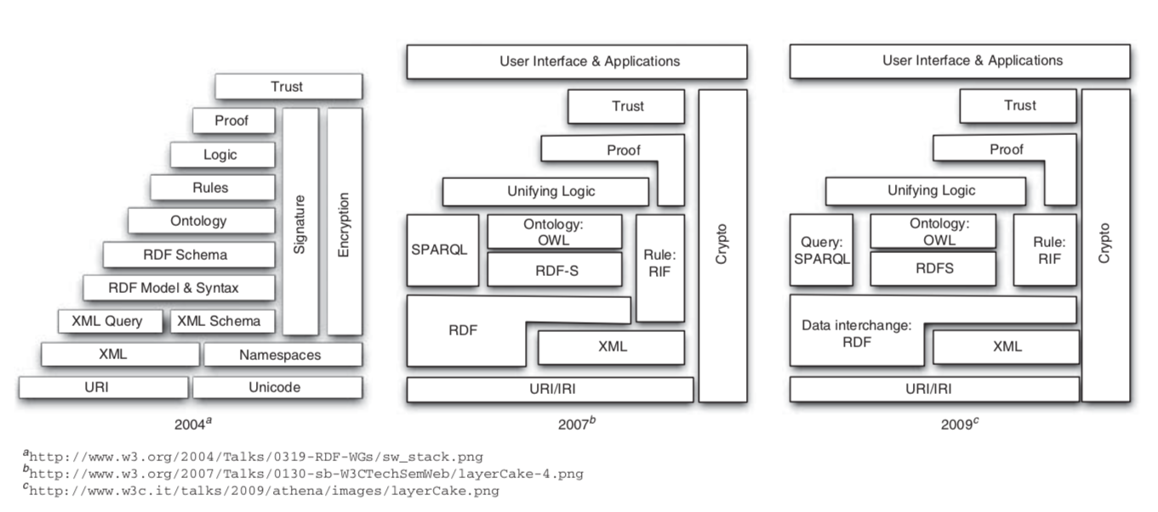
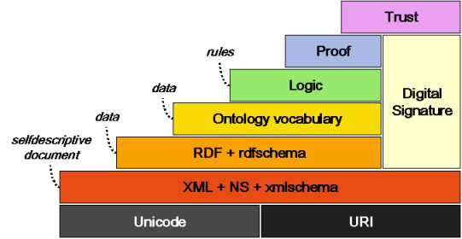

Semantic Web: Standard formats,
Reasoning & Logics
(2000s - ca. 2009)
Work on “Unified Logics”
Description Logics or Rules?
(Contextualized Reasoning?)
Good news! Boost in KR/AI research:
We know very well which ontological reasoning
approaches are decidable and how they scale
→ OWL, OBDA, but also: constraint checking (SHACL)
Semantic Web Activity
Olivier Boissier, Marco Colombetti, Michael Luck, John-Jules Meyer, and Axel Polleres. Norms, organizations, and semantics. The Knowledge Engineering Review, 28(1):107--116, March 2013.

Slide 6


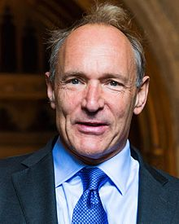

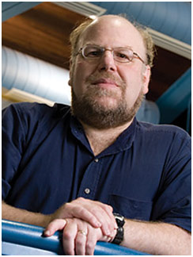
Focus on Data: Linked Data
(ca. 2006/7 – ca. 2013)
  Main question: How can I publish “Knowledge on the Web” …
Linked Data Principles
LDP1: use URIs as names for things
LDP2: use HTTP URIs so those names can be dereferenced
LDP3: return useful – RDF? – information upon dereferencing those URIs
LDP4: include links using externally dereferenceable URIs.
https://www.w3.org/DesignIssues/LinkedData.html (originally published 2006-07-27)
“A Little Semantics Goes a Long Way” (Jim Hendler)
http://linkeddatabook.com/editions/1.0/
https://www.cs.rpi.edu/~hendler/LittleSemanticsWeb.html
Notes:
So, how does this work? Strong reliance on standards and standard formats and query languages, such as SPARQL which make it eas to compile and aggregate these connected knowledge graphs to new special purpose knowledge graphs for your application!

Slide 7
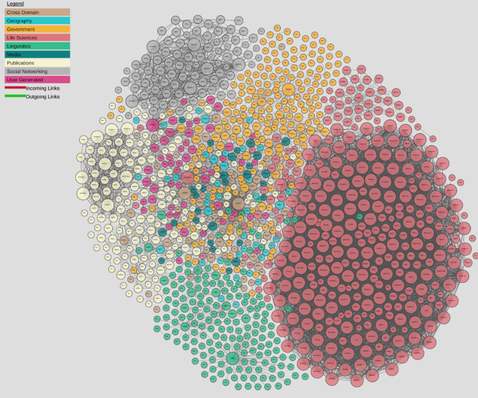

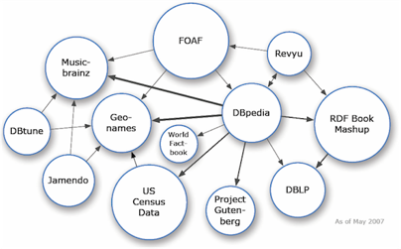
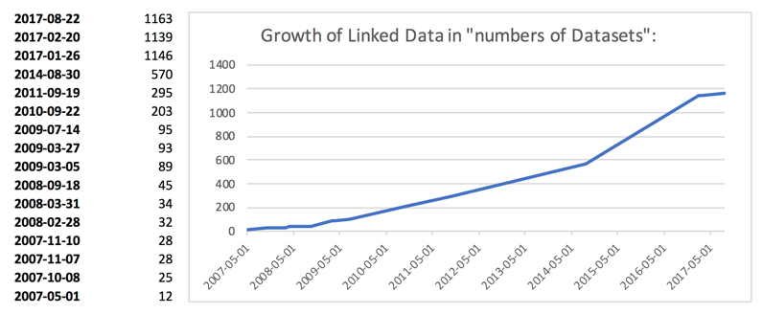
From Semantic Web to Linked (Open) Data
(ca. 2006/7 – 2012)
  Main question: How can I publish “Knowledge on the Web” …
    Linked Open Data… growth slowed down a bit
    A lot of active developments to publish and link RDF Data
    also in Enterprises (“Enterprise Linked Data”)
http://lod-cloud.net/
Axel Polleres, Maulik R. Kamdar, Javier D. Fernández, Tania Tudorache, and Mark A. Musen. A more decentralized vision for linked data. In Decentralizing the Semantic Web (Workshop of ISWC2018).

Slide 8
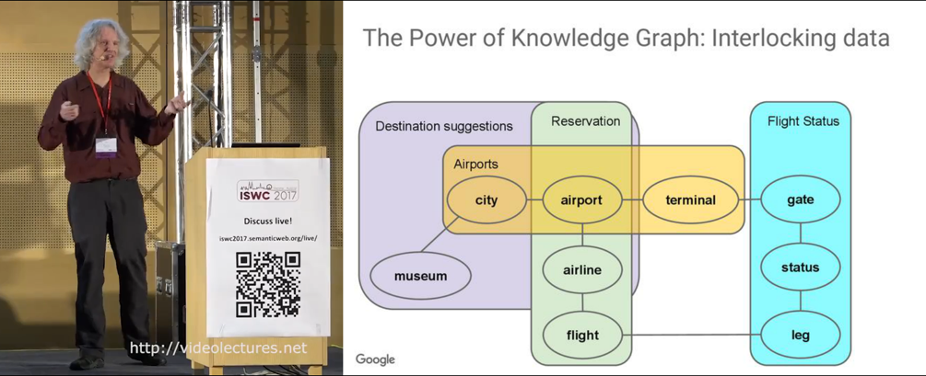
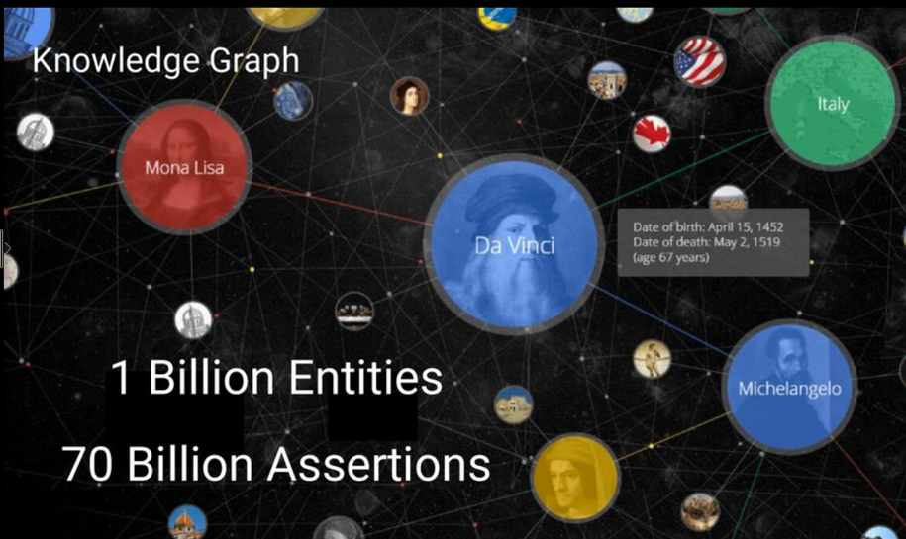
From Linked Open Data to Knowledge Graphs:
2013: Google adopts Semantic Web ideas under a new name
Jamie Taylor, Google, Inc., Keynote ISWC2017
Actors, Directors, Movies
Art Works & Museums
Cities & Countries
Islands, Lakes, Lighthouses
Music Albums & Music Groups
Planets & Spacecraft
Roller Coasters & Skyscrapers
Sports Teams [...]

Slide 9
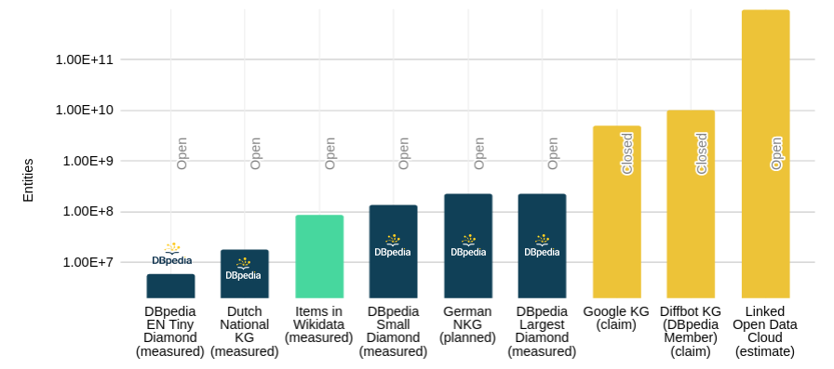
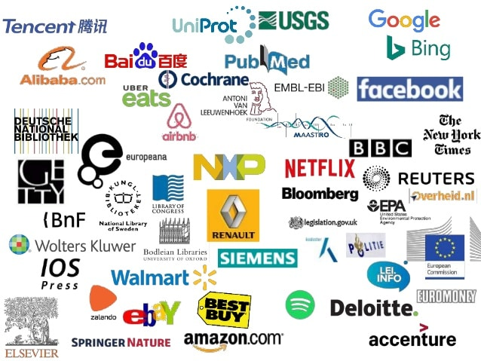
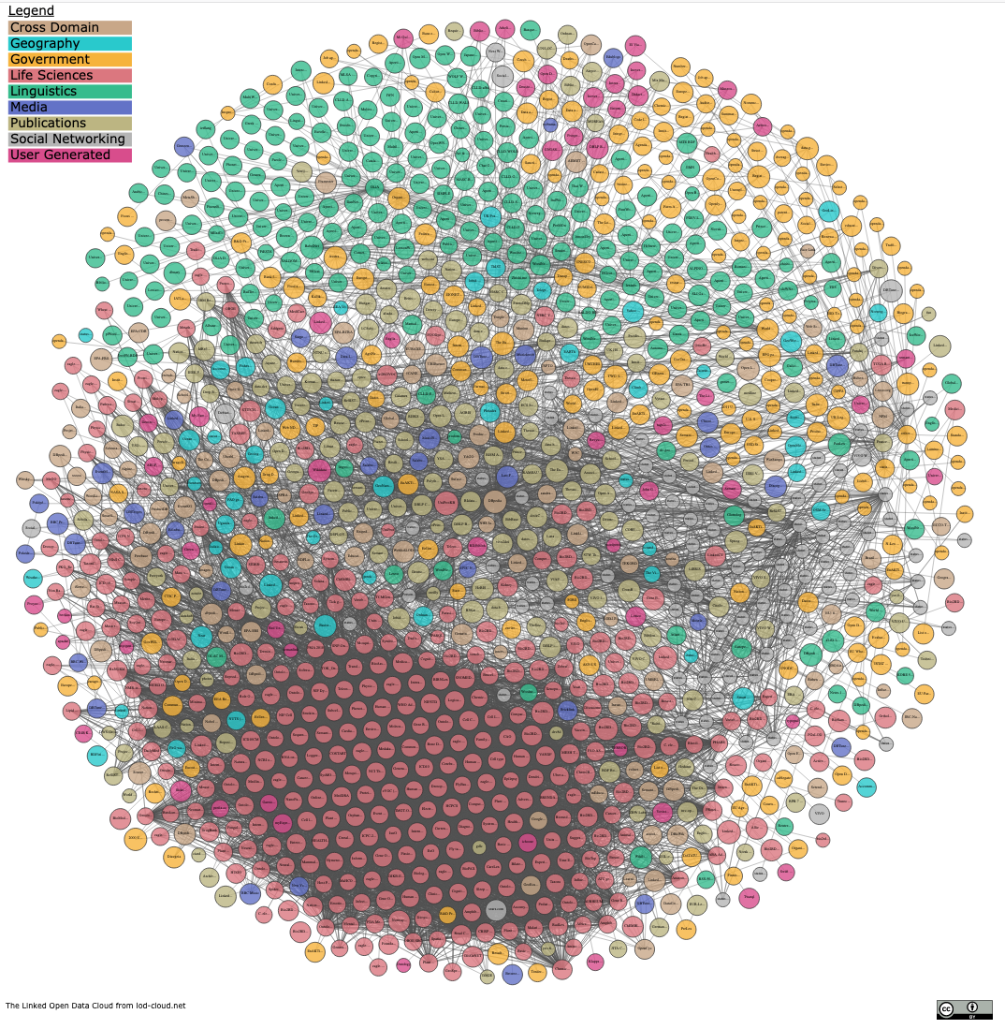
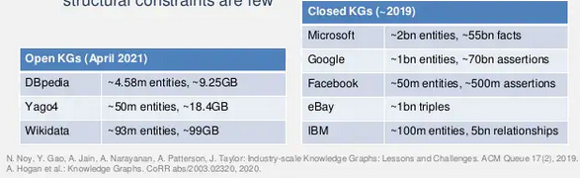


From Linked Open Data to Knowledge Graphs:
  Success stories of mainly monolithic (but huge) Knowledge Graphs rather than a network of Linked small KGs:
https://www.slideshare.net/Frank.van.Harmelen/adoption-of-knowledge-graphs-late-2019
https://www.dbpedia.org 2021
Notes:
https://www.slideshare.net/Frank.van.Harmelen/adoption-of-knowledge-graphs-late-2019

Slide 10
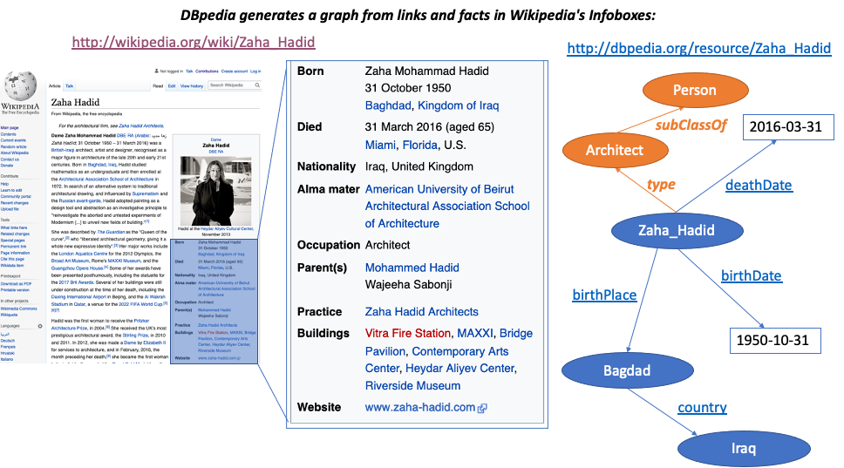
Collaborative, Open Knowledge Graphs:

Slide 11

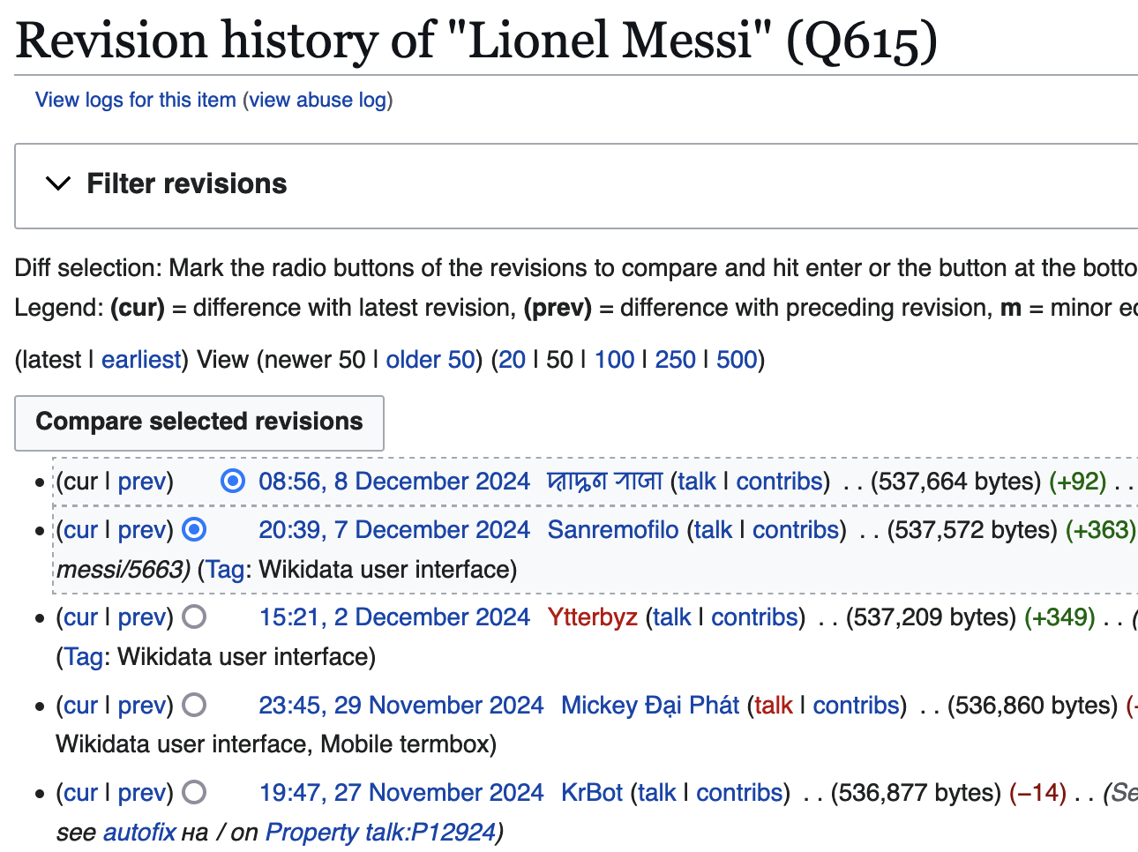

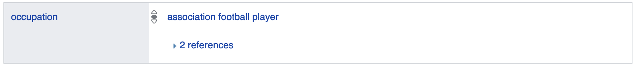
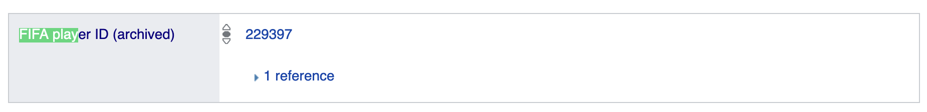
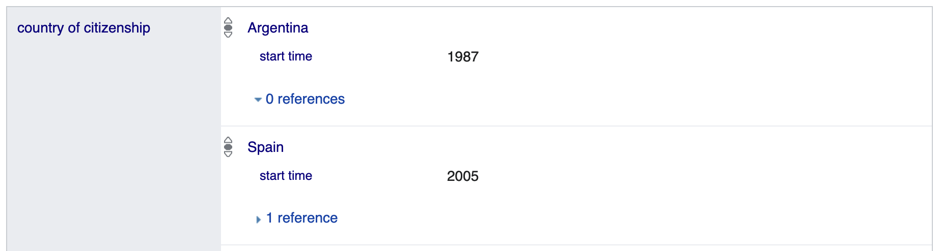
Collaborative, Open Knowledge Graphs:

Slide 12
From Linked Open Data to Knowledge Graphs:
What’s the state of affairs?
    Large-scale, still data-focused (rather than schema-focused)
    Often monolithic, rather than linked/decentralised
    Knowledge extraction rather than Knowledge engineering
    Collaborative large-scale KGs:
      Collectively created (automated or curated)
      Notoriously incomplete
      (Logical) consistency not a must
    Enterprise KGs: knowledge necessary to power applications
    Ontological expressivity not central – BUT: Expresssing context is!
Jamie Taylor, Google, Inc., Keynote ISWC2017
Actors, Directors, Movies
Art Works & Museums
Cities & Countries
Islands, Lakes, Lighthouses
Music Albums & Music Groups
Planets & Spacecraft
Roller Coasters & Skyscrapers
Sports Teams [...]
Answer whether (something like RDF and/or triple stores are used under the hood answered vaguely…
For instance:
Provenance
Temporal context
Confidence

Slide 13
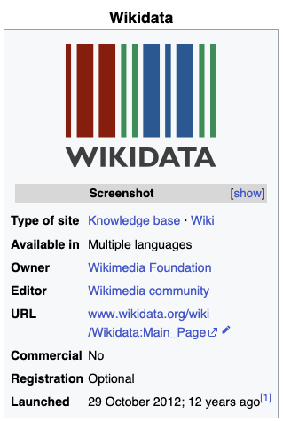
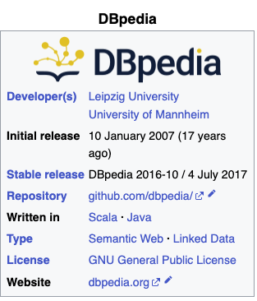


Let’s have a look at practical examples of such collaboratively curated Knowledge Graphs:
DBPedia (since 2007) vs. Wikidata (since 2012)
RDF
SPARQL endpoint
Standard ontology language (OWL)
Consistent
Context

Slide 14

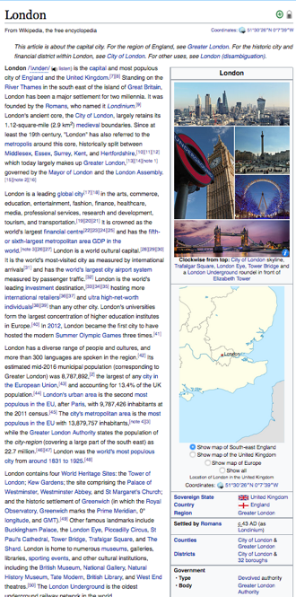
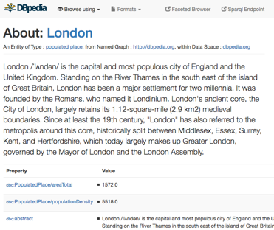
SPARQL: Using KGs to answer questions:
E.g. from
One of the central datasets of the Linked Open Data-Cloud
RDF extracted from Wikipedia-Infoboxes
You can use a language called SPARQL endpoint (roughly: SQL for RDF) to do structured queries over RDF:
  „Cities in the UK with more than 1M population“:
Structured queries (SPARQL):
https://api.triplydb.com/s/gZZskqRpQ
https://en.wikipedia.org/wiki/London
http://dbpedia.org/resource/London
PREFIX : <http://dbpedia.org/resource/>
PREFIX dbo: <http://dbpedia.org/ontology/>
PREFIX yago: <http://dbpedia.org/class/yago/>
SELECT DISTINCT ?city ?pop WHERE {
?city a schema:City .
?city dbo:country :United_Kingdom.
?city dbo:populationTotal ?pop
FILTER ( ?pop > 1000000 )
}
Automatic Exctractors

Slide 15
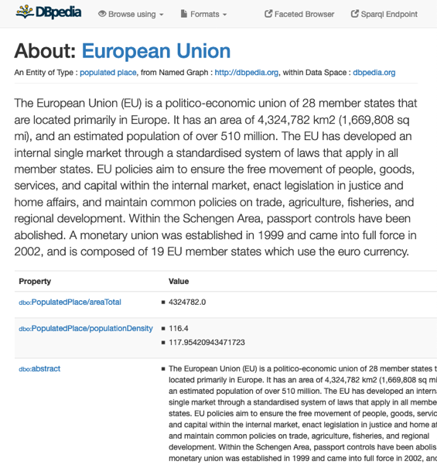

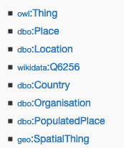

Dbpedia is not logically consistent! ☹ [1]
E.g.
Dbpedia Ontology:
dbo:Agent owl:disjointWith dbo:Place.
dbo:Country rdfs:subClassOf dbo:Place.
dbo:Organisation rdfs:subClassOf dbo:Agent.
Stefan Bischof, Markus Krötzsch, Axel Polleres, and Sebastian Rudolph. Schema-agnostic query rewriting in SPARQL 1.1. In Proceedings of the 13th International Semantic Web Conference (ISWC 2014), Lecture Notes in Computer Science (LNCS). Springer, October 2014. [ .pdf ]

Slide 16
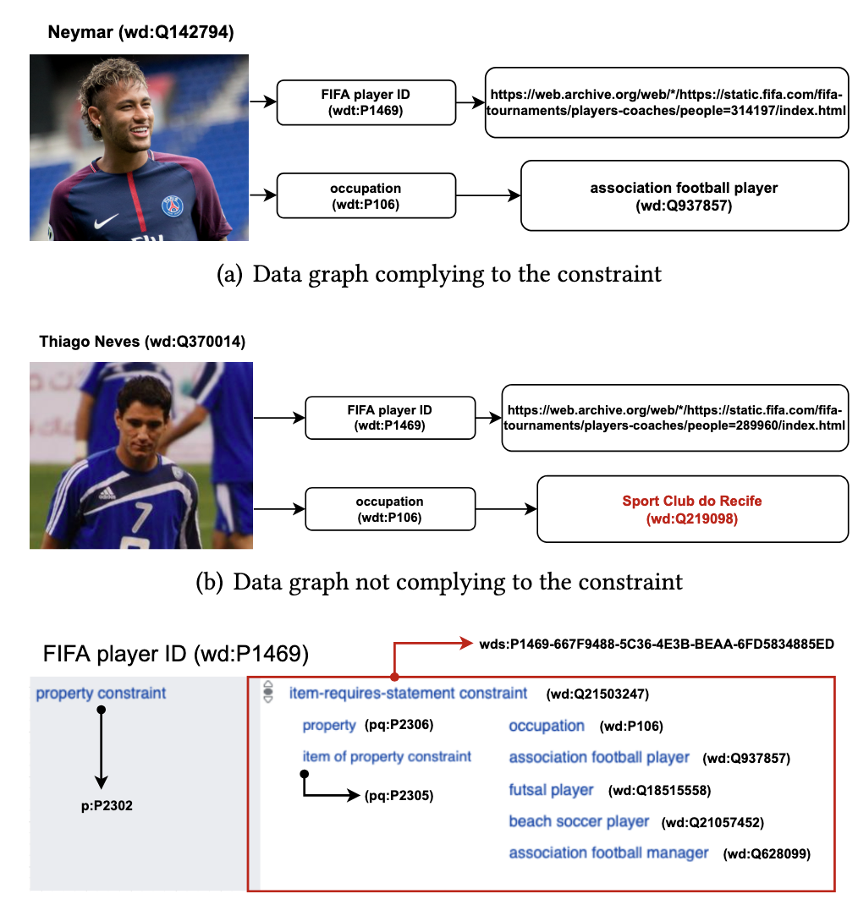
Wikidata is also not “consistent”, but doesn’t use OWL
… user defined
Property Constraints
(rather than OWL)

Slide 17

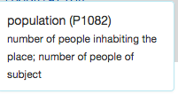
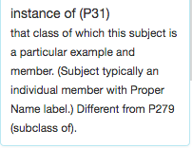
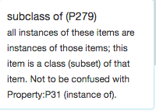


The same question as before in Wikidata:
Note: Wikidata does not even use standard OWL
Note: Wikidata uses numeric IDs
“Simple” surface query:
Which cities in the UK have more than 1M people?
What’s this?
SELECT DISTINCT ?city WHERE {
?city wdt:P31/wdt:P279* wd:Q515.
?city wdt:P1082 ?population .
?city wdt:P17 wd:Q38 .
FILTER (?population > 1000000) }
Page 17

Slide 18
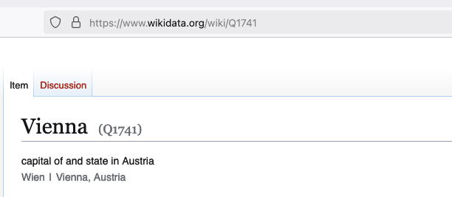
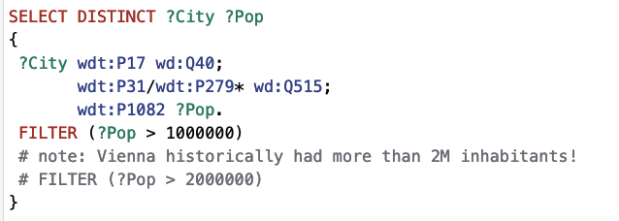
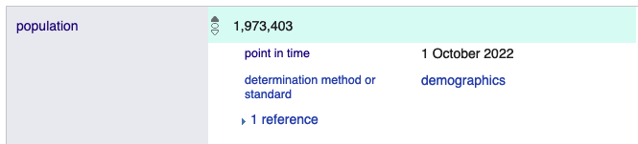

The same question as before in Wikidata:
https://w.wiki/BqRX
Which cities in the Austria have more than 1M/2M people?
  So, WHEN did Vienna have 2M inhabitants?
Note: Wikidata also has such contextual information!!!!
Page 18

Slide 19
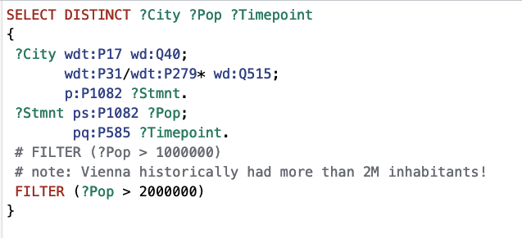
The same question as before in Wikidata:
https://w.wiki/BqRj
Which cities in the Austria have more than 1M/2M people?
  So, WHEN did Vienna have 2M inhabitants? Works!!!!
  But needs an understanding of Wikidata’s proprietary RDF reification model to model context!
See our recent ISWC2024 tutorial: https://ww101.ai.wu.ac.at/
Page 19

Slide 20
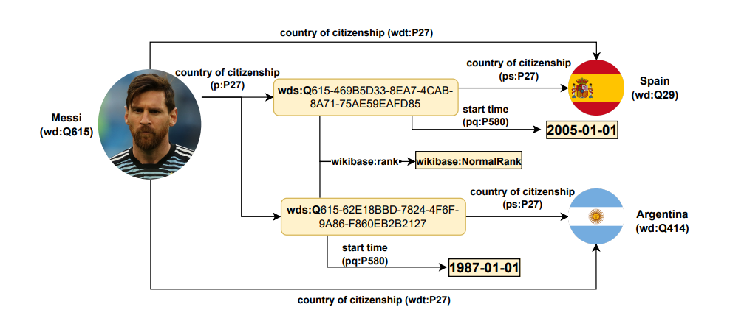
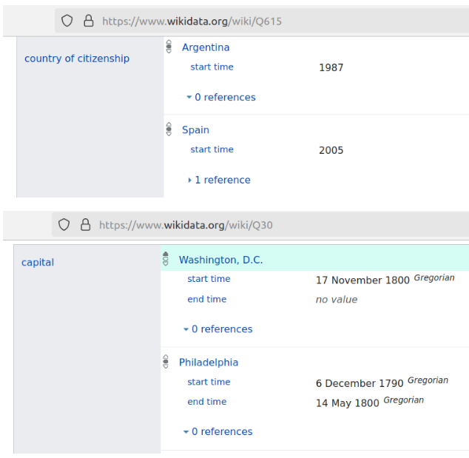
Wikidata’s proprietary RDF reification model
Wikidata’s internal Data Model rather is a Labelled Property Graph than fitting into “flat” RDF:
  See our recent ISWC2024 tutorial: https://ww101.ai.wu.ac.at/

Slide 21
So, for what are KGs actually good for in the age of LLMs and AI?
i.e.,
Large-scale, partially incomplete, inconsistent, labelled property graphs
(rather than curated ontologies)

Slide 22
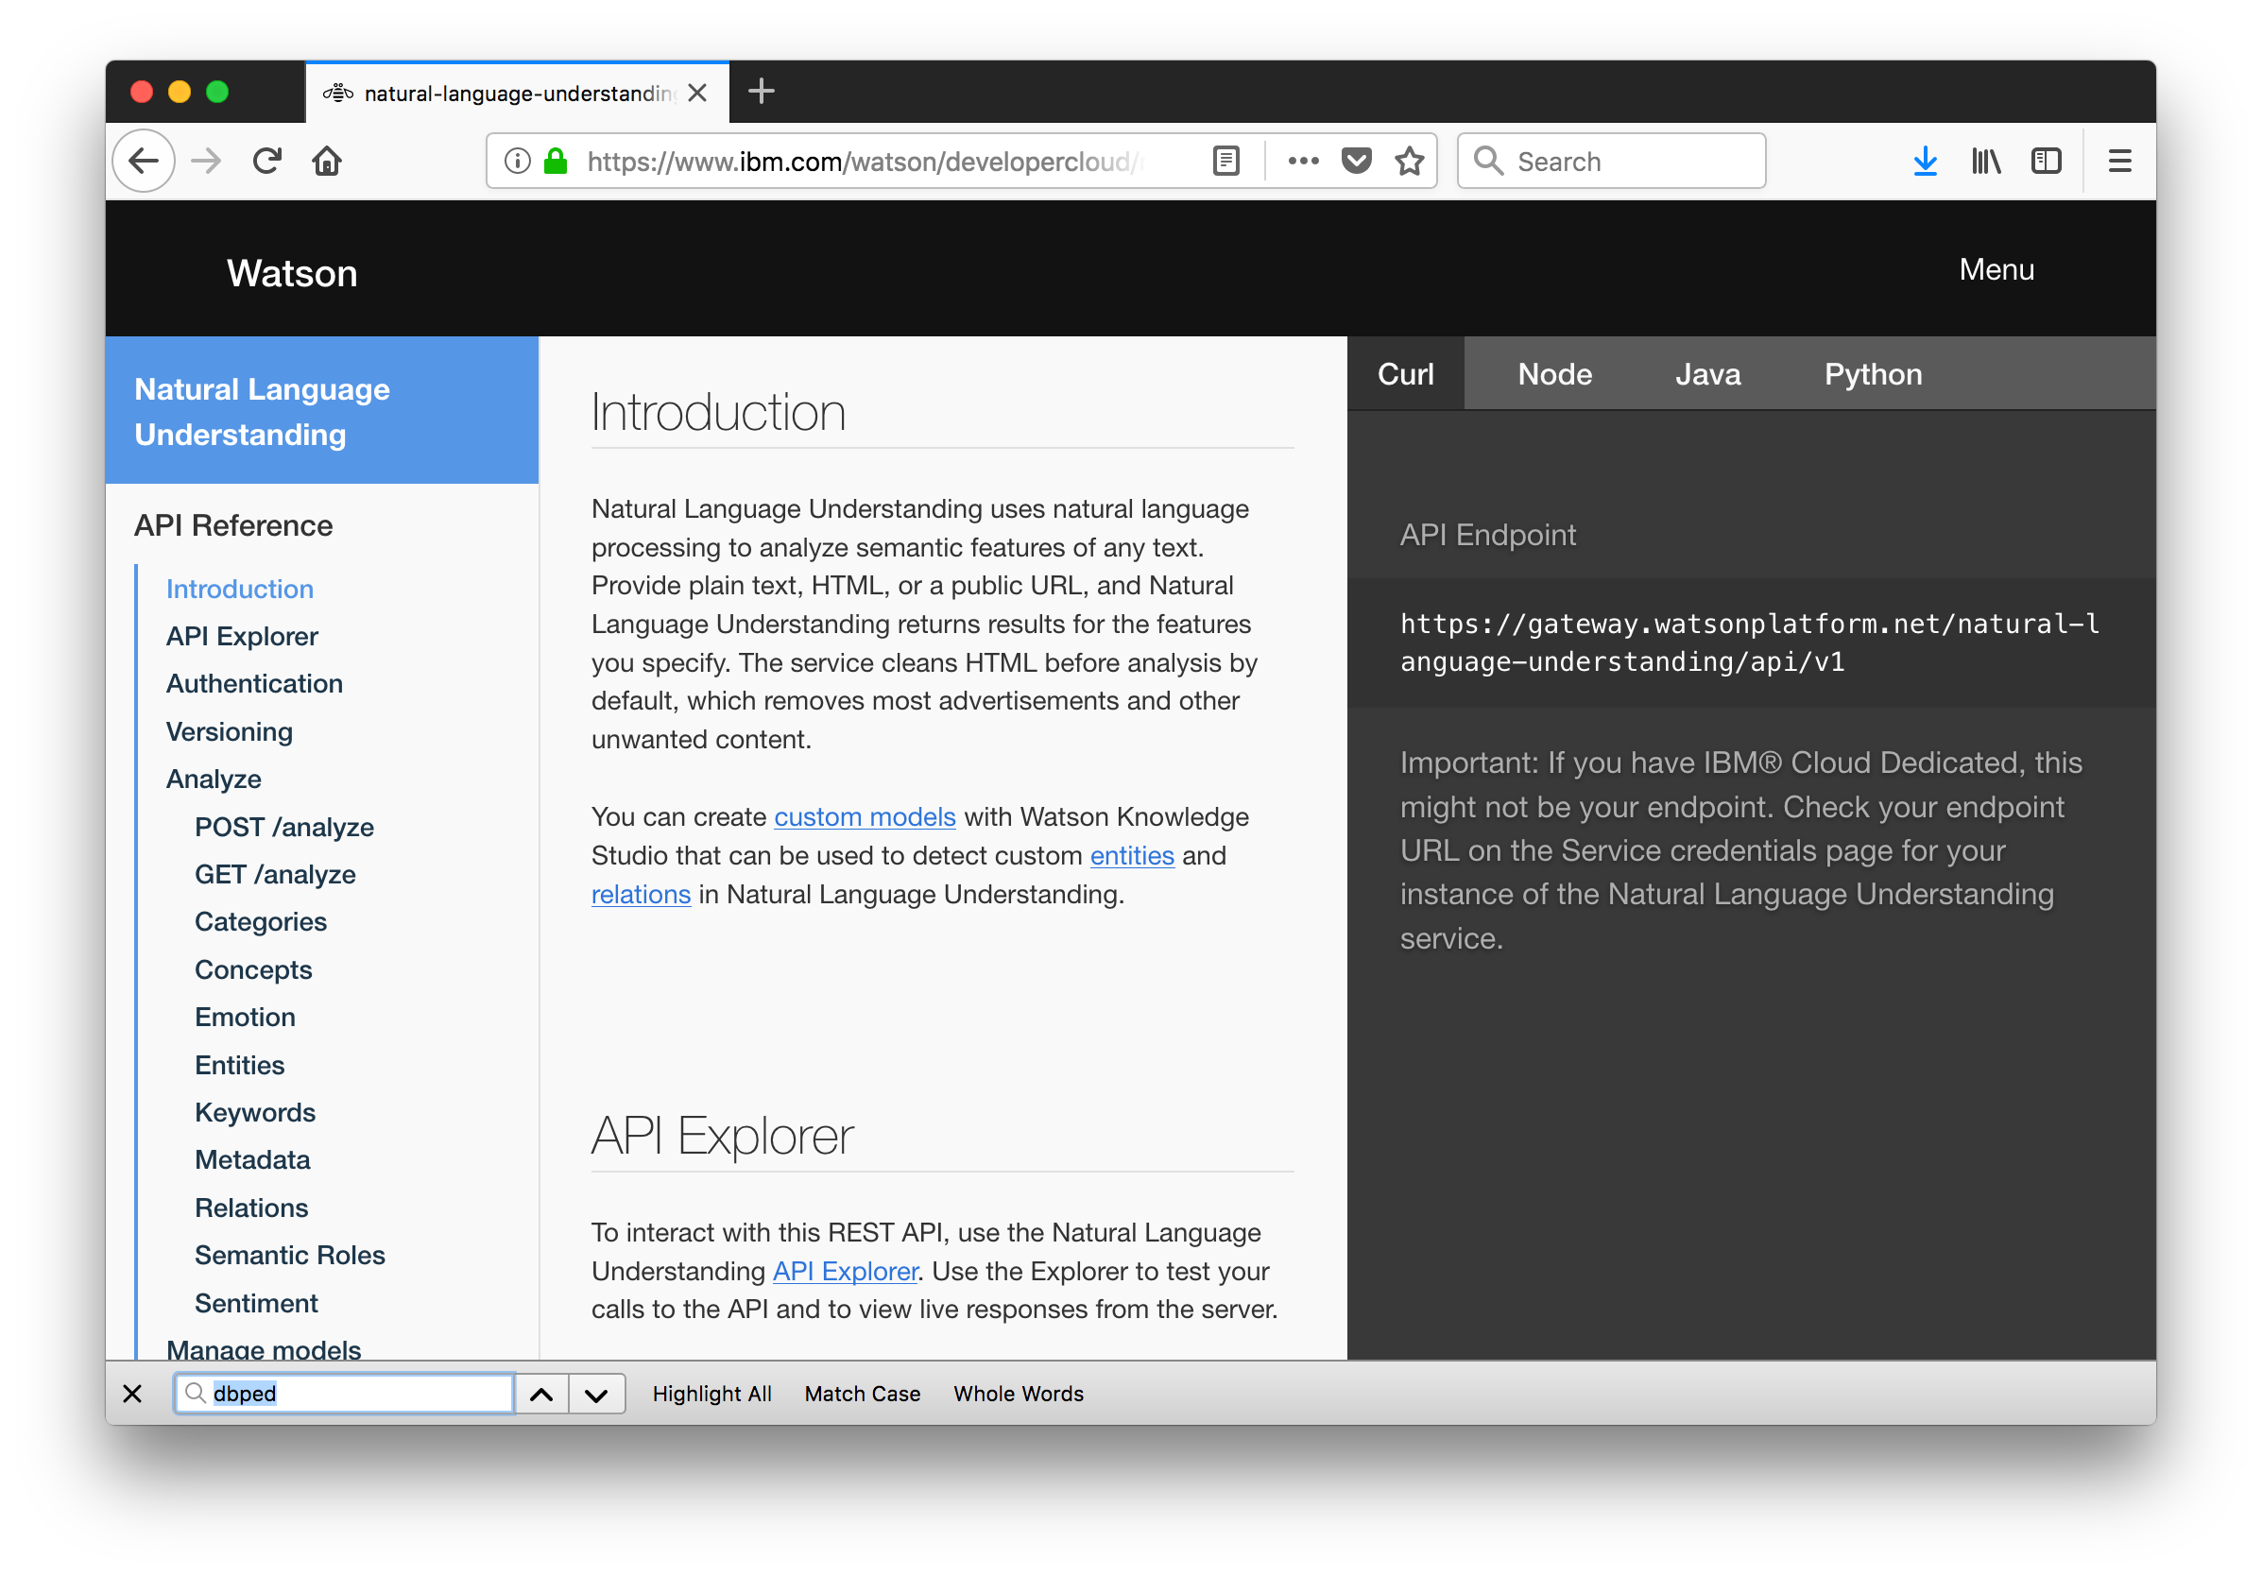
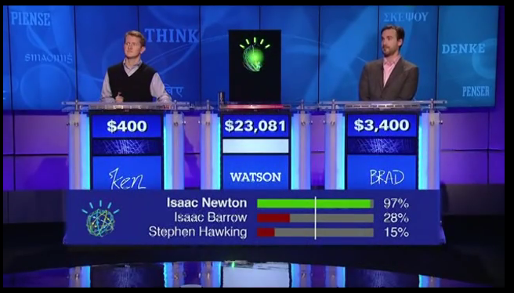
So, for what are these KGs actually good for in the age of LLMs and AI?
Interesting Note - IBM Watson - Jeopardy! (2011)
“Super-human” Question Answering was echieved by Knowledge Graphs before the LLM hype!
https://youtu.be/P0Obm0DBvwI?t=951

Slide 23
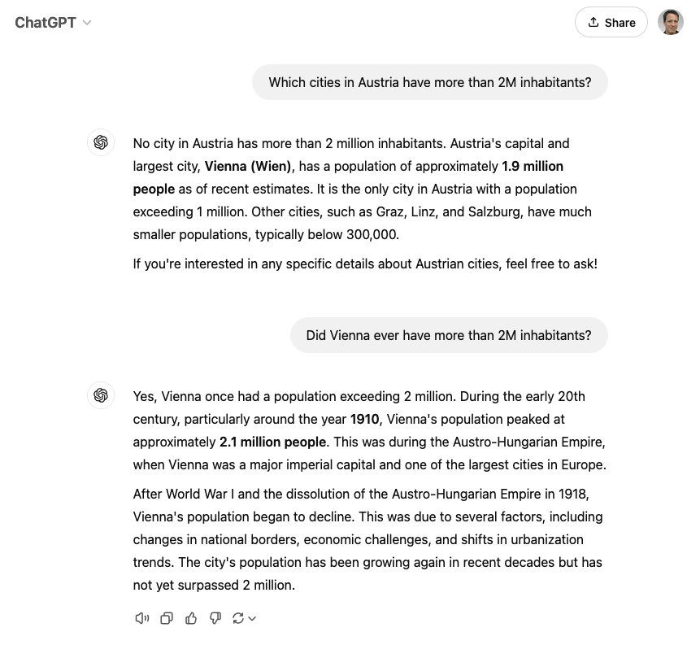

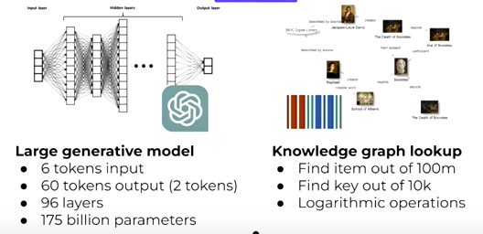
So, for what are these KGs actually good for in the age of LLMs and AI?
KGC23 Keynote: “The Future of Knowledge Graphs in a World of LLMs — Denny Vrandečić, Wikimedia”
https://www.youtube.com/watch?v=ww99npDh4cg

Slide 24
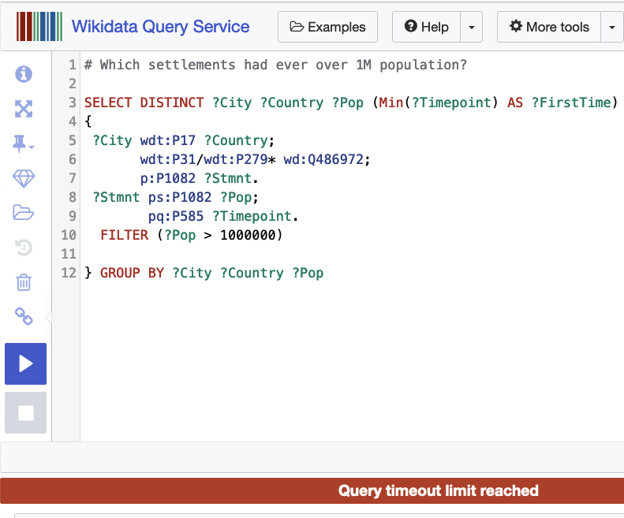
Admittedly, Denny didn’t talk about this…
… at least Wikidata also struggles on some questions: https://w.wiki/CLw9
Challenge: scaling queries to large-scale, schemaless KGs
For the records: comparison with GPT ;-)
https://chatgpt.com/share/675585c7-04cc-8006-a20e-c70d75619e13

Slide 25
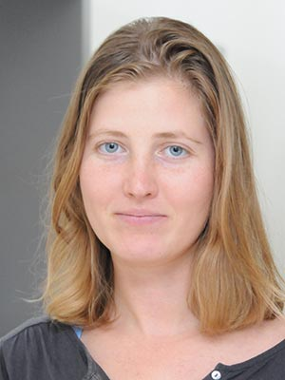
Some of our own research in this area:
How good or bad can KG swith Question can answering?
  Svitlana Vakulenko, Javier Fernández, Axel Polleres, Maarten de Rijke, and Michael Cochez. Message passing for complex question answering over knowledge graphs. In Proceedings of the 28th ACM International Conference on Information and Knowledge Management (CIKM2019, pages 1431--1440, Beijing, China, November 2019. ACM.

Slide 26
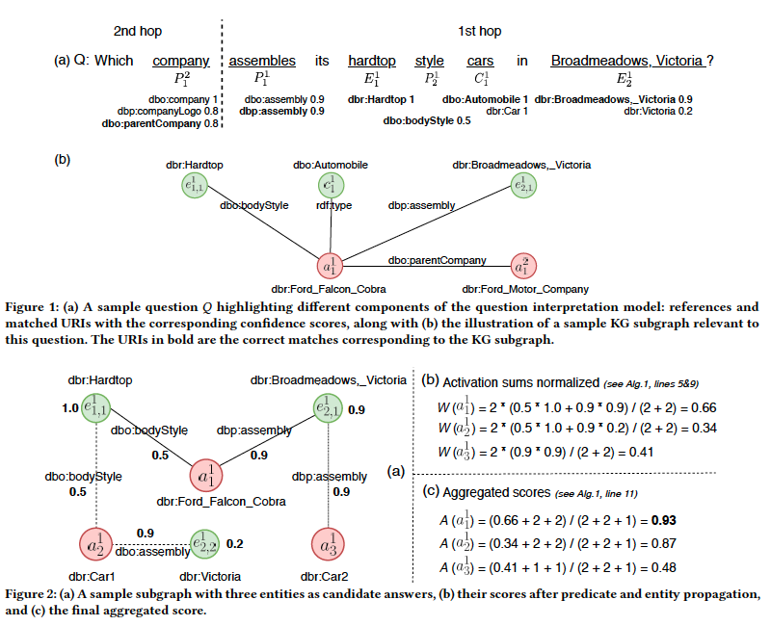
Some of our own research in this area:
Idea: use unsupervised message passing to propagate confidence scores obtained by parsing an input question and matching terms in the knowledge graph to a set of possible answers.
How good or bad can KG swith Question can answering?
  Svitlana Vakulenko, Javier Fernández, Axel Polleres, Maarten de Rijke, and Michael Cochez. Message passing for complex question answering over knowledge graphs. In Proceedings of the 28th ACM International Conference on Information and Knowledge Management (CIKM2019, pages 1431--1440, Beijing, China, November 2019. ACM.

Slide 27
Some of our own research in this area:
How good or bad can KG swith Question can answering?
  Svitlana Vakulenko, Javier Fernández, Axel Polleres, Maarten de Rijke, and Michael Cochez. Message passing for complex question answering over knowledge graphs. In Proceedings of the 28th ACM International Conference on Information and Knowledge Management (CIKM2019, pages 1431--1440, Beijing, China, November 2019. ACM.
How good or bad are LLMs with Question answering and what do they struggle with?
  Gerhard Georg Klager and Axel Polleres. Is GPT fit for KGQA? -- preliminary results. In Proceedings of the International Workshop on Knowledge Graph Generation from Text (Text2KG2023), co-located with Extended Semantic Web Conference 2023 (ESWC 2023), May 2023.
  Lessons learnt:
    One of LLMS main problem: recency
    Can we use LLMS to generate SPARQL queries?
      Main problem: “training” (identifiers in the database) is hard…

Slide 28
Other main trends in our community:
(Graph)RAG – Retrieval augmented generation leveraging Knowledge Graphs
(a significant share at this year’s ISWC)
Knowledge Graph Embeddings – similar to word embeddings use vector space embeddings to predict missing information in KGs
Neurosymbolic Systems that involve KGs
Trend is to combine:
  Search Engines (SE)
  Querying KGs (KG)
  LLMs (LM)
So… What’s good for what? And What’s next?

Slide 29
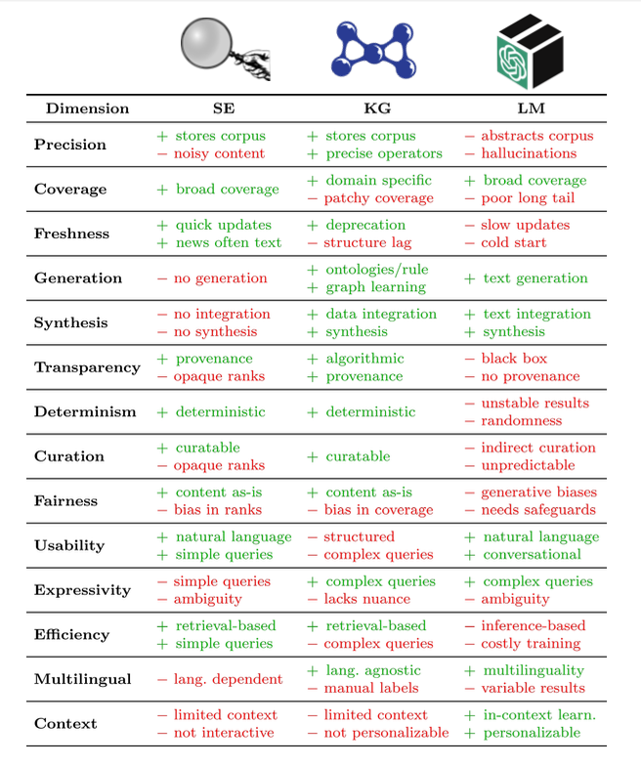

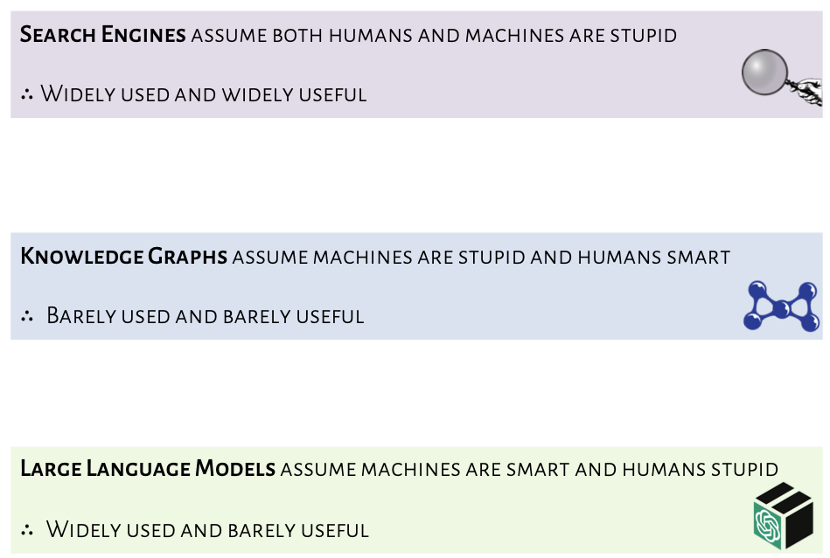
What’s good for what?
LLMs, Search Engines, KGs
Forthcoming work by :
Aidan Hogan, Xin Luna Dong,
Denny Vrandečić, Gerhard Weikum
https://aidanhogan.com/talks/2024-09-04-wuwien-invited-talk.pdf

Slide 30
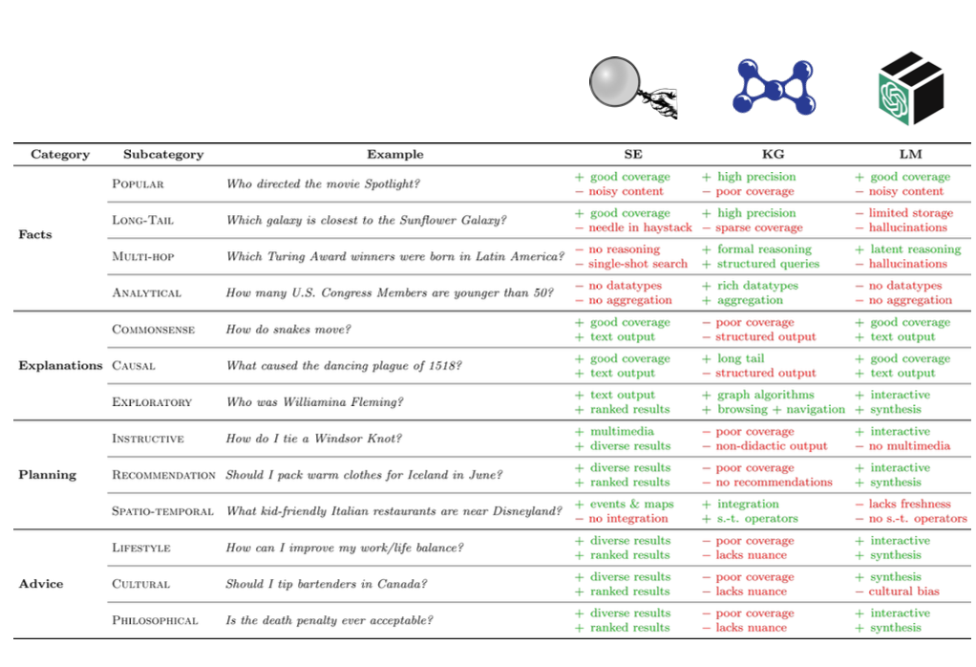
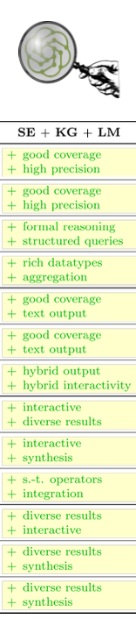
What’s good for what?
LLMs, Search Engines, KGs
https://aidanhogan.com/talks/2024-09-04-wuwien-invited-talk.pdf

Slide 31

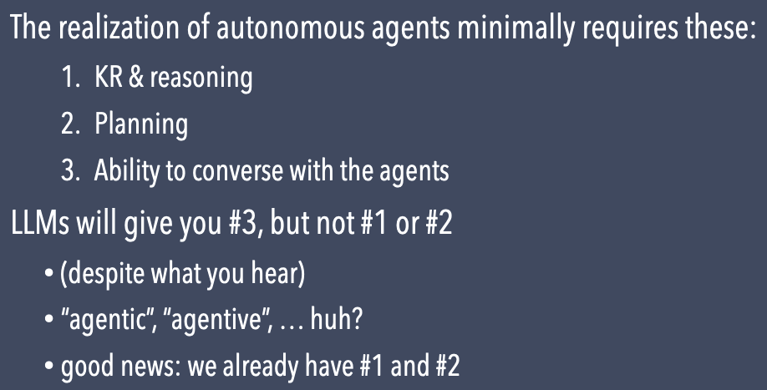
What’s missing?
Ora Lassila (Keynote ISWC2024) https://www.lassila.org/publications/2024/lassila-iswc2024-keynote.pdf
“Agents! The Semantic Web vision is predicated on the idea that we can converse with our agents and give them tasks to perform. Using LLMs, sufficiently flexible and open-ended conversational user interfaces are finally possible. Through curated and audited knowledge graphs, we get trusted sources
of information for the agents to consume (and avoid LLM hallucinations)”

Slide 32
What’s next (from our side)?
Austrian National “Cluster of Exellence” BILAI (funded by FWF):
  Vison of Broad AI
  Role of (Knowledge) Graph-Based AI in BILAI
Ongoing Research in our Institute/Department

Slide 33




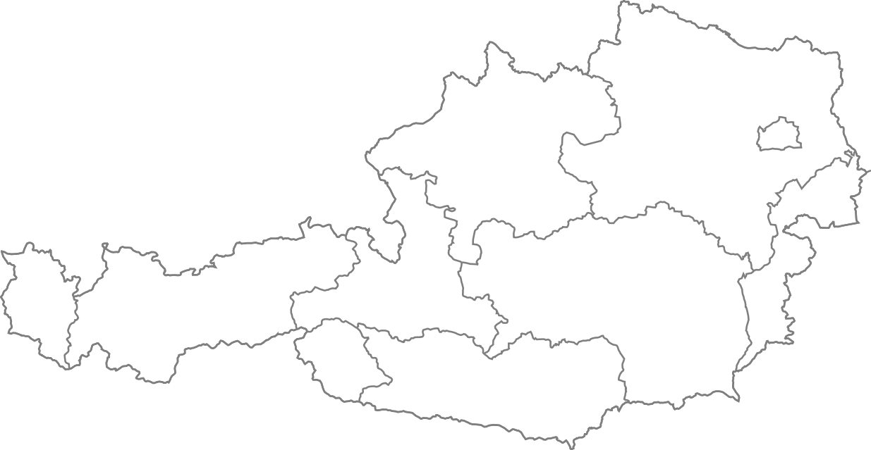













BilAI Consortium (~30M EUR, 5Y)
This research is funded in whole or in part by the
Austrian Science Fund (FWF) [10.55776/COE12].
Christoph Lambert
Machine Learning
Trustworthy Learning
https://www.bilateral-ai.net/
Machine Learning and Computer Vision group
ELLIS Unit ISTA
Agata Ciabattoni
Logic Reasoning
Martina Seidl
Symbolic AI
SAT Solving
Formal methods
Thomas Eiter
Symbolic AI
Knowledge representation
Institute for Logic and Computation
Sepp Hochreiter
Machine Learning
LSTM
Vanishing gradient
Institute für Machine Learning
ELLIS Unit Linz
LIT AI Lab
Institute for Symbolic Artificial Intelligrnce
Gerhard Friedrich
Symbolic AI
Model-based reasoning
Robert Legenstein
Machine Learning
Computational Neuroscience
Axel Polleres
Knowledge Graphs
Institute for Artificial Iltelligence and Cybersecurity
Institute of Theoretical Computer Science
Institute for Data Process and Knowledge Management
BILAI Slides: thanks to Günther Klambauer (JKU)

Slide 34

General Architecture
34
BILAI Slides: thanks to Günther Klambauer (JKU)

Slide 35
Vision: Building a „Broad“ AI
Human cognitive abilities
General AI
Human level abilities
Knowledge
&
Interaction
Adaptability
&
Robustness
Abstraction
&
Reasoning
Broad AI
Broad cognitive abilities
Efficiency
Chollet, F. (2019). On the measure of intelligence. arXiv preprint arXiv:1911.01547.
Hochreiter, S. (2022). Toward a broad AI. Communications of the ACM, 65(4), 56-57.
Image
generation
Language
processing
Game
playing
Structure
prediction
Narrow AI
Task specific skills
DALL·E 2
ChatGPT
AlphaGO
AlphaFold
35
BILAI Slides: thanks to Günther Klambauer (JKU)
Notes:
Rather than on the one hand merely skill-based, specific, narrow AI, or AGI on the other end, call for adding robustness, flexibility/adaptability generality/abstraction.
Causality, Planning, sptio-temporal understanding

Slide 36
Large language models and the essential properties of broad AI
Auto-Regressive LLMs can't plan
(and can't really reason). — Yann LeCun (September 2023)
Challenge1 (Knowledge): LLMs hallucinate.
  difficult to remove or delete particular knowledge or suppress particular examples from the training set
  knowledge that is gathered or collected after training, is difficult to integrate into LLMs (recency)
  questions that cannot be factually answered as the corresponding information is missing in the training data, LLMs hallucinate
  → tight integration of LLMs with symbolic [models (KGs) &] solvers […] could be employed to leverage incremental reasoning capabilities (RM1-4)
BILAI Slides: thanks to Günther Klambauer (JKU)

Slide 37
Large language models and the essential properties of broad AI
Auto-Regressive LLMs can't plan
(and can't really reason). — Yann LeCun (September 2023)
Challenge2 (adaptability and robustness): current LLMs lack adaptability and robustness.
  low adversarial robustness
    simple adversarial attacks can lead to critical threats, such as the extraction of training data
  underscores the pressing need for advancements in AI that can enhance the adaptability and robustness of LLMs
→ ensure reliability and safety of LLMs in diverse contexts with approaches [leveraging context and again tight integration of Symbolic and Sub-symbolic inference] (e.g., by verification) (RM2+3)
BILAI Slides: thanks to Günther Klambauer (JKU)

Slide 38
Large language models and the essential properties of broad AI
Auto-Regressive LLMs can't plan
(and can't really reason). — Yann LeCun (September 2023)
Challenge3 (abstraction & reasoning):
  LLMs are weak at reasoning and causality.
  if successful in causal inference, there is usually sufficiently close training data.
  Usual case: LLMs fail and, thus, they could be considered as weak “causal parrots”.
  LLMs are far from reasoning reliably about causality
  → Research Module on Causality (RM5) suggests how to approach such issues.
BILAI Slides: thanks to Günther Klambauer (JKU)

Slide 39
Research Questions & Starting points:
Time and other Contextual information: Temporal Evolution of Graphs (and their quality) vs. Evolution of Embeddings – Constraints & Repairs (TGDK)
Knowledge at scale - Modularization and Decentralization of Knowledge federated graph querying techniques and partitioning techniques vs. federated models/learning
Integrating vector representation vs graph representation ... what's good for what?
  graph pattern matching and isomorphism → obviously great for symbolic processing, modularization, etc.
  vector representation, embeddings → obviously great for modeling similarity, semantic closeness, link prediction, but also dissimilarity/inconsistency/outliers
  Different graph representations: RDF vs. Property Graphs
  How could we integrate these representations and their processing?

Slide 40





Research Questions & Starting points in my group
Time and other Contextual information
Our Starting Points:
  In order to learn over time, we nee to build Corpora (Crawling) of Evolving KGs
40

Slide 41





Research Questions & Starting points in my group
Automatically Repairing KGs
Starting Points:
  Formalizing the proprietary Integrity Constraint “Language” of Wikidata & Observing violations over time
  Wikidata does not rely on OWL or SHACL, but uses a community-defined way to define constraints:
    We formulated all these constraints in SPARQL, to extract all violations
    We now investigate which constraints have been repaired how to learn patterns!
41

Slide 42


Research Questions & Starting points in my group
Querying large-scale KGs
Starting Points:
  Speeding up decentralized SPARQL Querying by Graph partition-shipping to avoid query time-outs
    In Amr’s thesis we demonstrated that by clever graph partitioning and splitting processing between clients and SPARQL endpoints the performance, the problems of central query endpoints can be significantly alleviated
Future work in BILAI:
How can we similarly split work in a decentralized manner for other KG/AI tasks?
e.g. can we similarly modularize Knowledge Graph embeddings?
42

Slide 43




Starting points for collaboration:
Slide: Emanuel Sallinger
Notably, in BILAI, colleagues from TU Vienna (Sallinger, Pavlovic) work on graph Embeddings that can partially capture rules and constraints:
  Similar to word embeddings and LLMs, Knowledge Graph Embeddings allow to
    predict missing edges in incomplete KGs
    predict inconsistencies
    … I.e. predict possible repairs?
Open Problems:
  Scaling KG Embeddings to full KGs …
  … but (1) modularization might help here, relation to the
  (2) corresponding trend to LLMs-based “multi-agent frameworks”

Slide 44
What’s next?
Austrian National “Cluster of Exellence” BILAI:
  Vison of Broad AI
  Role of (Knowledge) Graph-Based AI in BILAI
Other Ongoing Research in our Institute/Department
P.S.: we’re hiring! ☺
https://www.bilateral-ai.net/jobs/

Slide 45











AI in our Department – at a glance
Data Management Group
(Axel Polleres, Elmar Kiesling, Amin Anjomshoaa)
Semantic Systems Group
(Marta Sabou)
AI areas of interest:
Neurosymbolic AI Systems
Digital Humanism and AI
AI for Engineering
AI for Data Ecosystems/
Data Ecosystems for AI
Inst. for Complex Networks
(Sabrina Kirrane)
=> AI based policy representation and reasoning (e.g., regulatory obligations)
=> AI Transparency and trust

Slide 46




Neurosymbolic AI Systems
Prof. Marta Sabou
= Semantic Web and Machine Learning systems
(a type of neural-symbolic systems)
A. Breit, L. Waltersdorfer, F.J. Ekaputra, M. Sabou, A. Ekelhart, A. Iana, H. Paulheim, J. Portisch, A. Revenko, A. ten Teije, and F. van Harmelen. 2023. Combining Machine Learning and Semantic Web: A Systematic Mapping Study. ACM Computing Survey. March 2023.

Slide 47


KG-based AI for Self-Determination
The three pillar research topics - trust, accountability, and autonomy - represent the desired goals for how AI can benefit society and facilitate self-determination
The pillars combine fundamental principles of the proposed EU AI Act and self-determination theory.
The pillars are supported via four foundational research topics that represent the tools and techniques needed to support the three research pillars:
  machine-readable norms and policies
  decentralised infrastructure
  decentralised KG management
  explainable and neuro-symbolic AI
KG-based AI for Self-determination Conceptualisation
47
Ibáñez, L., Domingue, J., Kirrane, S., Seneviratne, O., Third, A., Vidal, M., 2023. Trust, Accountability, and Autonomy in Knowledge Graph-based AI for Self-determination. Transactions on Graph Data and Knowledge (TGDK) (revised and resubmitted)

Slide 48








Building application specific Knowledge Graphs:
CRISP Knowledge Graph
Aims to establish the backbone of information integration for gathering Austrian infrastructure systems pertinent for crisis management.
Is built on the foundation of three core elements: event of hazards, geographical regions, and infrastructure networks.
Some statistics
  6,375,118 Triples collected from different open data resources.
  3,887 First Responders Organizations involved in crisis management.
  249,781 Observations of properties associated with specific features of interest
Shock & Stress
CRISP Cell
Networks
Road Network
Railway Network
Water Network
Telecom Network
Cell Data including weather, services, population, etc.

Slide 49

Thank you!
Summary:
  (Semantic) Web & Knowledge Graphs play in important role in latest trends in AI
    GraphRAG, NeuroSymbolic Systems powered by KGs, etc.
  GenAI could help to create, improve and curate KGs (but symbolic constraints will be needed!)
  Collaborative, Open Knowledge Graphs like Wikidata are a particularly interesting subject of study (observable!)
    evolution, repairs, etc.
    embeddings
    but also: collaboration patterns
  My guess: agents will play an important role!
    Getting back to decentralized approaches needed to scale & democratize AI
    Also for trends I didn’t talk about, e.g. Data Spaces
P.S.: we’re hiring! ☺
https://www.bilateral-ai.net/jobs/

Slide 50
Backup Slides

Slide 51
CRISP KG

Slide 52
Building application specific Knowledge Graphs:
CRISP Knowledge Graph
Aims to establish the backbone of information integration for gathering Austrian infrastructure systems pertinent for crisis management.
Is built on the foundation of three core elements: event of hazards, geographical regions, and infrastructure networks.
Some statistics
  6,375,118 Triples collected from different open data resources.
  3,887 First Responders Organizations involved in crisis management.
  249,781 Observations of properties associated with specific features of interest
Shock & Stress
CRISP Cell
Networks
Road Network
Railway Network
Water Network
Telecom Network
Cell Data including weather, services, population, etc.

Slide 53

CRISP Semantic Model

Slide 54

Crisis Management Use Case

Slide 55

Future Work: Real-time Crisis KG Construction + AI Services

Slide 56


CRISP Portal & SPARQL Endpoint
http://crisp.ai.wu.ac.at/

Slide 57
SMWCloud:

Slide 58


Apart from Wikidata, there are many other Semantic Wikis
Powered by MediaWiki software.
We know of 60527 currently active wikis.
(It’s a lot ☺)

Slide 59



How many Semantic MediaWikis?
SMW Cloud (1458 wikis)
Crawled RDF data available at semantic-data.cluster.ai.wu.ac.at/smwcloud/
Currently ongoing work/next steps:
also crawl historic data (Semantic MediaWiki edit history)
also crawl Wikiba.se instances!

Slide 60
Trust, Accountability, and Autonomy in
Knowledge Graph-based AI for Self-determination
Sabrina Kirrane
6.12.2024

Slide 61

KG-based AI for Self-Determination
Individuals use Artificial Intelligence (AI) assistants to make sense of data collected in their Personal Knowledge Graphs (PKGs).
They may share perspectives of their PKGs with other individuals and healthcare experts in knowledge-sharing communities that aggregate and curate data to power AI services for the benefit of all members.
Public and private organisations can negotiate access to data from communities and individuals to train KG-based AI models, which in turn are used to build services for them.
61
Ibáñez, L., Domingue, J., Kirrane, S., Seneviratne, O., Third, A., Vidal, M., 2023. Trust, Accountability, and Autonomy in Knowledge Graph-based AI for Self-determination. Transactions on Graph Data and Knowledge (TGDK) (revised and resubmitted)

Slide 62
KG-based AI for Self-Determination
The three pillar research topics - trust, accountability, and autonomy - represent the desired goals for how AI can benefit society and facilitate self-determination
The pillars combine fundamental principles of the proposed EU AI Act and self-determination theory.
The pillars are supported via four foundational research topics that represent the tools and techniques needed to support the three research pillars:
  machine-readable norms and policies
  decentralised infrastructure
  decentralised KG management
  explainable and neuro-symbolic AI
KG-based AI for Self-determination Conceptualisation
62
Ibáñez, L., Domingue, J., Kirrane, S., Seneviratne, O., Third, A., Vidal, M., 2023. Trust, Accountability, and Autonomy in Knowledge Graph-based AI for Self-determination. Transactions on Graph Data and Knowledge (TGDK) (revised and resubmitted)

Slide 63

Machine-readable norms and policies
KG-based AI for Self-determination Conceptualisation
Bonatti, P.A., Kirrane, S., Petrova, I.M. and Sauro, L., 2020. Machine understandable policies and GDPR compliance checking. KI-Künstliche Intelligenz.
Fernández, J.D., Sabou, M., Kirrane, S., Kiesling, E., Ekaputra, F.J., Azzam, A. and Wenning, R., 2020. User consent modeling for ensuring transparency and compliance in smart cities. Personal and Ubiquitous Computing.
Kirrane, S., Fernández, J.D., Dullaert, W., Milosevic, U., Polleres, A., Bonatti, P.A., Wenning, R., Drozd, O. and Raschke, P., 2018. A scalable consent, transparency and compliance architecture. In The Semantic Web: ESWC 2018 Satellite Events.
63

Slide 64

Decentralised infrastructure
KG-based AI for Self-determination Conceptualisation
Basile, D., Di Ciccio, C., Goretti, V. and Kirrane, S., 2023. Blockchain based Resource Governance for Decentralized Web Environments. Frontiers in Blockchain.
Basile, D., Di Ciccio, C., Goretti, V. and Kirrane, S., 2023. A Blockchain-driven Architecture for Usage Control in Solid. Proceedings of the 1st Workshop on Fintech and Decentralized Finance (FiDeFix) @ the 43rd IEEE International Conference on Distributed Computing Systems.
64

Slide 65

Decentralised KG management
Kirrane, S., 2021. Intelligent software web agents: A gap analysis. Web Semantics.
Kampik, T., Mansour, A., Boissier, O., Kirrane, S., Padget, J., Payne, T.R., Singh, M.P., Tamma, V. and Zimmermann, A., 2022. Governance of Autonomous Agents on the Web: Challenges and Opportunities. ACM Transactions on Internet Technology.
KG-based AI for Self-determination Conceptualisation
Fernández, J.D., Kirrane, S., Polleres, A. and Steyskal, S., 2020. HDTcrypt: Compression and encryption of RDF datasets. Semantic Web.
Fernández, J.D., Kirrane, S., Polleres, A. and Steyskal, S., 2017. Self-Enforcing Access Control for Encrypted RDF. Proceedings of the 14th Extended Semantic Web Conference.
65

Slide 66

Towards
Explainable and Neuro-Symbolic AI
Filtz, E., Kirrane, S. and Polleres, A., 2021. The linked legal data landscape: linking legal data across different countries. Artificial Intelligence and Law.
Navas-Loro, M., Filtz, E., Rodríguez-Doncel, V., Polleres, A. and Kirrane, S., 2019. TempCourt: evaluation of temporal taggers on a new corpus of court decisions. The Knowledge Engineering Review.
Filtz, E., Navas-Loro, M., Santos, C., Polleres, A. and Kirrane, S., 2020. Events Matter: Extraction of Events from Court Decisions. Proceedings of the 33rd International Conference on Legal Knowledge and Information Systems.
KG-based AI for Self-determination Conceptualisation
Dieber, J. and Kirrane, S., 2022. A novel model usability evaluation framework (MUsE) for explainable artificial intelligence. Information Fusion.
66

Slide 67

KG-based AI for Self-Determination
Challenges & Opportunities
General-purpose policy languages could be used for risk-based conformance checking such as that envisaged in the proposed EU AI Act
Policy profiles with well-defined semantics and complexity classes are needed for (semi)automatic compliance checking and to facilitate negotiation
Performance and scalability are major challenges as applications will need to interact with multiple distributed data sources
Self Sovereign Identity (SSI) technologies are relatively new and may suffer from vulnerabilities (e.g., identity theft)
The W3C recommendations for decentralized provenance management provides a mechanism for attributing data to its sources or contributors.
For approaches involving the interaction between LLM and KGs, the transparency of the LLM itself still depends on the owner
Studies report limitations of LLMs in human-like tasks (e.g., explanations, memories, and reasoning over factual statements)
Neuro-symbolic systems play a vital role in enhancing trustworthiness by enabling communication between modules and facilitating tracing
67

