Slide 1
The different “Shapes” of RDF(S) and OWL: a fragmented history Or: are Semantic Web standards (still) a good basis for Knowledge Graphs?

Slide 2
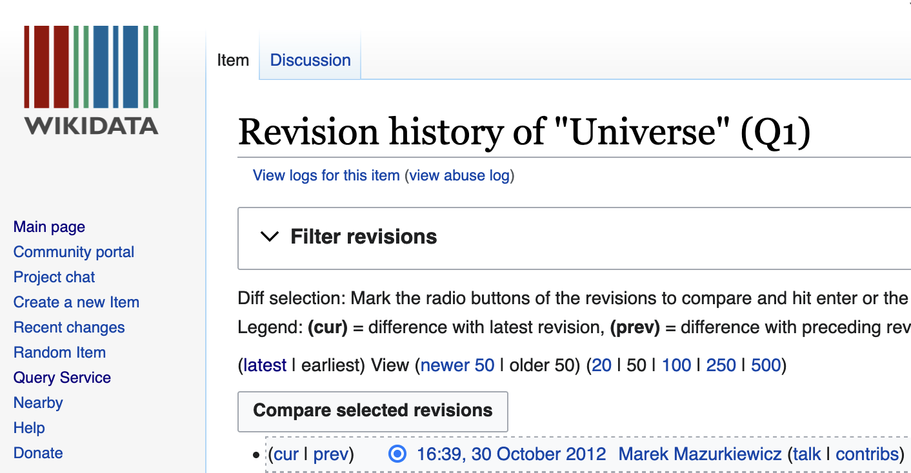
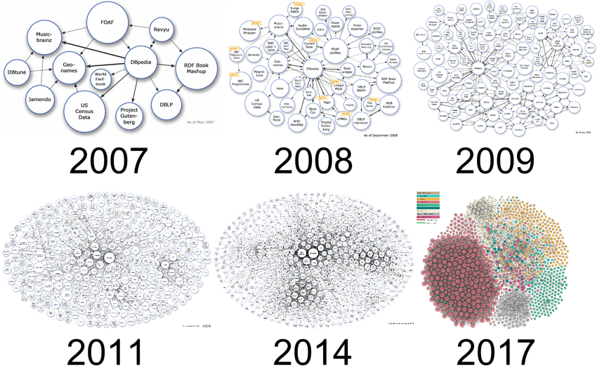
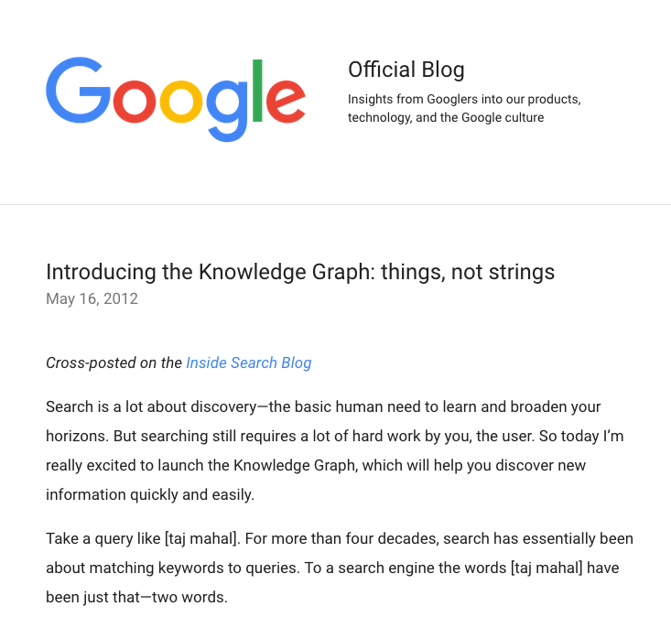
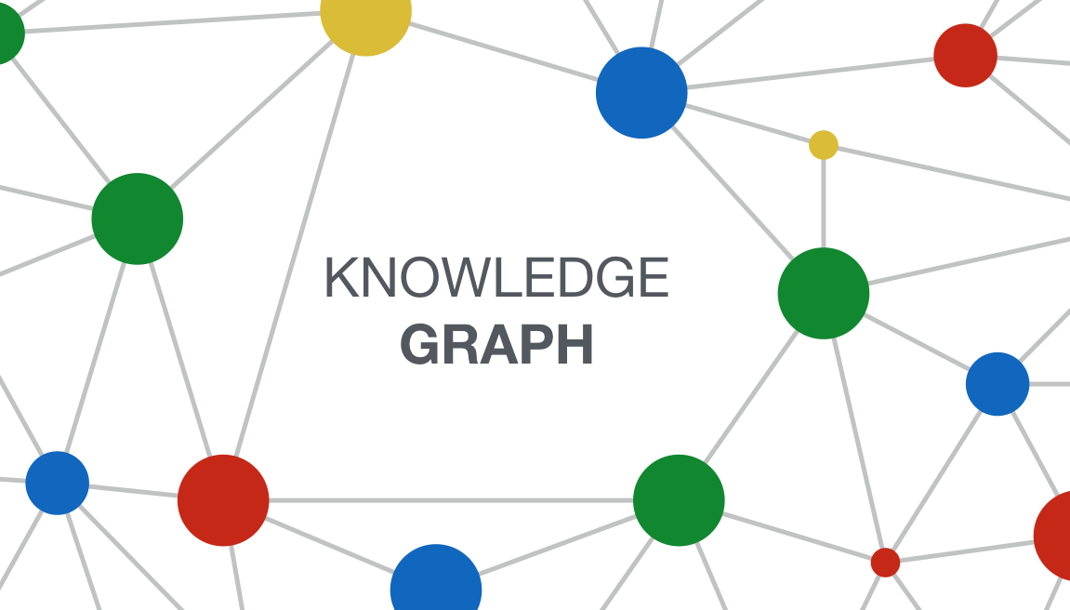
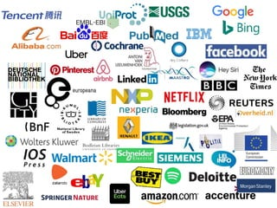
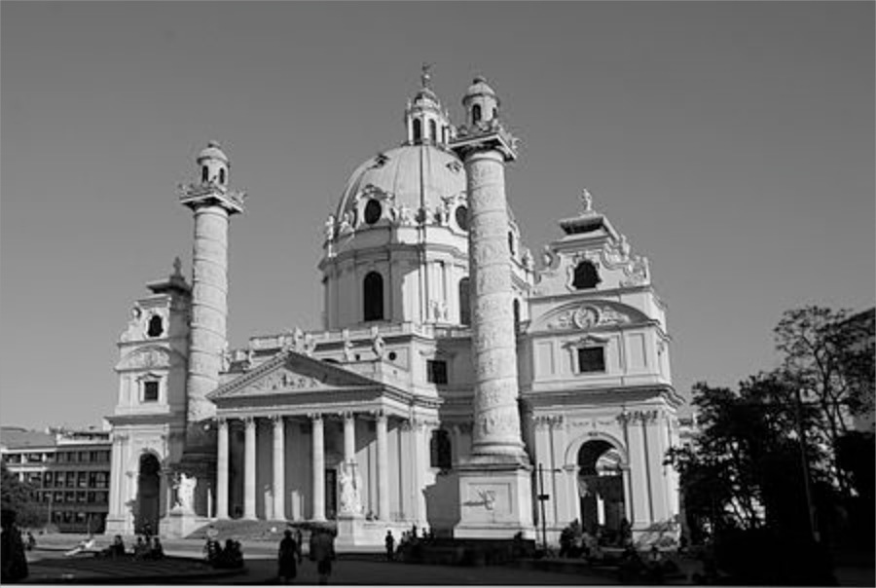
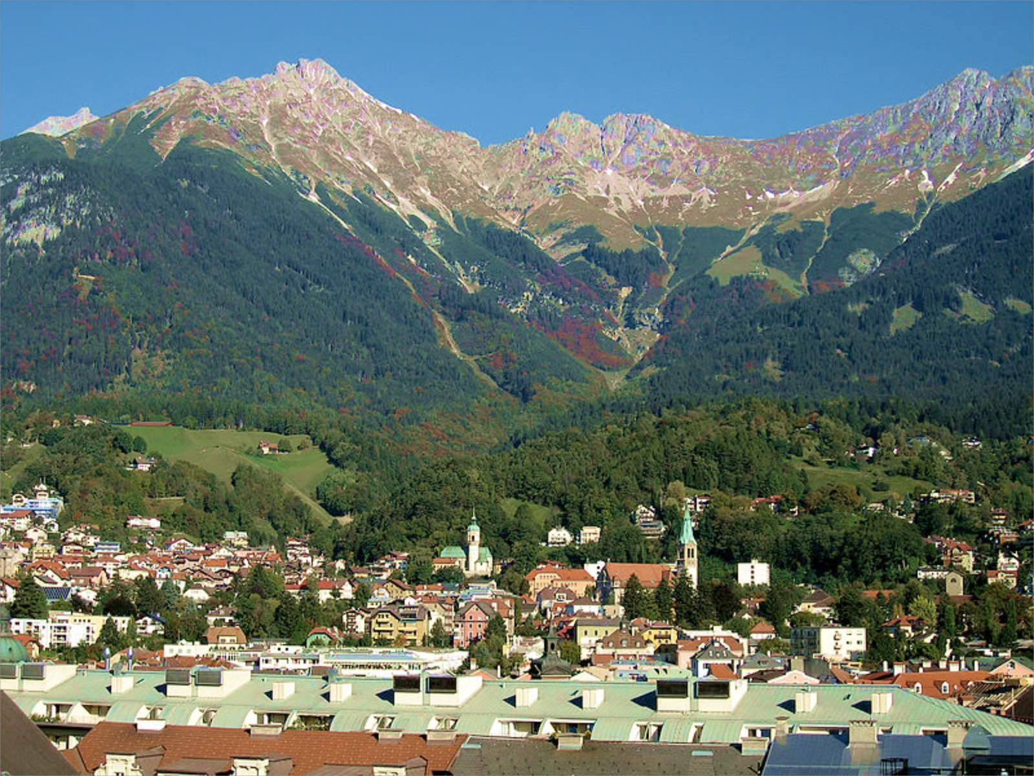
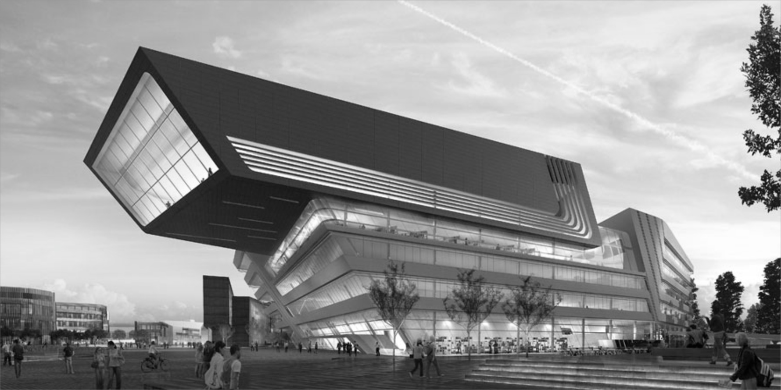
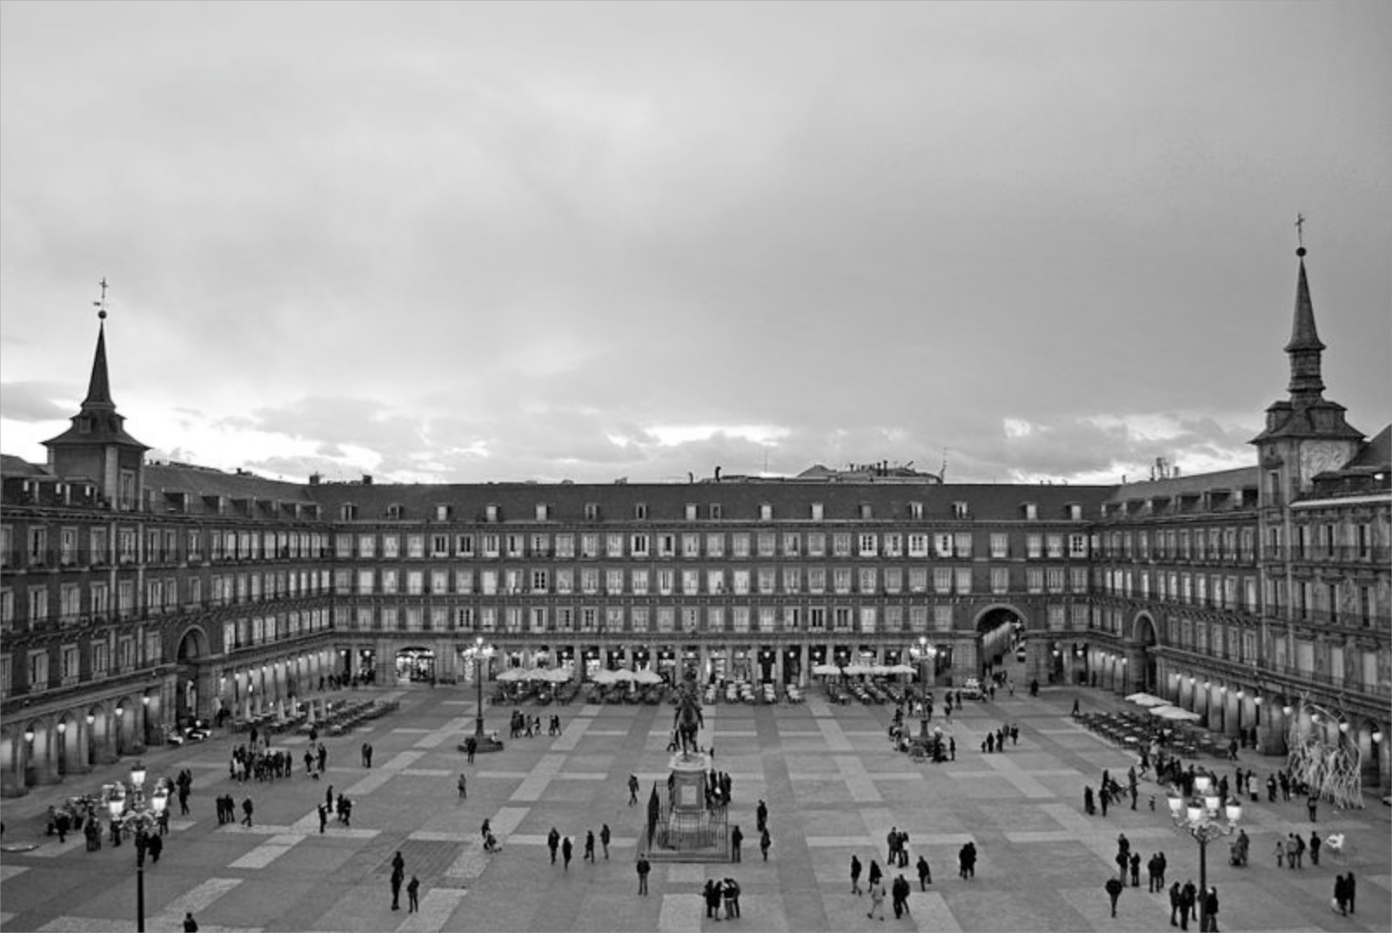
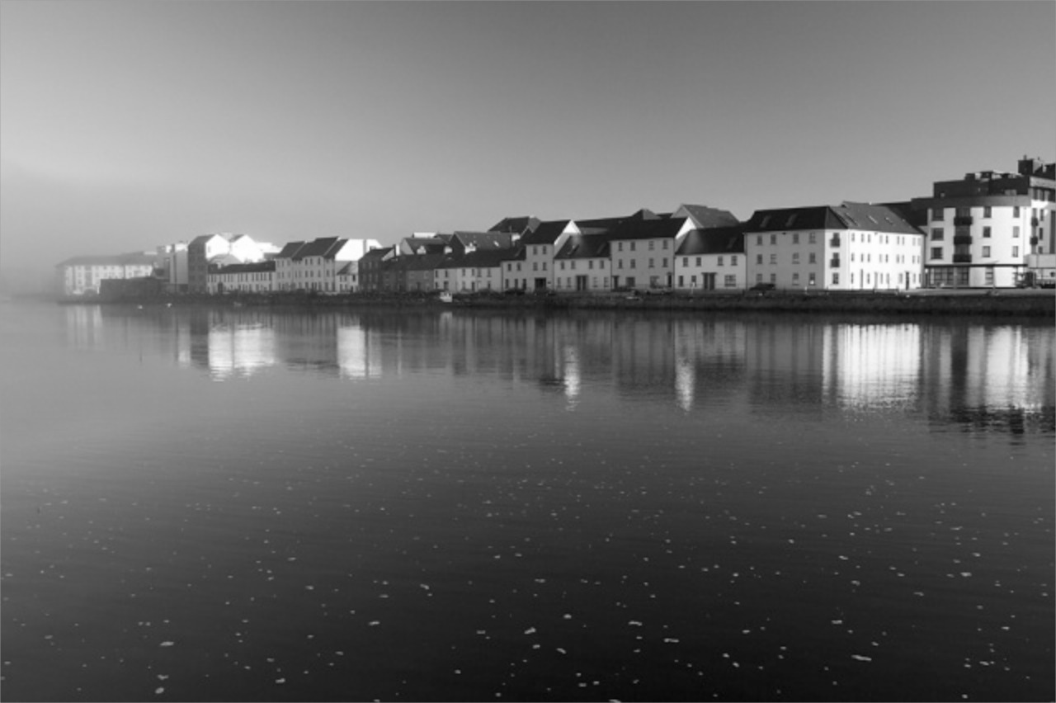
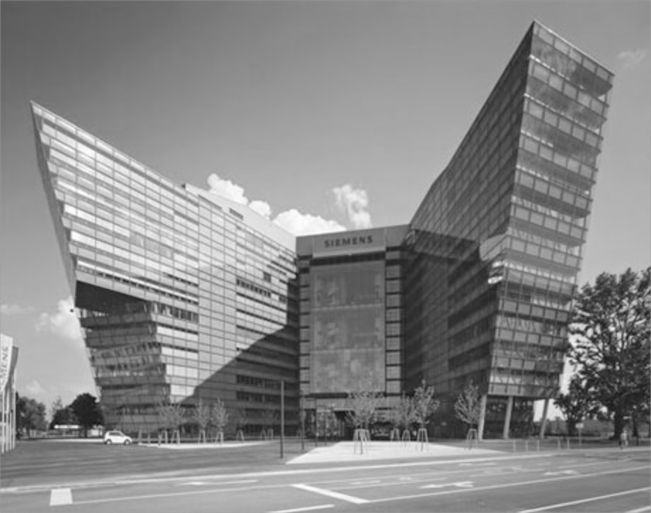
Great to be back ☺
 | 1999-2002 |  |  | 2001-2004 |  |  | 2012-2014 |  | 2022-2024
First Recommendations |  |  | RDF 1.0 |  |  | RDF 1.1 |  | OWL2 | RDF1.2
RDF 1999 | RDFS 2000 | OWL 2002 | RDF 2004 | RDFS 2004 | OWL 2004 | RDF 2014 | RDFS 2014 | OWL 2012 | RDF 2024 | RDFS 2024 |  | OWL 2024
TU Wien
Univ. Innsbruck
Univ. Rey Juan Carlos Madrid
NUI Galway Ireland
Siemens AG Österreich
Wirtschaftsuniversität Wien (WU)
Notes:
1:37
(1:15)‏

Slide 3
Great to be back ☺
 | 1999-2002 |  |  | 2001-2004 |  |  | 2012-2014 |  | 2022-2024
First Recommendations |  |  | RDF 1.0 |  |  | RDF 1.1 |  | OWL2 | RDF1.2
RDF 1999 | RDFS 2000 | OWL 2002 | RDF 2004 | RDFS 2004 | OWL 2004 | RDF 2014 | RDFS 2014 | OWL 2012 | RDF 2024 | RDFS 2024 |  | OWL 2024
TU Wien
Univ. Innsbruck
Univ. Rey Juan Carlos Madrid
NUI Galway Ireland
Siemens AG Österreich
Wirtschaftsuniversität Wien (WU)
Notes:
1:37
(1:15)‏

Slide 4
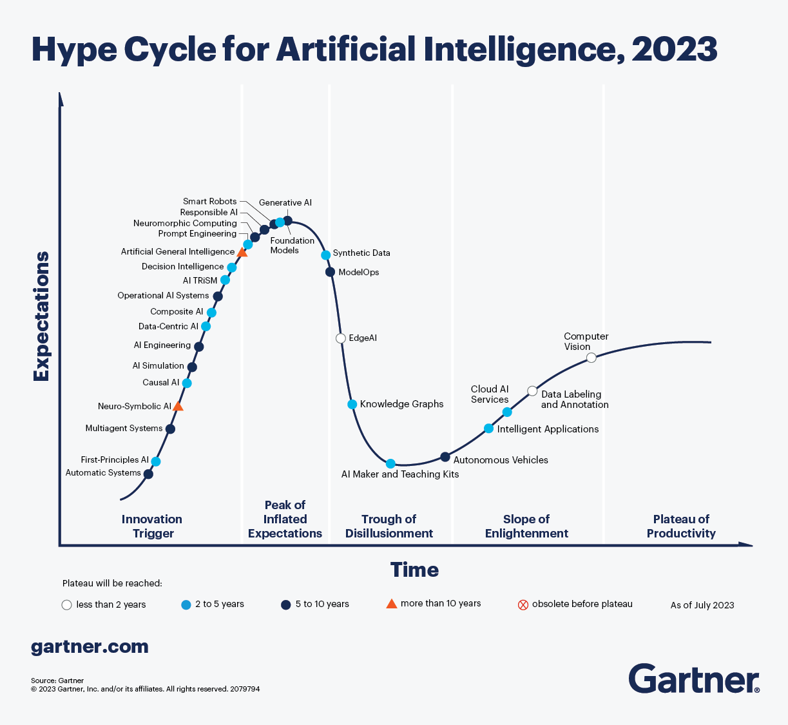
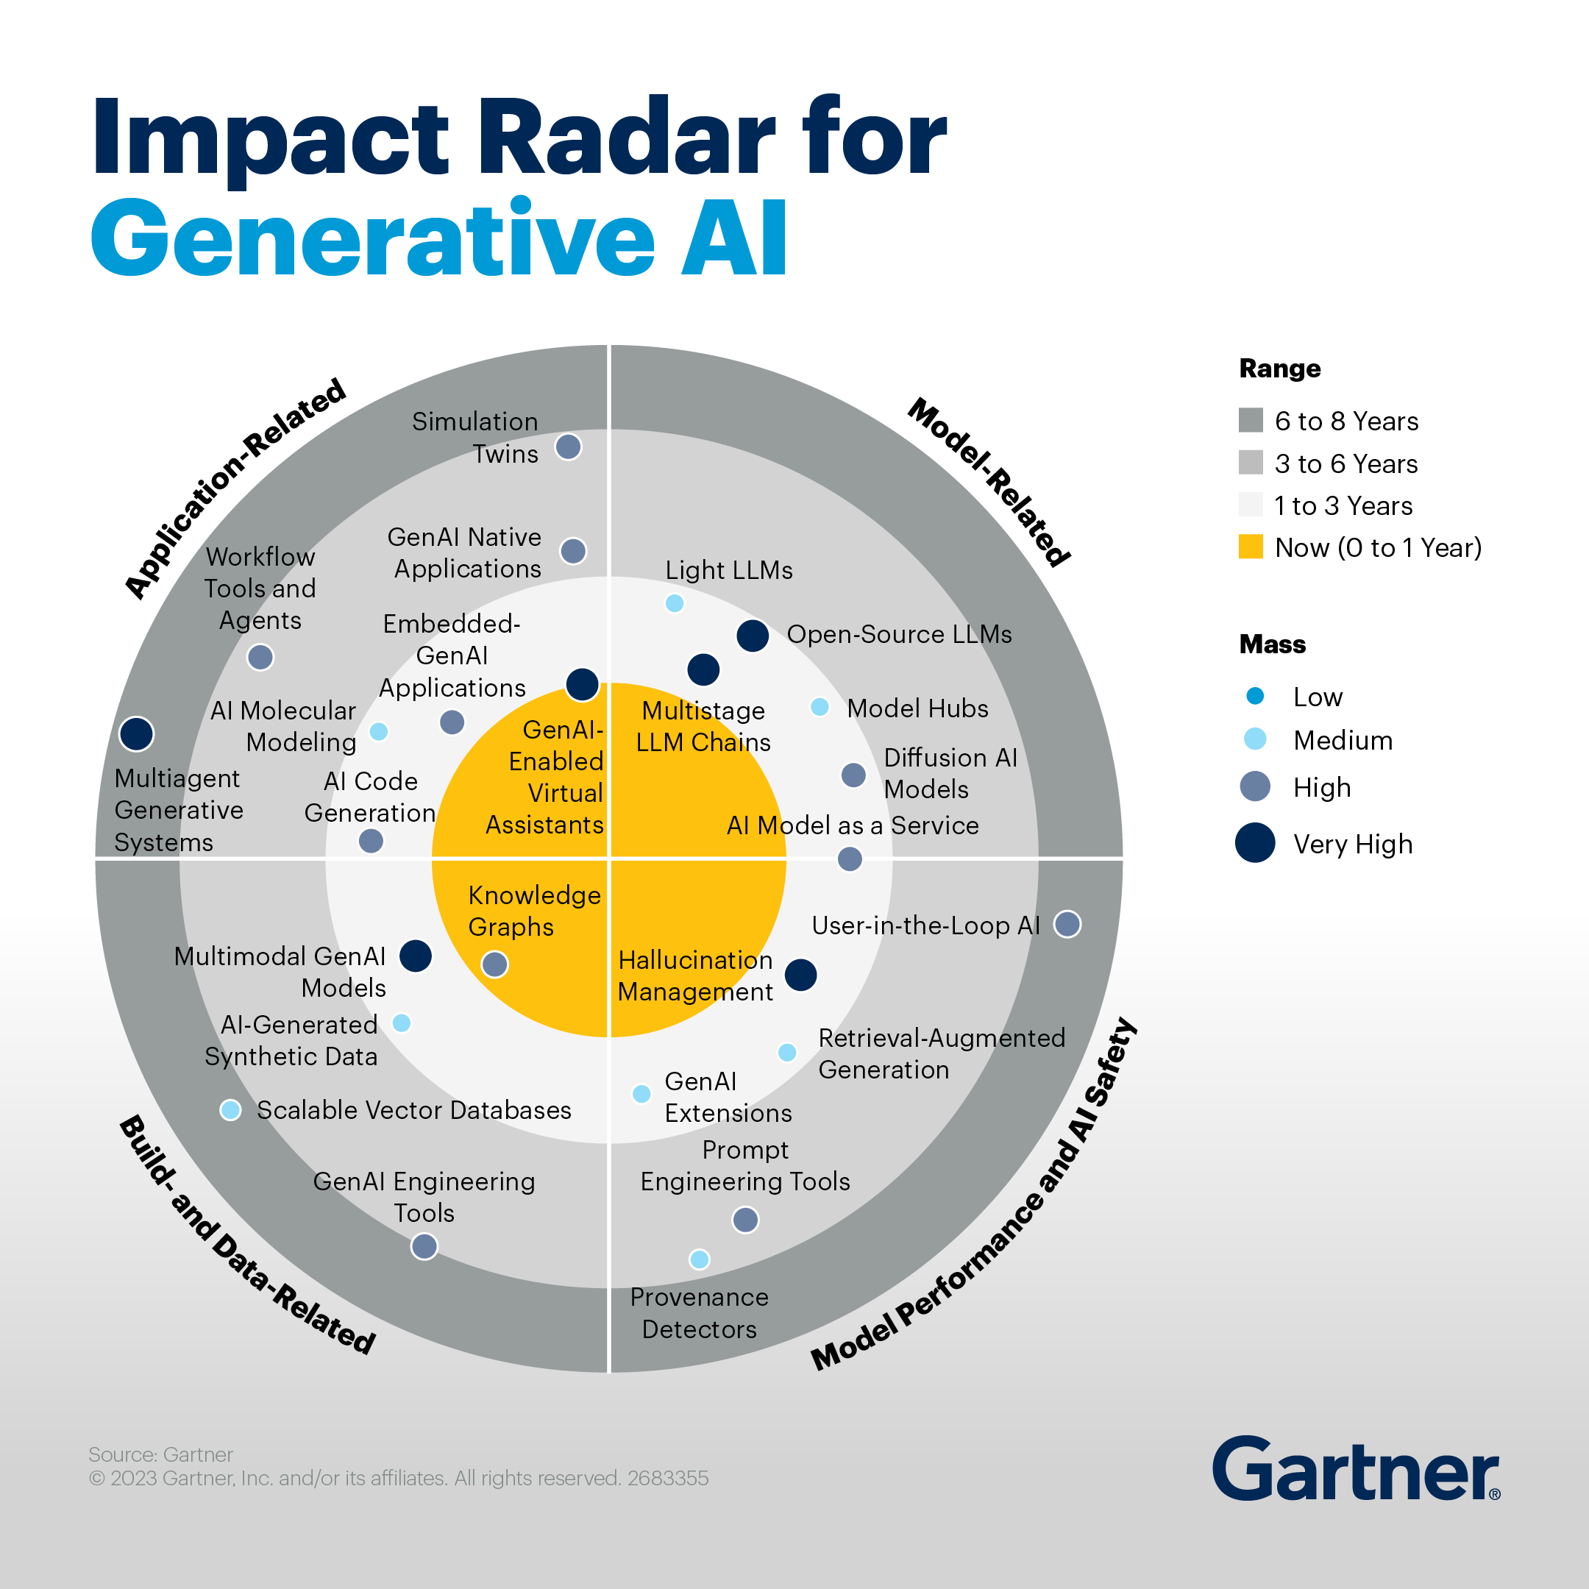
How are Knowledge Graphs actually doing in 2024?
On the one hand…
On the other hand…

Slide 5
What has changed?
Adoption of the concept by major commercial players
Fueled by “AI success stories”
Standards (RDF, SPARQL) adopted by major vendors
The focus has shifted
from (deductive) reasoning towards data quality (constraints)
towards“context”
Are Semantic Web languages (in particulat RDFS and OWL …) still fit for this purpose?

Slide 6
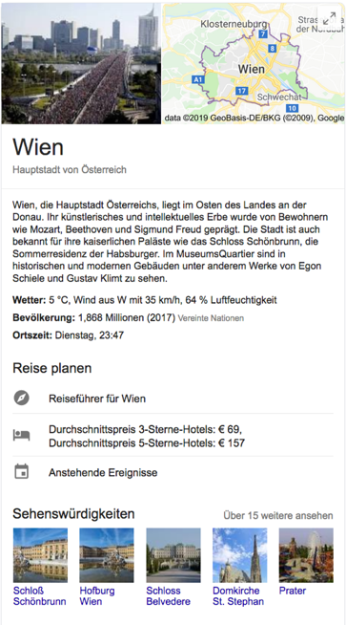
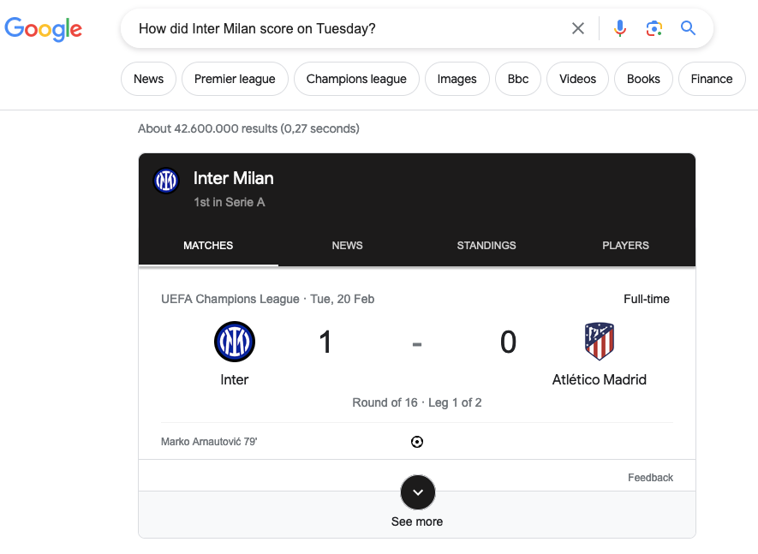
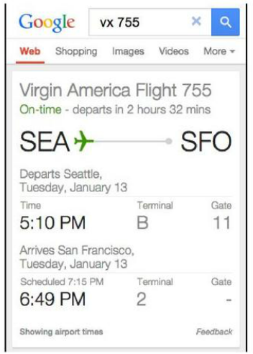
Fueled by “AI success stories” 1/3
Google – User Experience:
- Rich Snippets
- Personalised recommendations across services:
6

Slide 7
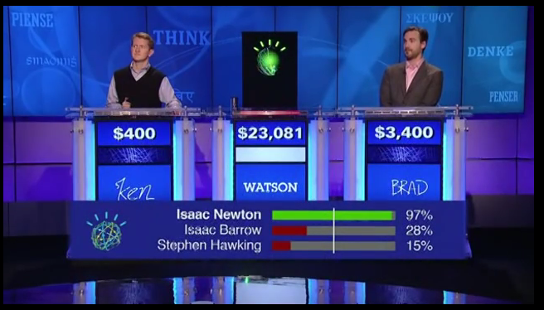
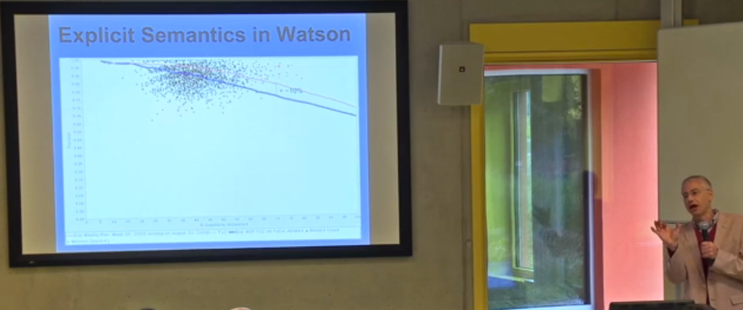
Fueled by “AI success stories” 2/3
IBM Watson :
Pre-LLM !!!
Used DBpedia as one of its underlying knowledge bases! Essentially:
formulating SPARQL queries underneath and using confidence scores.
https://youtu.be/P0Obm0DBvwI?t=951
7

Slide 8
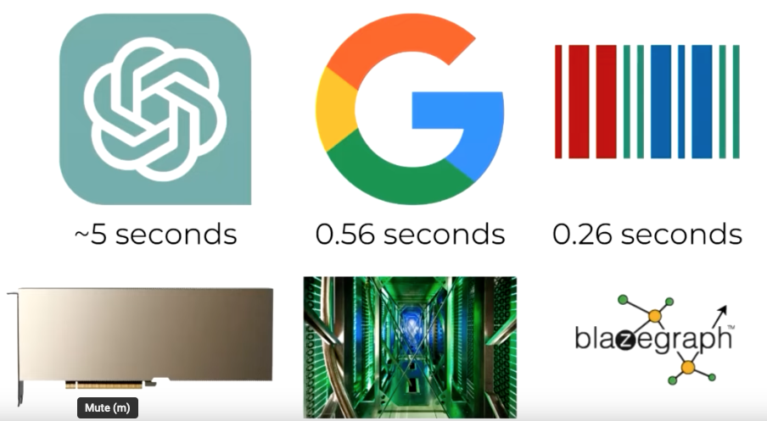
Fueled by “AI success stories” 3/3 “The Future of Knowledge Graphs in a World of LLMs”
Denny Vrandečić, WikimediaFoundation, Keynote KGC23
Trend: RAG – Search+KG+LLMs!
ISWC2024 workshop: Retrieval-Augmented Generation Enabled by Knowledge Graphs (RAGE-KG)
8
Notes:
Combining LLMs, search and querying is powerful!

Slide 9
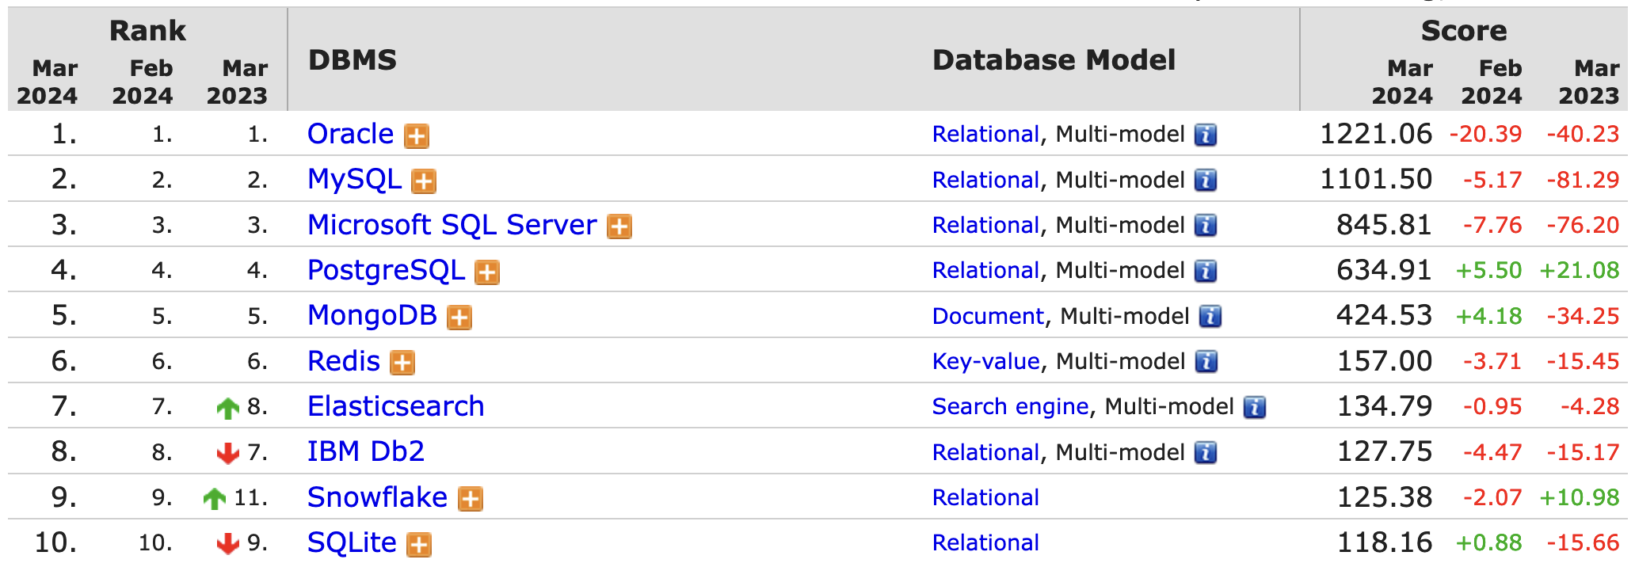
Standards (RDF, SPARQL) adopted by major vendors
“ORACLE supports RDF and SPARQL”
(Quoting Souripriya Das from Dagstuhl Seminar 24061 a month ago ;-) )

Slide 10
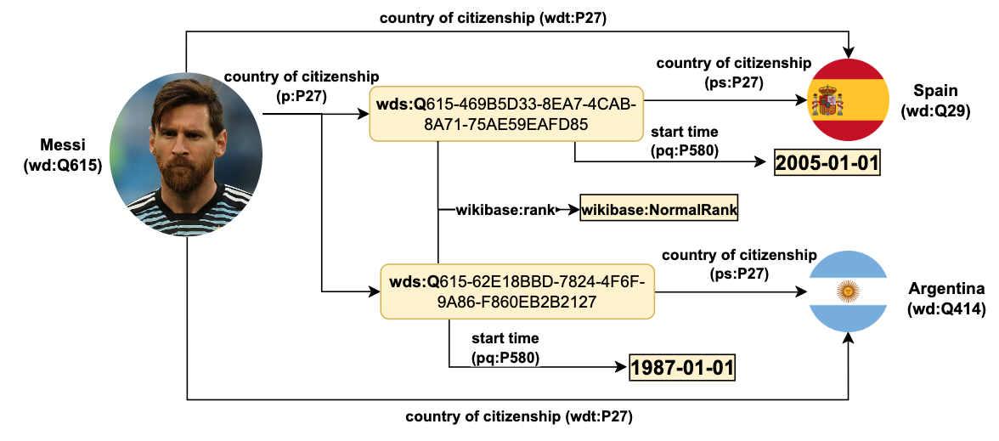
The focus has shifted
towards “context”
from (deductive) reasoning towards data quality (constraints)
Wikidata
Extremely rich, collaborative Knowledge Graph, directly integrated in Wikipedia
Available as RDF and can be queried in SPARQL
Rich contextual knowledge
Fine grained data available about context on a statement level:
time
provenance
Information source
edit information
constraints
https://www.wikidata.org/wiki/Q615
10

Slide 11
So, what happened to RDFS and OWL?
Wikidata does not even use OWL and RDFS
Are Semantic Web languages (in particular RDFS and OWL …) still fit for this purpose?

Slide 12
Starting point/disclaimer:
In this talk, I mainly consider RDFS and OWL as
RDF graphs
RDF (A-Box) Graph:
:s :p :o .
RDFS “T-Box Graph”:
:p rdfs:subClassOf :q.
OWL “T-Box Graph”:
:p rdfs:subClassOf :q.
:p rdf:type owl:inverseFunctionalProperty.
RDFS “Vocabulary Graph” :
rdfs:Property rdf:type rdfs:Class
When I talk about OWL fragments, I mean
which of the OWL(+RDFS+RDFS)
Vocabulary can be used how (syntactically) in an RDF graph

Slide 13
Recovering history: 1999-2000 First versions of RDF + RDFS:
“RDF is a foundation for processing metadata”
1999
The first recommendation version of the RDF syntax and model (all XML):
Ora Lassila, Ralph Swick 22 February 1999
https://www.w3.org/TR/1999/REC-rdf-syntax-19990222/
or: http://web.archive.org/web/20000815062516id_/http://www.w3.org/TR/REC-rdf-syntax/
The actually first version of the RDF namespace document was published a bit before:
http://web.archive.org/web/19990508090931id_/http://www.w3.org/1999/02/22-rdf-syntax-ns
1999
The first recommendation of RDF-Schema:
1999 Proposed Recommendation version
http://web.archive.org/web/20000815092251/http://www.w3.org/TR/1999/PR-rdf-schema-19990303/
never became a Standard, but advanced to Rec only with the RDF 2004 version!
The first version of the RDF-Schema namespace document:
https://web.archive.org/web/20000816181854id_/www.w3.org/2000/01/rdf-schema
Origins rather
“Web metadata exchange format“
than a“(Graph) data format”

Slide 14
First mention of RDF Schema in a W3C published document actually already 1998:
W3C Note 1998 (https://www.w3.org/TR/?filter-tr-name=RDF)

Slide 15
2002: first (draft) version of OWL
Namespace document first version online: www.w3.org/2002/07/owl
http://web.archive.org/web/20020815073440id_/www.w3.org/2002/07/owl

Slide 16
2004: RDF and RDFS 1.0
10 February 2004: Rehaul of the RDF and RDFS vocabulary
http://web.archive.org/web/20040213221349id_/http://www.w3.org/1999/02/22-rdf-syntax-ns
https://web.archive.org/web/20040204230820id_/http://www.w3.org/2000/01/rdf-schema

Slide 17
2004: OWL1
10 February 2004: First official Recommendation of OWL
http://web.archive.org/web/20040405111643id_/http://www.w3.org/2002/07/owl

Slide 18
2012: OWL2
11 December 2012: Quite substantial extension of OWL1
various new language features
3 sub”dialects”:
OWL RL
OWL EL
OWL QL
Whar changed? Let’s check!
http://web.archive.org/web/20121221014933id_/http://www.w3.org/2002/07/owl

Slide 19
2014: RDF1.1 +RDF Schema 1.1
25 February 2014
https://www.w3.org/TR/rdf11-concepts/
https://www.w3.org/TR/rdf11-schema/
What’s new?
https://www.w3.org/TR/rdf11-new/
IRIs instead of URIs and special characters allowed in IRIs.
New datatypes:
rdf:langString
rdf:HTML and rdf:XMLLiteral are non-normative in RDF 1.1
A table of RDF-compatible XSD datatypes has been added to RDF 1.1 Concepts and Abstract Syntax. Any XSD datatypes not represented in this table are incompatible with RDF

Slide 20
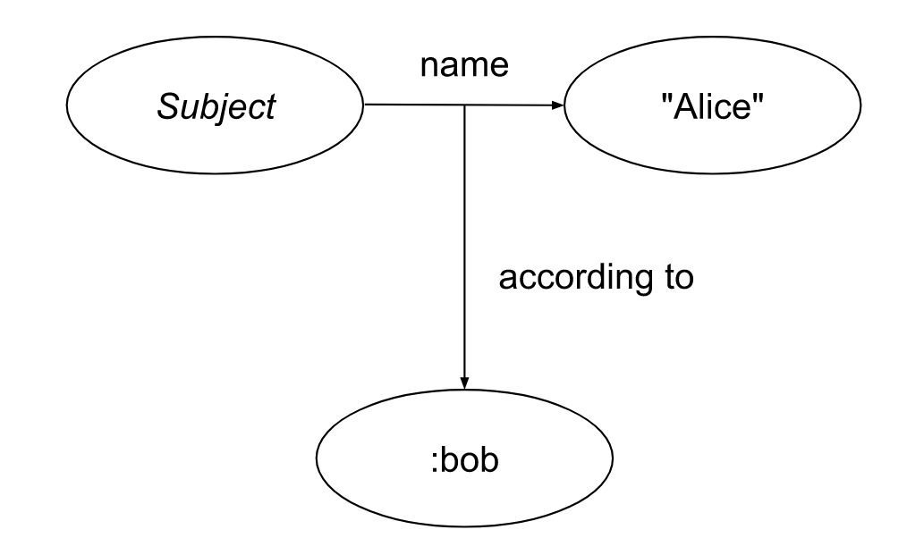
2024: RDF1.2 !
https://www.w3.org/TR/rdf12-schema/
What’s new?
Quoted triples
rdf:dirLangString
rdf:JSON
rdf:HTML and rdf:XMLLiteral now normative

Slide 21
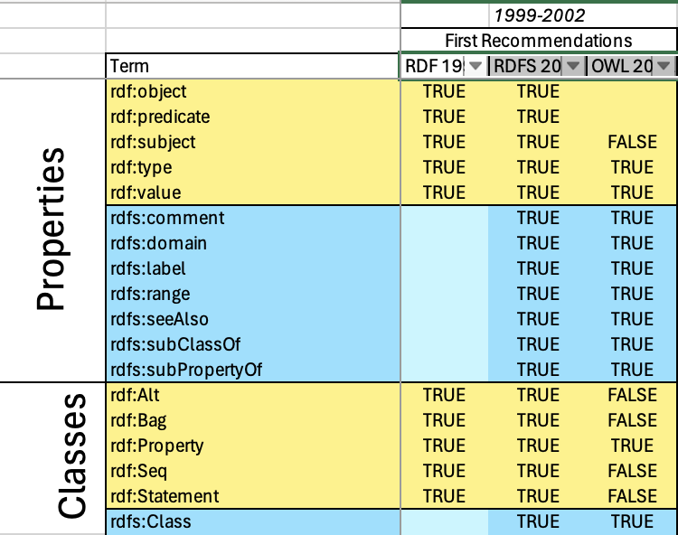
Let’s put these back on our timeline…
 | 1999-2002 |  |  | 2001-2004 |  |  | 2012-2014 |  | 2022-2024
First Recommendations |  |  | RDF 1.0 |  |  | RDF 1.1 |  | OWL2 | RDF1.2
RDF 1999 | RDFS 2000 | OWL 2002 | RDF 2004 | RDFS 2004 | OWL 2004 | RDF 2014 | RDFS 2014 | OWL 2012 | RDF 2024 | RDFS 2024 | OWL 2024
… and have a closer look:
Interesting asynchonicity of the standard’s evolution…
What was there from the beginning?
Some things came and went…
Are all of these constructs needed/used? in practice?
~2000

Slide 22
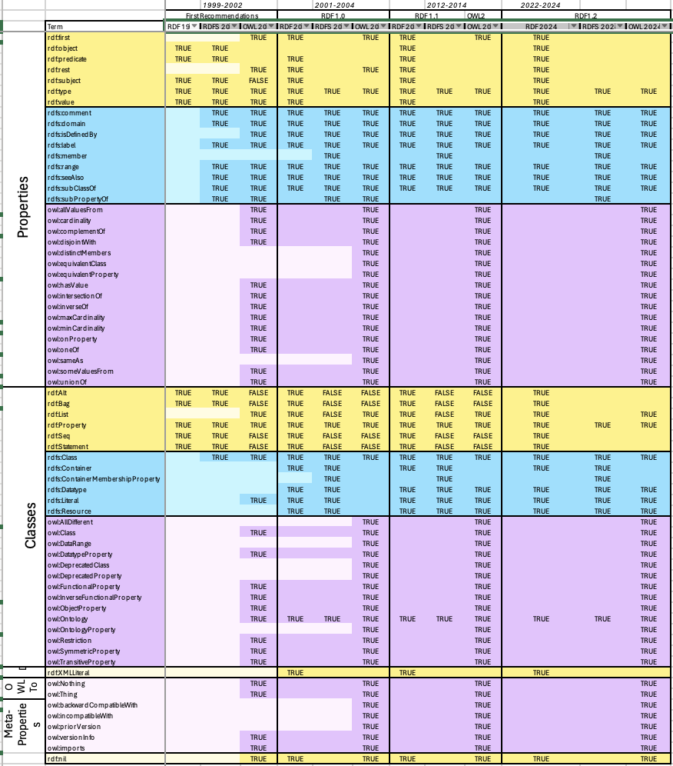
Let’s put these on a Timeline…
 | 1999-2002 |  |  | 2001-2004 |  |  | 2012-2014 |  | 2022-2024
First Recommendations |  |  | RDF 1.0 |  |  | RDF 1.1 |  | OWL2 | RDF1.2
RDF 1999 | RDFS 2000 | OWL 2002 | RDF 2004 | RDFS 2004 | OWL 2004 | RDF 2014 | RDFS 2014 | OWL 2012 | RDF 2024 | RDFS 2024 | OWL 2024
… and have a closer look:
Interesting asynchonicity of the standard’s evolution…
What was there from the beginning?
Some things came and went…
Are all of these constructs needed/used? in practice?
~2004

Slide 23
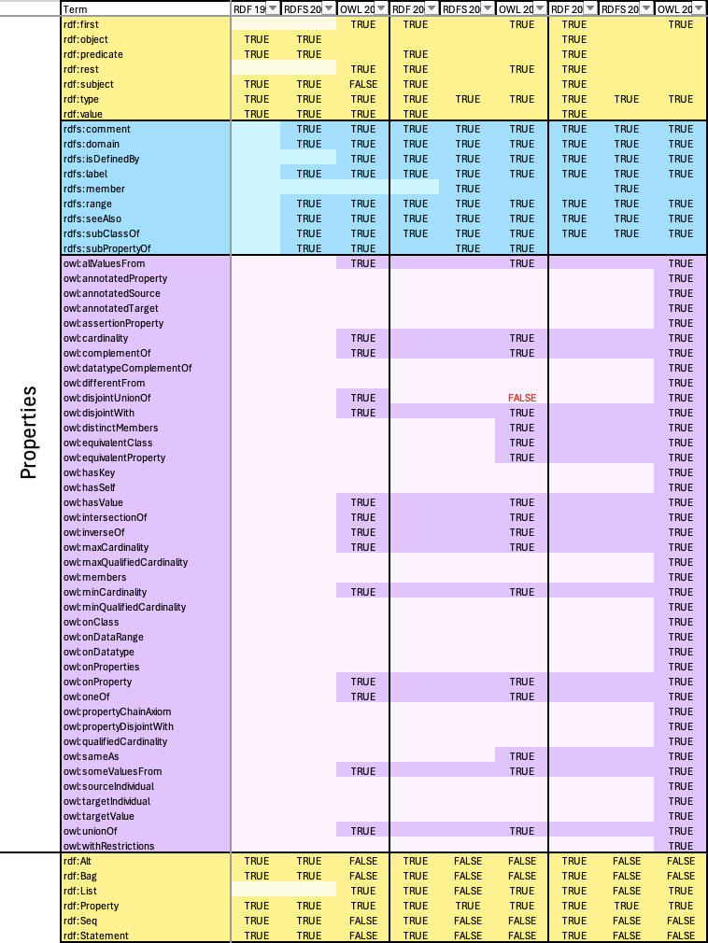
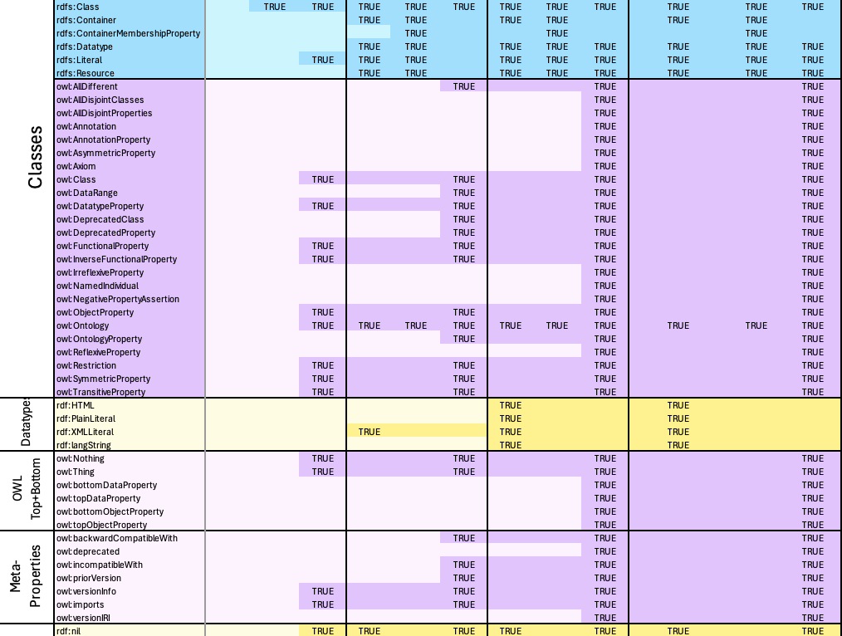
Let’s put these on a Timeline…
 | 1999-2002 |  |  | 2001-2004 |  |  | 2012-2014 |  | 2022-2024
First Recommendations |  |  | RDF 1.0 |  |  | RDF 1.1 |  | OWL2 | RDF1.2
RDF 1999 | RDFS 2000 | OWL 2002 | RDF 2004 | RDFS 2004 | OWL 2004 | RDF 2014 | RDFS 2014 | OWL 2012 | RDF 2024 | RDFS 2024 | OWL 2024
… and have a closer look:
Interesting asynchonicity of the standard’s evolution…
What was there from the beginning?
Some things came and went…
Are all of these constructs needed/used? in practice?
~2014
… and RDF1.2 adding a couple more as we speak ;-)

Slide 24
Even the smallest fragment…
… allows things (syntactically) that don’t make intuitive sense, or at least seem to be “distracting”… to most people who do NOT come from an RDF world.
Note: I’d argue that this is possibly one of the reasons for “slow” adpotion.

Slide 25
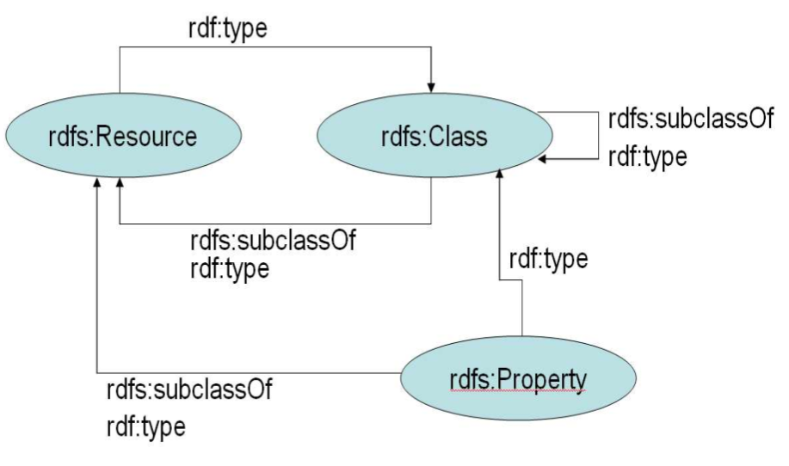
“axiomatic” triples
The vast majority of axiomatic triples seem to be an unnecessary burden, e.g.:
Only there to make the integration of axioms into the graph work, in a way to “justify” the ”mix” of syntax and semantics.

Slide 26
This IS possible…
rdf:subClassOf
a owl:SymmetricProperty .
rdf:type
rdfs:subPropertyOf rdfs:subClassOf, owl:imports.
rdfs:subClassOf
rdfs:subPropertyOf rdfs:Resource,
rdfs:subPropertyOf .
BTW, you here can sure think of similar issues in “SHACL graphs”… Botomline requirement:
You want to have the axioms and constraints represented in/with the graph, but you want to *syntactically* ensure, it keeps *separable*
Notes:
I didn’t manage to do the same thing without OWL, but without equality reasoning…. Shortcut: rdf:type rdfs:subPropertyOf owl:sameAs .

Slide 27
Apart from the official W3C standards
There’s a long list of OWL “fragments”
partially syntactically
partially semantically
motivated:
OWL “ter Horst” (2005) syntactic/semantic (Horn Logic)
OWL Flight (2005) semantic (CWA/Constraint reading)
RDFS- … Minimal RDFS (2007) syntactic/semantic
OWL LD (2012) syntactic/usage-motivated
Other fragments under discusion in the course of OWL2, such as “RDFS3.0”:
https://www.w3.org/2007/OWL/wiki/Fragments

Slide 28
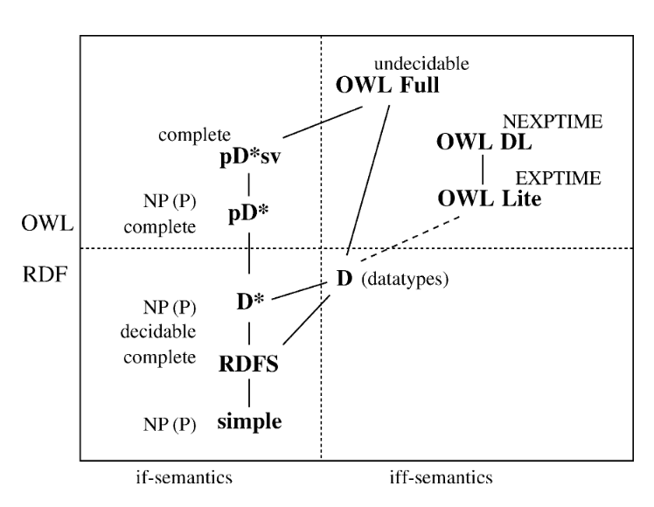
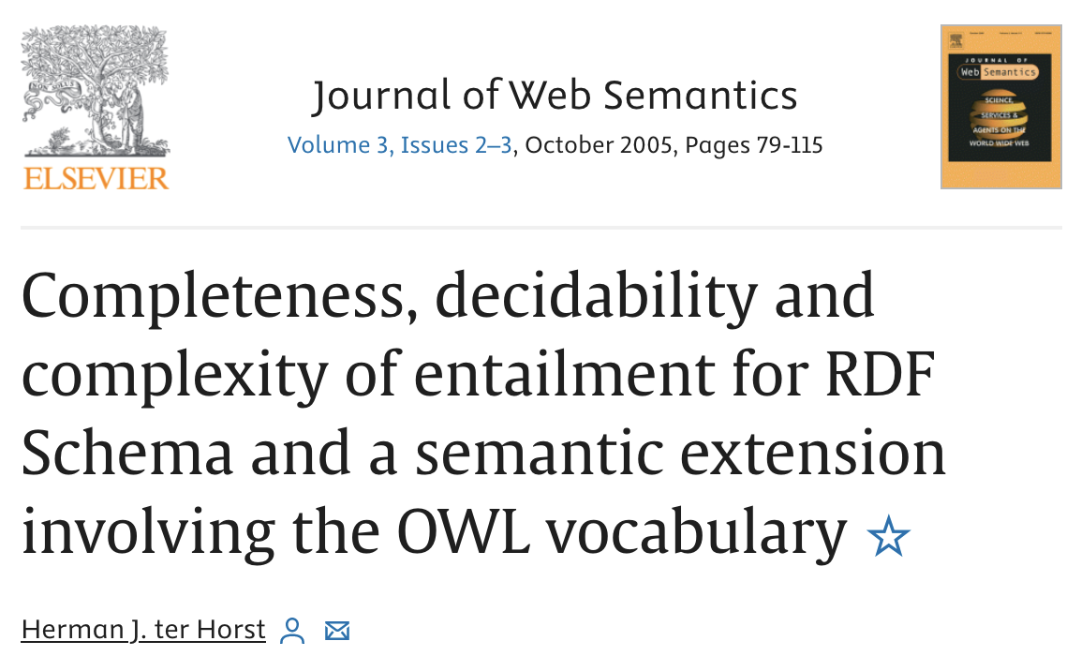
OWL “ter Horst” (2005)

Slide 29
OWL Flight (2005)
“Semantic” fragment:
Datalog-Based semantics
Unique Names Assumption
Important thing: proposing alternative constraint reading of property restrictions!

Slide 30
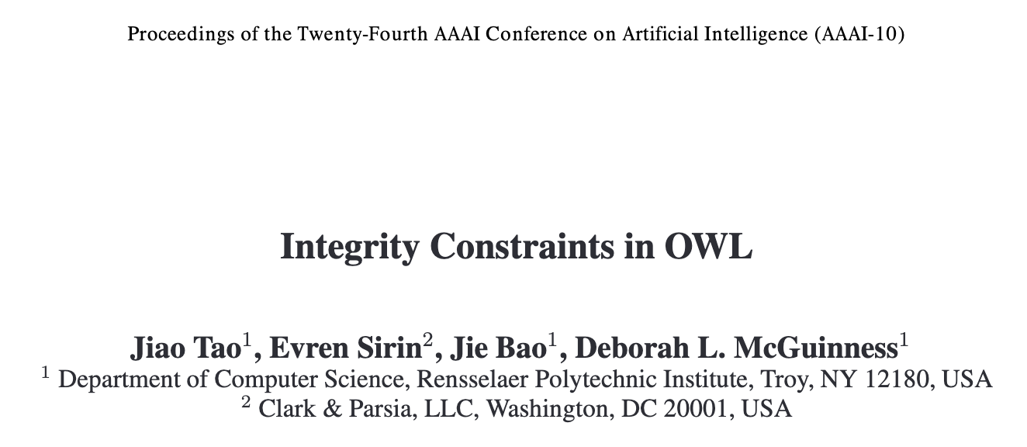
OWL IC (2010)
Similar idea!
Read (some) OWL axioms as constraints
E.g.:
CatOwner ⊑ ∃owns.Cat
“deductive” reading: there is a (possibly unknown) cat
vs.
“constraining” reading: there has to be a (known) owned cat
Problem: what about UNA? What about CWA?
CatOwner rdfs:subClassOf[ a owl:Restriction;
owl:onProperty owns;
owl:somevaluesFrom Cat ]
It’s not trivial to define intuitive semantics that combine these two views
… and it’s pretty ugly to write this as RDF triples

Slide 31
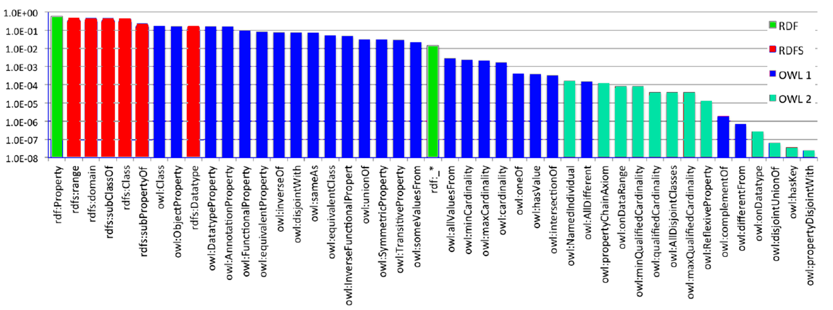
OWL LD (2012)
Goal: Define a fragement of “really used” OWL based on vocabulary usage
RDF Schema features amongst the most prominently used
OWL 2 features not used a lot prominently
RDF | RDFS | OWL | OWL 2

Slide 32
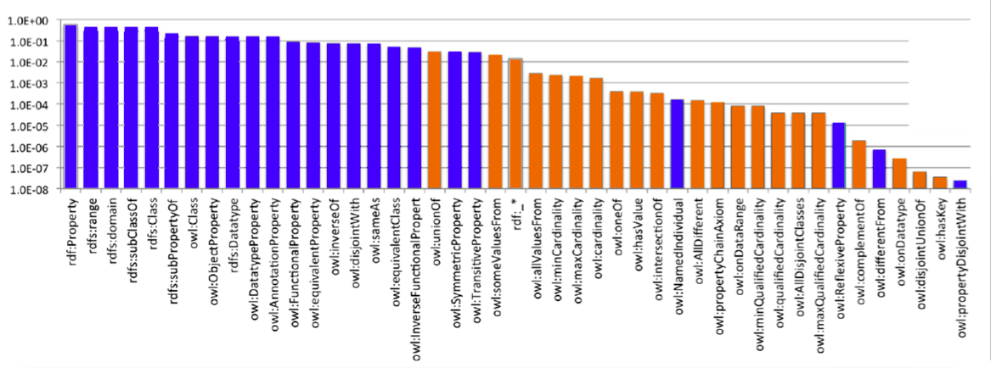
OWL LD (2012)
Goal: Define a fragement of “really used” OWL based on vocabulary usage
RDF Schema features amongst the most prominently used
OWL 2 features not used a lot prominently
Mostly single-triple
expressible axioms
Essential idea:
“Single-triple axiom OWL RL “

Slide 33
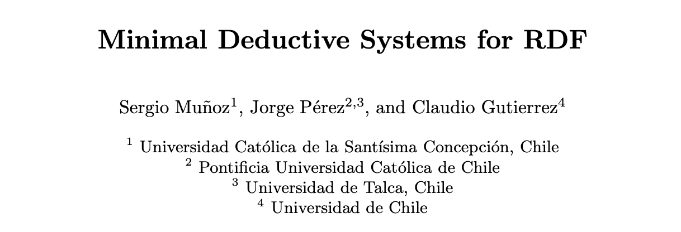
RDFS- (2007)
Arguing (well!) that only a minimal subset of the RDFS vocabulary is semantically relevant, obviously, this is a subset of OWL LD

Slide 34
So, let’s maybe dare a “fresh start” on Ontologies & Shapes? Idea:
Let’s dare to keep it simple and constrain ourselves! ☺
Start minimal.

Slide 35
Incremental Proposal, how could it look?
Start from
standard-use of the
minimal RDFS vocabulary
And extend this fragments by *features* (from OWL LD):
both syntactically and semantically
start with UNA, CWA, add (limited) equality reasoning later)
Goal: build up – gradually –
Useful and “Safe” OWL fragment(s)
Canonical means to fall back/repair non-compliant OWL ontologies to meet the required restrictions.
Hope (hidden goal): these safe fragments are also “compatible” with
New standards for constraints and SHAPES (SHACL, ShEx, etc.)
Modeling context!

Slide 36
Standard use of the RDF, RDFS, and OWL vocabulary
Reasonable starting points 1/3:
Further restrictions well conceivable, and expressible in SHAPEs:
e.g.
Use annotation properties only on URIs that denote an ontology.
Don’t explicitly use classes in G_res

Slide 37
Going beyond “Standard use”
Reasonable starting points 1/3:
More “tool-supportable” OWL fragments, e.g. enforce (or repair) what makes sense for ontology editors:
Keep DatatypeProperties and ObjectProperties separate, i.e. ensure all properties are either DatatypeProperties xor ObjectProperties
Disallow meta-modelling (or enable canonical ways to disambiguate user-defined URIs used as classes and instances).
Disallow “cycles” in taxonomies
Disable “URI hijacking”
…
Open question:
(How) can we also enforce this by syntactic restrictions on vocabulary usage?

Slide 38
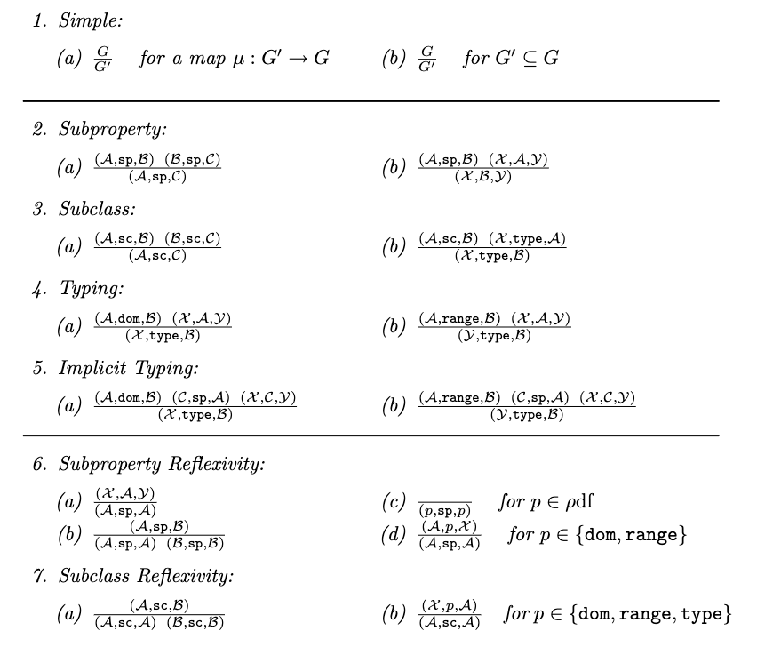
Reasonable starting points 2/3:
Minimal RDFS:
Argue – essentially that for RDFS, only the properties
rdfs:subPropertyOf [sp],
rdfs:subClassOf [sc],
rdfs:domain [dom],
rdfs:range [range]
rdf:type [type]
are relevant.

Slide 39
Reasonable Starting points 3/3: Connecting RDF to Property Graphs (PGs)...
... needs Reification, but reification does not necessarily complicate things!
Santiago LA380 Arica .
LA380 edgeType flight .
LA380 company “LATAM” .

Slide 40
Reasonable Starting points 3/3: Connecting RDF to Property Graphs (PGs)...
... needs Reification, but reification does not necessarily complicate things!
e.g. Singleton reification (with reasonable syntactic constraints) can cover PGs...
i.e., something like:
Drop namespaces (or restrict to 1 namespace)
edgeType a owl:inverseFunctionalProperty.
edgeType rdfs:subPropertyOf rdfs:subPropertyOf.
Shape constraint:
each other property used on a property in the domain of edgeType
is constrained to be a owl:DatatypeProperty

Slide 41
Take-home messages:
 | 1999-2002 |  |  | 2001-2004 |  |  | 2012-2014 |  | 2022-2024
First Recommendations |  |  | RDF 1.0 |  |  | RDF 1.1 |  | OWL2 | RDF1.2
RDF 1999 | RDFS 2000 | OWL 2002 | RDF 2004 | RDFS 2004 | OWL 2004 | RDF 2014 | RDFS 2014 | OWL 2012 | RDF 2024 | RDFS 2024 | OWL 2024
RDF remains a great “graph exchange” format…
… although it was not created for that!
A lot of work and thought have been put into it, over 20+ years, which we should probably not re-invent.
some things are more complicated than needed/actually useful.
The RDF, RDFS and OWL vocabulary allow us to store axioms within the data
feature or bug? … probably it’s a feature
BUT: the reserved vocabulary should (IMHO) not be tempered with → needs syntactic consgtraints (“shapes”)
Unifying RDF, PGs (and even RDB) under one roof should be nicely possible under an RDF “roof”
if we enforce syntactic restrictions to constrain (reserved) vocabulary usage by shape constraints.
Which language for “shape constraints”?
Partially, the OWL and RDFS vocabulary can be “read as constraints” itself (OWL IC, OWL Flight approaches)
SHACL? SheX?
Probably more features needed for things (e.g. acyclicity checks) covered by neither
Let’s dare to take step(s) back and (re-)start simple(r)!

Slide 42
Backup slides

Slide 43
Take-home messages:
 | 1999-2002 |  |  | 2001-2004 |  |  | 2012-2014 |  | 2022-2024
First Recommendations |  |  | RDF 1.0 |  |  | RDF 1.1 |  | OWL2 | RDF1.2
RDF 1999 | RDFS 2000 | OWL 2002 | RDF 2004 | RDFS 2004 | OWL 2004 | RDF 2014 | RDFS 2014 | OWL 2012 | RDF 2024 | RDFS 2024 | OWL 2024
RDF remains a great “graph exchange” format…
… although it was not created for that!
A lot of work and thought has been put into it, which we should probably not re-invent.
some things are more complicated than needed/actually useful.
The RDF, RDFS and OWL vocabulary allow us to store axioms within the data
feature or bug? … probably it’s a feature
BUT: the reserved vocabulary should (IMHO) not be tempered with → needs syntactic consgtraints (“shapes”)
Unifying RDF, PGs (and even RDB) under one roof should be nicely possible under an RDF “roof”
if we enforce syntactic restrictions to constrain (reserved) vocabulary usage by shapes
Which Shapes?
Partially, the OWL and RDFS vocabulary can be “read as constraints” itself (OWL IC, OWL Flight approaches)
SHACL? SheX?
Probably more needed for things (e.g. acyclicity checks) covered by neither
Let’s dare to take step(s) back and (re-)start simple(r)!
P.S.: and yes, probably RDF-star could be a (non-RDF1999-downwards-compatible) alternative to singleton reification, if someone thought about that, but, well… that would be another talk.

Slide 44
Open Question: How and what to repair?
More advanced “Repair” strategies, tricky parts:
e.g. collapsing or forbidding subclassOf and subPropertyof cycles
Incompatible Domain and range of subProperties → common intersection semantics often undesired in practice, e.g.:
Q subPropertyOf P
R subPropertyOf P
P domain A
Q domain B
Desideratum/Possible “repairs”:
Repair Option 1: add: B subclassOf A (only posible if instance data warrants this)
Repair Option 2: change: P domain disjointUnionOf (A,B)
Both might have “propagating” implications…
needs acyclic hierarchies,
multiple inheritance may also be an obstacle

Slide 45
Spinning this a bit further (lunch discussion idea): Unifying Relational Networks, RDBs, PGs and RDF:
This is for @GeorgeFletcher: in an OWL Constraint reading
EXCLUSIVE ~ owl:InverseFunctionalProperty
SINGLETON ~ owl:FunctionalProperty
MANDATORY ~ owl:minCardinality 1
“single property RDF”: Networks
“PlainRDF“ (Overlay Networks or DLGs):
RDF Graphs
using a signature P,C,
where typically |P| is finite
P ∩ C = ∅ and P ∩ G_{res} = ∅ and C ∩ G_{res} = ∅
“RDF PG”:
See previous slide
“RDF RDB”:
RDF PG with
a finite number of allowed Property combinations (finite number of “Characteristic sets”)
each property used domain rdfs:singletonPropertyOf: is constrained to be of type owl:FunctionalProperty (guarantee single value)
“RDF Wikidata?” :
RDF PG with allowing nodes in value positions?
RDF generalises all of these!
Only a half-baked idea so far: I would be really happy if someone wanted to develop this jointly!
This is for @Jose
Note to self: https://aidanhogan.com/docs/reification-wikidata-rdf-sparql.pdf

