Slide 1

Build a better life by translating problems to Datalog and Answer Set Programming(ASP)
Axel Polleres
Institute for Data, Process and Knowledge Management
28/11/2022 Invited Talk - TAASP 2022, Vienna, Austria
Social media: @AxelPolleres@wien.rocks
http://polleres.net/
November 2022

Slide 2

Why I love ASP (since over 20 years)…
Intuitive, understandable Problem encodings…`
… easily extensible
the beauty of Guess and Check to solve complex problems on top
Station 1:
1999-2003
AI Planning
Notes:
Thought about what I could talk about, since I am sure that there are many people in this room who can probably say much more about the state od the art of ASP and its development, new techniques and featues in solvers, … so I decided to tell you soemthing about my “story” and research I did over the past 20+ years since my PhD which on topics more or less related with ASP, but at least never left it completely.

Slide 3
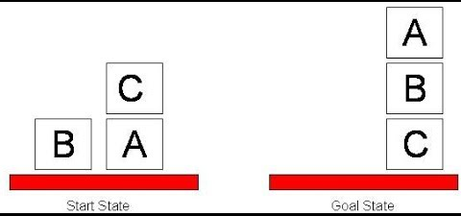
AI Planning…
fluents: on(c,a), on(b,table), on(a,table)
Actions: move(c,table) with
  preconditions:
    executable move(B, L) if block(B).
    nonexecutable move(B, B).
    nonexecutable move(B, L) if blocked(B).
    nonexecutable move(B, L) if blocked(L) .
  effects:
    caused on(B, L) after move(B, L).
    caused -on(B, L) after move(B, L1), on(B,L), L1<>L.
Notes:
Remarkable in the current AI and machine learning hype, this is- as soon as it needs complex symbolic background knowledge, usually what AI or DL can’t do.

Slide 4
AI Planning… intuitive encoding
fluents: on(c,a,0). on(b,table,0). on(a,table,0).
Actions: move(c,table,T).
  preconditions:
    :- move(B,B,T).
    :- move(B,L,T) , blocked(B,T).
    :-move(B,L) , blocked(L,T) .
  effects:
    on(B, L, T+1) :- move(B, L,T).
    -on(B, L,T+1) :- move(B, L1,T), on(B,L,T), L1<>L.
  implicit background knowledge:
    blocked(B,T) :- on(_,B,T), block (B).
    on(B,L,T+1) :- on(B,L,T), not –on(B,L,T).

Slide 5
AI Planning… intuitive encoding
fluents: on(c,a,0). on(b,table,0). on(a,table,0).
Actions: move(c,table,T).
  preconditions:
    :- move(B,B,T).
    :- move(B,L,T) , blocked(B,T).
    :-move(B,L) , blocked(L,T) .
  effects:
    on(B, L, T+1) :- move(B, L,T).
    -on(B, L,T+1) :- move(B, L1,T), on(B,L,T), L1<>L.
  implicit background knowledge:
    blocked(B,T) :- on(_,B,T), block (B).
    on(B,L,T+1) :- on(B,L,T), not –on(B,L,T).

Slide 6
AI Planning… guess and check:
fluents: on(c,a,0). on(b,table,0). on(a,table,0).
Actions: move(c,table,T).
  preconditions:
    move(B, L,T) v -move(B, L,T) :- block(B), location(L), time(T).
    :- move (B,B,T).
    :- move(B, L,T) , blocked(B,T). blocked(B,T) :- on(_,B,T).
    :- move(B, L) , blocked(L,T) .
  effects:
    on(B, L, T+1) :- move(B, L,T).
    -on(B, L,T+1) :- move(B, L1,T), on(B,L,T), L1<>L.
  implicit background knowledge:
    blocked(B,T) :- on(B1,B,T), block (B).
    on(B,L,T+1) :-on(B,L,T), not –on(B,L,T).
Goal:
goal(T) :- on(a,b),
on(b,c),
on(c,table).
:- not goal(maxTime).
time(0..maxTime).

Slide 7
AI Planning… ease of extensions:
Nondeterministic actions:
  E.g., “clumsy” move
    on(B, L, T+1) v on(B, table, T+1) :- cmove(B, L,T), on(B,L,T), block(L).
    on(B, L, T+1) :- cmove(B,L,T), on(B,table,T).
Action costs /cost optimal planning:
  cost(T,1) :- cmove(B,L,T).
  cost(T,2) :- move(B,L,T).
  :~ cost(T,Cost). [Cost:]

Slide 8
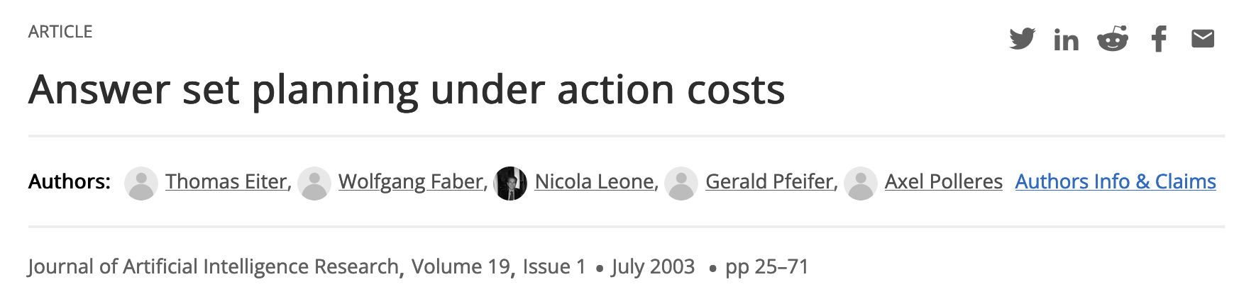
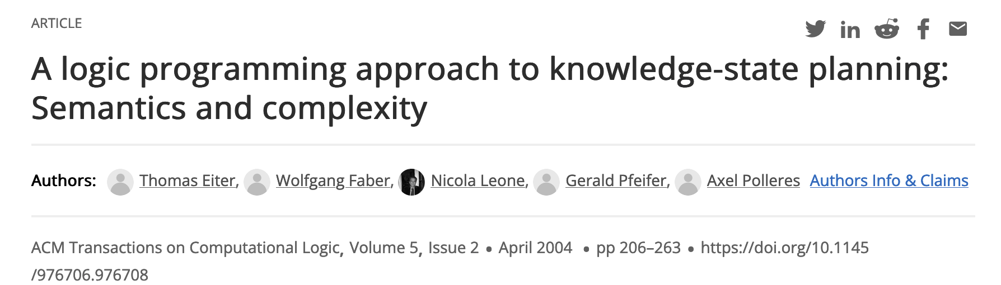
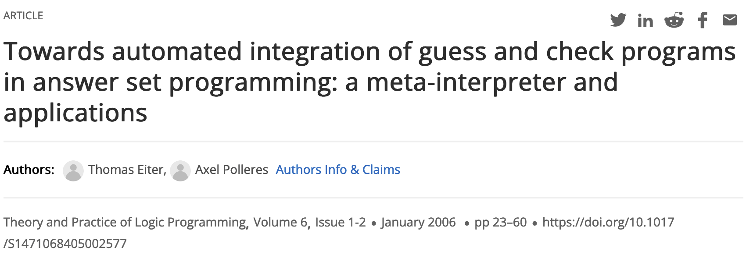
AI Planning… ease of extensions:
Nondeterministic actions:
  E.g., “clumsy” move
    on(B, L, T+1) v on(B, table, T+1) :- cmove(B, L,T), on(B,L,T), block(L).
    on(B, L, T+1) :- cmove(B,L,T), on(B,table,T).
Action costs /cost optimal planning:
  cost(T,1) :- cmove(B,L,T).
  cost(T,2) :- move(B,L,T).
  :~ cost(T,Cost). [Cost:]

Slide 9




Why I love ASP (since over 20 years)…
Intuitive, understandable Problem encodings…`
… easily extensible
the beauty of Guess and Check to solve complex problems on top
Part 1:
1999-2003
AI Planning
Part 2:
2003 – to date…
Semantic Web

Slide 10
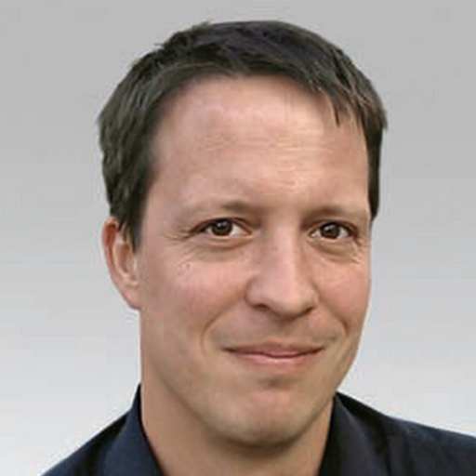

Semantic Web … RDF Triples
“Typed” links on the Web …
… can be seen as subject-predicate-object edges in a Graph:
it's just syntactic sugar…
<http://www.polleres.net#me> <http://xmlns.com/foaf/0.1/workplaceHomepage> <http://www.wu.ac.at> .
polleres.net#me
workplaceHomepage
www.wu.ac.at

Slide 11


Semantic Web … Standards like RDF have lead to (really) big Open “Knowledge Graphs”…
… availabe on the Web
… queryable via a query language called SPARQL!
1,101,215,718 triples/edges 13,602,048,837 triples/edges

Slide 12
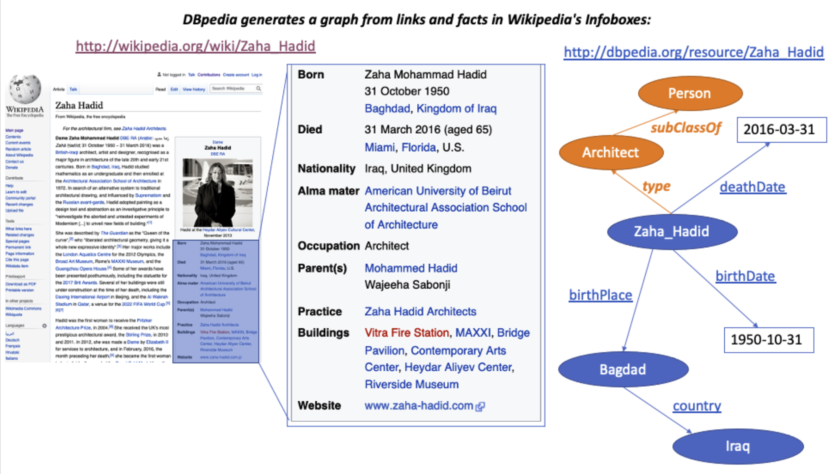
Semantic Web … Standards like RDF have lead to (really) big Open “Knowledge Graphs”…
… availabe on the Web
… queryable via a query language called SPARQL!
PREFIX dbr: <http://dbpedia.org/resource/>
PREFIX rdfs: <http://www.w3.org/2000/01/rdf-schema#>
PREFIX dbo: <http://dbpedia.org/ontology/>
PREFIX rdf: <http://www.w3.org/1999/02/22-rdf-syntax-ns#>
SELECT ?N WHERE {
?X rdf:type dbo:Architect ;
rdfs:label ?N .
{{?X dbo:birthPlace dbr:Baghdad}
UNION
{?X dbo:birthPlace dbr:Vienna}}
FILTER (lang(?N) = "en")
}

Slide 13
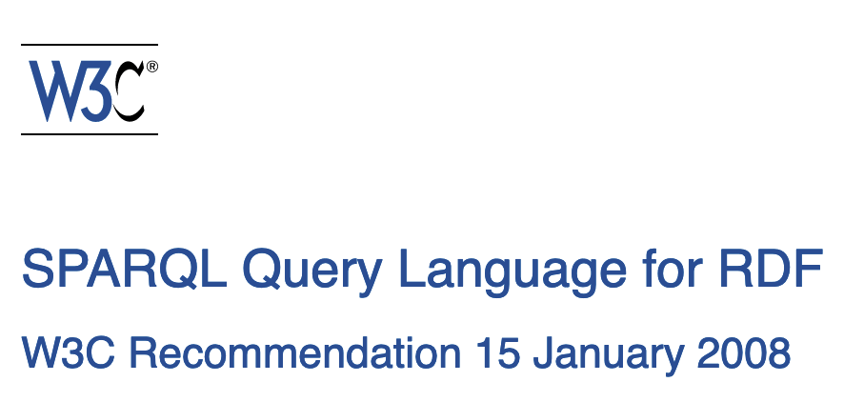
Semantic Web …Status ~2006
Semantics of SPARQL in parts undefined
Various extensions being discussed…

Slide 14
SPARQL… intuitive encoding
Why I liked SPARQL?
SELECT ?X
WHERE {
?X rdf:type dbpedia:Architect.
?X dbpedia:birthPlace dbpedia:Baghdad .
}
for the same reason I love ASP! Obvious similarities to Datalog...
answer(X) :-
triple( X, birthPlace , baghdad ) ,
triple( X, type , architect) .

Slide 15
SPARQL… intuitive encoding some not entirely trivial, e.g. OPTIONAL:
Give me people who know somebody and OPTIONALLY their email address:
:tim foaf:knows :jim . :tim :email <mailto:timbl@w3.org> .
:jim foaf:knows :tim .
Example Query:
triple( :tim, knows, :jim ) . triple(:tim, email, timbl@w3.org ) .
triple( :jim, knows, :tim ) .
evalP(X,Y,M) :- triple( X, knows, Y ) , triple( X, email, M) .
evalP(X,Y,null) :- triple( X, knows, Y ) , not evalP1(X) .
evalP1(X) :- triple( X, email, M) .
answer(X,M) :- evalP(X,Y,M) .
SELECT ?X ?M
WHERE {
{ ?X foaf:knows ?Y }
OPTIONAL
{ ?X :email ?M }
}
X | M
tim | timbl@w3.org
jim
X | Y
tim | jim
jim | tim
X | Y
tim | jim
jim | tim
X | Y | M
tim | jim | timbl@w3.org
jim | tim
X | M
tim | timbl@w3.org
U
\
X | M
tim | timbl@w3.org
= ?
=

Slide 16
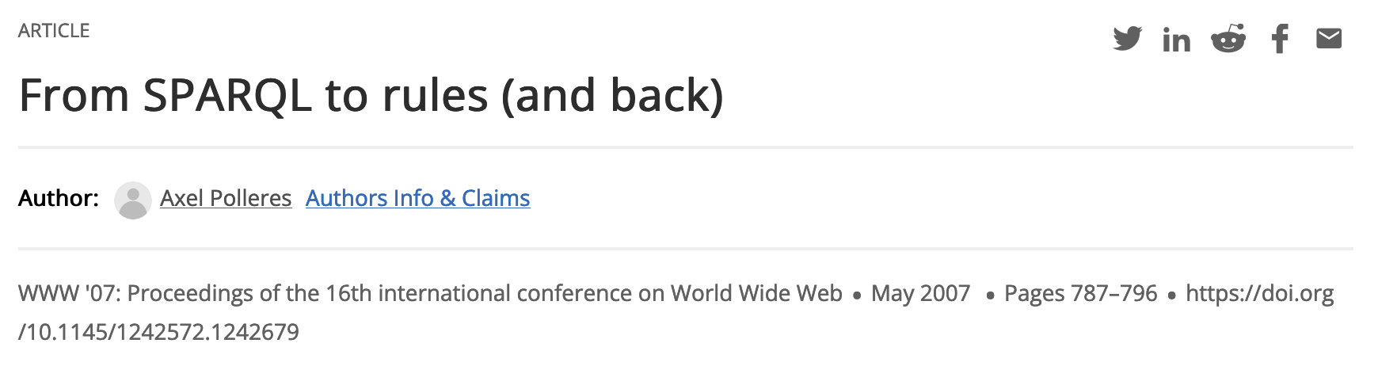

SPARQL… intuitive encoding
[Polleres, 2007] shows that all of SPARQL 1.0 can be translated to (safe) nonrecursive Datalog^{not}.
[Angles&Gutierrez 2008] vice versa show that (safe) nonrecursive Datalog^{not} likewise be encoded into SPARQL.

Slide 17
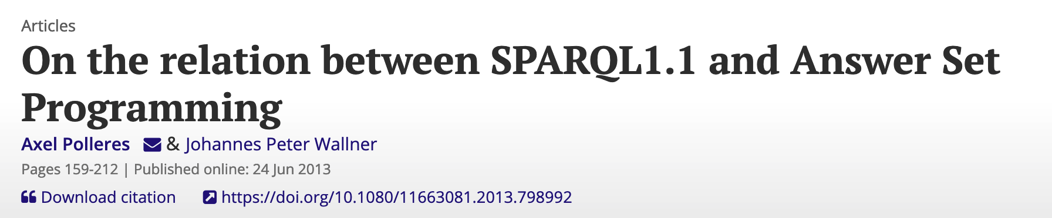
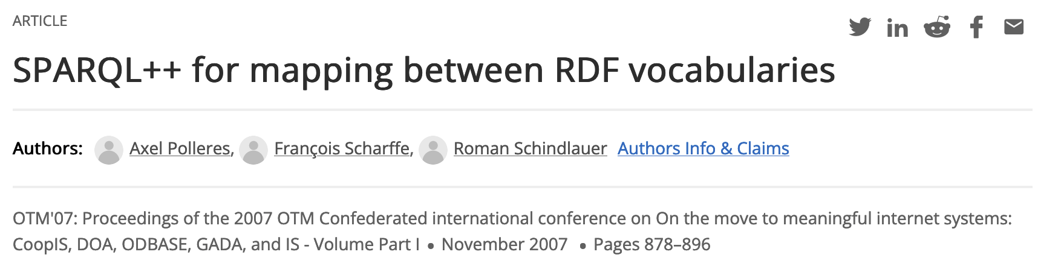
SPARQL… ASP’s ease of extensions:
1) We could show that additional features of SPARQL 1.1 were also easily encodable in Datalog…
2) … and (already before) proposed a semantics to using SPARQL as a rules language to define the semantics of RDF sources potentially mutually referring to each other…

Slide 18
SPARQL… ASP’s ease of extensions:
Unfortunately didn’t make
it to the standard ;-),
but here’s the idea:
Web source P1:
Web source P2:
:tim :knows :jim .
:tim :email <mailto:timbl@w3.org> .
:jim :knows :tim .
CONSTRUCT {?s :email ?m }
FROM P2
WHERE {?s :email ?m }
:jim <mailto:jim@rpi.edu> .
CONSTRUCT {jim :knows ?m }
FROM P1
WHERE {:jim :knows ?m }

Slide 19
SPARQL… ASP’s guess and check :
Unfortunately didn’t make
it to the standard ;-),
but here’s the idea:
Web source P1:
Web source P2:
:tim :knows :jim .
:tim :email <mailto:timbl@w3.org> .
:jim :knows :tim .
CONSTRUCT {?s :email ?m }
FROM P2
WHERE {?s … OPTIONAL … }
:jim <mailto:jim@rpi.edu> .
CONSTRUCT {jim :knows ?m }
FROM P1
WHERE {:jim … NOT EXISTS … }
Could involve recursion and cycles over negation, elegantly solvable with ASP semantics!

Slide 20

Semantic Web … more recent ASP applications:
SHACL: a language to formulate constraints over RDF graphs
E.g.:
Each defined target node needs to fulfill the constraints, in this case:
There needs to be at least one Course that the student is enrolled in.
Shape:
Data Graph:
:StudentShape a sh:NodeShape ;
sh:targetNode :Ben ;
sh : property [
sh:path :enrolledIn ;
sh : qualifiedMinCount 1 ;
sh : qualifiedValueShape [
sh:class :Course ]] .
: Ben :enrolledIn : C1 .
: Ben :enrolledIn :C1 .
:C1 :type Course.

Slide 21
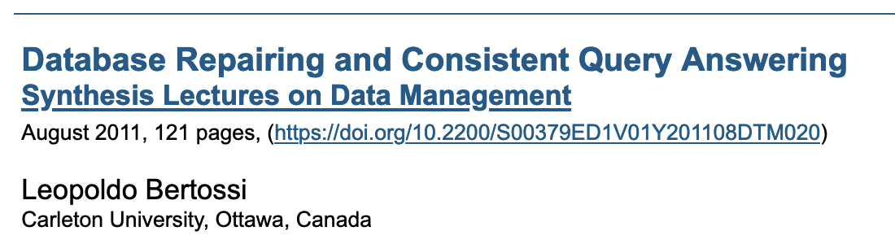
SHACL … computing repairs by Guess and check:
Idea: Without going into details of the encoding: we encode repairs inspired by

Slide 22
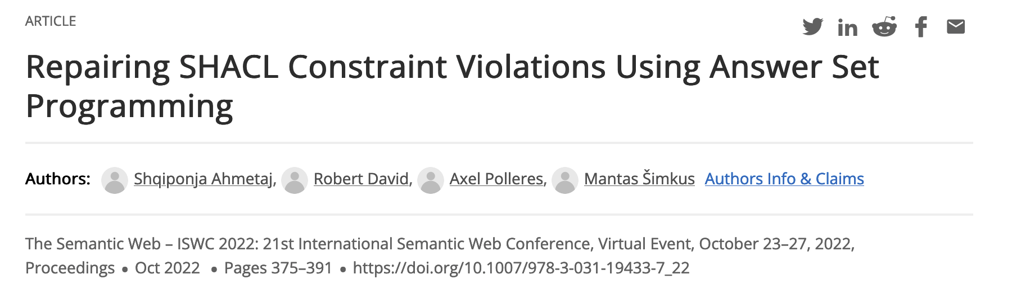

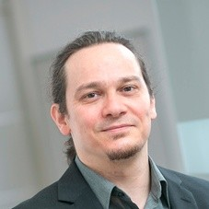
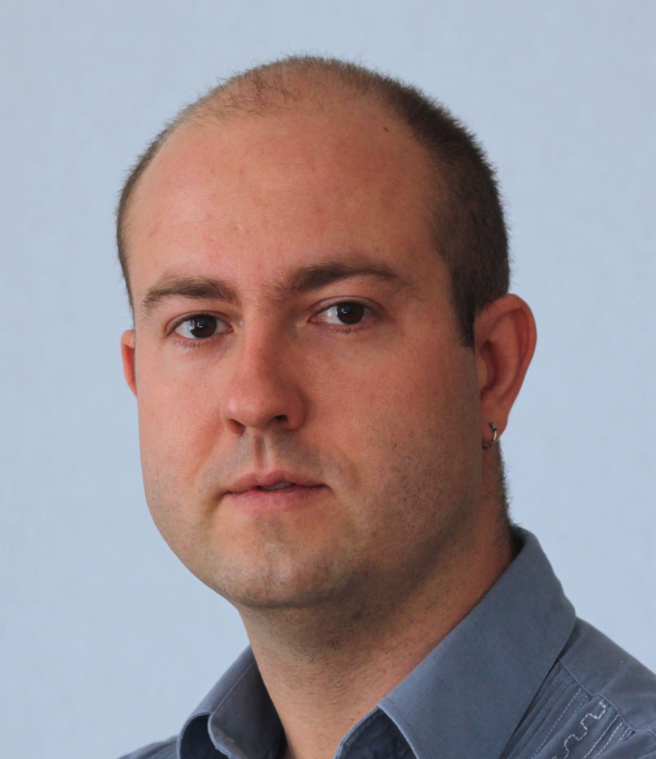
SHACL … computing repairs by Guess and check:
Idea: Without going into details of the encoding: we encode repairs inspired by
Data Graph:
vs.
Guess a pair (A,D) of additions and deletions that repair all target nodes
  cardinality minimality
  strategy for introducing new nodes (for minimality constaints
relaxed encoding to repair a maximal number of target nodes
  in the case not all target nodes can be repaired
Implementation using Java and Clingo
: Ben :enrolledIn :C1 .
:C1 :type Course.
:Ben :enrolledIn :C1.
:Ben :enrolledIn :new1.
:new1 :type Course.

Slide 23
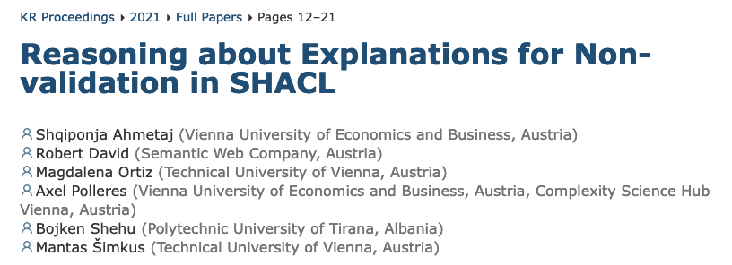
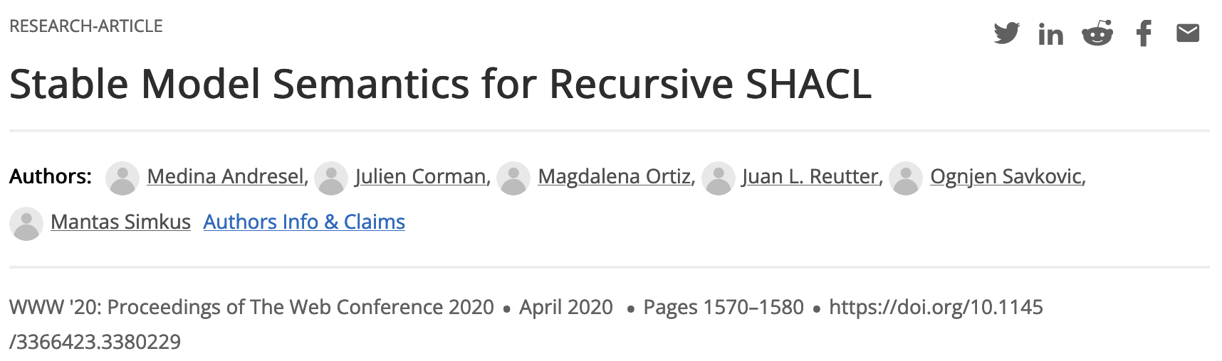
SHACL … computing repairs by Guess and check:
Somewhat work in progress, since it is not 100% clear what a “good” repair semantics should look like, but – we hope - encoding this as a repair problem helps to clarify the semantics of the standard:
- encode more complex repair policies
  e.g. fix a part of the vocabulary/signature
similar issues as in SPARQL++ arise when you allow recursion (cf.
raise a discussion about intuitive repairs, may need extension of the SHACL standard!
Active work in this space, we can built upon:

Slide 24


Why I love ASP (since over 20 years)…
Intuitive, understandable Problem encodings…`
… easily extensible
the beauty of Guess and Check to solve complex problems on top
Part 1:
1999-2003
AI Planning
Part 2:
2003 – to date…
Semantic Web
Part 3:
ca. 2014 – 2022…
Business Process Management

Slide 25

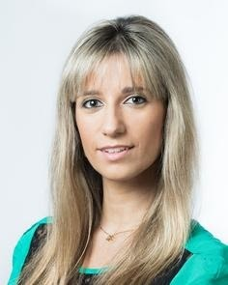
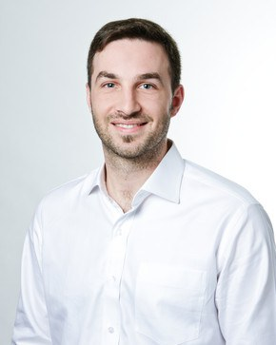
Resource allocation in BPM
Recently concluded PhD thesis:
        Giray Havur
Co-supervisor/Co-PI

Slide 26

Organizing Work
Business Process Modelling Notation
X
Activity 2
X
Activity 1
X
X
Activity 5
Activity 3
+
+
A standardized and popular graphical notation for specifying business processes
Activity 4
Resource Allocation in Business Processes

Slide 27
Organizing Work
Business Process Modelling Notation
X
Activity 2
X
Activity 1
X
X
Activity 5
Activity 3
+
+
Activity 4
Resource Allocation in Business Processes

Slide 28
Organizing Work
Business Process Modelling Notation
X
Activity 2
X
Activity 1
X
X
Activity 5
Activity 3
+
+
Activity 4
Resource Allocation in Business Processes

Slide 29
Organizing Work
Business Process Modelling Notation
X
Activity 2
X
Activity 1
X
X
Activity 5
Activity 3
+
+
Exclusive Gateway
(Diverging)
Activity 4
Exclusive Gateway
(Converging)
Resource Allocation in Business Processes

Slide 30
Organizing Work
Business Process Modelling Notation
Decision 1
Activity 2
X
X
Activity 1
Question?
Activity 5
X
X
Activity 3
+
+
Decision 2
Activity 4
Resource Allocation in Business Processes

Slide 31
Organizing Work
Business Process Modelling Notation
X
Activity 2
X
Activity 1
X
X
Activity 5
Activity 3
+
+
Activity 4
Resource Allocation in Business Processes

Slide 32
Organizing Work
Business Process Modelling Notation
X
Activity 2
X
Activity 1
X
X
Activity 5
Activity 3
+
+
Activity 4
Resource Allocation in Business Processes

Slide 33
Organizing Work
Business Process Modelling Notation
X
Activity 2
X
Activity 1
X
X
Activity 5
Activity 3
+
+
Activity 4
Resource Allocation in Business Processes

Slide 34
Organizing Work
Business Process Modelling Notation
X
Activity 2
X
Activity 1
X
X
Activity 5
Activity 3
+
+
Activity 4
Parallel Gateway
(Diverging)
Parallel Gateway
(Converging)
Resource Allocation in Business Processes

Slide 35
Organizing Work
Business Process Modelling Notation
X
Activity 2
X
Activity 1
X
X
Activity 5
Activity 3
+
+
Activity 4
Parallel Gateway
(Diverging)
Parallel Gateway
(Converging)
Resource Allocation in Business Processes

Slide 36
Organizing Work
BPMN Example
Develop backend
Verify backend
Study requirements
+
+
Deploy system
Develop frontend
Verify frontend
Process Model: A BPMN Model for Software Development
Resource Allocation in Business Processes

Slide 37
Organizing Work
BPMN Example
Develop backend
Verify backend
Study requirements
+
+
Deploy system
Develop frontend
Verify frontend
Process Model: A BPMN Model for Software Development
Resource Allocation in Business Processes

Slide 38
Organizing Work
BPMN Example
Develop backend
Verify backend
Study requirements
+
+
Deploy system
Develop frontend
Verify frontend
Process Model: A BPMN Model for Software Development
Resource Allocation in Business Processes

Slide 39
Organizing Work
BPMN Example
Develop backend
Verify backend
Study requirements
+
5 mos.
3 mos.
+
Deploy system
1 mo.
Develop frontend
Verify frontend
2 mos.
6 mos.
5 mos.
Process Model: A BPMN Model for Software Development
Resource Allocation in Business Processes

Slide 40
Organizing Resources
Role-based Access Control Model
Develop backend
Verify backend
Study requirements
+
5 mos.
3 mos.
+
Deploy system
1 mo.
Develop frontend
Verify frontend
2 mos.
6 mos.
5 mos.
Manager
Amy
Software Engineer
UI Developer
Testing Expert
Jessie
Junior Dev.
Oliver
Mia
Lisa
Liam
Glen
Organizational Model: An RBAC Model of the Software Development Company

Slide 41
Organizing Resources
Role-based Access Control Model
Develop backend
Verify backend
Study requirements
+
5 mos.
3 mos.
+
Deploy system
1 mo.
Develop frontend
Verify frontend
2 mos.
6 mos.
5 mos.
Manager
Amy
Software Engineer
UI Developer
Testing Expert
Resources
Jessie
Junior Dev.
Oliver
Mia
Lisa
Liam
Glen
Resource Allocation in Business Processes

Slide 42
Organizing Resources
Role-based Access Control Model
Develop backend
Verify backend
Study requirements
+
5 mos.
3 mos.
+
Deploy system
1 mo.
Develop frontend
Verify frontend
2 mos.
6 mos.
5 mos.
Manager
Amy
Software Engineer
UI Developer
Testing Expert
Resources
Roles
Jessie
Junior Dev.
Oliver
Mia
Lisa
Liam
Glen
Resource Allocation in Business Processes

Slide 43
Organizing Resources
Role-based Access Control Model
Develop backend
Verify backend
Study requirements
+
5 mos.
3 mos.
+
Deploy system
1 mo.
Develop frontend
Verify frontend
2 mos.
6 mos.
5 mos.
Manager
Amy
Software Engineer
UI Developer
Testing Expert
Resources
Roles
Resource-to-Role assignments
Jessie
Junior Dev.
Oliver
Mia
Lisa
Liam
Glen
Resource Allocation in Business Processes

Slide 44
Organizing Resources
Role-based Access Control Model
Develop backend
Verify backend
Study requirements
+
5 mos.
3 mos.
+
Deploy system
1 mo.
Develop frontend
Verify frontend
2 mos.
6 mos.
5 mos.
Manager
Amy
Software Engineer
UI Developer
Testing Expert
Resources
Roles
Resource-to-Role assignments
Activity-to-Role assignments
Jessie
Junior Dev.
Oliver
Mia
Lisa
Liam
Glen
Resource Allocation in Business Processes

Slide 45
Organizing Resources
Role-based Access Control Model
Develop backend
Verify backend
Study requirements
+
5 mos.
3 mos.
+
Deploy system
1 mo.
Develop frontend
Verify frontend
2 mos.
6 mos.
5 mos.
Manager
Amy
Software Engineer
UI Developer
Testing Expert
Resources
Roles
Resource-to-Role assignments
Activity-to-Role assignments
Role-to-Role assignments
Jessie
Junior Dev.
Oliver
Mia
Lisa
Liam
Glen
Resource Allocation in Business Processes

Slide 46



Running Business Processes
Business Process Management System
Develop backend
Verify backend
Business Process Management System (BPMS)
Study requirements
+
5 mos.
3 mos.
+
Deploy system
1 mo.
Develop frontend
Verify frontend
2 mos.
6 mos.
5 mos.
Manager
Amy
Resources
Software Engineer
UI Developer
Testing Expert
Jessie
Junior Dev.
Oliver
Mia
Lisa
Liam
Glen
Resource Allocation in Business Processes

Slide 47


Running Business Processes
Business Process Management System
Develop backend
Verify backend
Business Process Management System (BPMS)
Study requirements
+
5 mos.
3 mos.
+
Deploy system
1 mo.
Develop frontend
Verify frontend
2 mos.
6 mos.
5 mos.
Manager
Amy
Software Engineer
UI Developer
Testing Expert
Typical approaches for BPM systems:
pull-based or random allocation,
allocation-by-order
but scheduling aspect not considered so far,
rather: allocation by process managers.
Jessie
Junior Dev.
Oliver
Mia
Lisa
Liam
Glen
Resource Allocation in Business Processes

Slide 48


Running Business Processes
Business Process Management System
Develop backend
Verify backend
Business Process Management System (BPMS)
Study requirements
+
5 mos.
3 mos.
+
Deploy system
1 mo.
Develop frontend
Verify frontend
2 mos.
6 mos.
5 mos.
Study requirements
Manager
Amy
Software Engineer
UI Developer
Testing Expert
Jessie
Junior Dev.
Oliver
Mia
Lisa
Liam
Glen
Resource Allocation in Business Processes

Slide 49

Running Business Processes
Business Process Management System
Develop backend
Verify backend
Business Process Management System (BPMS)
Study requirements
+
5 mos.
3 mos.
+
Deploy system
1 mo.
Develop frontend
Verify frontend
2 mos.
6 mos.
5 mos.
event_id | trace_id | event_type | activity | resource | time_stamp
Available
Manager
Amy
Software Engineer
UI Developer
Testing Expert
Jessie
Junior Dev.
Oliver
Mia
Lisa
Liam
Glen
Resource Allocation in Business Processes

Slide 50
Running Business Processes
Business Process Management System
Develop backend
Verify backend
Business Process Management System (BPMS)
Study requirements
+
5 mos.
3 mos.
+
Deploy system
1 mo.
Develop frontend
Verify frontend
2 mos.
6 mos.
5 mos.
event_id | trace_id | event_type | activity | resource | time_stamp
Busy
e1 1 start Study_requirements Amy 01/2020
Manager
Amy
Software Engineer
UI Developer
Testing Expert
Jessie
Junior Dev.
Oliver
Mia
Lisa
Liam
Glen
Resource Allocation in Business Processes

Slide 51
Running Business Processes
Business Process Management System
Develop backend
Verify backend
Business Process Management System (BPMS)
Study requirements
+
5 mos.
3 mos.
+
Deploy system
1 mo.
Develop frontend
Verify frontend
2 mos.
6 mos.
5 mos.
event_id | trace_id | event_type | activity | resource | time_stamp
e1 1 start Study_requirements Amy 01/2020
e2 1 end Study_requirements Amy 02/2020
Manager
Amy
Software Engineer
UI Developer
Testing Expert
Jessie
Junior Dev.
Oliver
Mia
Lisa
Liam
Glen
Resource Allocation in Business Processes

Slide 52
Running Business Processes
Business Process Management System
Develop backend
Verify backend
Business Process Management System (BPMS)
Study requirements
+
5 mos.
3 mos.
+
Deploy system
1 mo.
Develop frontend
Verify frontend
2 mos.
6 mos.
5 mos.
event_id | trace_id | event_type | activity | resource | time_stamp
e1 1 start Study_requirements Amy 01/2020
e2 1 end Study_requirements Amy 02/2020
e3 1 start Develop_backend Glen 02/2020
Manager
Amy
Software Engineer
UI Developer
Testing Expert
Jessie
Junior Dev.
Oliver
Mia
Lisa
Liam
Glen
Resource Allocation in Business Processes

Slide 53
Running Business Processes
Business Process Management System
Develop backend
Verify backend
Business Process Management System (BPMS)
Study requirements
+
5 mos.
3 mos.
+
Deploy system
1 mo.
Develop frontend
Verify frontend
2 mos.
6 mos.
5 mos.
event_id | trace_id | event_type | activity | resource | time_stamp
e1 1 start Study_requirements Amy 01/2020
e2 1 end Study_requirements Amy 02/2020
e3 1 start Develop_backend Glen 02/2020
e4 1 start Develop_frontend Oliver 04/2020
Manager
Amy
Software Engineer
UI Developer
Testing Expert
Jessie
Junior Dev.
Oliver
Mia
Lisa
Liam
Glen
Resource Allocation in Business Processes

Slide 54
Running Business Processes
Business Process Management System
Develop backend
Verify backend
Business Process Management System (BPMS)
Study requirements
+
5 mos.
3 mos.
+
Deploy system
1 mo.
Develop frontend
Verify frontend
2 mos.
6 mos.
5 mos.
event_id | trace_id | event_type | activity | resource | time_stamp
e1 1 start Study_requirements Amy 01/2020
e2 1 end Study_requirements Amy 02/2020
e3 1 start Develop_backend Glen 02/2020
e4 1 start Develop_frontend Oliver 04/2020
e5 1 end Develop_backend Glen 07/2020
Manager
Amy
Software Engineer
UI Developer
Testing Expert
Jessie
Junior Dev.
Oliver
Mia
Lisa
Liam
Glen
Resource Allocation in Business Processes

Slide 55
Running Business Processes
Business Process Management System
Develop backend
Verify backend
Business Process Management System (BPMS)
Study requirements
+
5 mos.
3 mos.
+
Deploy system
1 mo.
Develop frontend
Verify frontend
2 mos.
6 mos.
5 mos.
event_id | trace_id | event_type | activity | resource | time_stamp
e1 1 start Study_requirements Amy 01/2020
e2 1 end Study_requirements Amy 02/2020
e3 1 start Develop_backend Glen 02/2020
e4 1 start Develop_frontend Oliver 04/2020
e5 1 end Develop_backend Glen 07/2020
e6 1 start Verify_backend Lisa 07/2020
Manager
Amy
Software Engineer
UI Developer
Testing Expert
Jessie
Junior Dev.
Oliver
Mia
Lisa
Liam
Glen
Resource Allocation in Business Processes

Slide 56
Running Business Processes
Business Process Management System
Develop backend
Verify backend
Business Process Management System (BPMS)
Study requirements
+
5 mos.
3 mos.
+
Deploy system
1 mo.
Develop frontend
Verify frontend
2 mos.
6 mos.
5 mos.
event_id | trace_id | event_type | activity | resource | time_stamp
e1 1 start Study_requirements Amy 01/2020
e2 1 end Study_requirements Amy 02/2020
e3 1 start Develop_backend Glen 02/2020
e4 1 start Develop_frontend Oliver 04/2020
e5 1 end Develop_backend Glen 07/2020
e6 1 start Verify_backend Lisa 07/2020
e7 1 end Develop_frontend Oliver 10/2020
Manager
Amy
Software Engineer
UI Developer
Testing Expert
Jessie
Junior Dev.
Oliver
Mia
Lisa
Liam
Glen
Resource Allocation in Business Processes

Slide 57
Running Business Processes
Business Process Management System
Develop backend
Verify backend
Business Process Management System (BPMS)
Study requirements
+
5 mos.
3 mos.
+
Deploy system
1 mo.
Develop frontend
Verify frontend
2 mos.
6 mos.
5 mos.
event_id | trace_id | event_type | activity | resource | time_stamp
e1 1 start Study_requirements Amy 01/2020
e2 1 end Study_requirements Amy 02/2020
e3 1 start Develop_backend Glen 02/2020
e4 1 start Develop_frontend Oliver 04/2020
e5 1 end Develop_backend Glen 07/2020
e6 1 start Verify_backend Lisa 07/2020
e7 1 end Develop_frontend Oliver 10/2020
e8 1 end Verify_backend Lisa 10/2020
e9 1 start Verify_frontend Lisa 10/2020
e10 1 end Verify_frontend Lisa 11/2020
e11 1 start Deploy_system Jessie 11/2020
e12 1 end Deploy_system Jessie 01/2021
Manager
Amy
Software Engineer
UI Developer
Testing Expert
Jessie
Junior Dev.
Oliver
Mia
Lisa
Liam
Glen
Resource Allocation in Business Processes

Slide 58


Running Business Processes
Mining a Temporal Model from the Event Log
Develop backend
Verify backend
Business Process Management System (BPMS)
Study requirements
+
5 mos.
3 mos.
+
Deploy system
1 mo.
Develop frontend
Verify frontend
2 mos.
6 mos.
5 mos.
event_id | trace_id | event_type | activity | resource | time_stamp
e1 1 start Study_requirements Amy 01/2020
e2 1 end Study_requirements Amy 02/2020
e3 1 start Develop_backend Glen 02/2020
e4 1 start Develop_frontend Oliver 04/2020
e5 1 end Develop_backend Glen 07/2020
e6 1 start Verify_backend Lisa 07/2020
e7 1 end Develop_frontend Oliver 10/2020
e8 1 end Verify_backend Lisa 10/2020
e9 1 start Verify_frontend Lisa 10/2020
e10 1 end Verify_frontend Lisa 11/2020
e11 1 start Deploy_system Jessie 11/2020
e12 1 end Deploy_system Jessie 01/2021
Manager
Amy
Software Engineer
UI Developer
Testing Expert
Jessie
Junior Dev.
Oliver
Mia
Lisa
Liam
Glen
  Default activity durations
Resource Allocation in Business Processes

Slide 59
Running Business Processes
Mining a Temporal Model from the Event Log
Develop backend
Verify backend
Business Process Management System (BPMS)
Study requirements
+
5 mos.
3 mos.
+
Deploy system
1 mo.
Develop frontend
Verify frontend
2 mos.
6 mos.
5 mos.
event_id | trace_id | event_type | activity | resource | time_stamp
e1 1 start Study_requirements Amy 01/2020
e2 1 end Study_requirements Amy 02/2020
e3 1 start Develop_backend Glen 02/2020
e4 1 start Develop_frontend Oliver 04/2020
e5 1 end Develop_backend Glen 07/2020
e6 1 start Verify_backend Lisa 07/2020
e7 1 end Develop_frontend Oliver 10/2020
e8 1 end Verify_backend Lisa 10/2020
e9 1 start Verify_frontend Lisa 10/2020
e10 1 end Verify_frontend Lisa 11/2020
e11 1 start Deploy_system Jessie 11/2020
e12 1 end Deploy_system Jessie 01/2021
Manager
Amy
Software Engineer
UI Developer
Testing Expert
Jessie
Junior Dev.
Oliver
Mia
Lisa
Lisa
Verify frontend
  Default activity durations
  Resource-specific activity durations
1 mo.
Liam
Glen
Resource Allocation in Business Processes

Slide 60
Running Business Processes
Mining a Temporal Model from the Event Log
Develop backend
Verify backend
Business Process Management System (BPMS)
Study requirements
+
5 mos.
3 mos.
+
Deploy system
1 mo.
Develop frontend
Verify frontend
2 mos.
6 mos.
5 mos.
event_id | trace_id | event_type | activity | resource | time_stamp
...
e3 1 start Develop_backend Glen 02/2020
e5 1 end Develop_backend Glen 07/2020
...
e12 2 start Develop_backend Liam 10/2020
e15 2 end Develop_backend Liam 01/2021
...
Manager
Amy
Software Engineer
UI Developer
Testing Expert
Jessie
Junior Dev.
Oliver
Mia
Lisa
Junior Dev.
Develop backend
  Default activity durations
  Role-specific activity durations
  Resource-specific activity durations
4 mos.
Liam
Glen
Resource Allocation in Business Processes

Slide 61
Running Business Processes
Mining a Temporal Model from the Event Log
Develop backend
Verify backend
Business Process Management System (BPMS)
Study requirements
+
5 mos.
3 mos.
+
Deploy system
1 mo.
Develop frontend
Verify frontend
2 mos.
6 mos.
5 mos.
event_id | trace_id | event_type | activity | resource | time_stamp
...
e3 1 start Develop_backend Glen 02/2020
e5 1 end Develop_backend Glen 07/2020
...
e12 2 start Develop_backend Liam 10/2020
e15 2 end Develop_backend Liam 01/2021
...
Manager
Amy
Software Engineer
UI Developer
Testing Expert
Jessie
Junior Dev.
Oliver
Mia
Lisa
GENERAL
Liam
Glen
  Default activity durations
  Role-specific activity durations
  Resource-specific activity durations
Resource Allocation in Business Processes
SPECIFIC

Slide 62
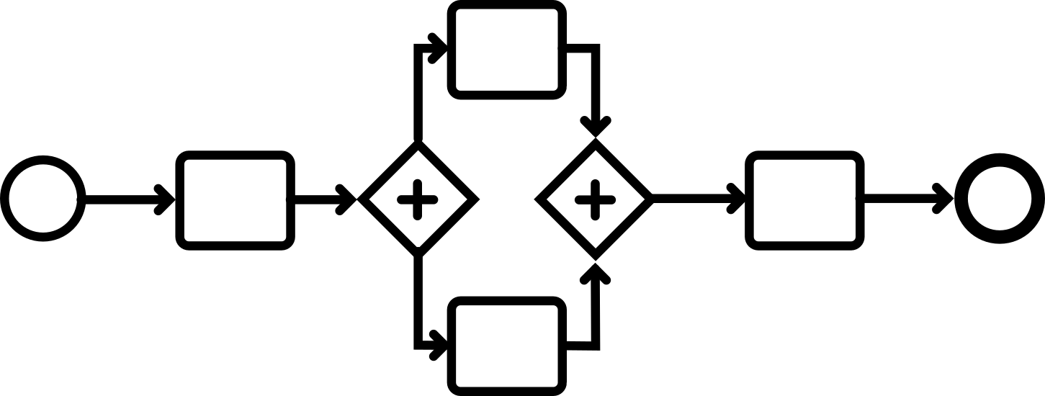

BPMS with RABP Support
Develop backend
Verify backend
Study requirements
+
5 mos.
3 mos.
+
Deploy system
Business Process Management System (BPMS)
1 mo.
Develop frontend
Verify frontend
2 mos.
6 mos.
5 mos.
Manager
Amy
RABP Method
Software Engineer
UI Developer
Testing Expert
Jessie
Junior Dev.
Oliver
Mia
Lisa
Amy
Sofia
Glen
Sofia
Lisa
Oliver
Verify frontend
Junior Dev.
Develop backend
Jessie
Lisa
t
1 mo.
4 mos.
0
5
10
14
Resource Allocation in Business Processes

Slide 63
BPMS with RABP Support
Develop backend
Verify backend
Study requirements
+
5 mos.
3 mos.
+
Deploy system
Business Process Management System (BPMS)
1 mo.
Develop frontend
Verify frontend
2 mos.
6 mos.
5 mos.
Manager
Amy
RABP Method
Software Engineer
UI Developer
Testing Expert
Jessie
Junior Dev.
Oliver
Mia
Lisa
Amy
SR
Verify backend
Sofia
Glen
Sofia
Develop backend
Lisa
VF
Oliver
Develop frontend
Verify frontend
Junior Dev.
Develop backend
Jessie
DS
Lisa
t
1 mo.
4 mos.
0
5
9
10
14
Resource Allocation in Business Processes

Slide 64
BPMS with RABP Support
Develop backend
Verify backend
Study requirements
+
5 mos.
3 mos.
+
Deploy system
Business Process Management System (BPMS)
1 mo.
Develop frontend
Verify frontend
2 mos.
6 mos.
5 mos.
Manager
Amy
RABP Method
Software Engineer
UI Developer
Testing Expert
Jessie
Junior Dev.
Oliver
Mia
Lisa
Amy
SR
Verify backend
Sofia
Glen
Sofia
Develop backend
Lisa
VF
Oliver
Develop frontend
Verify frontend
Junior Dev.
Develop backend
Jessie
DS
Lisa
t
1 mo.
4 mos.
0
5
9
10
14
Resource Allocation in Business Processes

Slide 65
BPMS with RABP Support
Develop backend
Verify backend
Study requirements
+
5 mos.
3 mos.
+
Deploy system
Business Process Management System (BPMS)
1 mo.
Develop frontend
Verify frontend
2 mos.
6 mos.
5 mos.
Manager
Amy
RABP Method
Software Engineer
UI Developer
Testing Expert
Jessie
Junior Dev.
Oliver
Mia
Lisa
Amy
SR
Verify backend
Sofia
Glen
Sofia
Develop backend
Lisa
VF
Oliver
Develop frontend
Verify frontend
Junior Dev.
Develop backend
Jessie
DS
Lisa
t
1 mo.
4 mos.
0
5
9
10
14
Resource Allocation in Business Processes

Slide 66
BPMS with RABP Support
Develop backend
Verify backend
Study requirements
+
5 mos.
3 mos.
+
Deploy system
Business Process Management System (BPMS)
1 mo.
Develop frontend
Verify frontend
2 mos.
6 mos.
5 mos.
Manager
Amy
RABP Method
Software Engineer
UI Developer
Testing Expert
Jessie
Junior Dev.
Oliver
Mia
Lisa
Amy
SR
Verify backend
Sofia
Glen
Sofia
Develop backend
Lisa
VF
Oliver
Develop frontend
Verify frontend
Junior Dev.
Develop backend
Jessie
DS
Lisa
t
1 mo.
4 mos.
0
5
9
10
14
Resource Allocation in Business Processes

Slide 67









Goals:
SIEMENS
Business Process Management System
1..1Representing a wide variety of resources in RABP
2. Selecting suitable KRR formalisms for implementing RABP
  Declarative formalisms
    Answer Set Programming (ASP)
    Constraint Programming (CP)
3. Devising a realistic benchmark for testing RABP methods
Request
Response
RABP in ASP
RABP in CP
ASP solvers
CP solvers
Resource Allocation in Business Processes

Slide 68
BPM…. Ease of encoding in ASP
SIEMENS
Develop backend
Verify backend
Study requirements
+
+
Deploy system
Develop frontend
Verify frontend

Slide 69
BPM…. Ease of encoding in ASP
SIEMENS
Develop backend
Verify backend
Study requirements
+
+
Deploy system
Develop frontend
Verify frontend
activity(“StudyRequirements”).
activity(“DevelopBackend”).
activity(“VerifyBackend”).
activity(“DevelopFrontend”).
activity(“VerifyFrontend”).
activity(“DeploySystem”).

Slide 70
BPM…. Ease of encoding in ASP
SIEMENS
Develop backend
Verify backend
Study requirements
+
+
Deploy system
Develop frontend
Verify frontend
activity(“StudyRequirements”).
activity(“DevelopBackend”).
activity(“VerifyBackend”).
activity(“DevelopFrontend”).
activity(“VerifyFrontend”).
activity(“DeploySystem”).
dprec(“StudyRequirements”, “DevelopBackend”).

Slide 71
BPM…. Ease of encoding in ASP
SIEMENS
Develop backend
Verify backend
Study requirements
+
+
Deploy system
Develop frontend
Verify frontend
activity(“StudyRequirements”).
activity(“DevelopBackend”).
activity(“VerifyBackend”).
activity(“DevelopFrontend”).
activity(“VerifyFrontend”).
activity(“DeploySystem”).
dprec(“StudyRequirements”, “DevelopBackend”).
dprec(“StudyRequirements”, “DevelopFrontend”).
dprec(“DevelopBackend”, “VerifyBackend”).
dprec(“DevelopFrontend”, “VerifyFrontend”).
dprec(“VerifyBackend”, “DeploySystem”).
dprec(“VerifyFrontend”, “DeploySystem”).

Slide 72
Contributions to RQ 1
Representation of Processes in ASP
SIEMENS
Develop backend
Verify backend
Study requirements
+
+
Deploy system
Develop frontend
Verify frontend
activity(“StudyRequirements”).
activity(“DevelopBackend”).
activity(“VerifyBackend”).
activity(“DevelopFrontend”).
activity(“VerifyFrontend”).
activity(“DeploySystem”).
dprec(“StudyRequirements”, “DevelopBackend”).
dprec(“StudyRequirements”, “DevelopFrontend”).
dprec(“DevelopBackend”, “VerifyBackend”).
dprec(“DevelopFrontend”, “VerifyFrontend”).
dprec(“VerifyBackend”, “DeploySystem”).
dprec(“VerifyFrontend”, “DeploySystem”).
conc(“DevelopBackend”, “DevelopFrontend”).
conc(“DevelopBackend”, “VerifyFrontend”).
conc(“DevelopFrontend”, “DevelopBackend”).
conc(“DevelopFrontend”, “VerifyBackend”).

Slide 73
BPM…. Ease of encoding in ASP
SIEMENS
Develop backend
Verify backend
Study requirements
+
+
Deploy system
Develop frontend
Verify frontend
activity(“StudyRequirements”).
activity(“DevelopBackend”).
activity(“VerifyBackend”).
activity(“DevelopFrontend”).
activity(“VerifyFrontend”).
activity(“DeploySystem”).
dprec(“StudyRequirements”, “DevelopBackend”).
dprec(“StudyRequirements”, “DevelopFrontend”).
dprec(“DevelopBackend”, “VerifyBackend”).
dprec(“DevelopFrontend”, “VerifyFrontend”).
dprec(“VerifyBackend”, “DeploySystem”).
dprec(“VerifyFrontend”, “DeploySystem”).
conc(“DevelopBackend”, “DevelopFrontend”).
conc(“DevelopBackend”, “VerifyFrontend”).
conc(“DevelopFrontend”, “DevelopBackend”).
conc(“DevelopFrontend”, “VerifyBackend”).

Slide 74
BPM…. Ease of encoding in ASP
Manager
SIEMENS
Amy
Software Engineer
UI Developer
Testing Expert
Jessie
Junior Dev.
Oliver
Mia
Lisa
Liam
Glen

Slide 75
BPM…. Ease of encoding in ASP
Manager
SIEMENS
Amy
Software Engineer
UI Developer
Testing Expert
Jessie
Junior Dev.
Oliver
Mia
Lisa
Liam
Glen
resource(“Amy”).
resource(“Jessie”).
resource(“Liam”).
resource(“Glen”).
resource(“Oliver”).
resource(“Mia”).
resource(“Lisa”).

Slide 76
BPM…. Ease of encoding in ASP
Manager
SIEMENS
Amy
Software Engineer
UI Developer
Testing Expert
Jessie
Junior Dev.
Oliver
Mia
Lisa
Liam
Glen
resource(“Amy”).
resource(“Jessie”).
resource(“Liam”).
resource(“Glen”).
resource(“Oliver”).
resource(“Mia”).
resource(“Lisa”).
role(“Manager”).
role(“SoftwareEngineer”).
role(“JuniorDeveloper”).
role(“UIDeveloper”).
role(“TestingExpert”).

Slide 77
BPM…. Ease of encoding in ASP
Manager
SIEMENS
Amy
Software Engineer
UI Developer
Testing Expert
Jessie
Junior Dev.
Oliver
Mia
Lisa
Liam
Glen
resource(“Amy”).
resource(“Jessie”).
resource(“Liam”).
resource(“Glen”).
resource(“Oliver”).
resource(“Mia”).
resource(“Lisa”).
role(“Manager”).
role(“SoftwareEngineer”).
role(“JuniorDeveloper”).
role(“UIDeveloper”).
role(“TestingExpert”).
rlAC(“Amy”, “Manager”).
rlAC(“Jessie”,”SoftwareEngineer”).
rlAC(“Liam”,”JuniorDeveloper”).
rlAC(“Glen”,”JuniorDeveloper”).
rlAC(“Oliver”,”UIDeveloper”).
rlAC(“Mia”,”UIDeveloper”).
rlAC(“Lisa”,”TestingExpert”).

Slide 78
BPM…. Ease of encoding in ASP
Manager
SIEMENS
Amy
Software Engineer
UI Developer
Testing Expert
Jessie
Junior Dev.
Oliver
Mia
Lisa
Liam
Glen
resource(“Amy”).
resource(“Jessie”).
resource(“Liam”).
resource(“Glen”).
resource(“Oliver”).
resource(“Mia”).
resource(“Lisa”).
role(“Manager”).
role(“SoftwareEngineer”).
role(“JuniorDeveloper”).
role(“UIDeveloper”).
role(“TestingExpert”).
rlAC(“Amy”, “Manager”).
rlAC(“Jessie”,”SoftwareEngineer”).
rlAC(“Liam”,”JuniorDeveloper”).
rlAC(“Glen”,”JuniorDeveloper”).
rlAC(“Oliver”,”UIDeveloper”).
rlAC(“Mia”,”UIDeveloper”).
rlAC(“Lisa”,”TestingExpert”).
llAC(“Manager”, “TestingExpert”).
llAC(”SoftwareEngineer”,“JuniorDeveloper”).

Slide 79
BPM…. Ease of encoding in ASP
SIEMENS
Develop backend
Verify backend
Manager
Study requirements
5 mos.
3 mos.
Deploy system
Amy
+
+
1 mo.
Develop frontend
Verify frontend
2 mos.
6 mos.
5 mos.
Software Engineer
UI Developer
Testing Expert
Jessie
Junior Dev.
Oliver
Mia
Lisa
Liam
Glen
resource(“Amy”).
resource(“Jessie”).
resource(“Liam”).
resource(“Glen”).
resource(“Oliver”).
resource(“Mia”).
resource(“Lisa”).
role(“Manager”).
role(“SoftwareEngineer”).
role(“JuniorDeveloper”).
role(“UIDeveloper”).
role(“TestingExpert”).
rlAC(“Amy”, “Manager”).
rlAC(“Jessie”,”SoftwareEngineer”).
rlAC(“Liam”,”JuniorDeveloper”).
rlAC(“Glen”,”JuniorDeveloper”).
rlAC(“Oliver”,”UIDeveloper”).
rlAC(“Mia”,”UIDeveloper”).
rlAC(“Lisa”,”TestingExpert”).
llAC(“Manager”, “TestingExpert”).
llAC(”SoftwareEngineer”,“JuniorDeveloper”).
alAC(“StudyRequirements”, “Manager”).
alAC(“DevelopBackend”, “JuniorDeveloper”).
alAC(“VerifyBackend”, “TestingExpert”).
alAC(“DevelopFrontend”, “UIDeveloper”).
alAC(“VerifyFrontend”, “TestingExpert”).
alAC(“DeploySystem”, “SoftwareEngineer”).

Slide 80
BPM…. Ease of encoding in ASP
Develop backend
Verify backend
Study requirements
+
5 mos.
3 mos.
+
Deploy system
Lisa
Verify frontend
Junior Dev.
Develop backend
1 mo.
Develop frontend
Verify frontend
2 mos.
1 mo.
4 mos.
6 mos.
5 mos.
defaultDuration(“StudyRequirements”,1).
defaultDuration(“DevelopBackend”,5).
defaultDuration(“VerifyBackend”,3).
defaultDuration(“DevelopFrontend”,6).
defaultDuration(“VerifyFrontend”,5).
defaultDuration(“DeploySystem”,2).
rsaDuration(“Lisa”,”VerifyFrontend”,1).
lsaDuration(“JuniorDeveloper”,”DevelopBackend”,4).
Specific
SIEMENS
  Resource-specific activity durations
  Role-specific activity durations
  Default activity durations
  Resource-to-role assignments
  Activity-to-role assignments
  Role-to-role assignments
General
allowedRAD(R,A,D) :- rsaDuration(R,A,D), rlAC(R,L), alAC(A,L).
allowedRAD(R,A,D) :- lsaDuration(L,A,D), not rsaDuration(R,A,_), rlAC(R,L), alAC(A,L).
allowedRAD(R,A,D) :- defaultDuration(A,D), not rsaDuration(R,A,_), not lsaDuration(L,A,_), rlAC(R,L), alAC(A,L).

Slide 81
BPM…. Guess and Check
% generate allocations
1<={allocation(R,A,S,C): time(S), time(C), allowedRAD(R,A,D), C=S+D}<=1 :- activity(A).
% check for scheduling of the preceding activities
:- dPrec(A1,A2), allocation(_,A1,_,C1), allocation(_,A2,S2,_), C1>S2.
% check for scheduling of the concurrent activities
:- conc(A1,A2), allocation(R,A1,S1,_), allocation(R,A2,S2,C2), S2<=S1, C2>S1, A1<A2.
:- conc(A1,A2), allocation(R,A1,_,C1), allocation(R,A2,S2,C2), S2<C1, C2>=C1, A1<A2.
:- conc(A1,A2), allocation(R,A1,S1,C1), allocation(R,A2,S2,C2), S2>S1, C2<C1, A1<A2.
% minimize makespan
:˜ makespan(U). [U]
Develop backend
Verify backend
Study requirements
+
+
Deploy system
Develop frontend
Verify frontend
Amy
SR
Verify backend
Liam
Develop backend
VF
Lisa
Oliver
Develop frontend
Jessie
DS
t
0
5
9
10
14

Slide 82
BPM … Easily Extensible encoding
Teams
  E.g., team(“team_backend”,R) :- rlAC(R,”JuniorDeveloper”).
  team(“team_backend”,R) :- rlAC(R,”SoftwareEngineer”).
  tRequirement(“DevelopBackend”,”team_backend”).
team_backend
Glen
Develop backend
Jessie
Liam
Manager
Amy
Software Engineer
UI Developer
Testing Expert
Jessie
Junior Dev.
Oliver
Mia
Lisa
Liam
Glen

Slide 83


BPM … Easily Extensible encoding
Teams
  E.g., team(“team_backend”,R) :- rlAC(R,”JuniorDeveloper”).
  team(“team_backend”,R) :- rlAC(R,”SoftwareEngineer”).
tRequirement(“DevelopBackend”,”team_backend”).
Partially-renewable resources
  E.g., pResource(“workroom_101”,8).
  pRequirement(“DevelopBackend”,”workroom_101”, N) :-
  N = #count{R: team(“team_backend”,R)}.
workroom_101
Develop backend

Slide 84
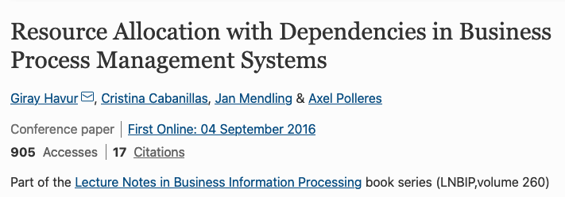



BPM … Easily Extensible encoding
Teams
  E.g., team(“team_backend”,R) :- rlAC(R,”JuniorDeveloper”).
  team(“team_backend”,R) :- rlAC(R,”SoftwareEngineer”).
tRequirement(“DevelopBackend”,”team_backend”).
Partially-renewable resources
  E.g., pResource(“workroom_101”,8).
  pRequirement(“DevelopBackend”,”workroom_101”, N) :-
  N = #count{R: team(“team_backend”,R)}.
Non-renewable resources
  E.g., nResource(“budget_software_dev_1”,50000).
  nRequirement(“DevelopBackend”,”budget_software_dev_1”,N) :-
  TPM = #sum{PM,R: allocate(R,”DevelopBackend”,S,C), PM=C-S},
  costPersonMonth(CPM), N = TPM * CPM.
budget_software_dev_1
Develop backend

Slide 85
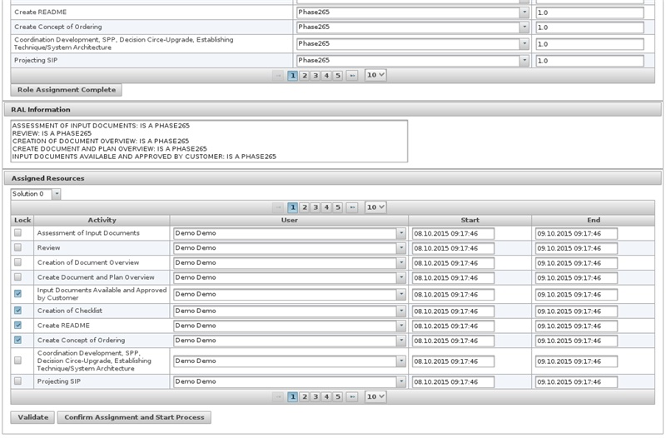

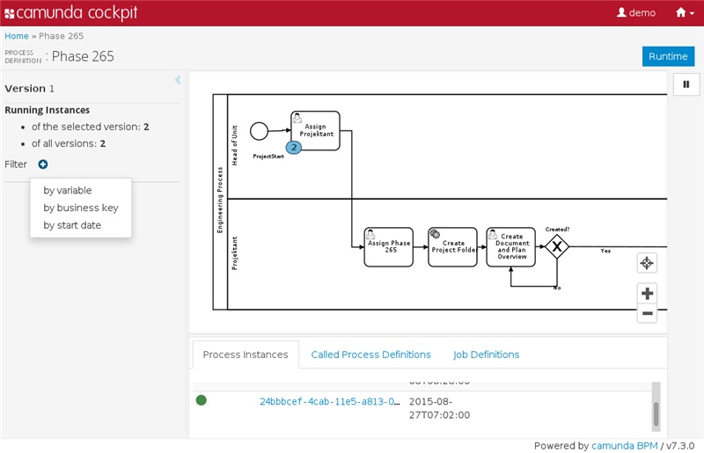


RABP in Practice: Camunda BPMS Integration
SIEMENS
camunda
BPMS
RABP (ASP)
Saimir Bala, Giray Havur, Simon Sperl, Simon Steyskal, Alois Haselbock, Jan Mendling, and Axel Polleres. Shapeworks: A BPMS extension for complex process management. In the BPM Demo Track 2016 co-located with BPM 2016, volume 1789 of CEUR Workshop Proceedings, pages 50–55, 2016.
https://www.youtube.com/watch?v=31PxXoQR9n4

Slide 86
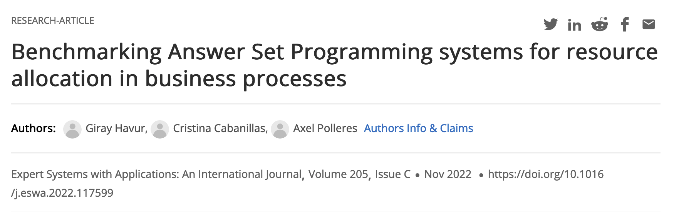
BRANCH: An ASP Systems Benchmark for RABP “hot from the press”
SIEMENS
BRANCH
  RABP instance generator
  ASP system configurator
  Benchmark configurator
  Benchmark executor
  Results viewer

Slide 87
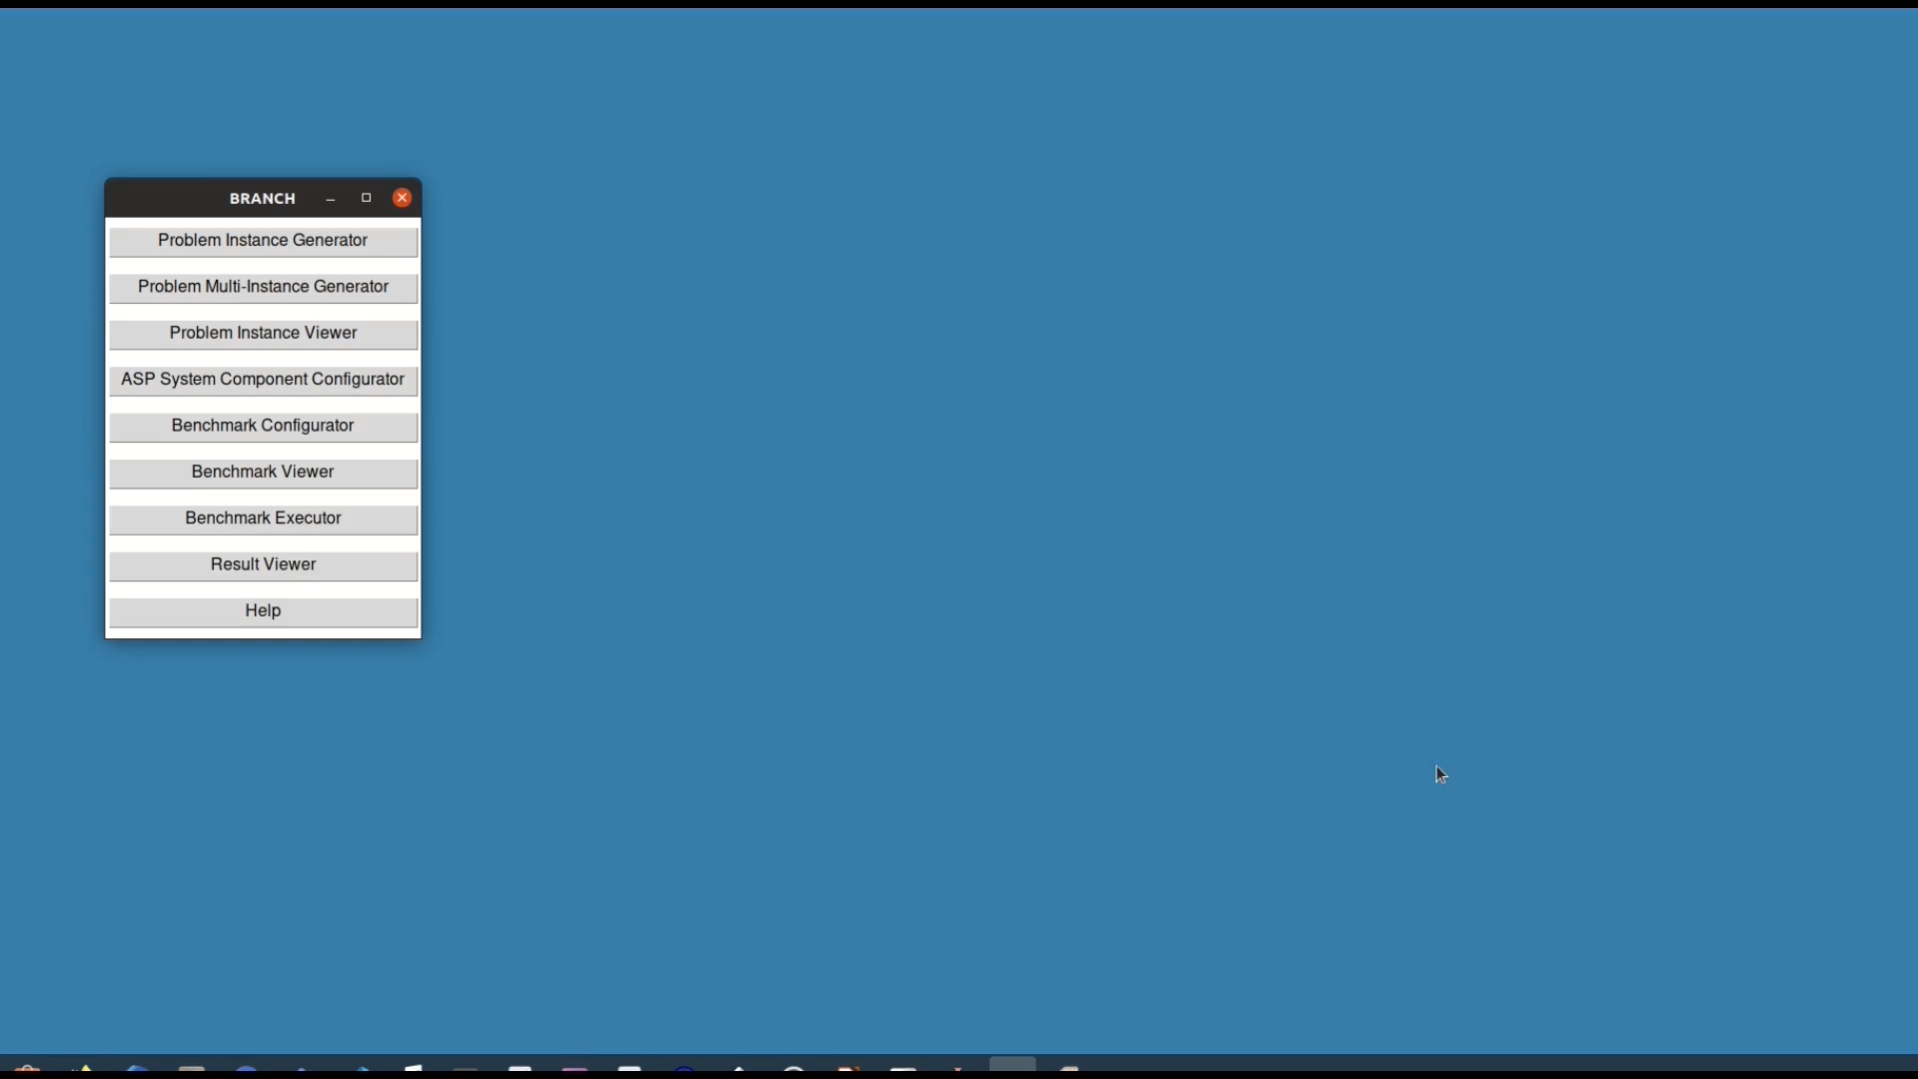
An ASP Systems Benchmark for RABP
SIEMENS

Slide 88
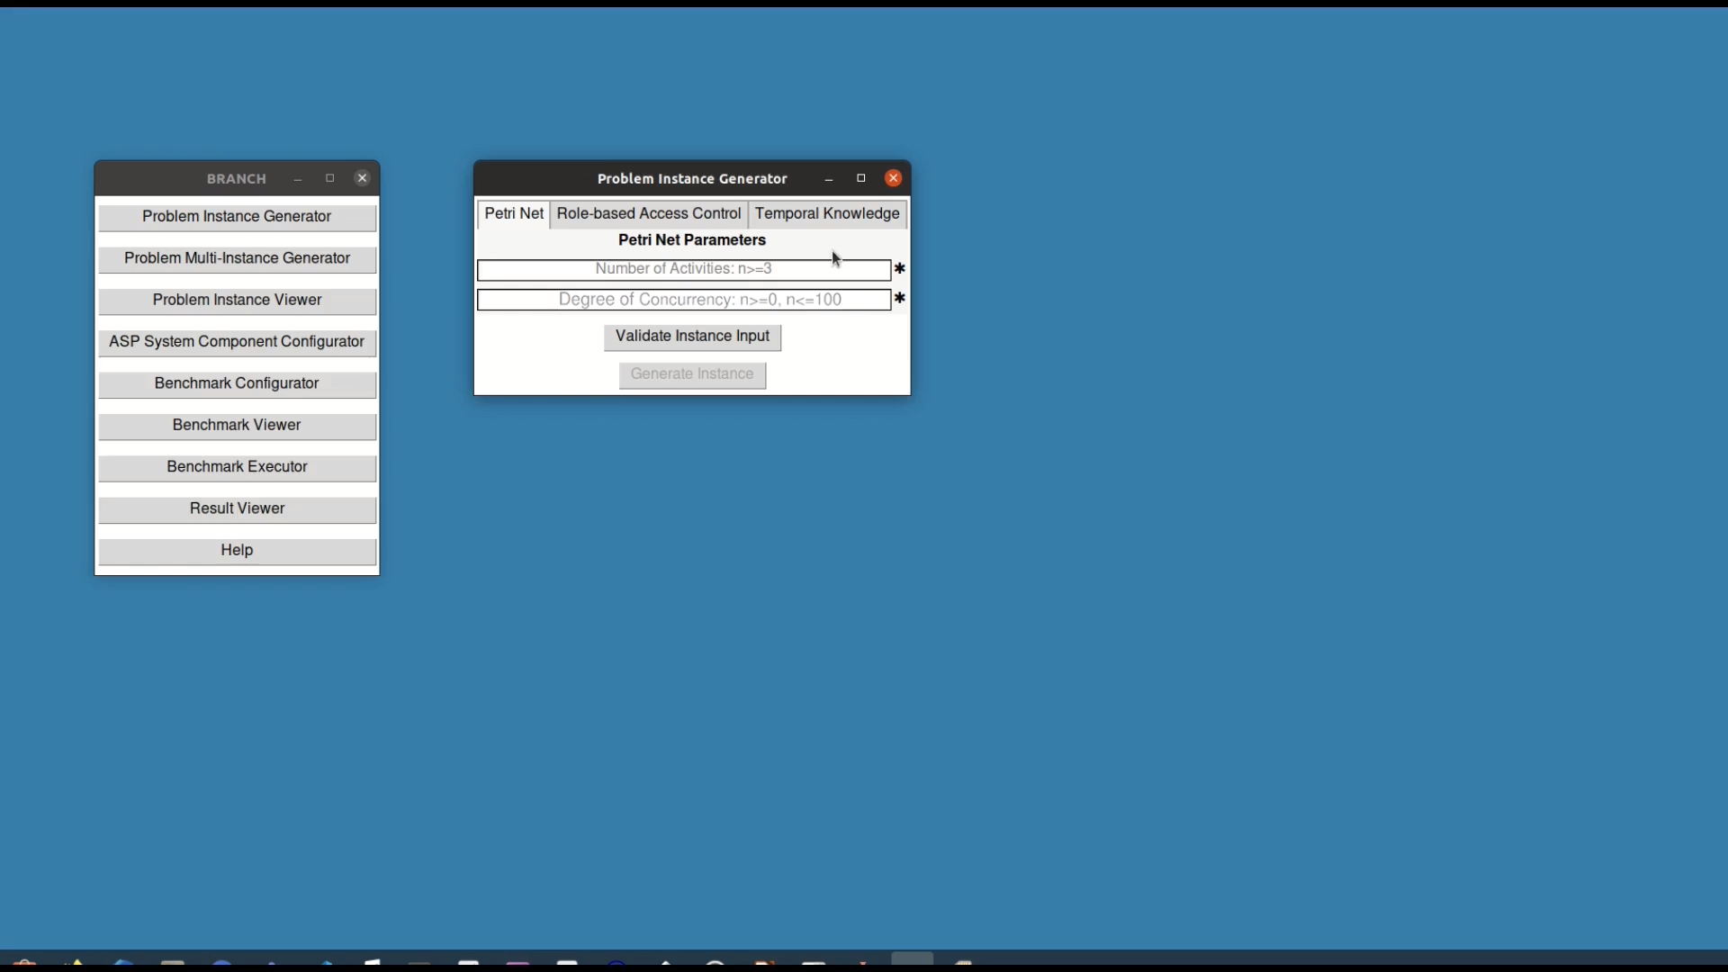
An ASP Systems Benchmark for RABP
SIEMENS

Slide 89



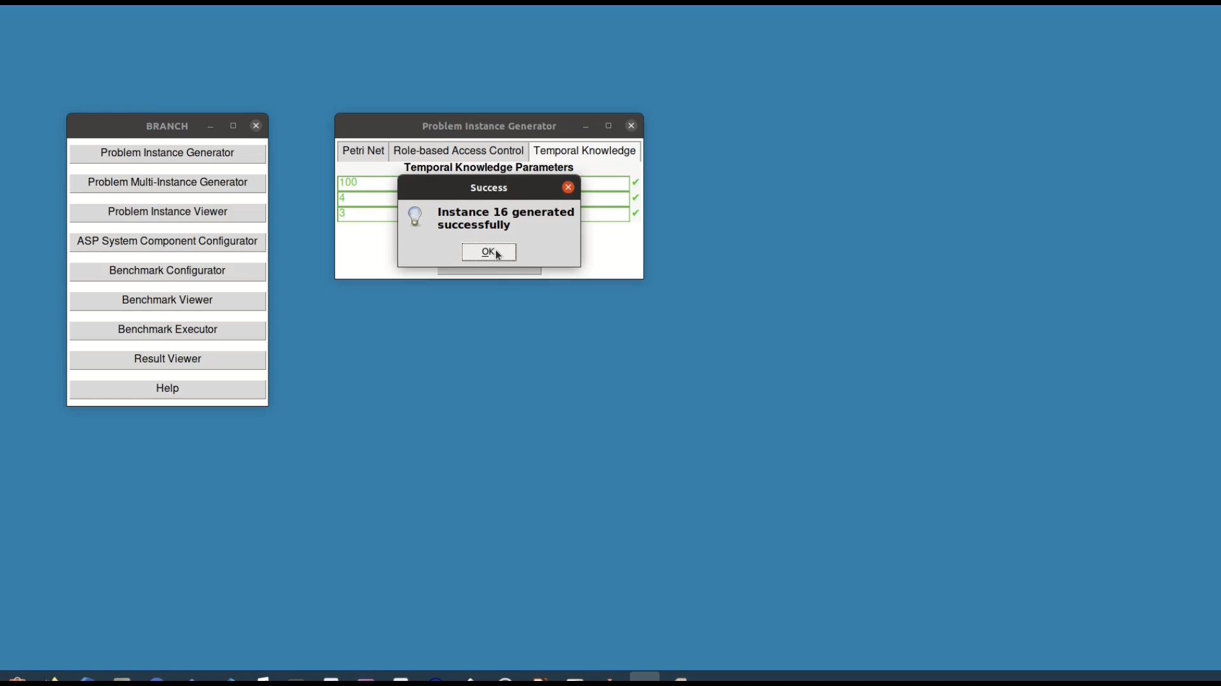
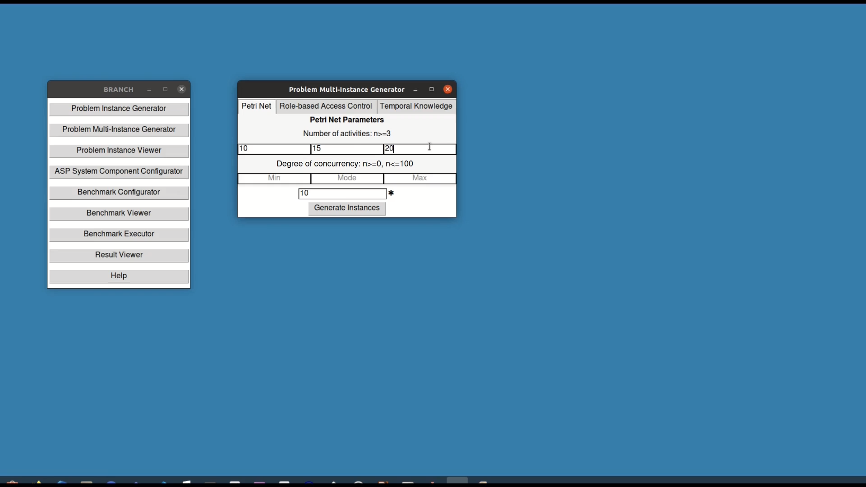
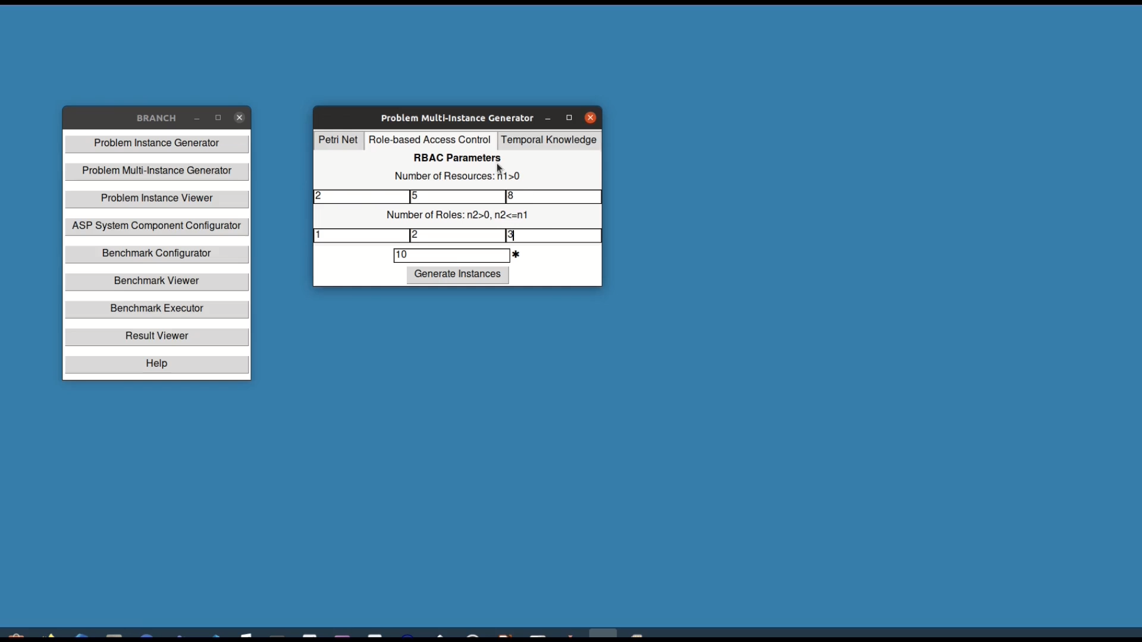
An ASP Systems Benchmark for RABP
SIEMENS

Slide 90
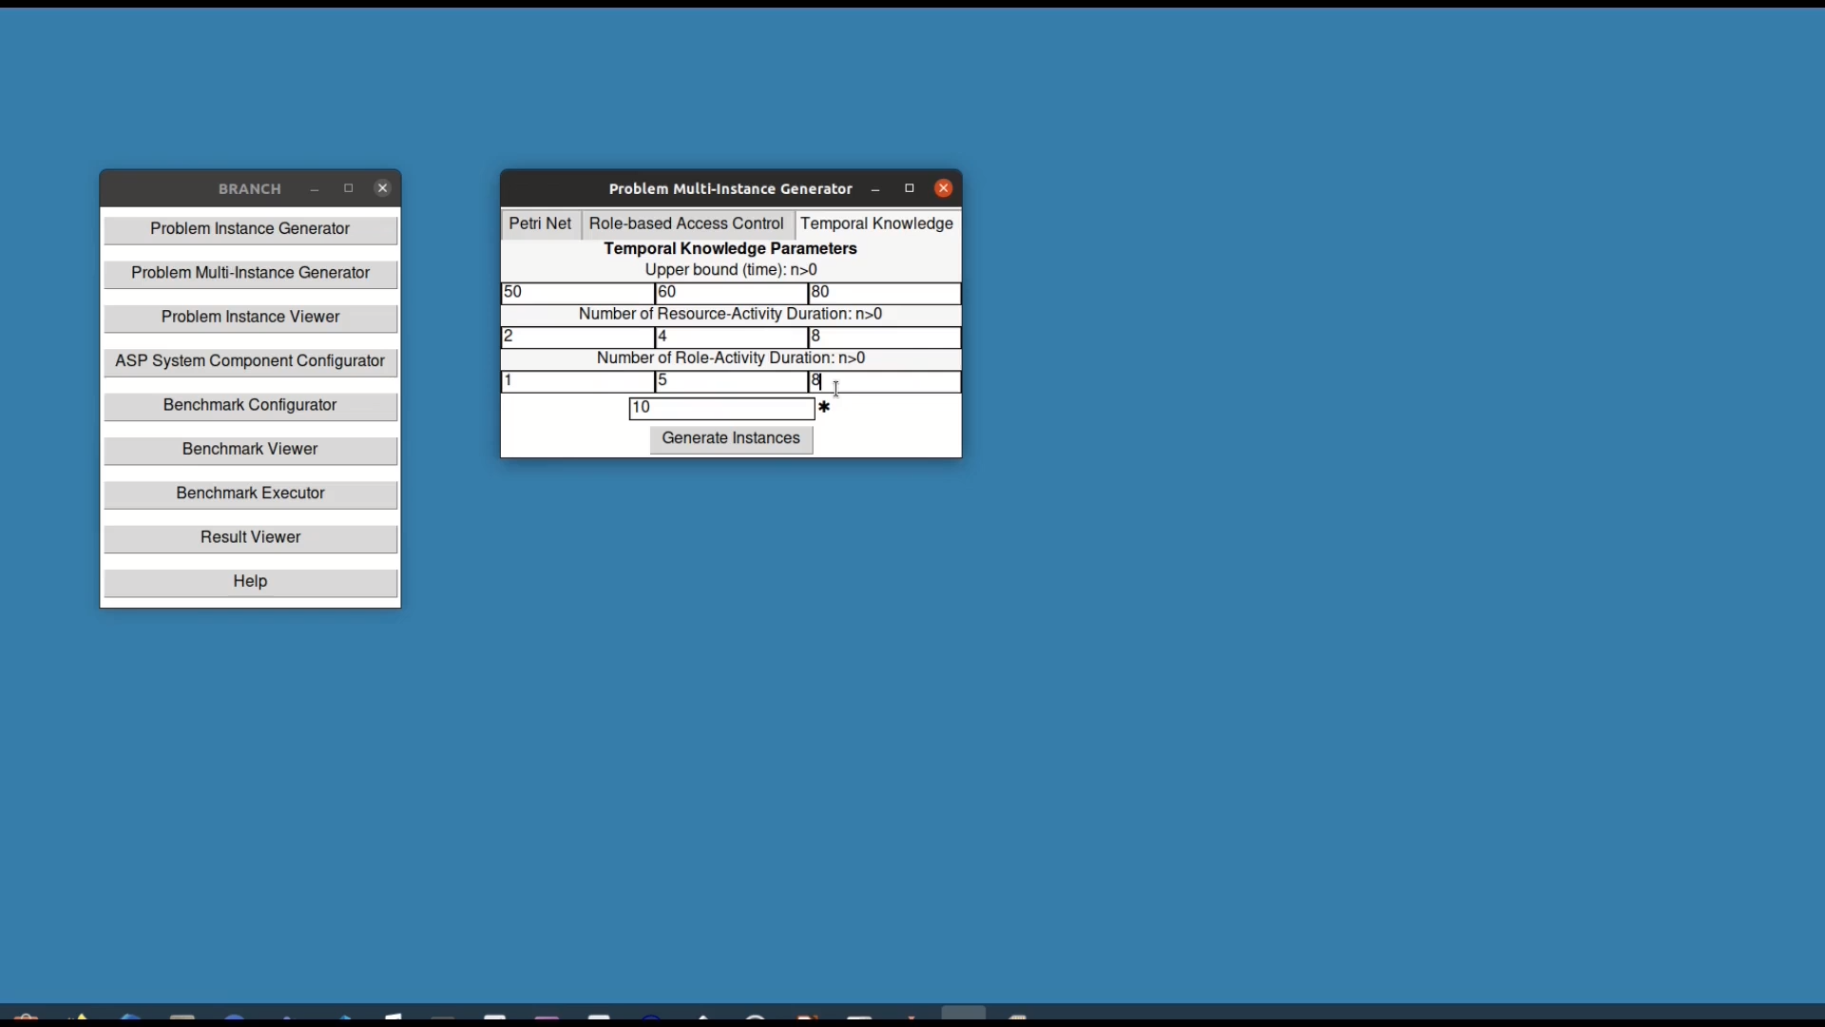
An ASP Systems Benchmark for RABP
SIEMENS

Slide 91
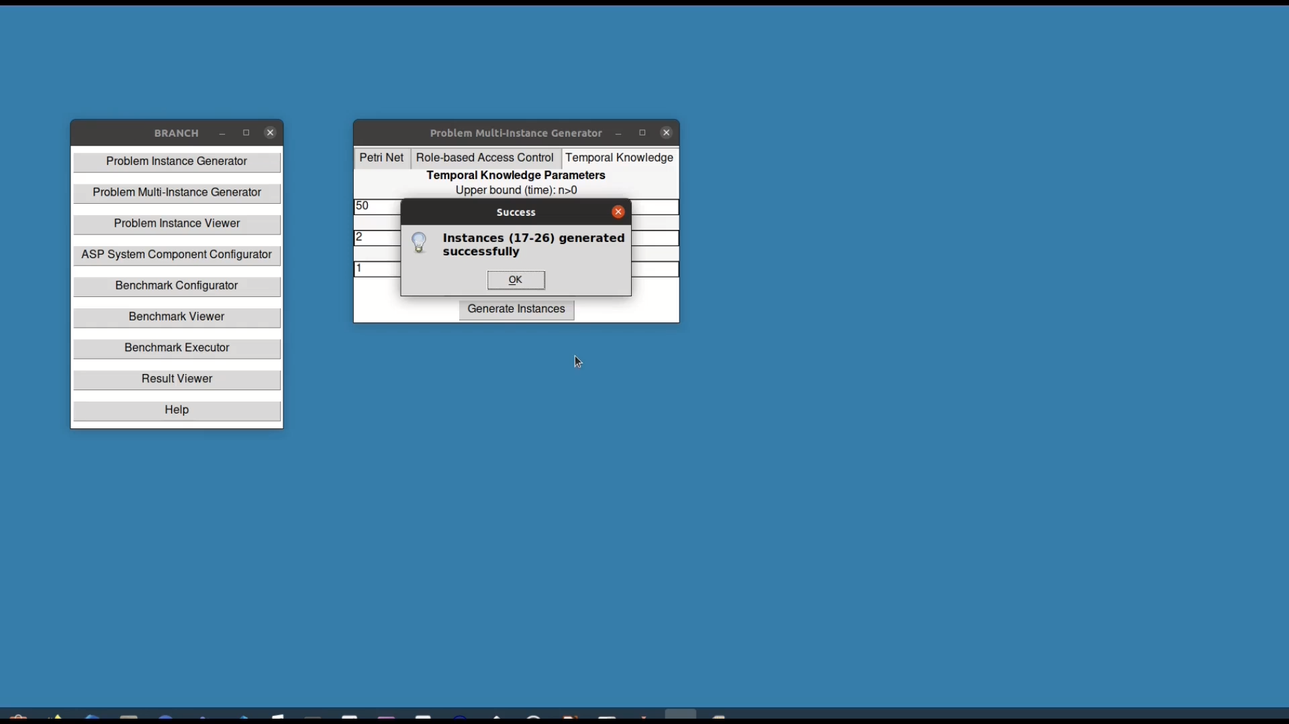
An ASP Systems Benchmark for RABP
SIEMENS

Slide 92
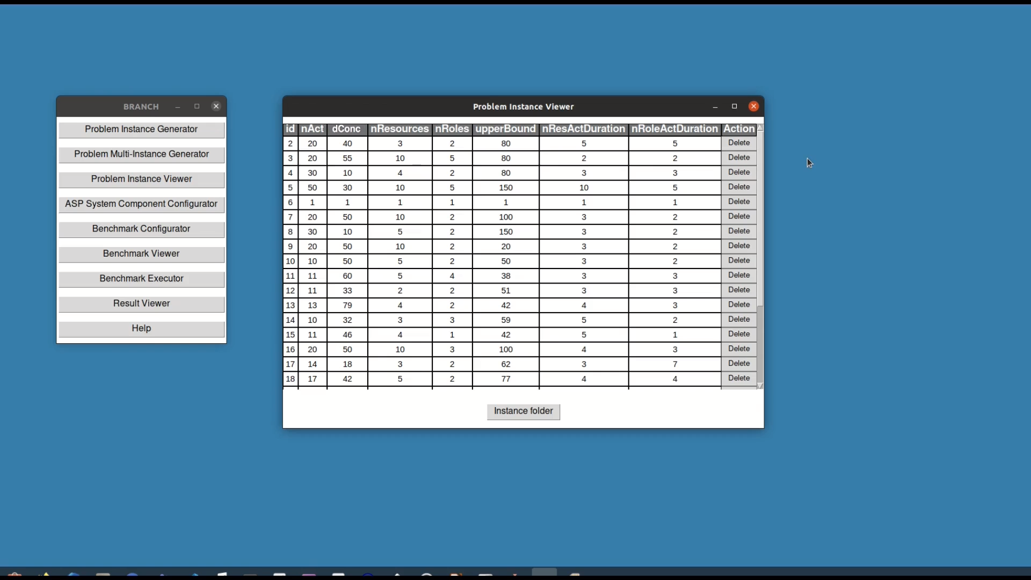
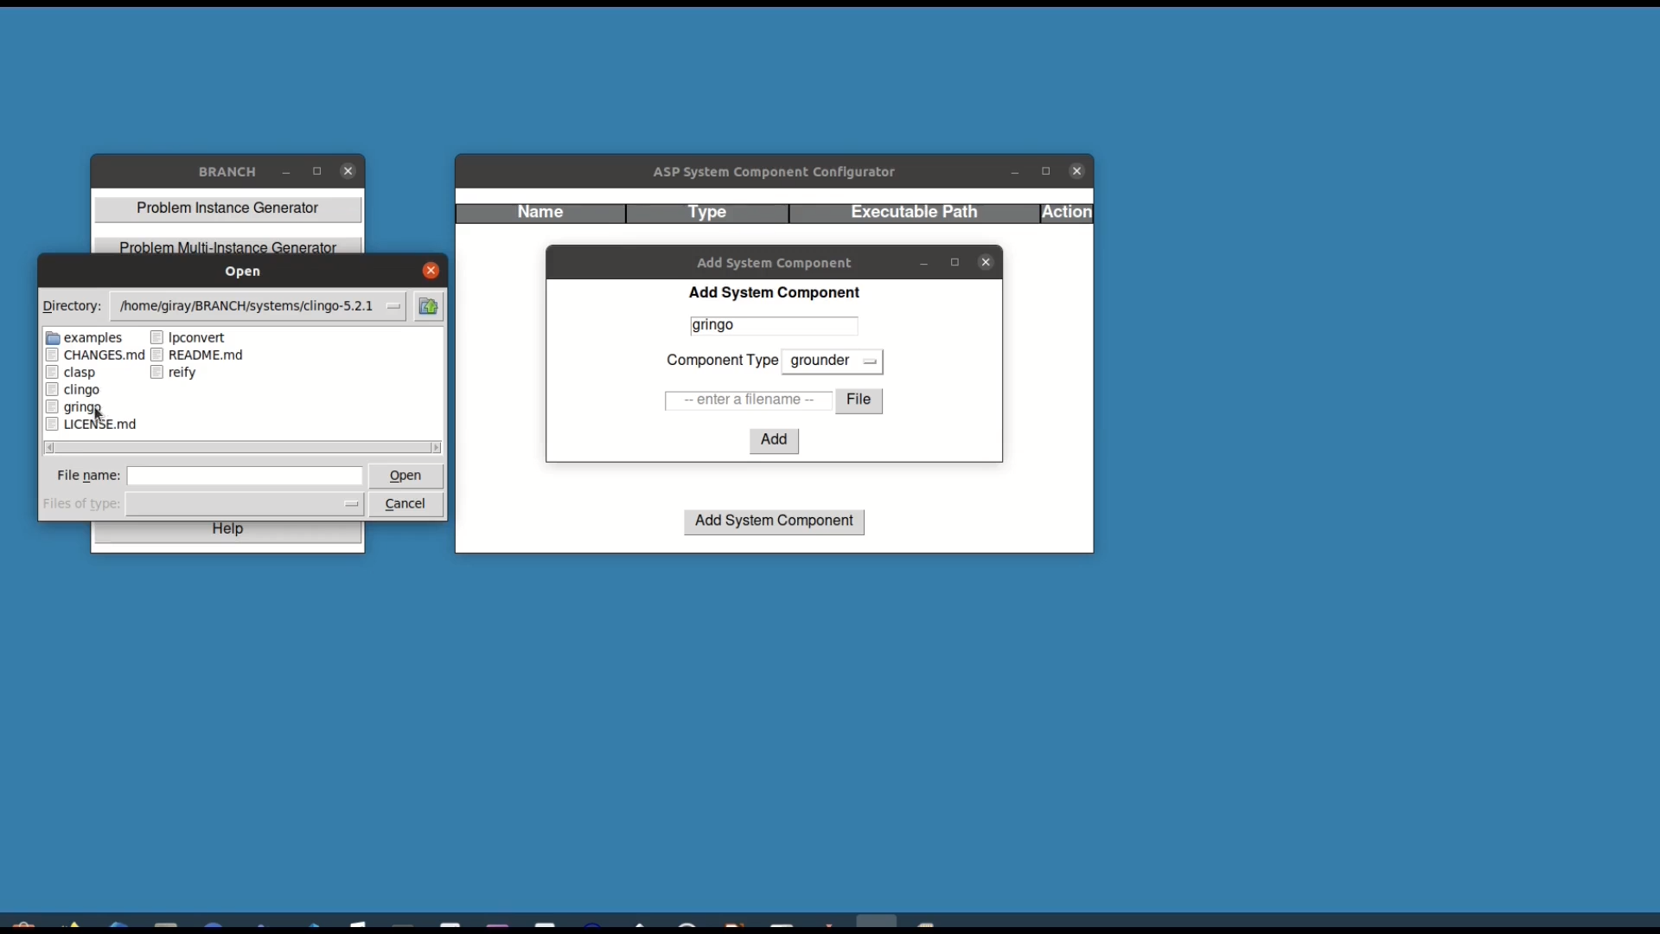
An ASP Systems Benchmark for RABP
SIEMENS

Slide 93
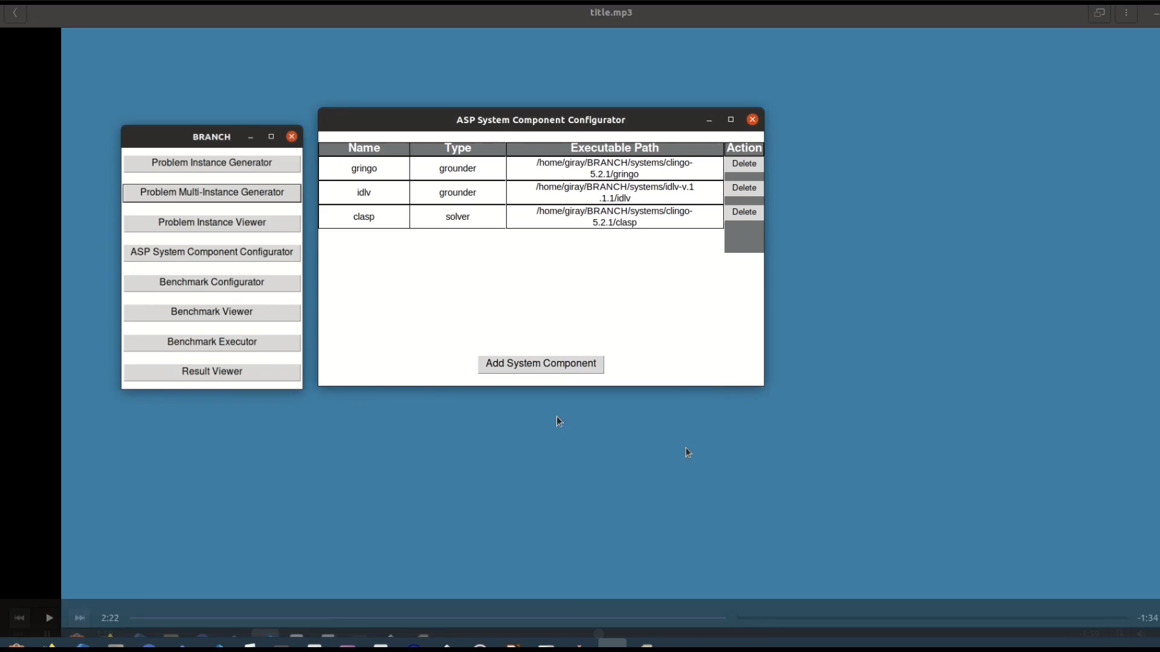
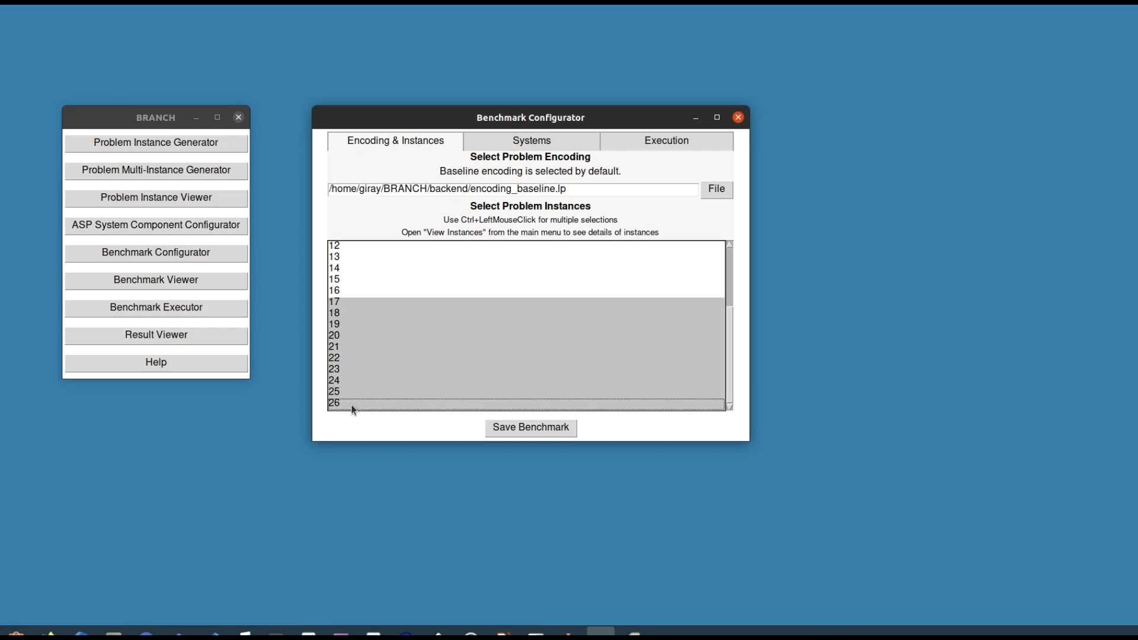
An ASP Systems Benchmark for RABP
SIEMENS

Slide 94
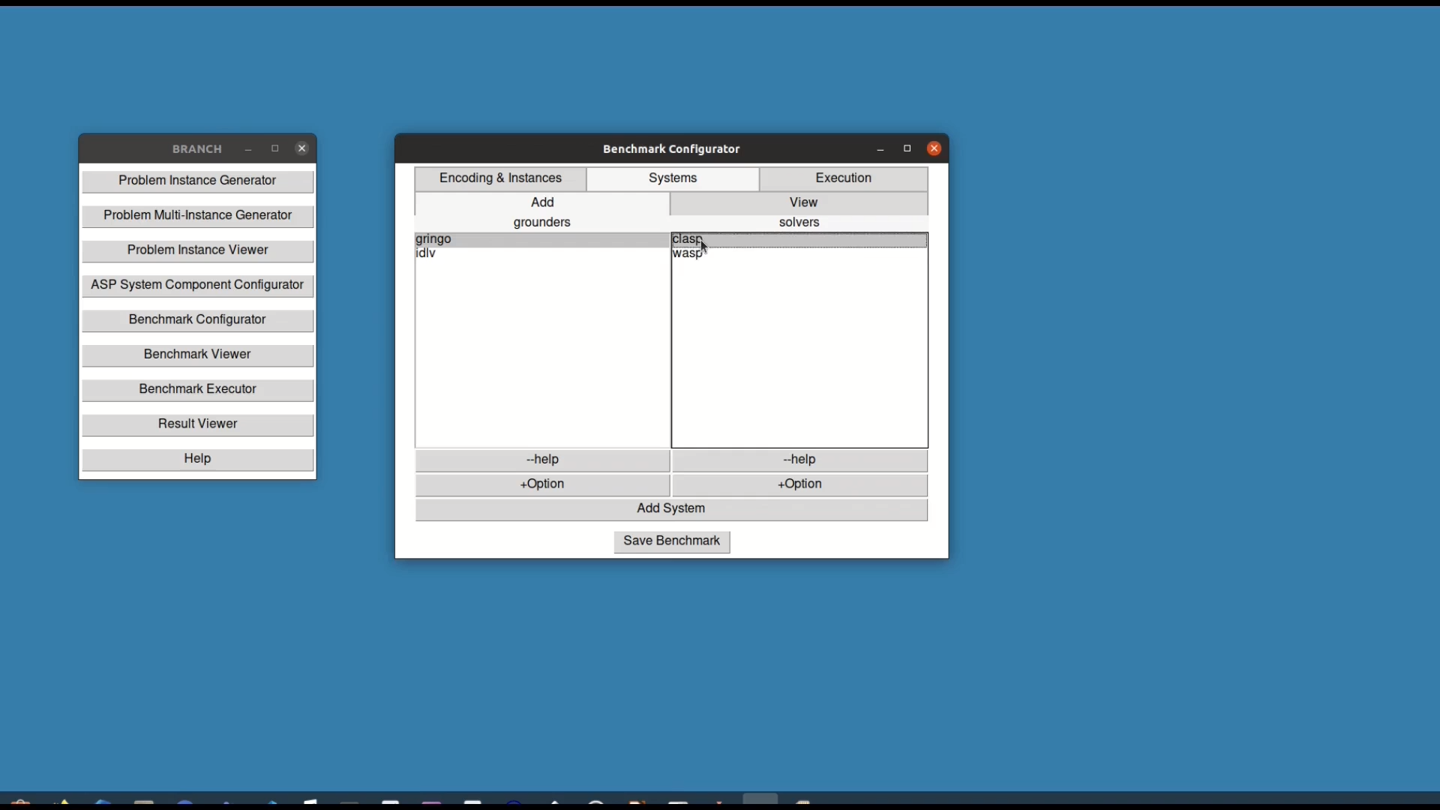
An ASP Systems Benchmark for RABP
SIEMENS

Slide 95

An ASP Systems Benchmark for RABP
SIEMENS

Slide 96
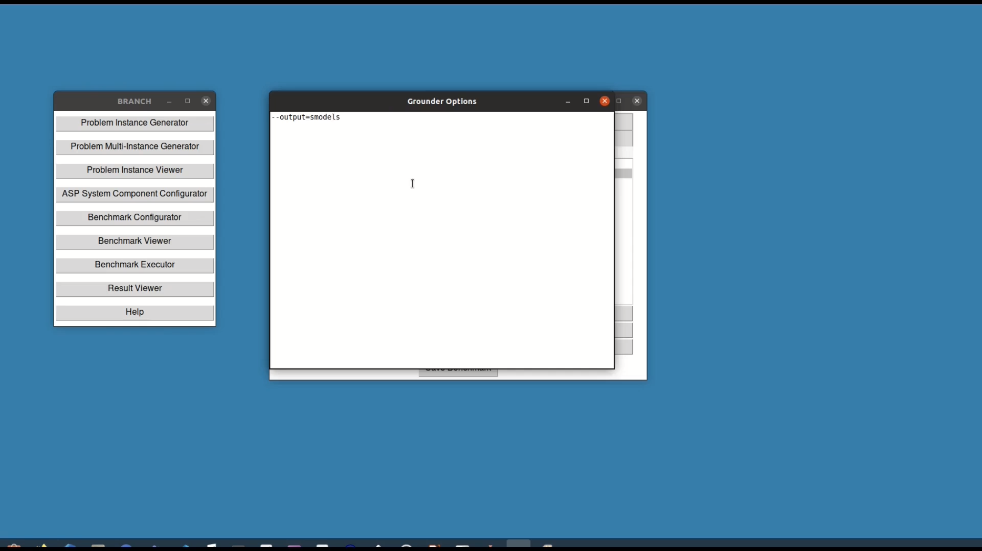
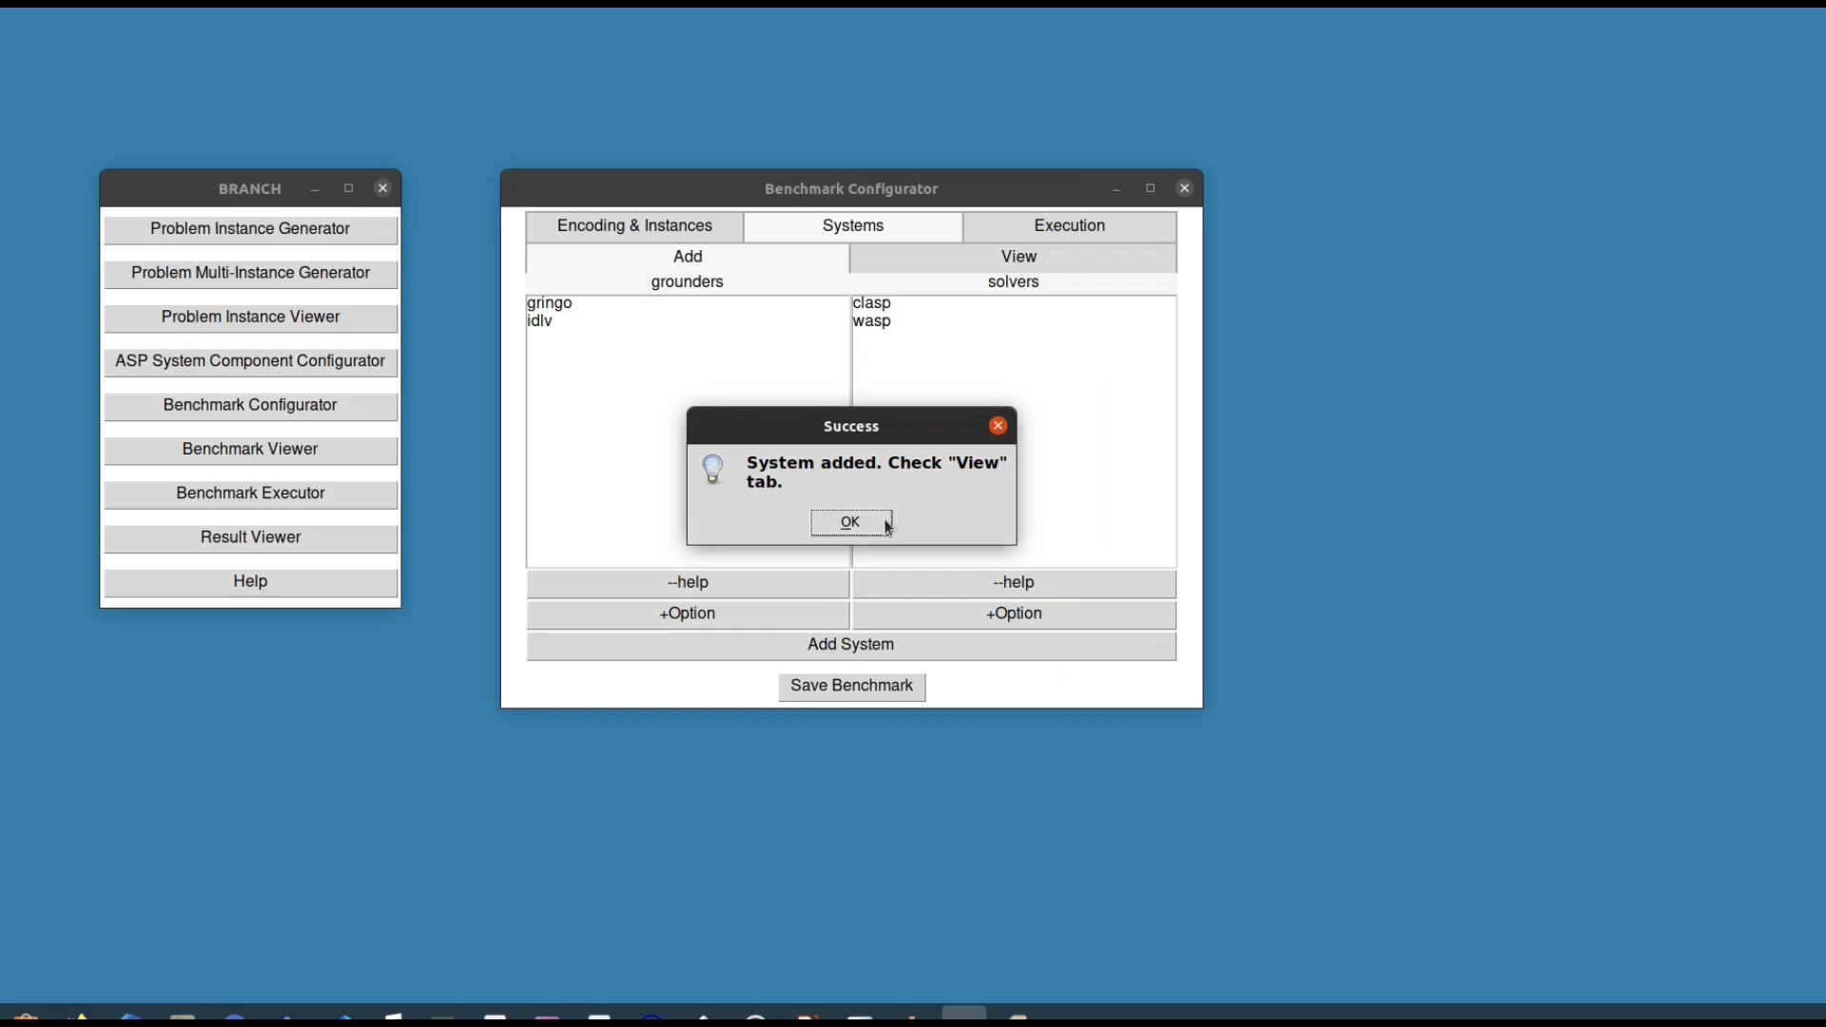
An ASP Systems Benchmark for RABP
SIEMENS

Slide 97
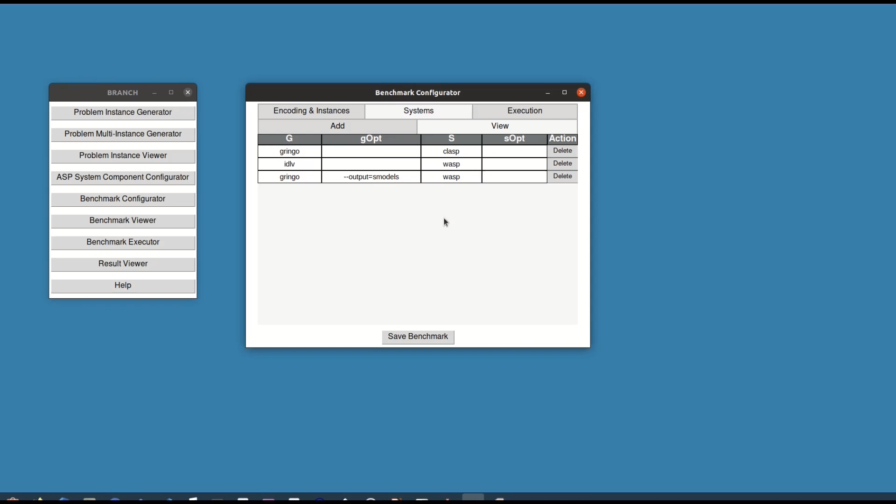
An ASP Systems Benchmark for RABP
SIEMENS

Slide 98
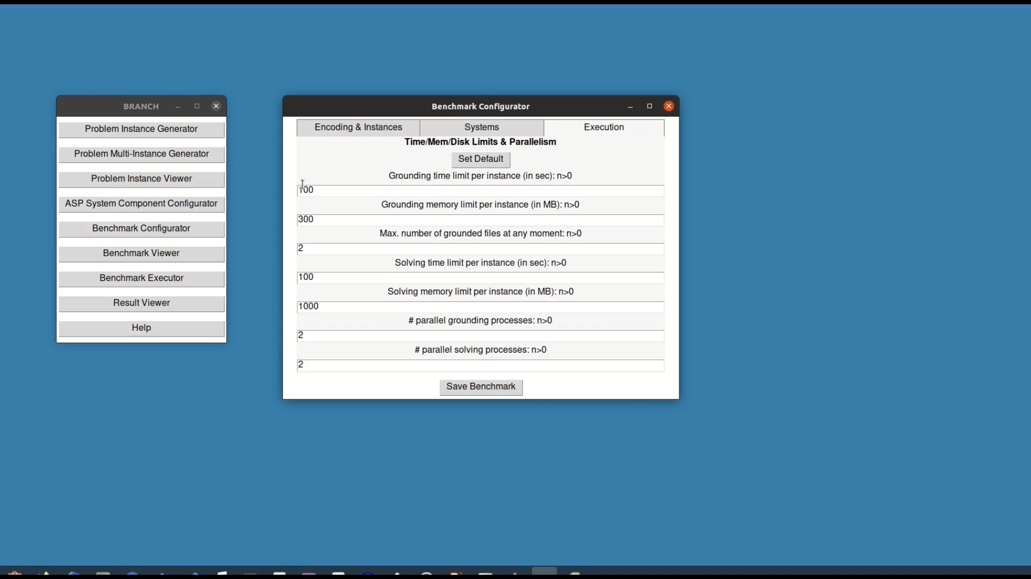
An ASP Systems Benchmark for RABP
SIEMENS

Slide 99
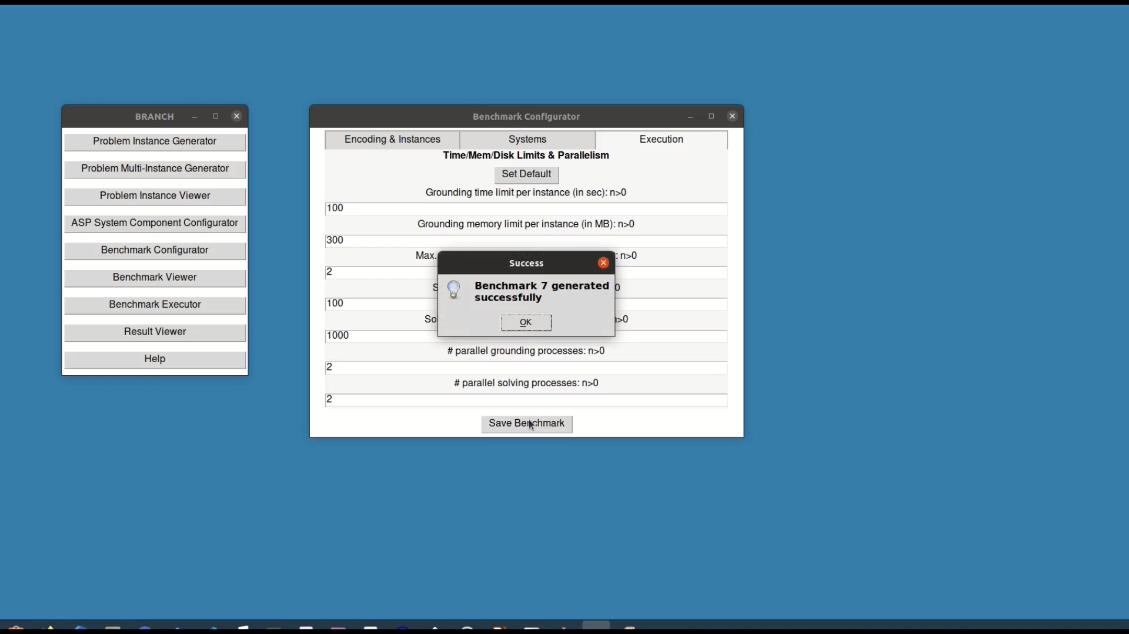
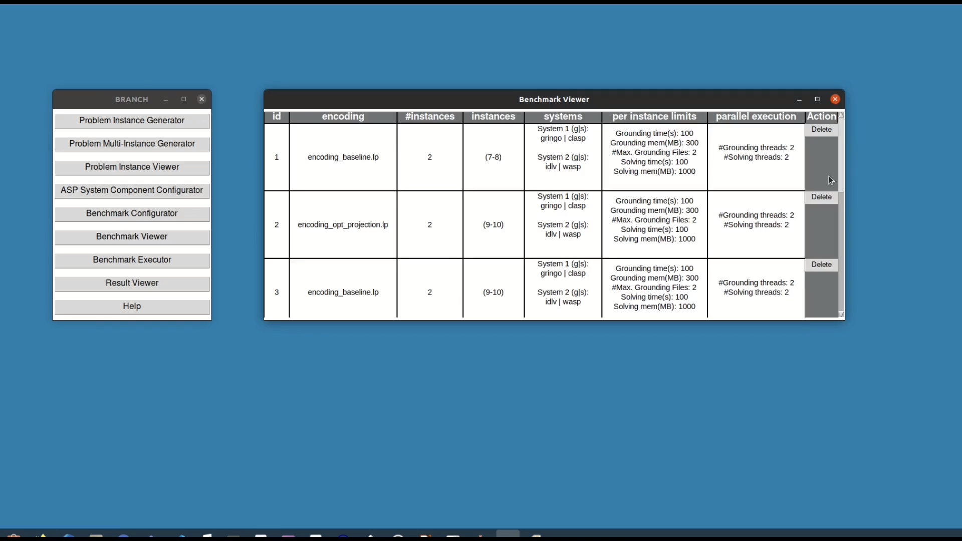
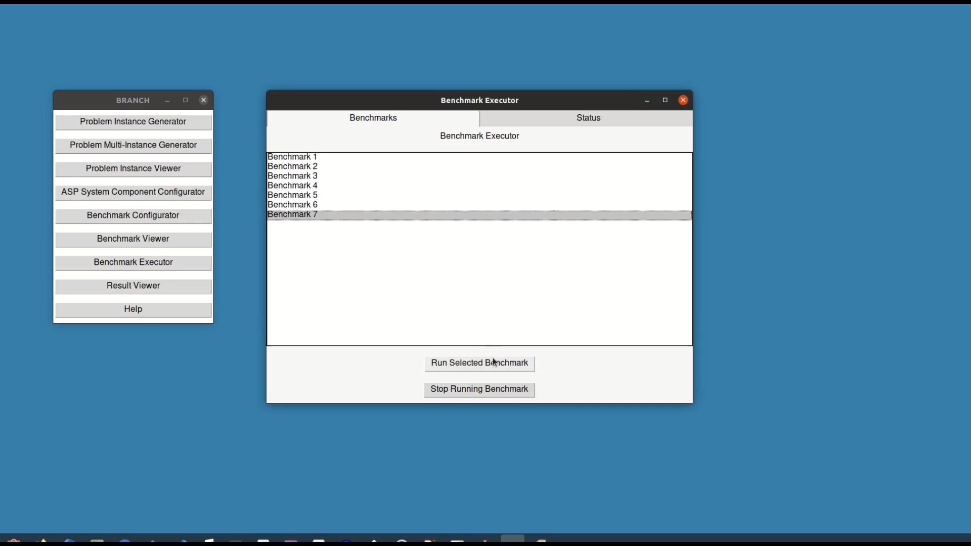
An ASP Systems Benchmark for RABP
SIEMENS

Slide 100
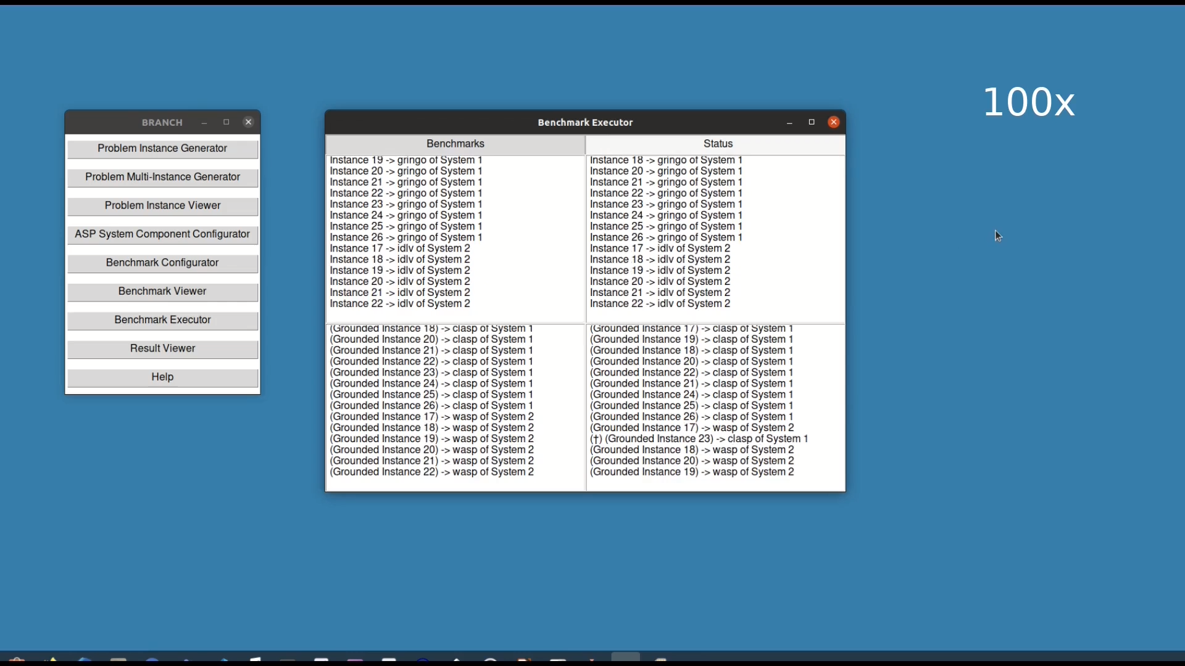
An ASP Systems Benchmark for RABP
SIEMENS

Slide 101
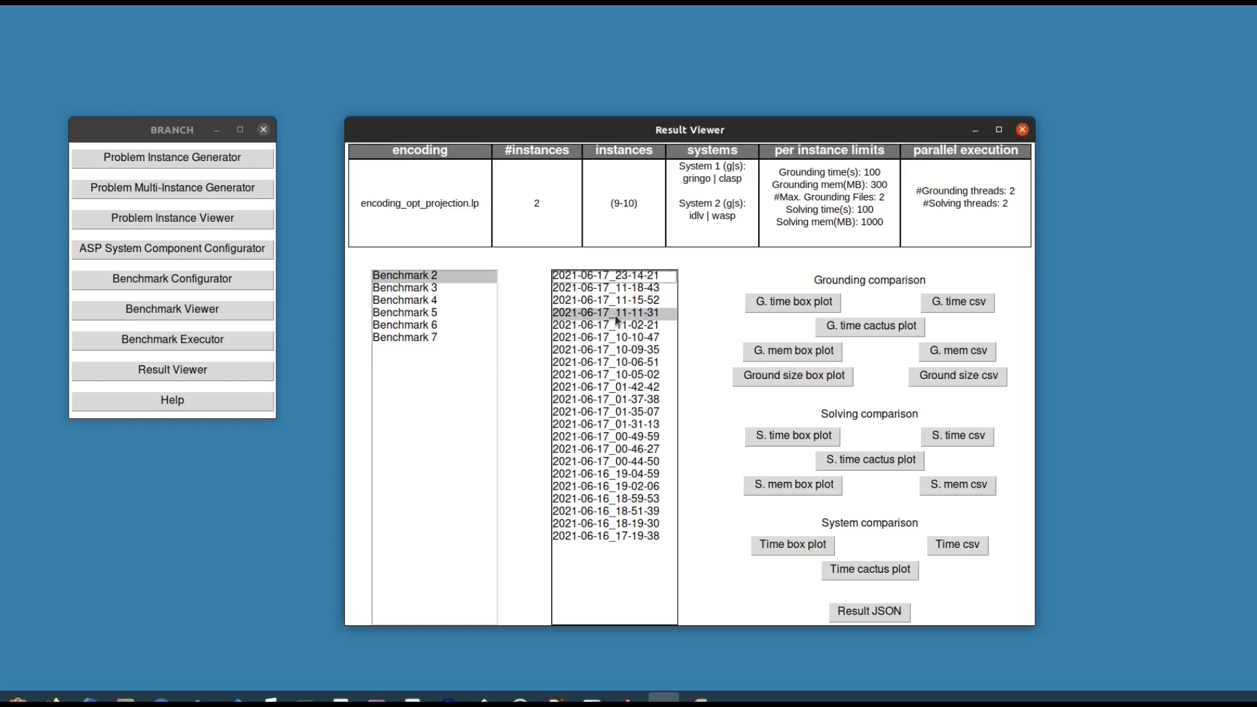
An ASP Systems Benchmark for RABP
SIEMENS

Slide 102
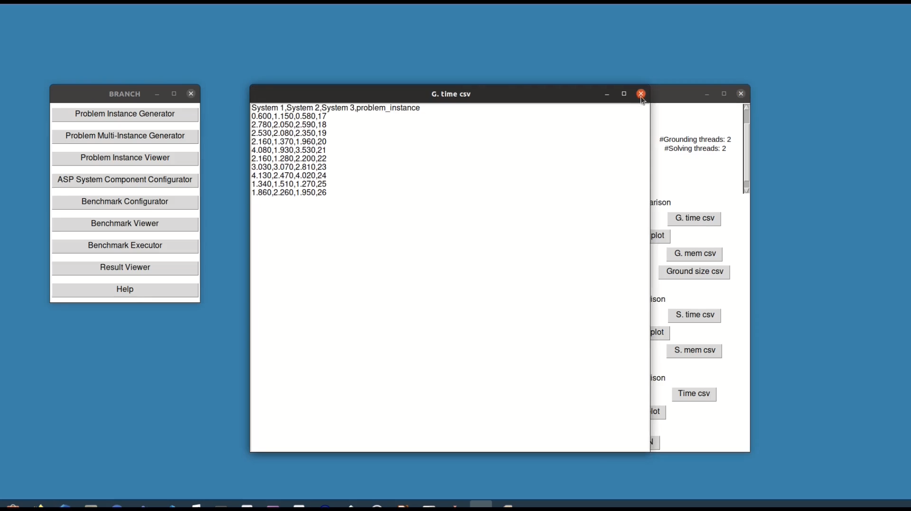
Contributions to RQ 2
An ASP Systems Benchmark for RABP
SIEMENS

Slide 103
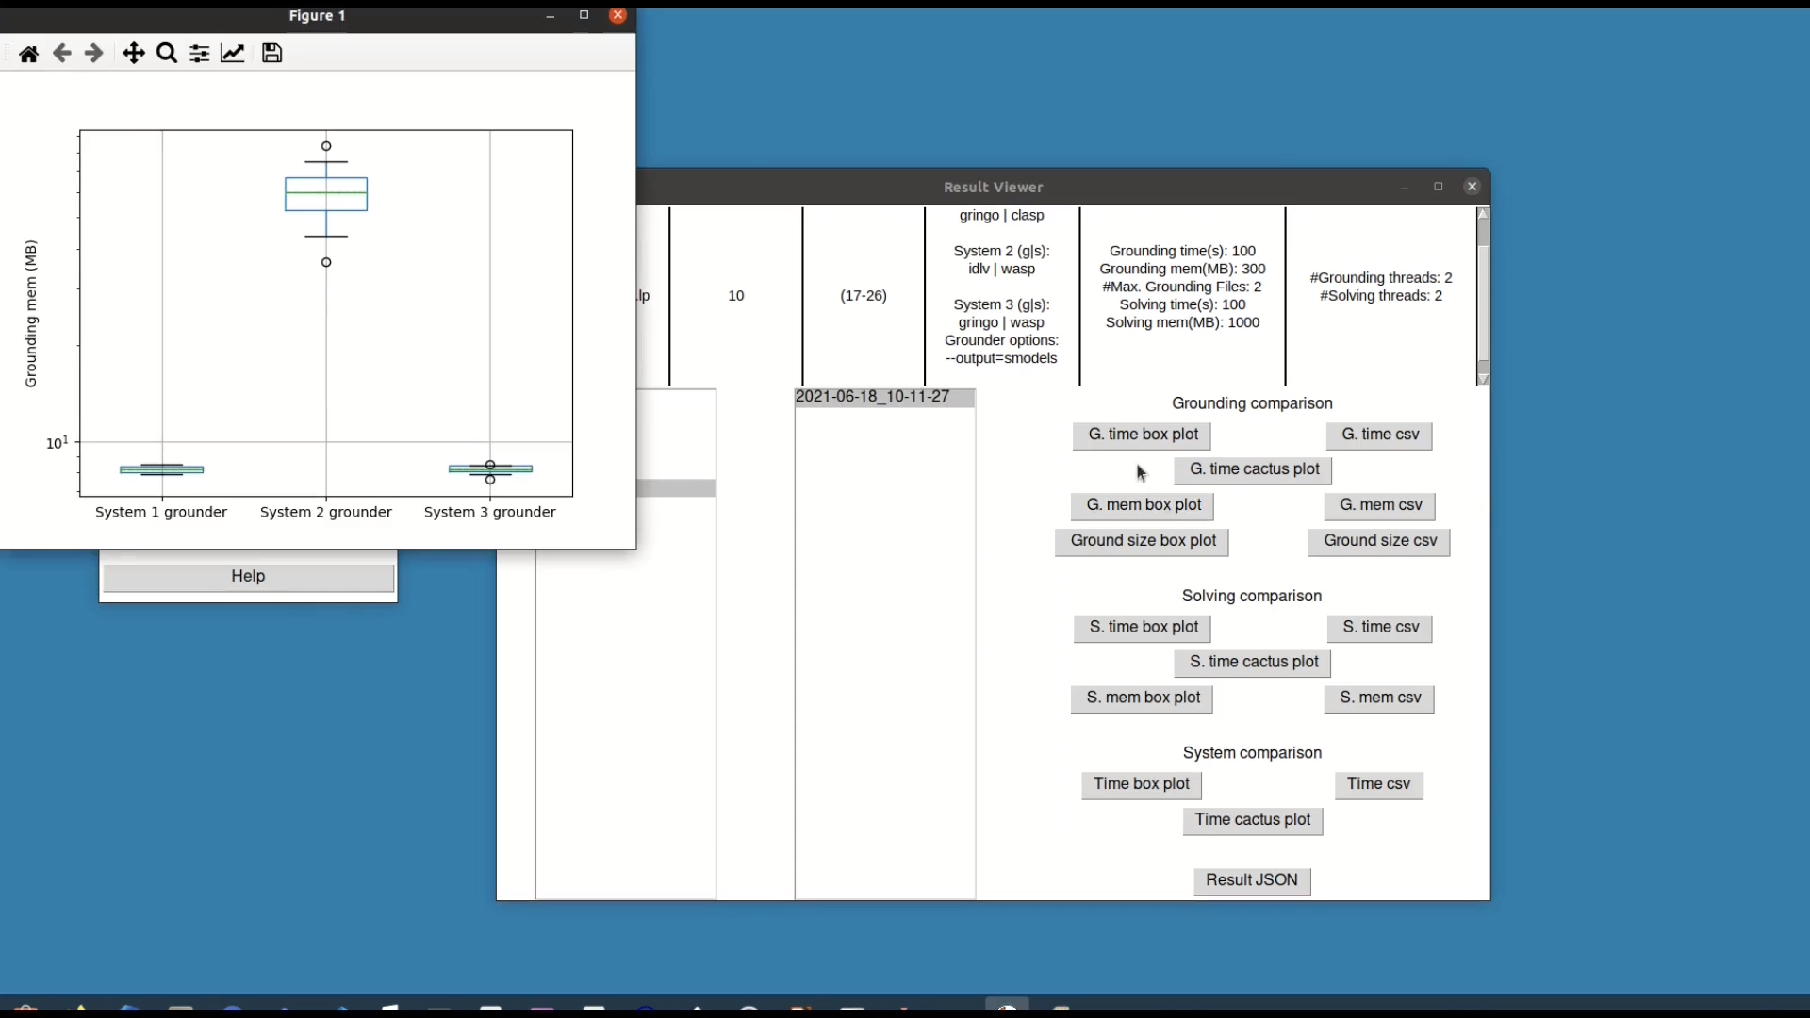
Contributions to RQ 2
An ASP Systems Benchmark for RABP
SIEMENS

Slide 104
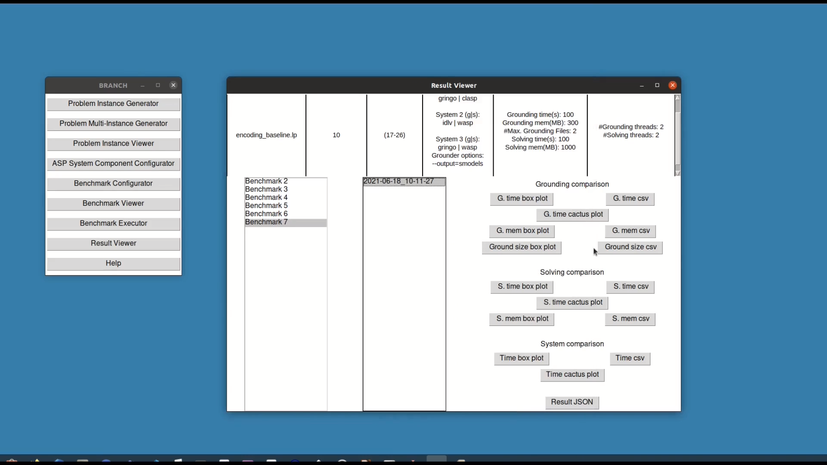
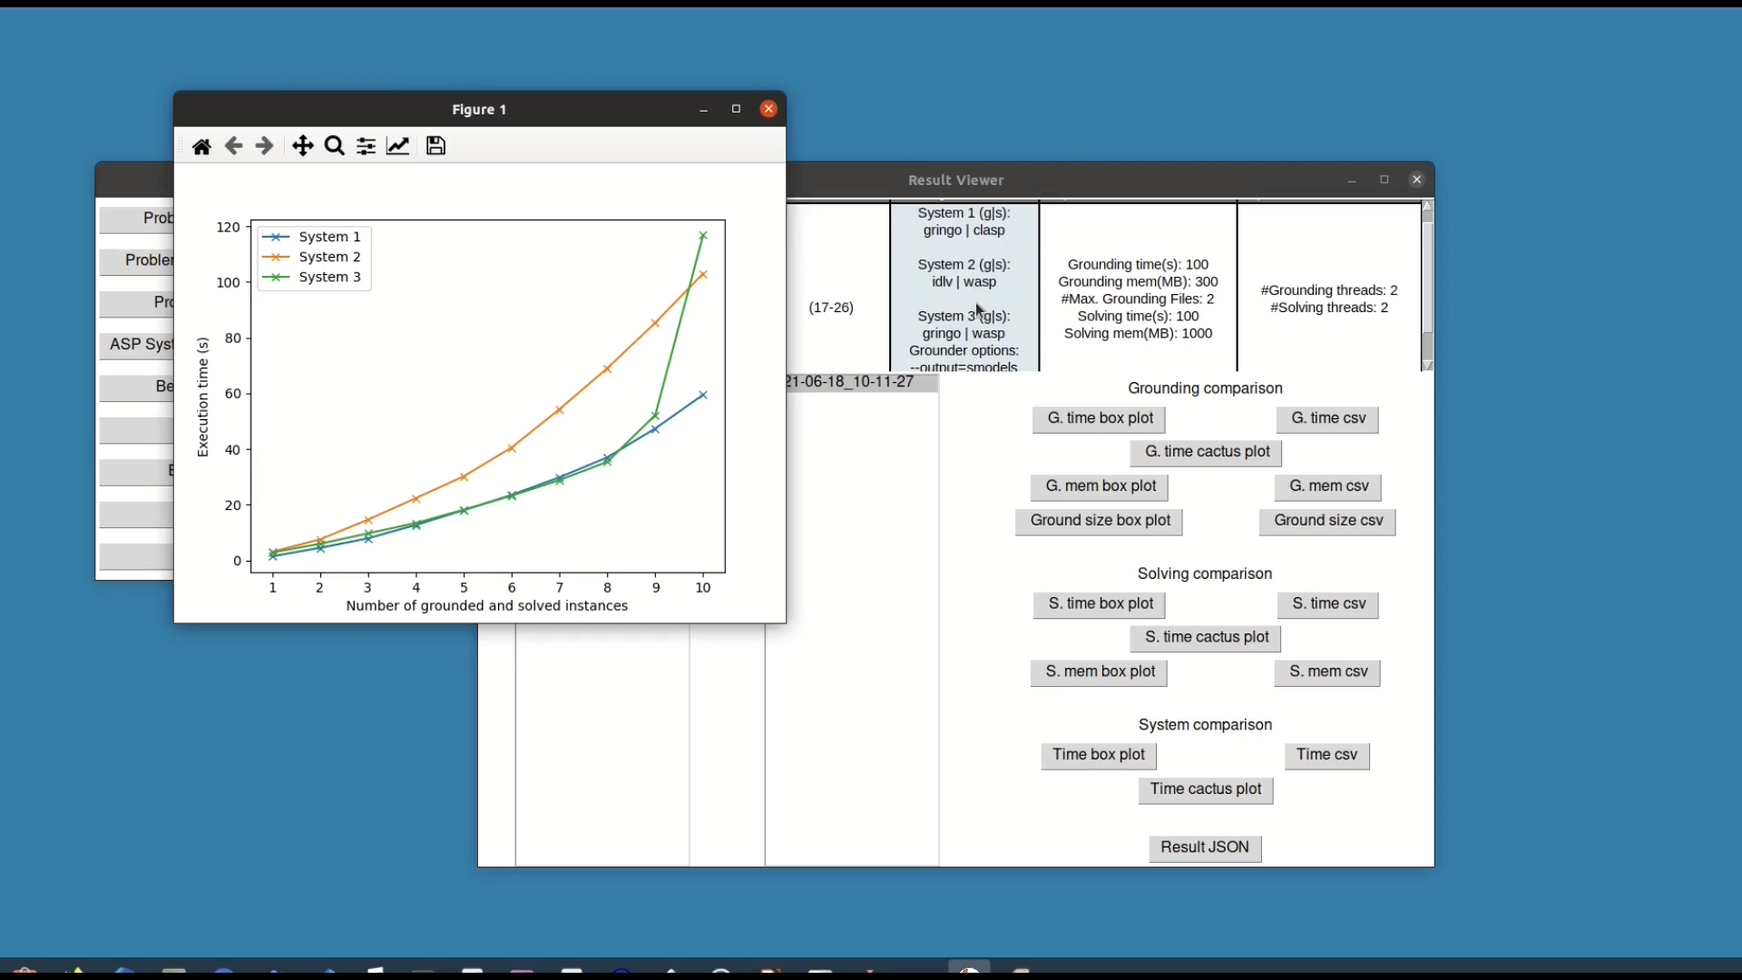
Contributions to RQ 2
An ASP Systems Benchmark for RABP
SIEMENS

Slide 105
ASP vs CP: Performance Evaluation
Running RABP Instances in ASP and CP
INPUT
PROCESSING
INTERMEDIARY MODEL
SOLVING
OUTPUT
RABP ASP encoding
ASP grounder
Ground program
ASP solver
Result
RABP ASP problem instance
Generated RABP problem instance
RABP MiniZinc encoding
MiniZinc flattener
FlatZinc model
CP solver
Result
RABP MiniZinc problem instance
Comparison of four ASP systems against four CP systems
  ASP systems: gringo+clasp, gringo+wasp, idlv+clasp, idlv+wasp
  CP systems: mzn2fzn+gecode, mzn2fzn+chuffed, mzn2fzn+hcsp, mzn2fzn+or-tools

Slide 106
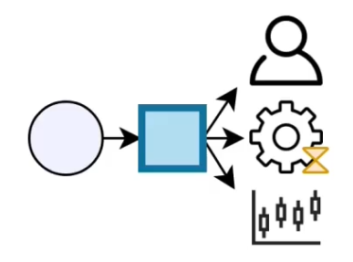
ASP vs CP: Performance Evaluation
id | #A | %conc | #R | #L | u | id | #A | %conc | #R | #L | u
1 | 16 | 10 | 2 | 1 | 32 | 22 | 16 | 50 | 2 | 1 | 48
2 | 16 | 50 | 2 | 1 | 32 | 23 | 16 | 50 | 2 | 1 | 64
3 | 16 | 90 | 2 | 1 | 32 | 24 | 24 | 50 | 3 | 1 | 72
4 | 24 | 10 | 3 | 1 | 48 | 25 | 24 | 50 | 3 | 1 | 96
5 | 24 | 50 | 3 | 1 | 48 | 26 | 32 | 50 | 4 | 2 | 96
6 | 24 | 90 | 3 | 1 | 48 | 27 | 32 | 50 | 4 | 2 | 128
7 | 32 | 10 | 4 | 2 | 64 | 28 | 48 | 50 | 6 | 3 | 144
8 | 32 | 50 | 4 | 2 | 64 | 29 | 48 | 50 | 6 | 3 | 192
9 | 32 | 90 | 4 | 2 | 64 | 30 | 64 | 50 | 8 | 4 | 192
10 | 48 | 10 | 6 | 3 | 96 | 31 | 64 | 50 | 8 | 4 | 256
11 | 48 | 50 | 6 | 3 | 96 | 32 | 96 | 50 | 12 | 6 | 288
12 | 48 | 90 | 6 | 3 | 96 | 33 | 96 | 50 | 12 | 6 | 384
13 | 64 | 10 | 8 | 4 | 128 | 34 | 128 | 50 | 16 | 8 | 384
14 | 64 | 50 | 8 | 4 | 128 | 35 | 128 | 50 | 16 | 8 | 512
15 | 64 | 90 | 8 | 4 | 128
16 | 96 | 10 | 12 | 6 | 192
17 | 96 | 50 | 12 | 6 | 192
18 | 96 | 90 | 12 | 6 | 192
19 | 128 | 10 | 16 | 8 | 256
20 | 128 | 50 | 16 | 8 | 256
21 | 128 | 90 | 16 | 8 | 256
BRANCH
Instance
Generator

Slide 107
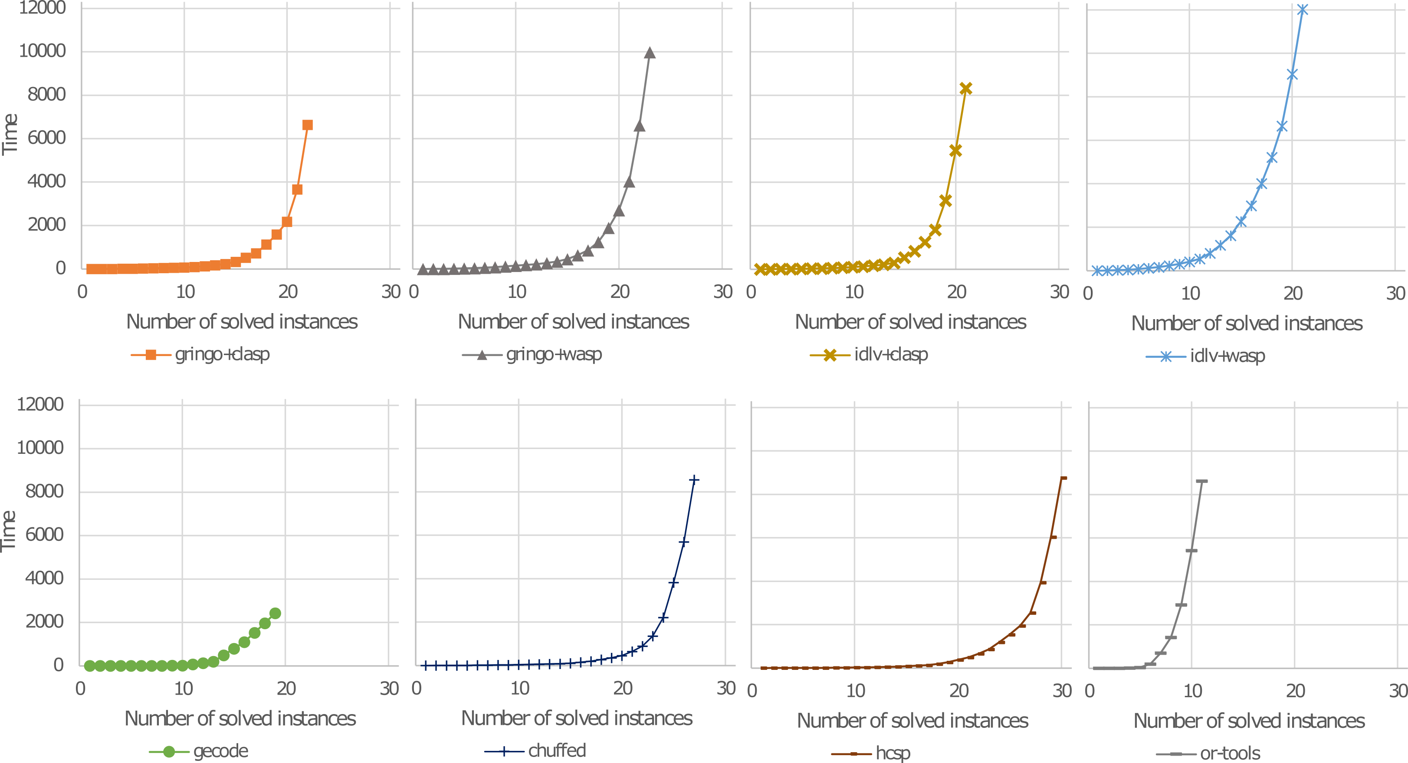
ASP vs CP: Performance Evaluation
ASP Systems
  gringo+clasp
gringo+wasp
idlv+clasp
idlv+wasp
CP Systems
mzn2fzn+gecode
mzn2fzn+chuffed
mzn2fzn+hcsp
mzn2fzn+or-tools

Slide 108
ASP vs CP
 | ASP | CP
Performance | ++ | +++
Readability | +++ | +
Encoding RABP Problem | +++ | ++
Encoding RABP Instances | +++ | +

Slide 109

Representing a wide variety of resources in RABP
BPI15: Giray Havur, Cristina Cabanillas, Jan Mendling, and Axel Polleres. Automated resource allocation in business processes with answer set programming. In Business Process Management Workshops: (BPI 2015), Revised Papers, pages 191–203, 2016.
SIMPDA15: Saimir Bala, Cristina Cabanillas, Alois Haselbock, Giray Havur, Jan Mendling, Axel Polleres, Simon Sperl, and Simon Steyskal. A framework
for safety-critical process management in engineering projects. In SIMPDA 2015, Revised Selected Papers, volume 244 of LNBIP, pages 1–27, Springer, 2015.
BPMDemo15: Saimir Bala, Giray Havur, Simon Sperl, Simon Steyskal, Alois Haselbock, Jan Mendling, and Axel Polleres. Shapeworks: A BPMS extension for complex process management. In the BPM Demo Track 2016 co-located with BPM 2016, volume 1789 of CEUR Workshop Proceedings, pages 50–55, 2016.
BPMForum16: Giray Havur, Cristina Cabanillas, Jan Mendling, and Axel Polleres. Resource allocation with dependencies in business process management systems. In Business Process Management Forum, pages 3–19, 2016.
More details in Giray’s thesis…
Thank you!

Slide 110
Why I love ASP (since over 20 years)…
Intuitive, understandable problem encodings…`
… easily extensible
the beauty of Guess and Check to solve complex problems on top
integrateable in real systems… looking forward to learn more from you!
Part 1:
1999-2003
AI Planning
Part 2:
2003 – to date…
Semantic Web
Part 3:
ca. 2014 – 2022…
Business Process Management

