Slide 1
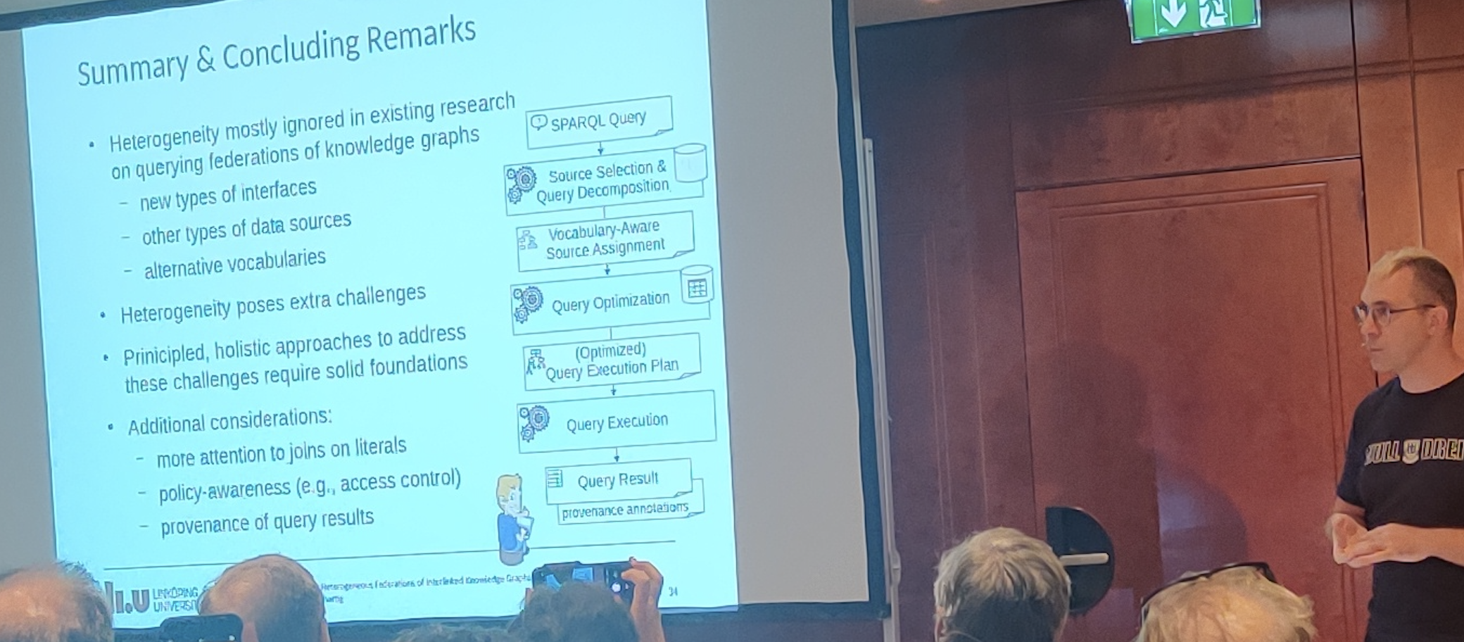
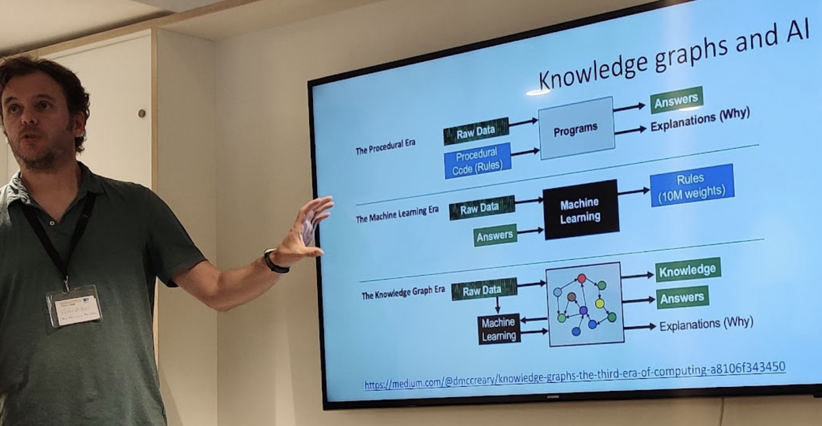
Decentralized Open Knowledge Graphs: a Basis for Hybrid AI?
Axel Polleres
Spoiler (most things I wanted to talk about have been said alreay today):
January 2022

Slide 2
Decentralized Open Knowledge Graphs: a Basis for Hybrid AI?
History
Promise
Challenges
Starting point

Slide 3
Semantic AI… were are we coming from? 20+ years of "Semantic AI"
"If HTML and the Web made all the online documents look like one huge book, RDF,
schema and inference languages will make all the data in the world look like one huge
database"
Tim Berners-Lee, Weaving the Web, 1999
… are the basis for the "Web of Data"…
… and its more recent focus on Open Knowledge Graphs…
" huge knowledge bases, also known as knowledge graphs, have been automatically constructed from web data, and have become a key asset for search engines and other use cases.
Gerhard Weikum, Knowledge Graphs 2021: A Data Odyssey, VDLB 2021

Slide 4
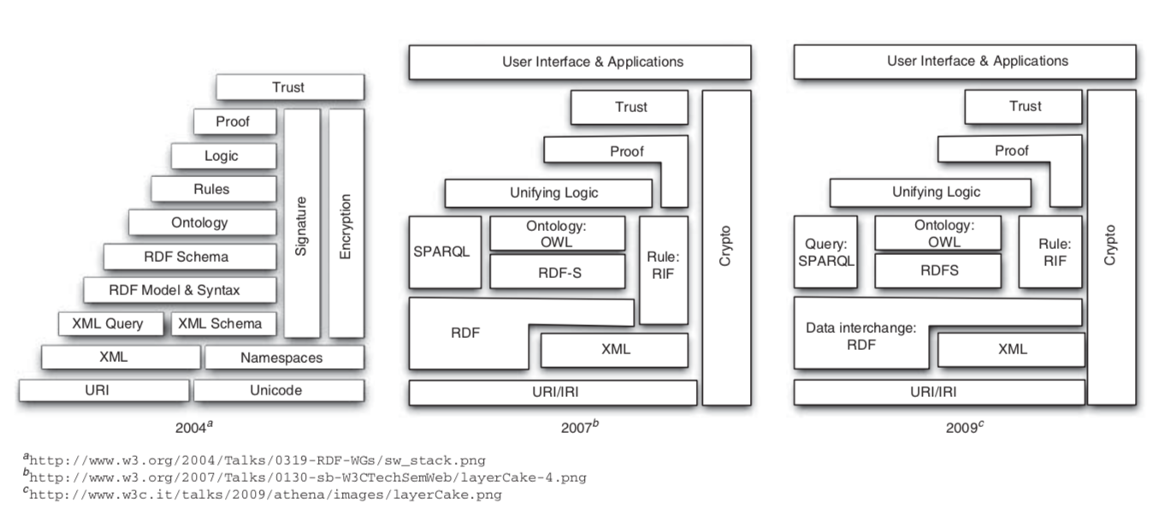
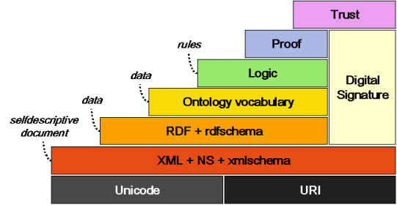
Semantic Web: Reasoning & Logics
(2000s - ca. 2009)
Work on Unified Logics?
Keep DL and Rules separate?
Contextualized Reasoning?s
Good news! Boost in KR/AI research:
We know very well which ontological reasoning
approaches are decidable and how they scale
→ OWL, OBDA, but also: constraint checking (SHACL)
Semantic Web Activity
Olivier Boissier, Marco Colombetti, Michael Luck, John-Jules Meyer, and Axel Polleres. Norms, organizations, and semantics. The Knowledge Engineering Review, 28(1):107--116, March 2013.

Slide 5
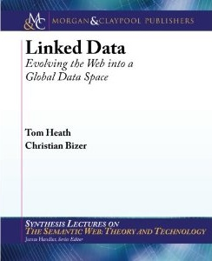
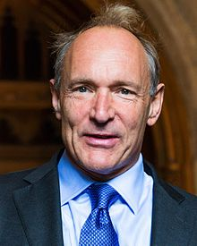
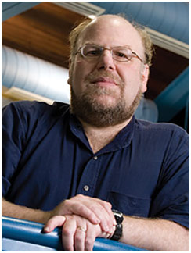
Linked Data: Focus on Data
(ca. 2006/7 – ca. 2013)
Main question: How can I publish “Knowledge on the Web” …
Linked Data Principles
LDP1: use URIs as names for things
LDP2: use HTTP URIs so those names can be dereferenced
LDP3: return useful – RDF? – information upon dereferencing those URIs
LDP4: include links using externally dereferenceable URIs.
https://www.w3.org/DesignIssues/LinkedData.html (originally published 2006-07-27)
“A Little Semantics Goes a Long Way” (Jim Hendler)
http://linkeddatabook.com/editions/1.0/
https://www.cs.rpi.edu/~hendler/LittleSemanticsWeb.html
Notes:
So, how does this work? Strong reliance on standards and standard formats and query languages, such as SPARQL which make it eas to compile and aggregate these connected knowledge graphs to new special purpose knowledge graphs for your application!

Slide 6
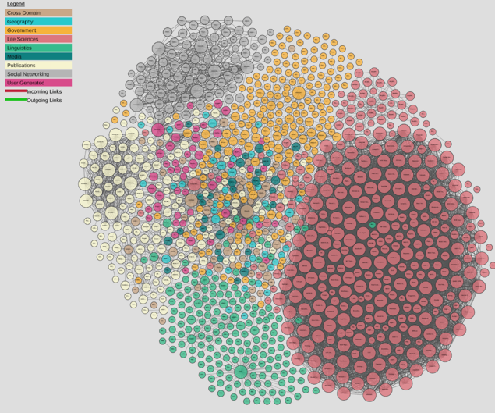
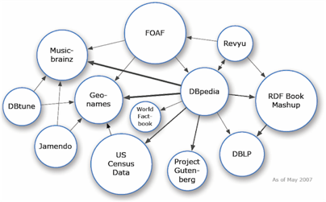
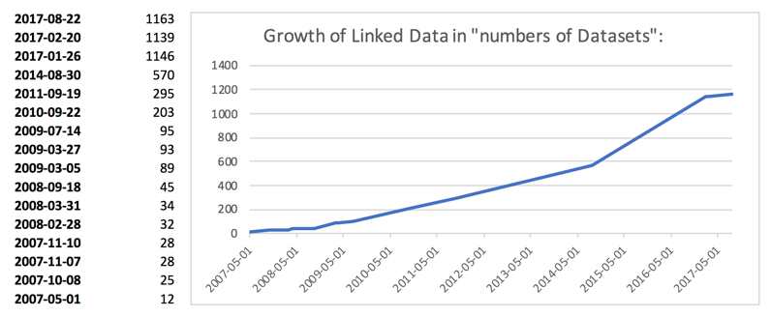
From Semantic Web to Linked (Open) Data
(ca. 2006/7 – now)
Main question: How can I publish “Knowledge on the Web” …
Linked Open Data… growth slowed down a bit
A lot of active developments to publish and link RDF Data
http://lod-cloud.net/
Axel Polleres, Maulik R. Kamdar, Javier D. Fernández, Tania Tudorache, and Mark A. Musen. A more decentralized vision for linked data. In Decentralizing the Semantic Web (Workshop of ISWC2018).

Slide 7
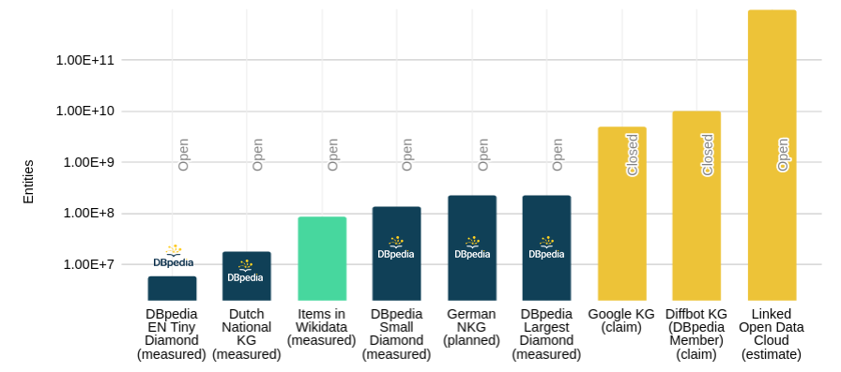
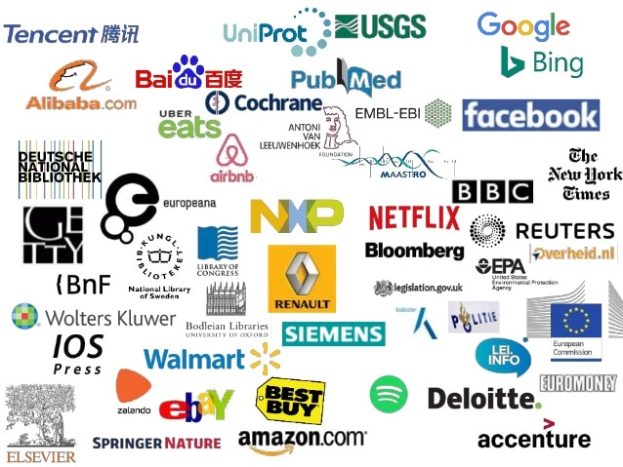
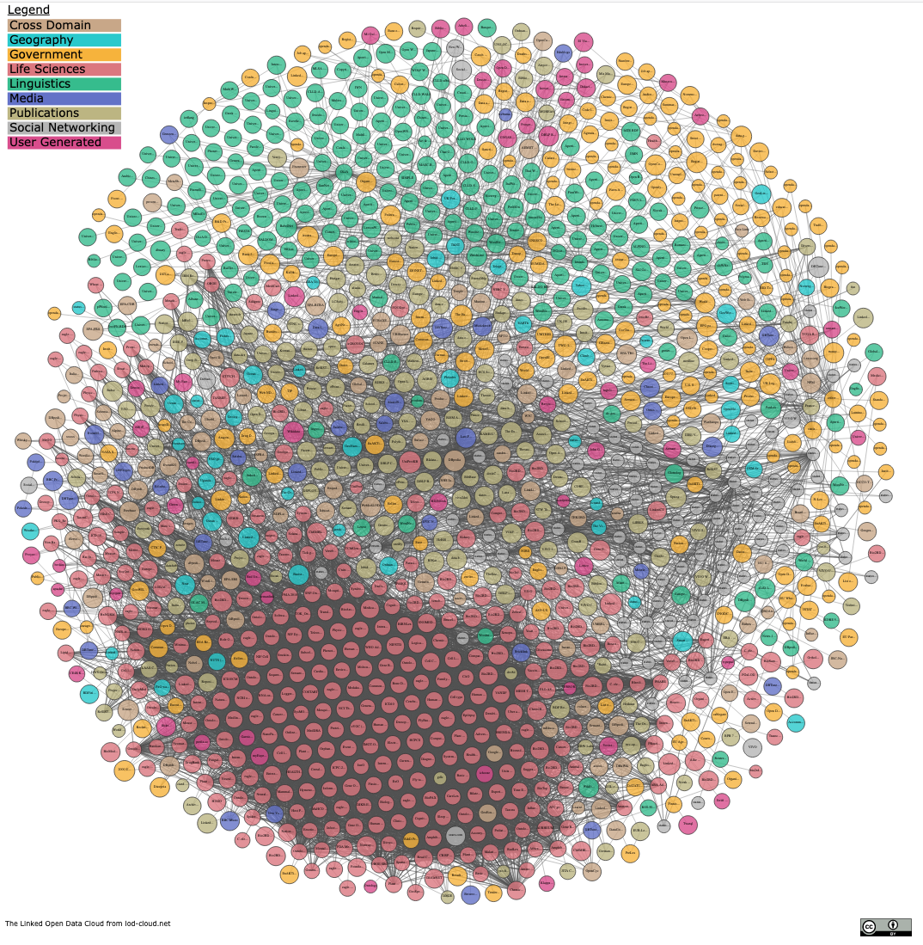
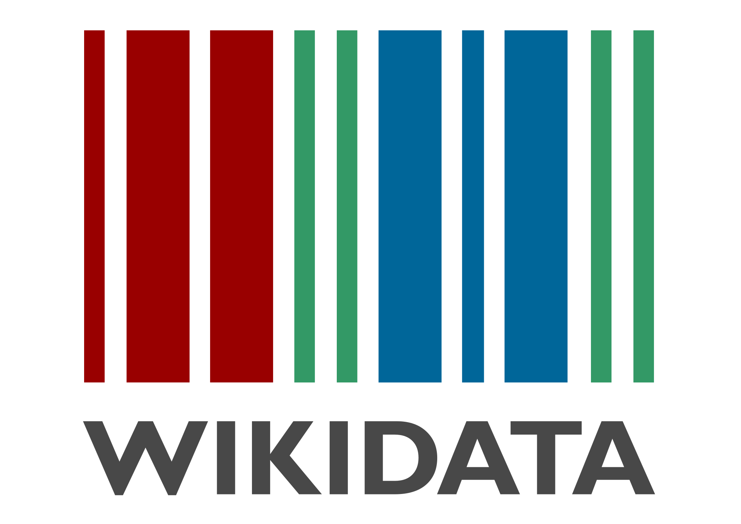
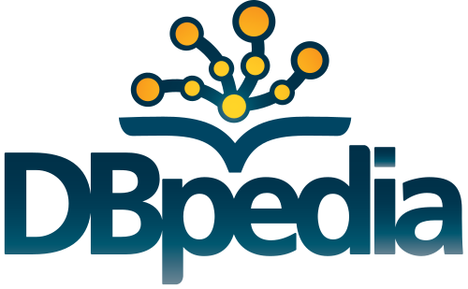
From Linked Open Data to Knowledge Graphs:
Success stories of mainly monolithic (but huge) Knowledge Graphs rather than a network of Linked small KGs:
https://www.slideshare.net/Frank.van.Harmelen/adoption-of-knowledge-graphs-late-2019
https://www.dbpedia.org 2021
Notes:
https://www.slideshare.net/Frank.van.Harmelen/adoption-of-knowledge-graphs-late-2019

Slide 8
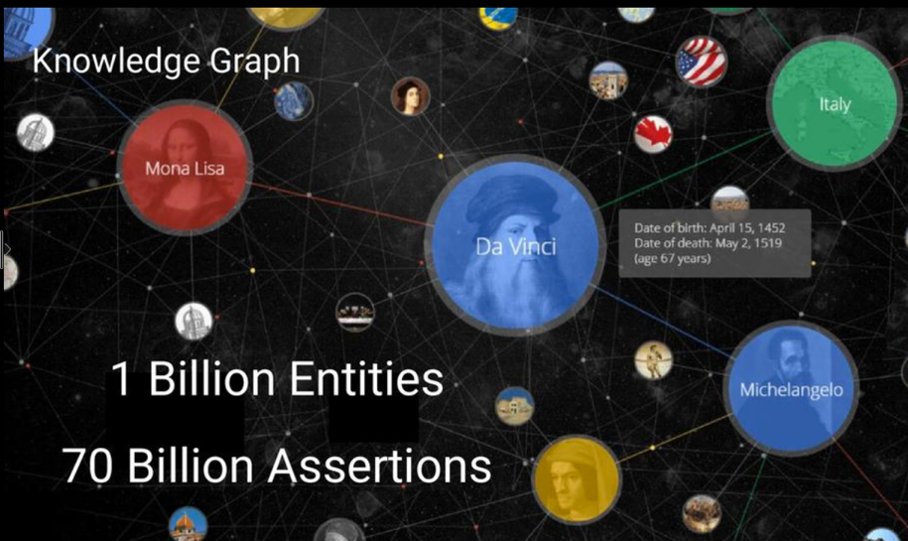
From Linked Open Data to Knowledge Graphs: What's new?
Large-scale, still data-focused (rather than schema-focused)
Monolithic, rather than linked
Knowledge extraction rather than Knowledge engineering
Collectively created (automated or curated)
Purpose-driven: knowledge necessary to power applications
(Logical) consistency not a must
Ontological expressivity not central – BUT: Expresssing context is!
Jamie Taylor, Google, Inc., Keynote ISWC2017
Actors, Directors, Movies
Art Works & Museums
Cities & Countries
Islands, Lakes, Lighthouses
Music Albums & Music Groups
Planets & Spacecraft
Roller Coasters & Skyscrapers
Sports Teams [...]
Answer whether (something like RDF and/or triple stores are used under the hood answered vaguely…
For instance:
Provenance
Temporal context
Confidence

Slide 9
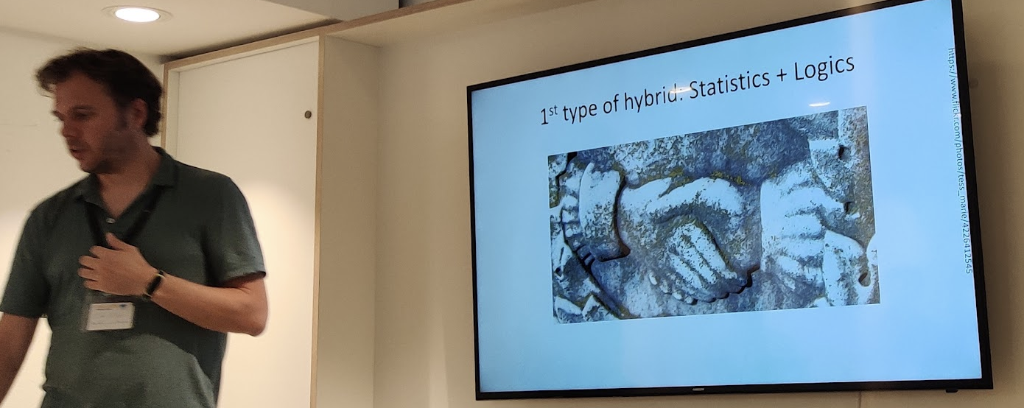
Decentralized Open Knowledge Graphs: a Basis for Hybrid AI?
History
The Promise
Challenges
Starting point

Slide 10
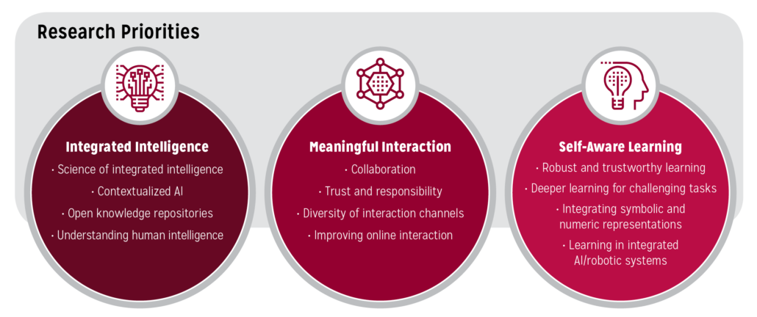
Why are these considered a basis for the next step of (Hybrid) AI:
https://cra.org/ccc/ai-roadmap-integrated-intelligence/
Yolanda Gil and Bart Selman, A 20-Year Community Roadmap for Artificial Intelligence Research in the US: Executive Summary, White Paper, 2019.

Slide 11
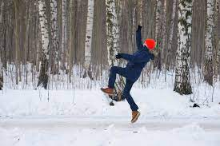
Hybrid AI: Machine Learning and Statistical AI entered the field!
Good progresses in e.g.
Language Processing (etc. Semantic QA)
Image processing and annotation
Still a promise:
KGs can be the basis for XAI
What's (still?) missing? Don't all move to Deep Learning!
We still have homework to do here, e.g.
scalable access to high quality Open KGs!
understanding how knowledge graphs evolve

Slide 12
Decentralized Open Knowledge Graphs: a Basis for Hybrid AI?
History
The Promise
Challenges
Starting point

Slide 13
(Some) challenges I see:
Challenge 1: scalably serving queries centrally is too expensive (for most of us and for many exiciting applications)
Challenge 2: many (academic) efforts to publish, host, and link Data in Open Knowledge Repositories on the Web are not sustainable, or develops in unforeseen ways.
Challenge 3: Knowledge Graphs and other Open Open Data sources are inherently inconsistent and messy, and it's getting worse

Slide 14
Decentralized Open Knowledge Graphs: a Basis for Hybrid AI?
History
The Promise
Challenges
Starting points
incl.

Slide 15
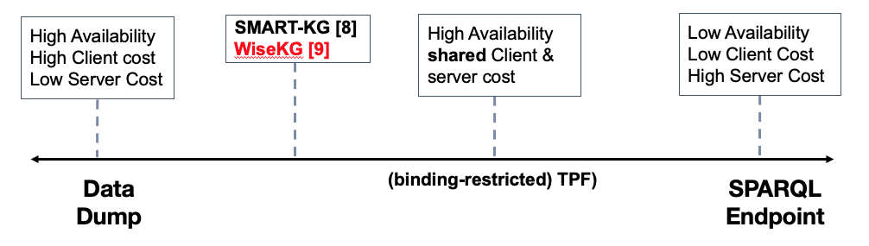
Challenge 1: scalably querying decentralised graph data
Good progress:
cf. Olaf Hartig's keynote this morning!
Next Steps:
Peer-to-peer: collaboration among clients, updates/replication
Querying contextual KGs (such as Wikidata!)
Federated (Path) Queries?

Slide 16
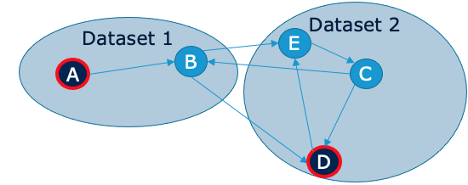
Challenge 1: possible directions
Contextual KGs:
KGs such as Wikidata are not "flat", but contain temporal or provenance information:
Property Graphs vs RDF
Temporal querying and Storage/Archiving of evolving Graph data
Path Queries:
While (regular) path queries aren't even yet a part of SPARQL…
… Path queries in federated environments will be needed to connect decentralized KGs
Rome
Italy
capitalOf
Q220
Q38
Q5119
type: capitalOf
added: 2019-06-12
author: @Bob
validityrFrom: 1861
Name: Rome
Type: City
added: 2019-06-11
author: @Alice
Name: Italy
Type: Country
added: 2019-06-11
author: @Chalrlie

Slide 17
Challenge 1: possible directions
Contextual KGs:
KGs such as Wikidata are not "flat", but contain temporal or provenance information:
Property Graphs vs RDF
Temporal querying and Storage/Archiving of evolving Graph data
Path Queries:
While (regular) path queries aren't even yet a part of SPARQL…
… Path queries in federated environments will be needed to connect decentralized KGs
Starting points (examples), but still no standards yet,
SPARQL/RDF* maybe?

Slide 18
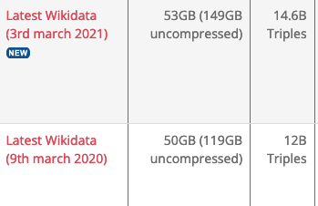
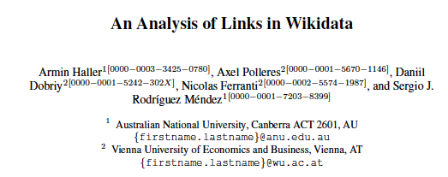
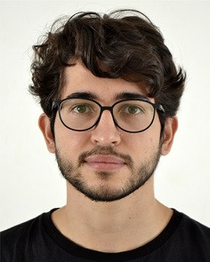
Challenge 2: "KGs are often not sustainable, or develops in unforeseen ways."
Research Objectives:
Investigate how Open Knowledge Repositories evolve over time
investigate and understand their dynamics!
Chance for Hybrid AI: Investigate how Graph Embeddings and can Network analysis be combined to support this goal
https://www.rdfhdt.org/datasets/
Starting points (examples):

Slide 19
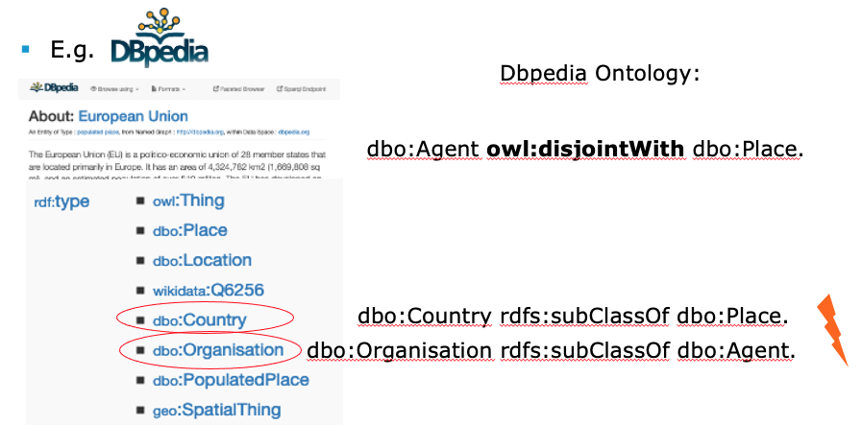
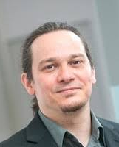
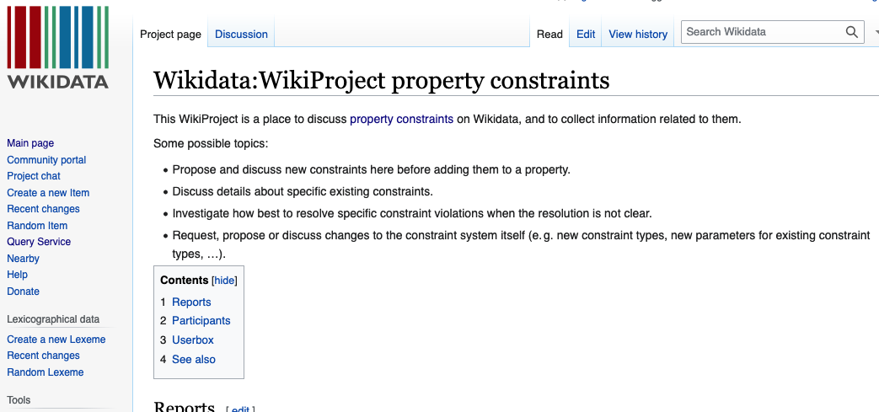
Challenge 3: Inconsistencies in Open Knowledge Repositories …
a great playground for Hybrid AI! SHACL, SHEX, OWL (+ Statistical methods?)
Main
(Open) Research Question:
Bridge between theory and practice!
Starting point: recently started cooperation on KG constraints and repairs:

Slide 20
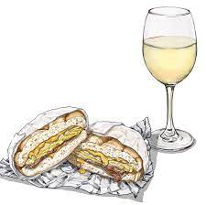
Summary:
Open Knowledge Graphs can be a backbone for Hybrid AI
We can draw from 20+ years of foundational research!
(Reasoning, Query Answering, Databases, Standards)
Machine Learning can greatly add on top, but not substitute these!
before we can achieve our final goal…
Use KGs to improve AI!
…We still have homework to do:
make querying Open KGs scale! (Olaf's talk)
Understand how (large) collaborative Knowledge (Graphs) develop
Use AI to improve KG quality!
There are many other challenges and issues, but…

