Slide 1
Serving and Querying Open Knowledge Graphs on the Web - Basics
ISWS 2022
Axel Polleres
July 2022

Slide 2
What I've planned for today:
Basics:
Interlude – some words on syntax…
Practical SPARQL on examples querying Open KGs with SPARQL
Challenges/limitations of SPARQL over public endpoints
Bonus Material (time allowed or upon request):
Serve and query KGs for local processing – HDT
Addressing the SPARQL endpoint bottleneck – where are we?
Linked Data Fragments
Smart-KG
Wise-KG

Slide 3
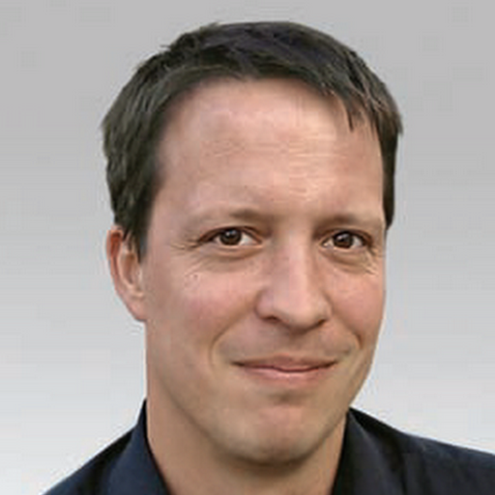
Standard format (RDF) & Standard Query language (SPARQL) for Graph Data
Data representation
RDF (= Resource Description Framework)
a standard Format for publishing Graph Data on the Web.
Can be seen as a labeled graph
Querying
SPARQL
a query language (similar to SQL) for RDF data
We'll have some riddles for the students at the shool
Do you need a nasty SPARQL query? :)
the SPARQL query abilities could have very different levels among students
Let's fix that in the tutorial! :)

Slide 4
RDF… we need to talk about syntax!
We already mentioned… triple of URLs
… can be seen as an edge in a Graph:
it's just syntactic sugar…
<http://www.polleres.net#me> <http://xmlns.com/foaf/0.1/workplaceHomepage> <http://www.wu.ac.at> .
polleres.net#me
workplaceHomepage
www.wu.ac.at

Slide 5
RDF vocabularies, common prefixes 1/2:
Vocabularies (collections of URIs to define meaning for Links) are identified by a common URI prefix:
The
RDF Core (rdf: http://www.w3.org/1999/02/22-rdf-syntax-ns#) and
RDFS Schema (rdfs: http://www.w3.org/2000/01/rdf-schema#)
vocabularies define basic meaning for relations such as is-A, subclasses/subproperties, (human-readable) labels,
etc. according to the RDF specification:
Important URIs that used for links (in many KGs):
http://www.w3.org/1999/02/22-rdf-syntax-ns#type (or short rdf:type)
http://www.w3.org/2000/01/rdf-schema#label (or short rdfs:label)
http://www.w3.org/2000/01/rdf-schema#subPropertyOf (or short rdfs:subClassOf)
http://www.w3.org/2000/01/rdf-schema#subClassOf (or short rdfs:subPropertyOf)
http://www.w3.org/2000/01/rdf-schema#domain (or short rdfs:domain)
http://www.w3.org/2000/01/rdf-schema#range (or short rdfs:range)

Slide 6
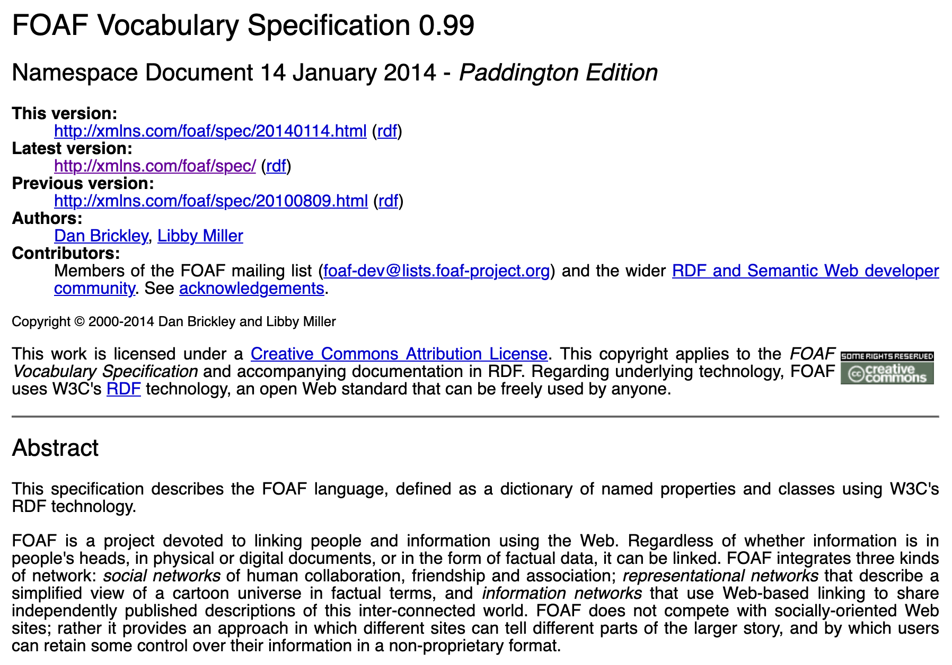
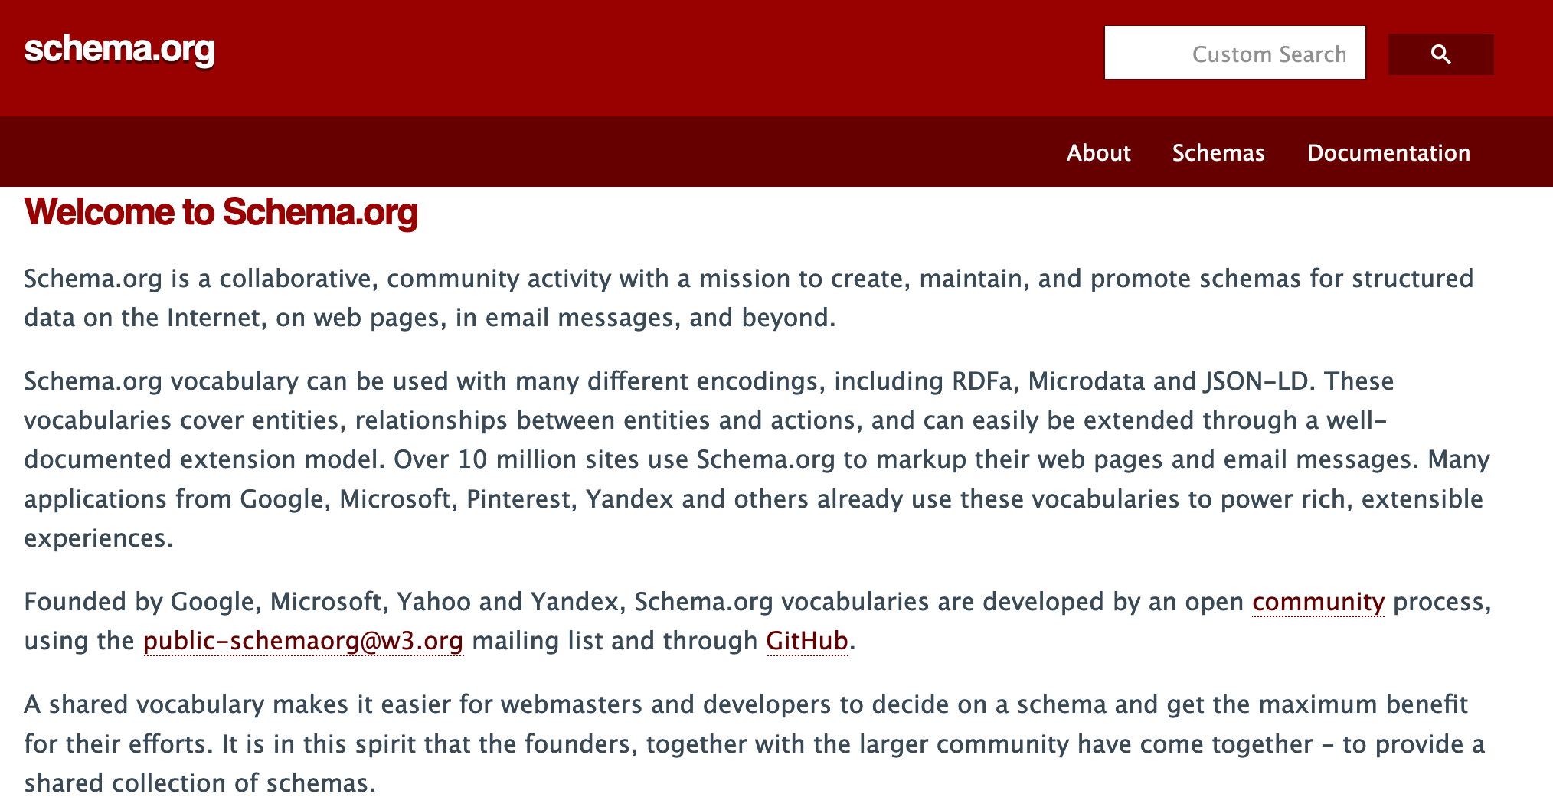
RDF vocabularies, common prefixes 2/2 :
Other vocabularies:
foaf: Prefix: http://xmlns.com/foaf/0.1/ … The "Friend-of-a-friend' vocabulary models common properties of and classses relating to Persons and social relationships. E.g.:
Properties:
name
nickname
workplaceHomepage
knows
Classes:
Agent
Person
Document
Image
schema: Prefix: http://schema.org/ …
Classes and properties important for search engines
(founded by Google, Microsoft, Yahoo and Yandex)
or domain/KG-specific vocabularies, eg.
dbo: (DBpedia Ontology)
wd:, wdt: (Wikidata entities and properties)

Slide 7
RDF Syntaxes – A simple RDF file:
simple1.nt in NTriples Syntax :
<http://www.example.org/klaus> <http://xmlns.com/foaf/0.1/knows> <http://www.example.org/karl> .
<http://www.example.org/klaus> <http://xmlns.com/foaf/0.1/nickname> "Niki" .
<http://www.example.org/alice> <http://xmlns.com/foaf/0.1/knows> <http://www.example.org/bob> .
<http://www.example.org/alice> <http://xmlns.com/foaf/0.1/knows> <http://www.example.org/karl> .
<http://www.example.org/alice> <http://xmlns.com/foaf/0.1/name> "Alice Wonderland" .
<http://www.example.org/karl> <http://xmlns.com/foaf/0.1/name> "Karl Mustermann" .
<http://www.example.org/karl> <http://xmlns.com/foaf/0.1/knows> <http://www.example.org/joan> .
<http://www.example.org/bob> <http://xmlns.com/foaf/0.1/name> "Robert Mustermann" .
<http://www.example.org/bob> <http://xmlns.com/foaf/0.1/nickname> "Bobby" .

Slide 8
RDF Syntaxes – A simple RDF file:
simple1.ttl in Turtle (Terse RDF Language) Syntax is a bit more readable:
# using the FOAF vocabulary, see http://xmlns.com/foaf/spec/
@prefix : <http://www.example.org/> .
@prefix foaf: <http://xmlns.com/foaf/0.1/>.
:klaus foaf:knows :karl .
:klaus foaf:nickname "Niki".
:alice foaf:knows :bob .
:alice foaf:knows :karl .
:alice foaf:name "Alice Wonderland" .
:karl foaf:name "Karl Mustermann" .
:karl foaf:knows :joan.
:bob foaf:name "Robert Mustermann" .
:bob foaf:nickname "Bobby" .

Slide 9
RDF Syntaxes – A simple RDF file:
simple1.ttl in Turtle (Terse RDF Language) Syntax is a bit more readable –
Turtle Syntax also allows some shortcuts to group Triples with common subjects:
# using the FOAF vocabulary, see http://xmlns.com/foaf/spec/
@prefix : <http://www.example.org/> .
@prefix foaf: <http://xmlns.com/foaf/0.1/>.
:klaus foaf:knows :karl ;
foaf:nickname "Niki".
:alice foaf:knows :bob , :karl ; foaf:name "Alice Wonderland" .
:karl foaf:name "Karl Mustermann" ; foaf:knows :joan.
:bob foaf:name "Robert Mustermann" ; foaf:nickname "Bobby" .
Note: We will need Turtle Syntax for querying RDF data!

Slide 10
Standards like RDF have lead to (really) big open KGs…
… some of which availabe on the Web
… queryable via SPARQL endpoints!
plus useful convenience tools:
http://prefix.cc/ … find out common URI prefixes for formulating queries
http://yasgui.triply.cc/ … really nice frontend for querying SPARQL endpoints, e.g. DBpedia
https://query.wikidata.org/ … really nice frontend specifically for querying Wikidata
Plus tons of APIs (e.g. Python, R packages, etc.)
1,101,215,718 triples/edges 13,602,048,837 triples/edges

Slide 11
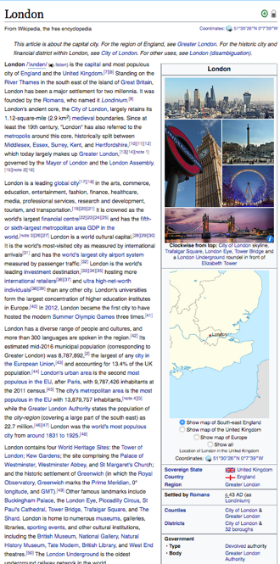
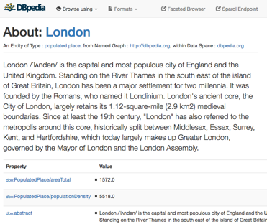
RDF used in practice on the Web: DBpedia - a "Database-version" of Wikipedia:
E.g. from
One of the central datasets of the Linked Open Data-Cloud
RDF extracted from Wikipedia-Infoboxes
You can use a language called SPARQL (roughly: SQL for RDF) to do structured queries over RDF via Web accessible SPARQL endpoints, e.g. http://dbpedia.org/sparql
„Cities in the UK with more than 1M population“:
Structured queries (SPARQL):
PREFIX : <http://dbpedia.org/resource/>
PREFIX dbo: <http://dbpedia.org/ontology/>
PREFIX yago: <http://dbpedia.org/class/yago/>
SELECT DISTINCT ?city ?pop WHERE {
?city a yago:City108524735 .
?city dbo:country :United_Kingdom.
?city dbo:populationTotal ?pop
FILTER ( ?pop > 1000000 )
}
https://en.wikipedia.org/wiki/London
http://dbpedia.org/resource/London
Automatic Exctractors
Try it on yasgui.triply.cc … short link to the query: https://api.triplydb.com/s/Of19_c3-e

Slide 12
RDF used in practice on the Web: Another Open Knowledge Graph: Wikidata
Slightly different idea than DBpedia:
a Wikimedia foundation project itself
put simply: "replace factual data within Wikipedia by a (graph) Database"
Wikidata can also be queried as RDF with SPARQL!

Slide 13
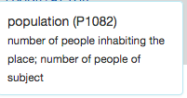
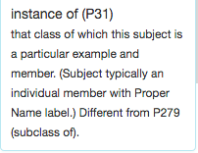
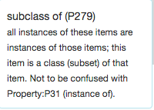
Let's learn some SPARQL with Wikidata
“Simple” surface query:
Which cities in the UK have more than 1M people?
What’s this?
SELECT DISTINCT ?city WHERE {
?city wdt:P31/wdt:P279* wd:Q515.
?city wdt:P1082 ?population .
?city wdt:P17 wd:Q38 .
FILTER (?population > 1000000) }
Page 13

Slide 14
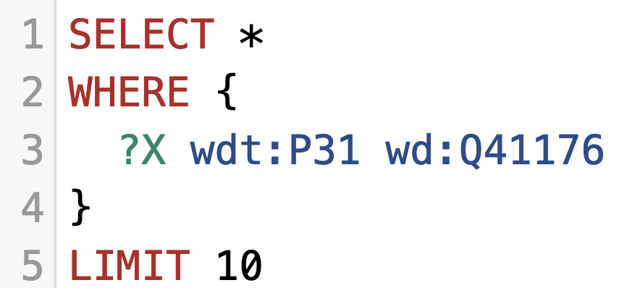
Let's learn some SPARQL with Wikidata
You can try out the queries on http://query.wikidata.org/
https://www.wikidata.org/entity/Q41176 (wd:Q41176) … Building http://www.wikidata.org/prop/direct/P31 (wdt:P31) … instanceOf
Triple Patterns (TPs): Try this query for
"Give me 10 buildings"
https://w.wiki/4TAP

Slide 15
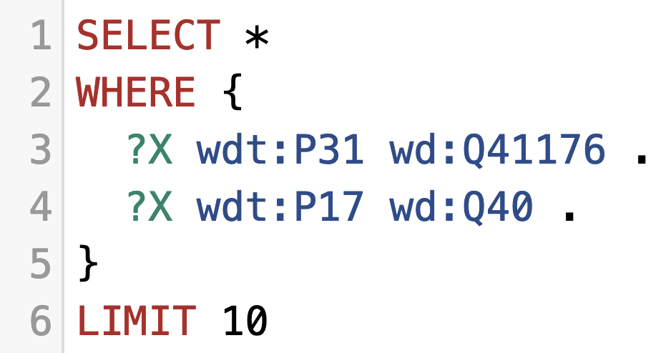
Let's learn some SPARQL with Wikidata
You can try out the queries on http://query.wikidata.org/
https://www.wikidata.org/entity/Q41176 (wd:Q41176) … Building http://www.wikidata.org/prop/direct/P31 (wdt:P31) … instanceOf
Basic Graph patterns (BGPs): "Join" between edges/triples:
"Give me 10 buildings in Austria"
https://w.wiki/4TAY

Slide 16
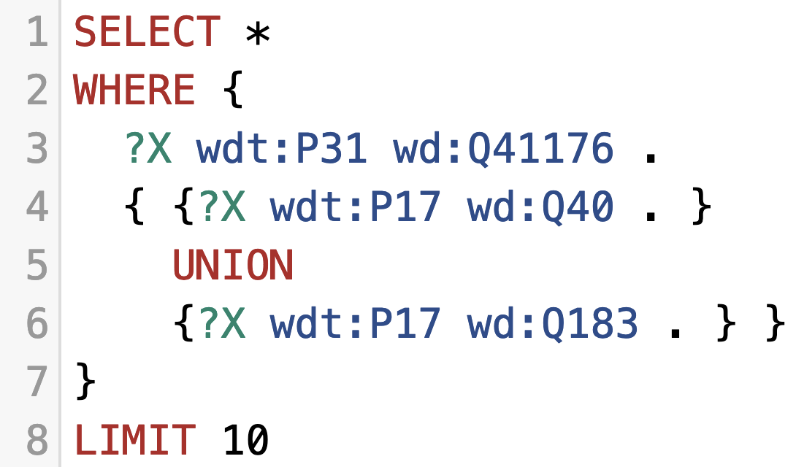
Let's learn some SPARQL with wikidata
You can try out the queries on http://query.wikidata.org/
https://www.wikidata.org/entity/Q41176 (wd:Q41176) … Building http://www.wikidata.org/prop/direct/P31 (wdt:P31) … instanceOf
UNION between patterns:
"Give me 10 buildings in Austria or Germany"
https://w.wiki/4TAf

Slide 17
Let's learn some SPARQL with wikidata
You can try out the queries on http://query.wikidata.org/
https://www.wikidata.org/entity/Q41176 (wd:Q41176) … Building http://www.wikidata.org/prop/direct/P31 (wdt:P31) … instanceOf
FILTERs (similar to WHERE conditions in SQL):
"Give me the German labels of 10 buildings in Austria or Germany"
https://w.wiki/4TAk

Slide 18
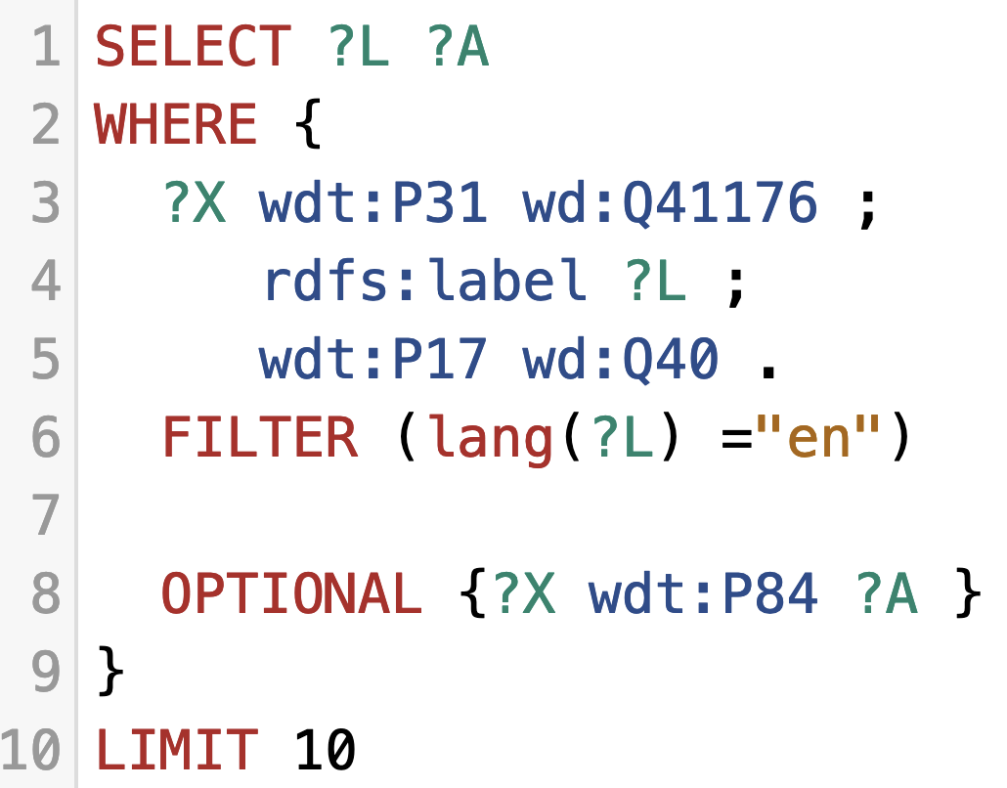
Let's learn some SPARQL with wikidata
You can try out the queries on http://query.wikidata.org/
https://www.wikidata.org/entity/Q41176 (wd:Q41176) … Building http://www.wikidata.org/prop/direct/P31 (wdt:P31) … instanceOf
OPTIONAL (similar to OUTER JOIN in SQL):
"Give me the German labels of 10 buildings in Austria
and their architect (if available)"
https://w.wiki/4TAn

Slide 19
Full details of SPARQL and many more examples:
https://www.w3.org/TR/sparql11-query/
Supported by various modern graph databases.

Slide 20
What I've planned for today:
Basics:
Interlude – some words on syntax…
Practical SPARQL on examples querying Open KGs with SPARQL
Challenges/limitations of SPARQL over public endpoints
Bonus Material (time allowed or upon request):
Serve and query KGs for local processing – HDT
Addressing the SPARQL endpoint bottleneck – where are we?
Linked Data Fragments
Smart-KG
Wise-KG

Slide 21
(Some) Challenges:
Challenge 1: How to query Contextualized Data (e.g. temporal, provenance,…)
Challenge 2: What about real graph queries (paths, paths across distributed data)?
Challenge 3: Scalability (and costs of hosting) SPARQL endpoints
Challenge 4: Mixing querying and reasoning (how? how to scale?)
Challenge 5: Sustainability of RDF and SPARQL resources

Slide 22
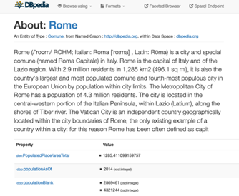
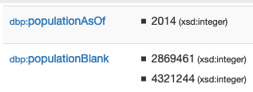
Challenge 1: Often, you also need to deal with contextualized information
E.g. from
Doesn’t work!
„Cities in the Italy with more than 1M population“:
Structured queries (SPARQL):
https://en.wikipedia.org/wiki/Rome
http://dbpedia.org/resource/Rome
http://yasgui.org/short/UVOyhX8ft
Automatic Exctractors
PREFIX : <http://dbpedia.org/resource/>
PREFIX dbo: <http://dbpedia.org/ontology/>
PREFIX yago: <http://dbpedia.org/class/yago/>
SELECT DISTINCT ?city ?pop WHERE {
?city a yago:City108524735 .
?city dbo:country :Italy.
?city dbo:populationTotal ?pop
FILTER ( ?pop > 1000000 )
}

Slide 23
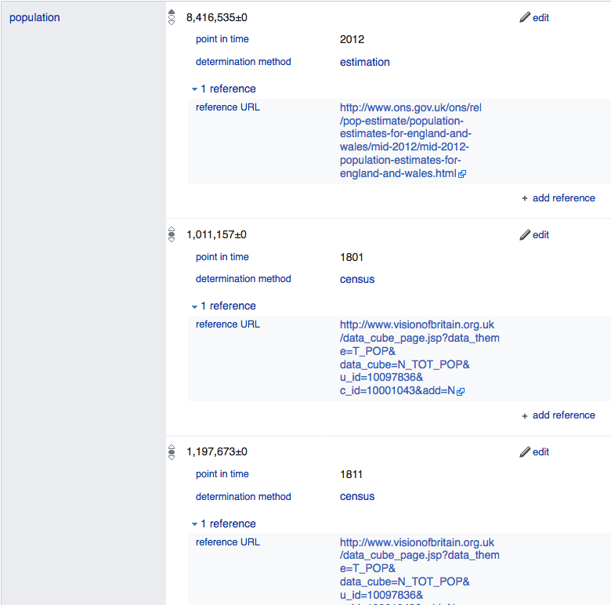
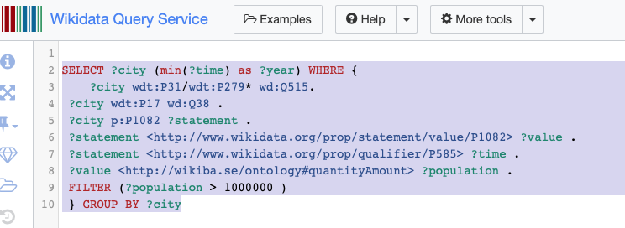
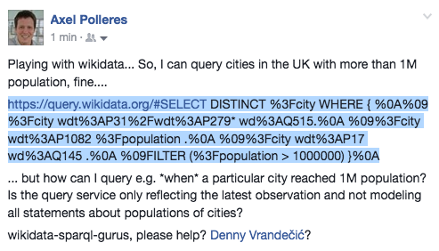
Challenge 1: Wikidata as RDF … In Wikidata even context information can be queried by SPARQL
However, Wikidata has more complex info: (temporal context, provenance,…)
Rome:
https://www.wikidata.org/wiki/Q220
… Can I query that with SPARQL?
Yes!
https://w.wiki/4rs
Page 23
Notes:
Not so easy, despite it’s Linked Data… no “common semantics by names”? And as far as I know in the Linked Data realm this is the exception, not the rule…

Slide 24
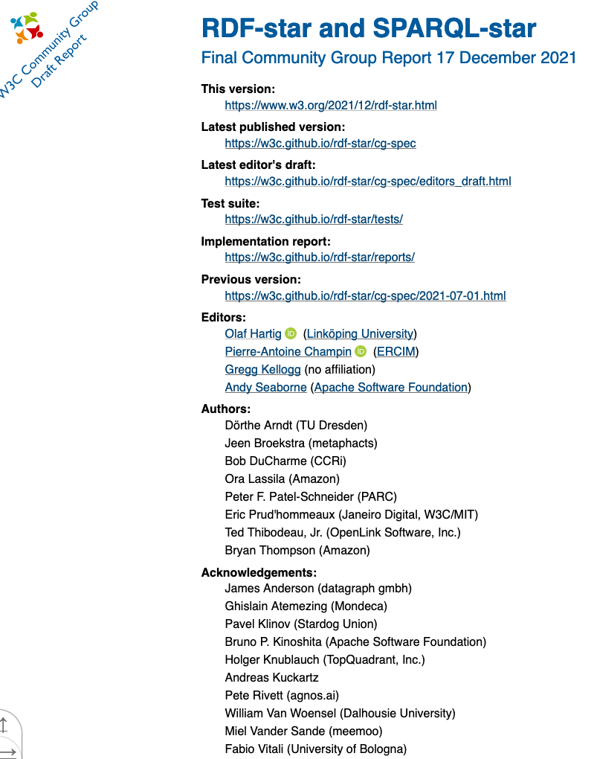
Challenge 1: Contextualized information in RDF
no standard as of yet. State of affairs:
Wikidata has its own proprietary extension (cf. last slide)
Alternative representations/engines involve Property Graphs
ongoing work: RDF*/SPARQL* community group
Rome
Italy
capitalOf
Q220
Q38
Q5119
type: capitalOf
added: 2019-06-12
author: @Bob
validityrFrom: 1861
Name: Rome
Type: City
added: 2019-06-11
author: @Alice
Name: Italy
Type: Country
added: 2019-06-11
author: @Chalrlie

Slide 25
Challenge 2: Path queries
While it is possible to do path queries in SPARQL via property path expressions, it is still not possible to return paths in SPARQL1.1:
i.e.: what is the (shortest) path ?Path connecting ?city and wd:Q515?
SELECT DISTINCT ?city ?Path WHERE {
?city wdt:P31/wdt:P279* wd:Q515.
?city wdt:P1082 ?population .
?city wdt:P17 wd:Q38 .
FILTER (?population > 1000000) }

Slide 26
Challenge 2: Path queries – prototype solution
Common problem in graphs, not doable with SPARQL, but with extensions [1]:
“Give me the (k) shortest paths between two nodes?”
Dataset 2
Dataset 1
E
:a :p :b.
:b :p :d, :e.
:c :p :b, :d.
:d :p :e.
:e :p :c.
B
A
C
D
rdf2hdt.sh -rdftype turtle testgraph.ttl testgraph.hdt
hdtsparql.sh testgraph.hdt "PREFIX ppf: <java:at.ac.wu.arqext.path.>
SELECT * WHERE{ ?path ppf:topk (:a :d 2) }"
We solved this by extending SPARQL [1] with bidirectional BFS over HDT
Open research question(s): e.g. But how to do this effectively in a Federated setting?
k=2
https://bitbucket.org/vadim_savenkov/topk-pfn/
[Savenkov et al, SEMANTiCS 2017]
Still interesting question also in (Graph)DB Theory… regarding entailments, coverage of queries in such settings.

Slide 27
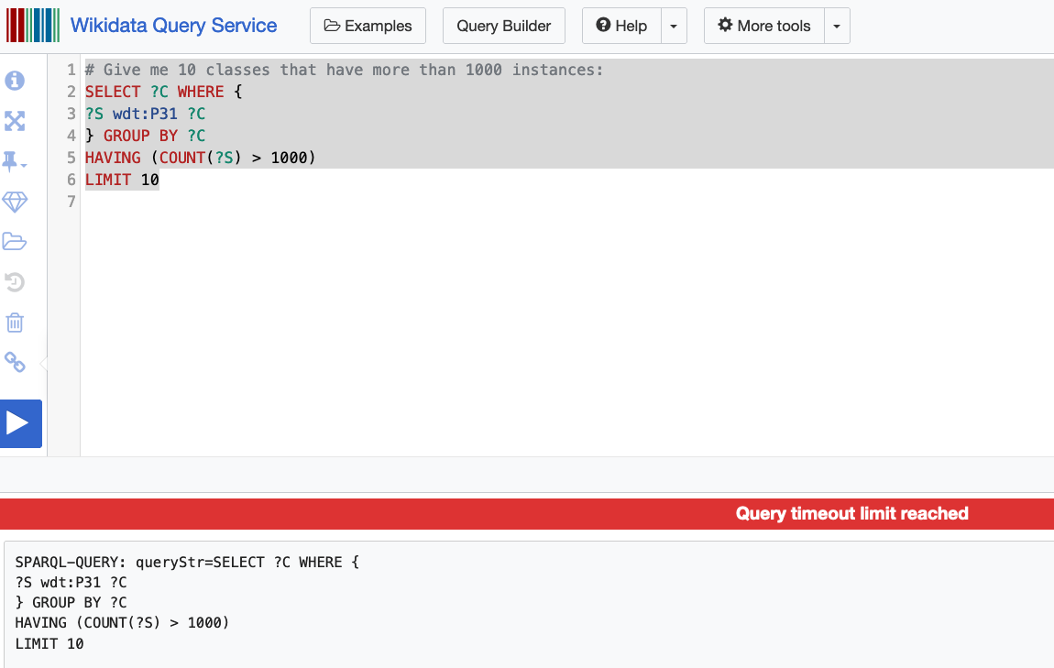
Challenge 3: Scalability of SPARQL endpoints?
Example:
"Classes with their number of instances"
Challenge 3.1: serve complex/long running queries to single users
Challenge 3.2: serve many queries to many users concurrently
https://w.wiki/4mTj
[Fernández et al. 2013, JWS]
[Vergbourgh et al. 2016, JWS]
[Fernández et al. 2020, WebConf]
[Azzam et al. 2022, WebConf]

Slide 28
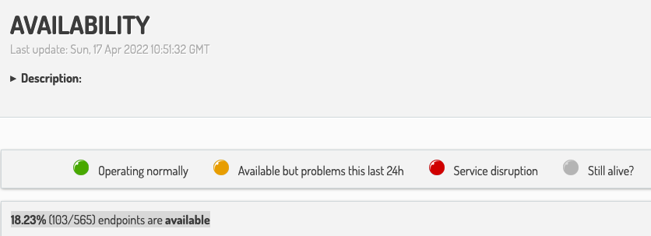
Challenge 3: Scalability of SPARQL endpoints?
Observation 2:
Serving SPARQL endpoints sustainably is too hard/expensive?
Linked Data has rather evolved into a set of few, but huge, popular (Open) Knowledge Graphs:
https://sparqles.ai.wu.ac.at/availability , operating since 2012 [Käfer et al. 2012, LDOW]

Slide 29
Challenge 3: Scalability of SPARQL endpoints? What's the problem?
https://iccl.inf.tu-dresden.de/web/Wikidata_SPARQL_Logs/
https://w.wiki/4mTj
Challenge 1: serve complex/long running queries to single users
Challenge 2: serve many queries to many users concurrently
[Fernández et al. 2013, JWS]
[Vergbourgh et al. 2016, JWS]
[Fernández et al. 2020, WebConf]
[Azzam et al. 2022, WebConf]

Slide 30
Challenge 4: Reasoning and Inconsistencies
A lot of work has been done in the past on (deductive reasoning over KGs) in particular to retrieve implicit answers through
exploiting the OWL and RDFS semantics.
… e.g. by query rewriting or materialisation.
Howewer:
existing KGs are inconsistent
some important KGs don't use OWL and RDFS

Slide 31
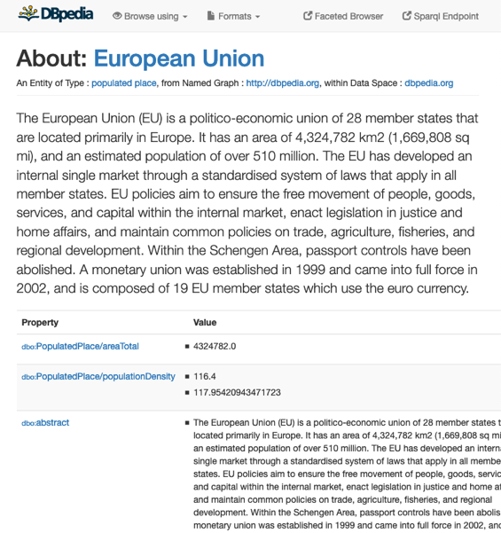
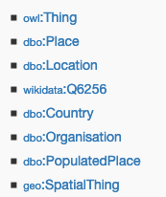
Existing KGs aren’t consistent ☹ [1]
Challenge 4: Reasoning and Inconsistencies
E.g.
Dbpedia Ontology:
dbo:Agent owl:disjointWith dbo:Place.
dbo:Country rdfs:subClassOf dbo:Place.
dbo:Organisation rdfs:subClassOf dbo:Agent.
[Bischof et al. 2014]

Slide 32
Challenge 4: Reasoning and Inconsistencies
important KGs don't use OWL and RDFS
Wikidata!
use "somewhat similar" properties:
wdt:P31 ~ rdf:type
wdt:P279 ~ rdfs:subClassOf
SELECT DISTINCT ?city ?Path WHERE {
?city wdt:P31/wdt:P279* wd:Q515.
?city wdt:P1082 ?population .
?city wdt:P17 wd:Q38 .
FILTER (?population > 1000000) }

Slide 33
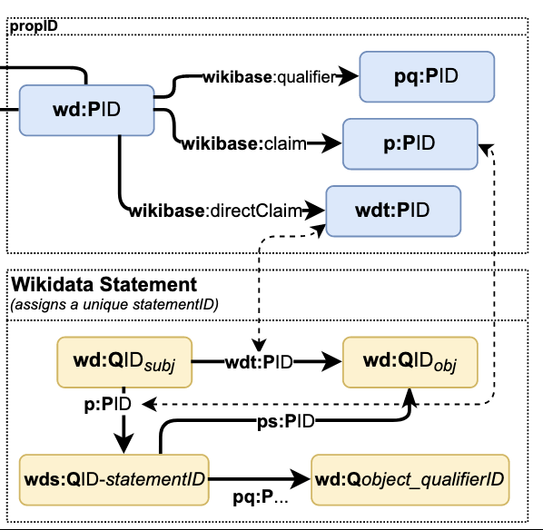
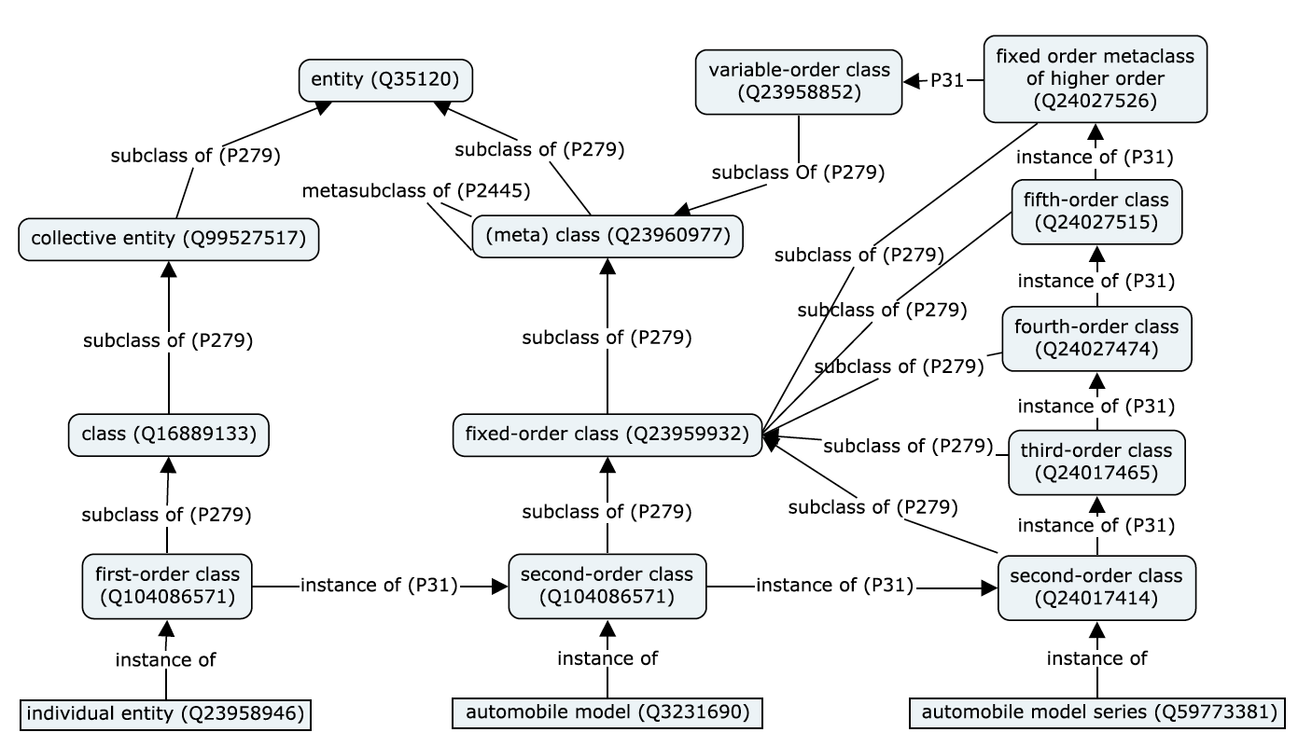
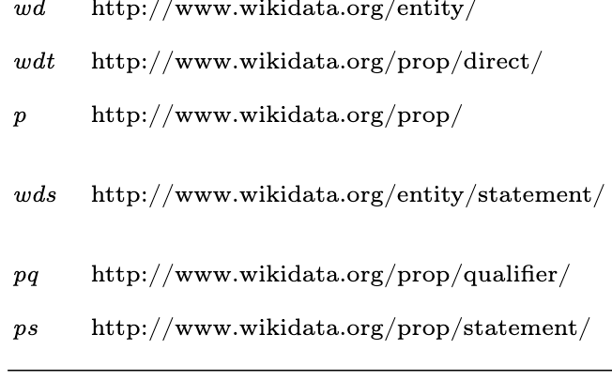
Challenge 4: Reasoning and Inconsistencies Prefixes can carry semantics (not only owl: and rdfs:) …
Wikidata metamodel "by prefixes":
[Haller et al., ESWC 2022]

Slide 34
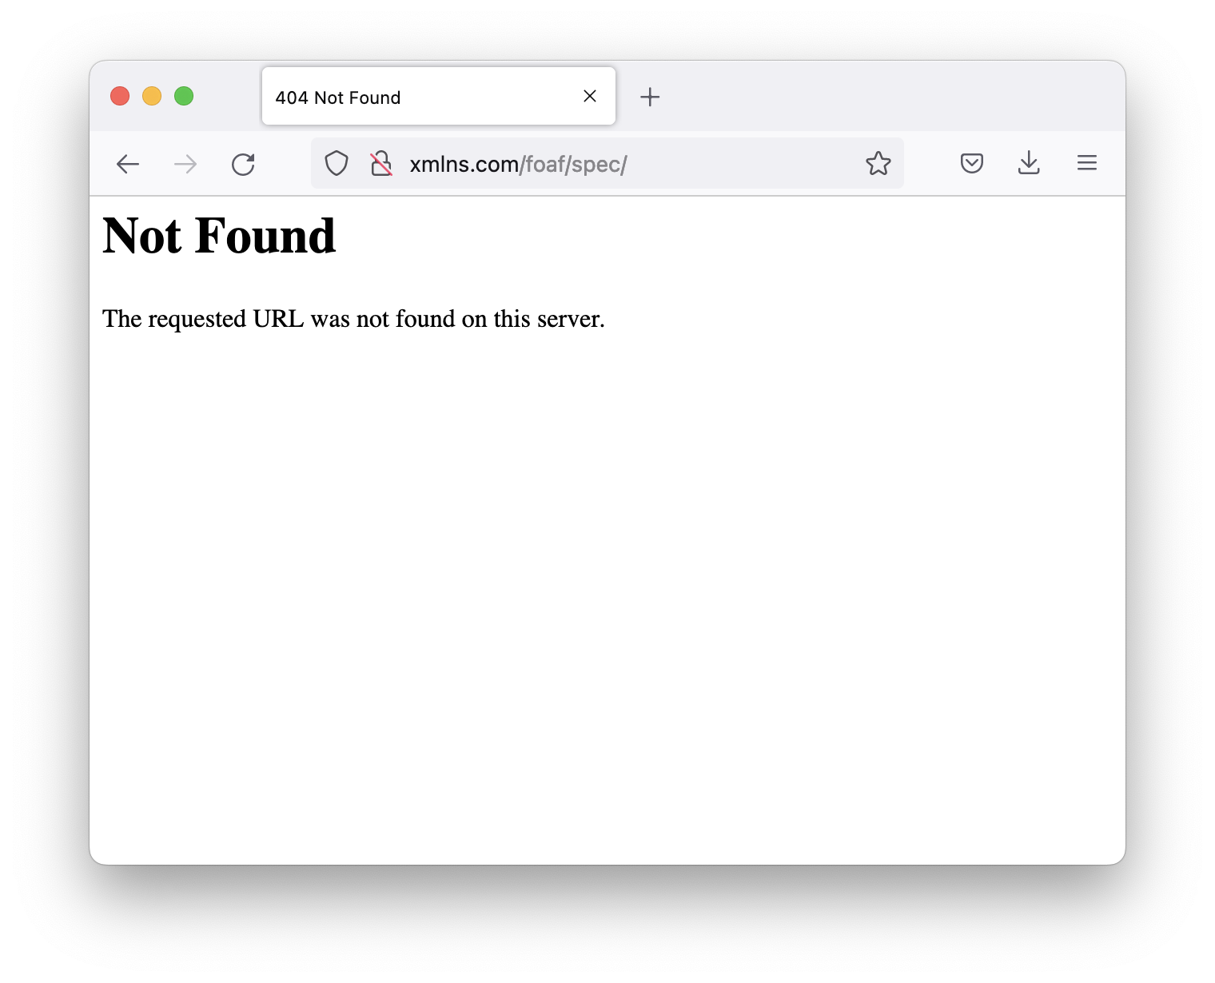
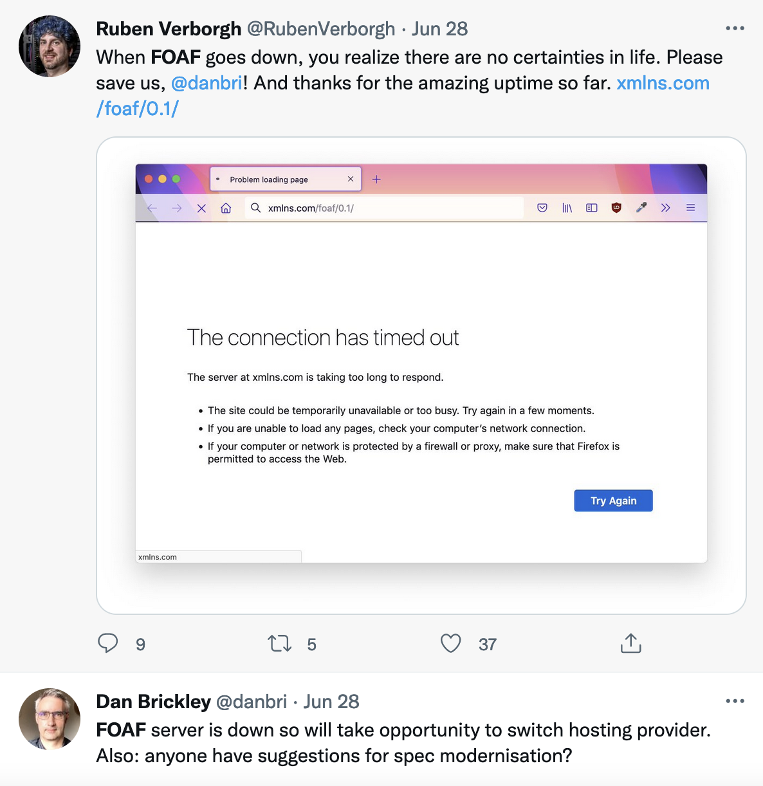
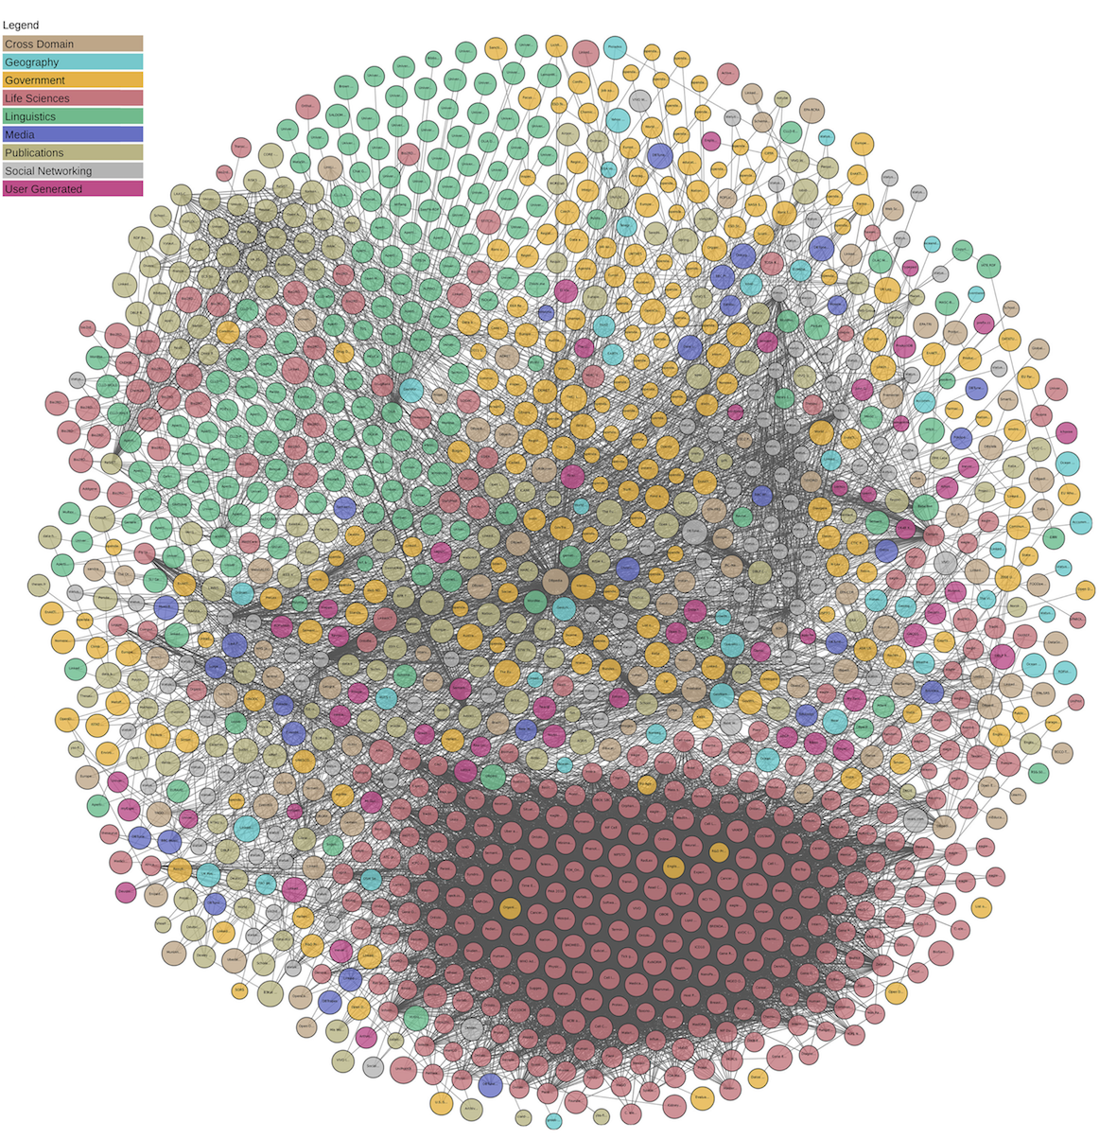
Challenge 5: Sustainability of RDF and OWL resources on the Web…
Vocabularies? FOAF:
Linked Open Data? [Polleres et al.2020, SWJ]:
"Among the mentioned 5435 resources in the 1281
"LOD"-tagged datasets on datahub.io, there are
only 1917 resources URLs that could be dereferenced."

Slide 35
What I've planned for today:
Basics:
Interlude – some words on syntax…
Practical SPARQL on examples querying Open KGs with SPARQL
Challenges/limitations of SPARQL over public endpoints
Bonus Material (time allowed or upon request):
Serve and query KGs for local processing – HDT
Addressing the SPARQL endpoint bottleneck – where are we?
Linked Data Fragments
Smart-KG
Wise-KG

Slide 36
(subjective, highly incomplete list of) References
Armin Haller, Axel Polleres, Daniil Dobriy, Nicolas Ferranti, Sergio José Rodríguez Méndez: An Analysis of Links in Wikidata. ESWC 2022: 21-38
Axel Polleres, Maulik Rajendra Kamdar, Javier D. Fernández, Tania Tudorache, and Mark A. Musen. A more decentralized vision for linked data. 11(1):101--113, January 2020. Semantic Web Journal (SWJ) 11(1):101-113, 2020.
Armin Haller, Javier D. Fernández, Maulik R. Kamdar, and Axel Polleres. What are links in linked open data? a characterization and evaluation of links between knowledge graphs on the web. ACM Journal of Data and Information Quality (JDIQ), 2(2):1–34, 2020.
Tobias Käfer, Jürgen Umbrich, Aidan Hogan, and Axel Polleres. Towards a dynamic linked data observatory. In WWW2012 Workshop on Linked Data on the Web (LDOW2012), Lyon, France, April 2012.
Javier D. Fernández, Miguel A. Martinez-Prieto, Claudio Gutiérrez, Axel Polleres, and Mario Arias. Binary RDF Representation for Publication and Exchange (HDT). Journal of Web Semantics (JWS), 19(2), 2013.
Ruben Verborgh, Miel Vander Sande, Pieter Colpaert, Sam Coppens, Erik Mannens, Rik Van de Walle: Web-Scale Querying through Linked Data Fragments. LDOW 2014
Ruben Verborgh, Miel Vander Sande, Olaf Hartig, Joachim Van Herwegen, Laurens De Vocht, Ben De Meester, Gerald Haesendonck, Pieter Colpaert: Triple Pattern Fragments: A low-cost knowledge graph interface for the Web. J. Web Semant. 37-38: 184-206 (2016)
O. Hartig and C. B. Aranda. 2016. Bindings-Restricted Triple Pattern Fragments. In ODBASE 2016. 762–779
S. Clearly-Strange, Is Happening At ISWS. (2022), check what you can find about http://dbpedia.org/resource/Bertinoro https://w3id.org/framester/isws2022_th.owl#hauntedBy some entity, at this SPARQL endpoint: http://etna.istc.cnr.it/framester2/sparql and get all the info you are able to find about it!
Amr Azzam, Javier D. Fernández, Maribel Acosta, Martin Beno, and Axel Polleres. SMART-KG: Hybrid shipping for SPARQL querying on the web. In The Web Conference 2020, Taipei,Taiwan, 2020.
Amr Azzam, Christian Aebeloe, Gabriela Montoya, Ilkcan Keles, Axel Polleres, and Katja Hose. WiseKG: Balanced Access to Web Knowledge Graphs. In The Web Conference 2021, pages 1422–--1434, Ljubljana, Slovenia, 2021. ACM / IW3C2.
T. Minier, H. Skaf-Molli, and P. Molli. 2019. SaGe: Web Preemption for Public SPARQL Query Services. In WWW 2019. 1268–1278.

