Slide 1
Serving and Querying Large Knowledge Graphs on the Web – Bonus Material
ISWS 2022
Axel Polleres
referring to joint work with: Javier Fernández, Amr Azzam, Maribel Acosta, Martin Beno, Vadim Savenkov, Katja Hose, Christian Aebeloe, Gabriela Montoya
Thanks to Javier and Amr for some of the slides!
JULY 2022

Slide 2
What I've planned for today:
Part 1:
Interlude
Practical SPARQL on examples querying Open KGs
Challenges/limitations of SPARQL over public endpoints
Part 2:
Serve and query KGs for local processing – HDT
Addressing the SPARQL endpoint bottleneck – where are we?
Linked Data Fragments
Smart-KG
Wise-KG

Slide 3
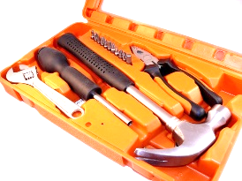
HDT - a Linked Data hacker toolkit
Highly compact serialization of RDF
W3C member submission 2011: https://www.w3.org/Submission/HDT/
Allows fast RDF retrieval in compressed space (without prior decompression)
Includes internal indexes to solve basic queries with small memory footprint.
Very fast on basic queries (triple patterns), x 1.5 faster than Virtuoso, Jena, RDF3X.
Supports FULL SPARQL as the compressed backend store of Jena, with an efficiency on the same scale as current more optimized solutions
Challenges:
Publisher has to pay a bit of overhead to convert the RDF dataset to HDT (but then it is ready to consume efficiently!)
Inefficient for live updates
837 M.triples 122 GB
 | NT + gzip 9.6 GB | HDT 13 GB
▷Slightly more but you can query!
Notes:
Put image of sparql availability in sparqles

Slide 4
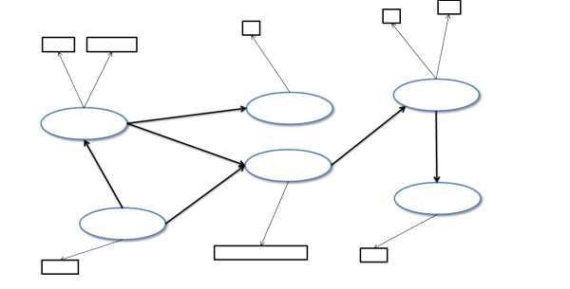
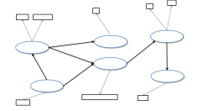
HDT (Header-Dictionary-Triples) Overview
Header
RDF
metadata describing the RDF dataset
Dictionary
ab..
bu ..
1 aa..
2 ab..
3 bu ..
Mapping between IDs 🡨🡪elements in the dataset
aa..
Triples
3
2
Structure of the data after the ID replacement
1
Notes:
Due to time restrictions I can’t go into details of HDT, I will give you a brief overview of the idea. An RDF dataset is converted to three components which give the name to HDT: Header, Dictionary and Triples
- A header, including logical and physical metadata describing the RDF data set. It
serves as an entrance point to the information on the data set.
- A dictionary, organizing all the identifiers in the RDF graph. It provides a catalog
of the information entities in the RDF graph with high levels of compression.
- A set of triples, which comprises the pure structure of the underlying RDF graph
while avoiding the noise produced by long labels and repetitions.

Slide 5
HDT – Header information:
$ hdtInfo wikidata20210305.hdt
<file://[latest-all.ttl.gz]> <http://www.w3.org/1999/02/22-rdf-syntax-ns#type> <http://purl.org/HDT/hdt#Dataset> .
<file://[latest-all.ttl.gz]> <http://www.w3.org/1999/02/22-rdf-syntax-ns#type> <http://rdfs.org/ns/void#Dataset> .
<file://[latest-all.ttl.gz]> <http://rdfs.org/ns/void#triples> "14578569927" .
<file://[latest-all.ttl.gz]> <http://rdfs.org/ns/void#properties> "38867" .
<file://[latest-all.ttl.gz]> <http://rdfs.org/ns/void#distinctSubjects> "1625057179" .
<file://[latest-all.ttl.gz]> <http://rdfs.org/ns/void#distinctObjects> "2538585808" .
<file://[latest-all.ttl.gz]> <http://purl.org/HDT/hdt#formatInformation> "_:format" .
_:format <http://purl.org/HDT/hdt#dictionary> "_:dictionary" .
_:format <http://purl.org/HDT/hdt#triples> "_:triples" .
<file://[latest-all.ttl.gz]> <http://purl.org/HDT/hdt#statisticalInformation> "_:statistics" .
<file://[latest-all.ttl.gz]> <http://purl.org/HDT/hdt#publicationInformation> "_:publicationInformation" .
_:publicationInformation <http://purl.org/dc/terms/issued> "2021-04-24T12:42Z" .
_:dictionary <http://purl.org/dc/terms/format> <http://purl.org/HDT/hdt#dictionaryFour> .
_:dictionary <http://purl.org/HDT/hdt#dictionarynumSharedSubjectObject> "1451915667" .
_:triples <http://purl.org/dc/terms/format> <http://purl.org/HDT/hdt#triplesBitmap> .
_:triples <http://purl.org/HDT/hdt#triplesnumTriples> "14578569927" .
_:triples <http://purl.org/HDT/hdt#triplesOrder> "SPO" .
_:statistics <http://purl.org/HDT/hdt#hdtSize> "159085366343" .
Page 5

Slide 6
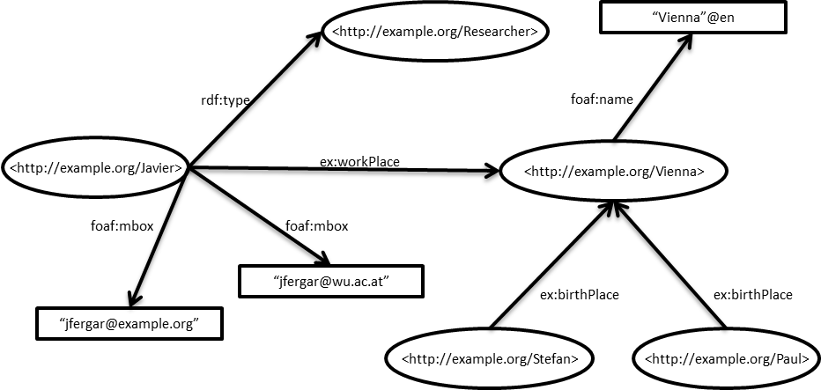
Dictionary+Triples partition
Hint: imagine HDT for now as "SPO-sorted Turtle"
ex:Vienna foaf:name "Vienna"@en.
ex:Javier ex:workPlace ex:Vienna;
foaf:mbox "jfergar@example.org",
"jfergar@wu.ac.at";
rdf:type ex:Researcher .
ex:Paul ex:birthplace ex:Vienna.
ex:Stefan ex:birthplace ex:Vienna.
Notes:
Applications managing huge RDF commonly represent the dataset
using the vocabulary + triples partition

Slide 7
Dictionary+Triples partition
1
2
3
4
5
6
7
8
9
10
11
12
13
ex:Vienna
ex:Javier>
ex:Paul>
ex:Researcher
ex:Stefan
ex:birthPlace
ex:workPlace
foaf:mbox
foaf:name
rdf:type
“jfergar@example.org”
“jfergar@wu.ac.at”
“Vienna”@en
4
13
10
9
2
7
1
8
8
12
6
6
11
5
3
Page 7
Notes:
Applications managing huge RDF commonly represent the dataset
using the vocabulary + triples partition

Slide 8
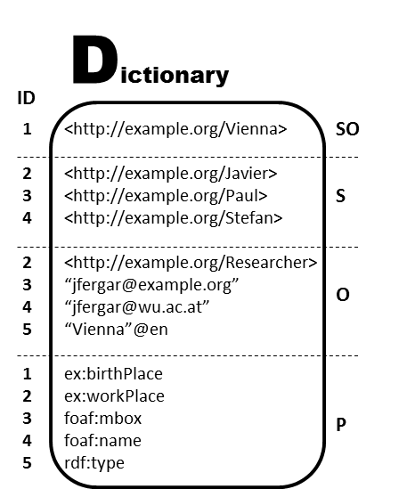
Dictionary (in practice)
1
2
3
4
5
6
7
8
9
10
11
12
13
ex:Vienna
ex:Javier
ex:Paul
ex:Researcher
ex:Stefan
ex:birthPlace
ex:workPlace
foaf:mbox
foaf:name
rdf:type
“jfergar@example.org”
“jfergar@wu.ac.at”
“Vienna”@en
i.e.,dictionary is not exactly "SPO-sorted" but "SO-S-O-P"-sorted
Split by role
Prefix-Based compression for each role
Efficient ID+String operations

Slide 9
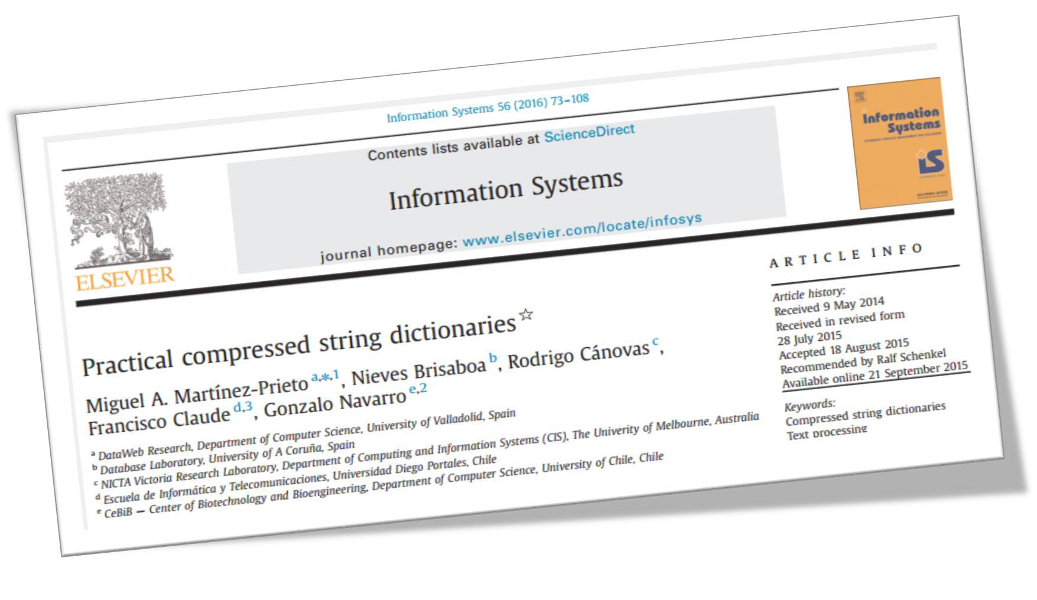
Dictionary compression: Plain Front Coding (PFC)
relies on sophisticated prefix-based compression
Each string is encoded with two values
An integer representing the number of characters shared with the previous string
A sequence of characters representing the suffix that is not shared with the previous string
A
An
Ant
Antivirus
Antivirus Software
Best
(0,a) (1,n) (2,t) (3,ivirus) (9, Software) (0,Best)
Page 9

Slide 10
Bitmap Triples Encoding
Bitmap Triples, idea a bit similar to "sorted Turtle":
ex:Vienna foaf:name "Vienna"@en.
ex:Javier ex:workPlace ex:Vienna;
foaf:mbox "jfergar@example.org",
"jfergar@wu.ac.at";
rdf:type ex:Researcher .
ex:Paul ex:birthplace ex:Vienna.
ex:Stefan ex:birthplace ex:Vienna.
1 4 5.
2 2 1;
3 3,
4;
5 2.
3 1 1.
4 1 1.
subjects
Predicates:
Objects:
We index the bitsequences to provide a SPO index

Slide 11
Bitmap Triples Encoding
Bitmap Triples:
subjects
S P O
S P ?
S ? O
S ? ?
? ? ?
Predicates:
Objects:
E.g. retrieve (2,5,?)
Find the position of the first and second ‘1’-bits in B_{p} (select)
Binary search on the list of predicates S_{p} in this range, looking for 5
Note that such predicate 5 is in position 4 of S_{p}
Find the position of the fourth ‘1’-bit in B_{o} (select) → 5
i.e. retrieve 5th value of S_{o} → 2
Notes:
Como vimos en ocasiones los ceros que delimitaban las listas en CT llevaba un sobrecoste, y además no tiene mucho sentido mezclar datos con separadores, si podemos marcar los separadores en otra estructura más pequeña. Pues es lo que realizamos, eliminamos los delimitadores de cada lista de las secuencias que teníamos antes Sp y So. Y tenemos dos bitmaps, Bp y So que nos indican estos separadores pero con bits. Antes teníamos separadores de enteros, ahora tenemos separadores de bits. Estos bits me indican con 0 que la lista continúa, y con 1 que ese elemento es final de lista. Por ejemplo el sujeto 1, con el 4 y es final de lista, y con el objeto 5 y es final de lista. El sujeto 2 con el predicado 2, (como hay un 0 en la misma posición en Bp hay más predicados), es decir el sujeto 2 también está con el 3, y también con 5, y ya no hay más predicados asociados con 2. Y de manera similar en los objetos.
En el fondo es similar a representar un árbol por cada sujeto, como se muestra en la figura, y marcar con un 1 el último hijo. (sería equivalente marcar el primero)

Slide 12
On-the-fly indexes: HDT-FoQ (Focus-on-Querying indexes)
From the exchanged HDT to the functional HDT-FoQ:
Publish and Exchange HDT (i.e., B_{p},S_{p},B_{o},S_{o} from last slide) and
At the consumer:
Process | Type of Index | Patterns
index the bitsequences | Subject SPO | SPO, SP?, S??, S?O, ???
index the position of each predicate (just a position list) | Predicate PSO | ?P?, ?PO
index the position of each object | Object OPS | ??O
1
2
separate index
file , created by consumer client (or published as as well)
3
Martínez-Prieto, M., M. Arias, and J. Fernández (2012). Exchange and Consumption of Huge RDF Data. In Proc. of the 9th Extended Semantic Web Conference (ESWC), pp. 437-452.

Slide 13
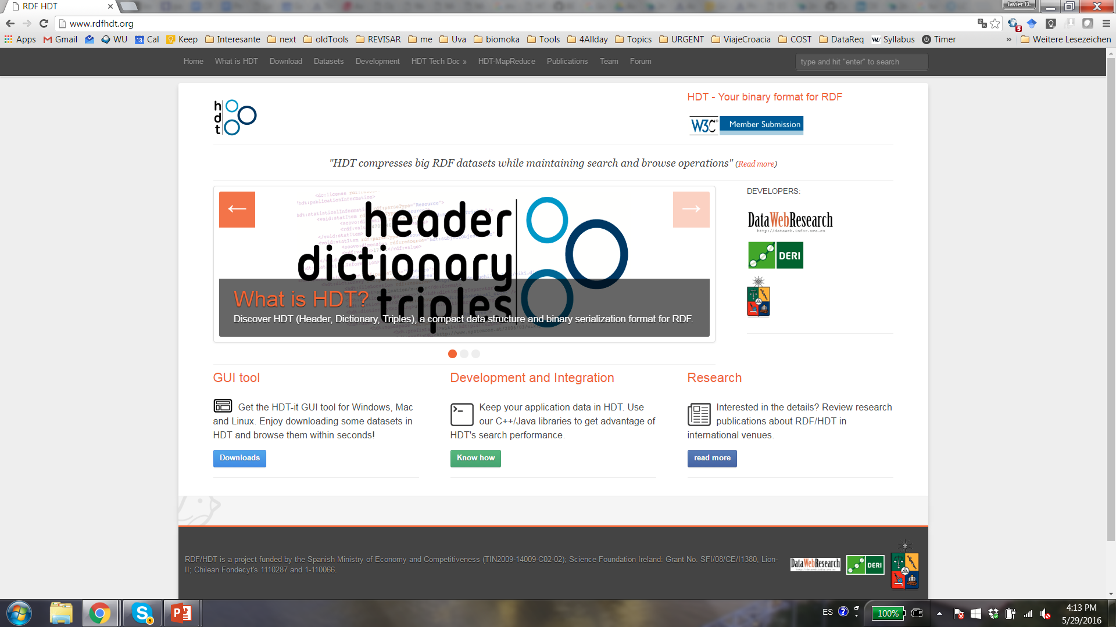
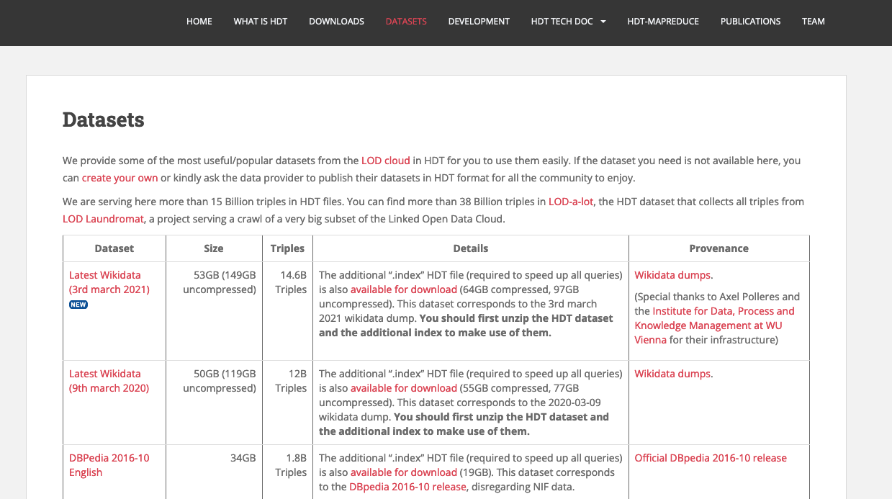
rdfhdt.org community
Notes:
Libraries, link to source code, datasets, updated specifications

Slide 14
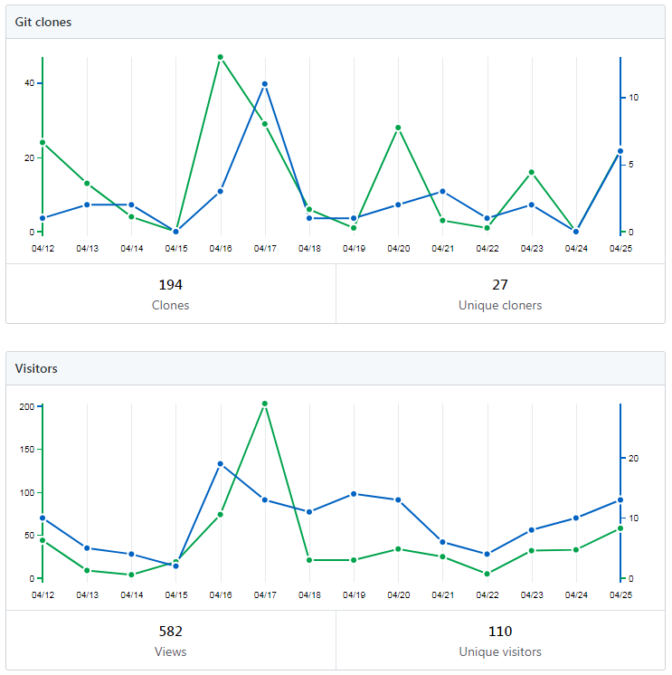
https://github.com/rdfhdt C++ and Java tools
HDT-cpp
(+python!)
https://github.com/Callidon/pyHDT/
Notes:
Libraries, link to source code, datasets, updated specifications

Slide 15
Results
Data is ready to be consumed 10-15x faster than loading in an RDF triple store
HDT << any other RDF format || RDF engine
Competitive query performance.
Very fast on triple patterns, x 1.5 faster (Virtuoso, RDF3x).
Integration with Jena
Joins on the same scale of existing solutions (Virtuoso, RDF3x).
Notes:
And some results: Data is ready to be consumed ten to fifteen times faster. This means that the consumer has all the engine ready, all the indexes loaded quickly. The following strange expression just means that HDT takes much less space than any other format or RDF engine (to the best of our knowledge), that it is still slightly bigger than gzip but just for exchange, in any case we can also compress HDT and be even more compressed than gzip.
Moreover the lightweight the client processing and we are competitive at query performance: one point five times faster on triple patterns over existing solutions, and joins on the same scale, with still much room for optimizations, in particular on query planning for complex questions.

Slide 16
Hands-on example: trying out the query that timed out on https://w.wiki/4mTj
$ls
wikidata20210305.hdt
wikidata20210305.hdt.index.v1-1
$ time hdtsparql.sh wikidata20210305.hdt "$(<large_classes.rq)"
C
http://www.wikidata.org/entity/Q846110
http://www.wikidata.org/entity/Q69529214
http://www.wikidata.org/entity/Q1195942
http://www.wikidata.org/entity/Q55488
http://www.wikidata.org/entity/Q18691601
http://www.wikidata.org/entity/Q372363
http://www.wikidata.org/entity/Q174782
http://www.wikidata.org/entity/Q513550
http://www.wikidata.org/entity/Q88865432
http://www.wikidata.org/entity/Q22652
Took some ~10min on my VM (92GB RAM)

Slide 17
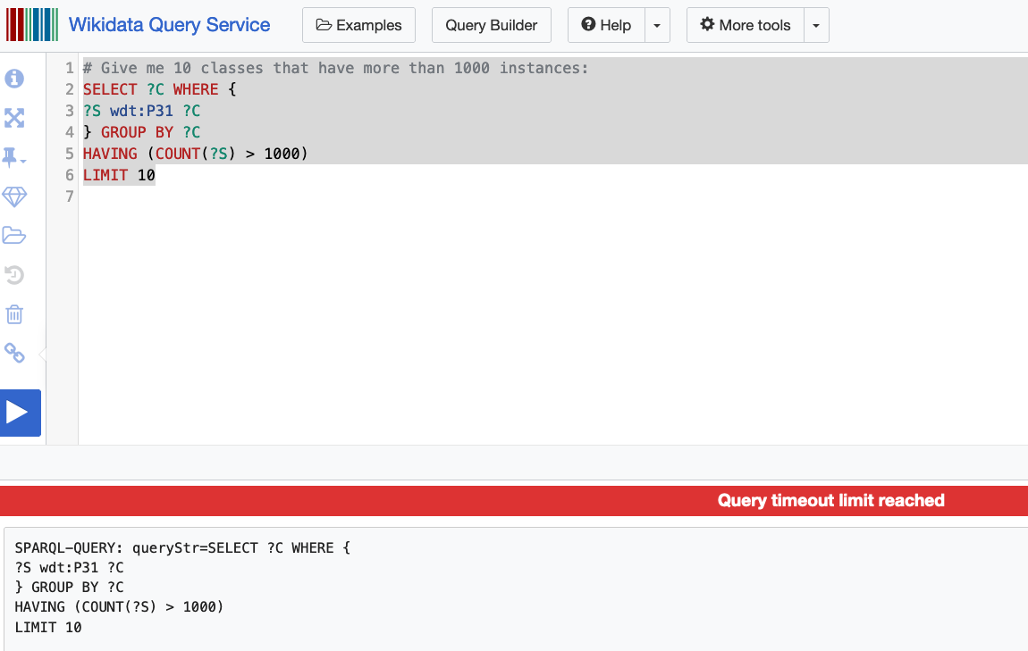
Challenge 3: Scalability of SPARQL endpoints? - It's often too expensive to host Open KGs
Challenge 3.1: serve complex/long running queries to single users
Challenge 3.2: serve many queries to many users concurrently

Slide 18
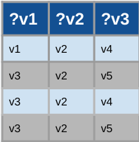
Querying KGs with SPARQL "abstractly": What happens if you have many clients?
KG = RDF Graph
A set of RDF triples (<Subject, Predicate, Object>)
can be interpreted as edge-labeled directed graph.
SPARQL
Standard query language for RDF (W3C recommendation).
Subgraph pattern matching
→ returns variable bindings (table)

Slide 19
Server Solution: SPARQL Endpoint
Client:
Network:
Server:
SELECT ?v1 ?v2 ?v3
WHERE { ?v1 owl:starring "Brad Pitt" .
?v1 rdfs:label ?v2;
?v1 dbo:director ?v3. }
SPARQL Endpoint
C1
"Query Shipping"
Query Shipping
19
Notes:
A common way to expose open RDF Graphs is that each data publisher owns SPARQL endpoint, while RDF stores offer server-side solutions that have good performance in single queries. The client submits a SPARQL query to the server that executes it over RDF data store and then the server returns the query results back to the client.

Slide 20
Server Solution: SPARQL Endpoint
Client:
Network:
Server:
SPARQL Endpoint
C1
C2
C3
C4
C5
C6
C7
C8
"Query Shipping"
fails under concurrency
Query Shipping
20
Notes:
A common way to expose open RDF Graphs is that each data publisher owns SPARQL endpoint, while RDF stores offer server-side solutions that have good performance in single queries. The client submits a SPARQL query to the server that executes it over RDF data store and then the server returns the query results back to the client.

Slide 21
Alternative Client Solution: Data Dump
Client:
Network:
Server:
SPARQL Endpoint
C1
C2
C3
C4
C5
C6
C7
C8
Data Shipping
might add prohibitive load on the network
Query Shipping
21
Notes:
A common way to expose open RDF Graphs is that each data publisher owns SPARQL endpoint, while RDF stores offer server-side solutions that have good performance in single queries. The client submits a SPARQL query to the server that executes it over RDF data store and then the server returns the query results back to the client.

Slide 22
Alternative Client Solution: Data Dump
Client:
Network:
Server:
SPARQL Endpoint
C1
C2
C3
HDT
HDT
HDT
C4
C5
HDT
C6
C7
C8
Data Shipping – using HDT
might add prohibitive load on the network
Query Shipping
22
Notes:
A common way to expose open RDF Graphs is that each data publisher owns SPARQL endpoint, while RDF stores offer server-side solutions that have good performance in single queries. The client submits a SPARQL query to the server that executes it over RDF data store and then the server returns the query results back to the client.

Slide 23
Variants in between: What are the current mitigations to the availability problem of the open RDF KGs?
Linked Data Fragment Framework(LDF) Proposed to design new mixes of trade-offs.
High Availability
High Client cost
Low Server Cost
High Availability
Low Client Cost
High Server Cost
Low Availability
Low Client Cost
High Server Cost
Triple Pattern Fragment (TPF)
ISWC 2014
Data
Dump
SPARQL
Endpoint
Hybrid Shipping

Slide 24
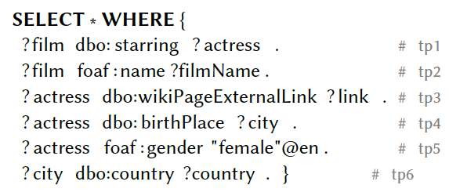
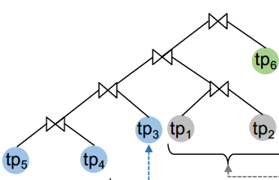
Triple Pattern Fragments :
Idea:
Execute triple patterns on the server
Let the clients do JOINs etc. by themselves.
less footprint on the server, only triple patterns and intermediate results communicated.
can still have significant overhead by large intermediate results
C1
HDT
?film | ?act
… | …
… | …
… | …
… | …
R. Verborgh, M. V. Sande, O. Hartig, J. Van Herwegen, L. De Vocht, B. De Meester,
G. Haesendonck, and P. Colpaert. 2016. Triple Pattern Fragments: A low-cost
knowledge graph interface for the Web. J. Web Semant. 37-38 (2016), 184–206.

Slide 25
Binding-restricted Triple Pattern Fragments :
Idea:
ship intermediate bindings with TP and let server only return results matching results
→ smaller intermediate results, "join work" distributed between client and server
C1
HDT
?film | ?act
… | …
?film
…
…
…
…
O. Hartig and C. B. Aranda. 2016. Bindings-Restricted Triple Pattern Fragments.
In ODBASE 2016. 762–779

Slide 26
Variants in between: What are the current mitigations to the availability problem of the open RDF KGs?
Linked Data Fragment Framework(LDF) Proposed to design new mixes of trade-offs.
High Availability
High Client cost
Low Server Cost
High Availability
Low Client Cost
High Server Cost
Mod. Availability
Low Client Cost
High Server Cost
Low Availability
Low Client Cost
High Server Cost
Triple Pattern Fragment (TPF)
ISWC 2014
Data
Dump
SaGe
WebConf 2019
SPARQL
Endpoint
Hybrid Shipping

Slide 27
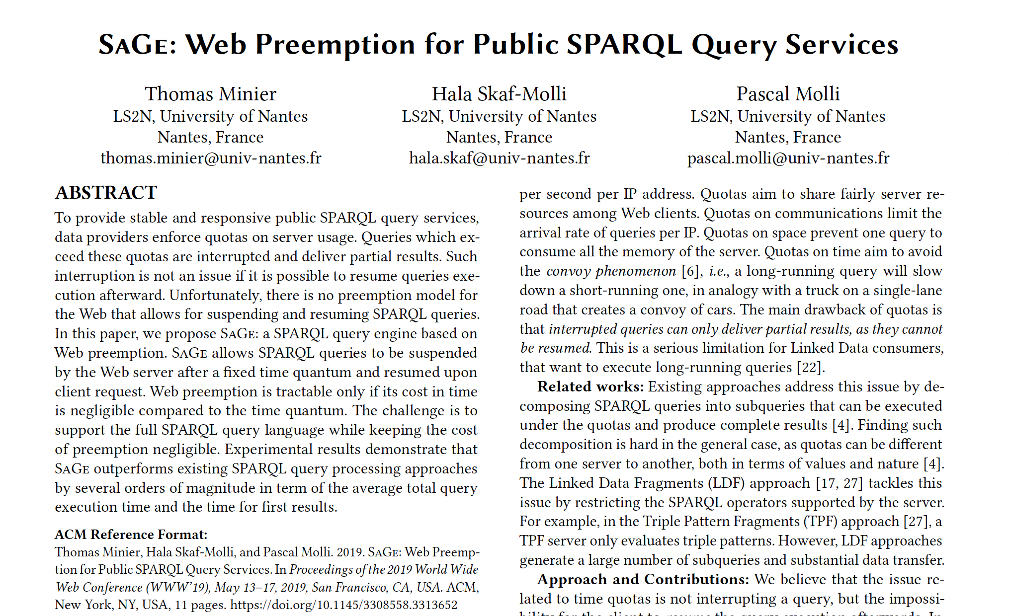
Slightly different approach: SaGe
Idea: keep working on the server, but improve fair allocation of resources,
i.e. interrupt resource-intensive queries …
BGP, UNION, FILTER are executed fully at the server as "interuptable iterators"
… can be stopped and sent back to clients with results "so far"
… while giving clients the possibility to resume them later on
server suspends running query after a fixed quantum of time and resume the next waiting query
more complex operations are done on the client (e.g. OPTIONAL, SERVICE, ORDER BY, GROUP BY, DISTINCT, MINUS, FILTER EXIST and aggregations)

Slide 28
Variants in between: What are the current mitigations to the availability problem of the open RDF KGs?
Linked Data Fragment Framework(LDF) Proposed to design new mixes of trade-offs.
High Availability
High Client cost
Low Server Cost
High Availability
Low Client Cost
High Server Cost
Mod. Availability
Low Client Cost
High Server Cost
Low Availability
Low Client Cost
High Server Cost
smart-KG
WebConf 2020
Triple Pattern Fragment (TPF)
ISWC 2014
Data
Dump
SaGe
WebConf 2019
SPARQL
Endpoint
"Partition" Shipping

Slide 29
Smart-KG
Idea:
Partition graph by "predicate families", i.e. characteristic sets,
create 1 HDT per family
Combine TPF with partition shipping
Client:
Network:
Server:
RDF Graph G
KG Partitions (separate HDTs)
C1
Smart-KG Server
(TPF + Partitions Server)

Slide 30
smart-KG server: Family Generator
Partition Generator (PG): Upon loading a graph G, decompose it into partitions G1,...,Gm, one per "predicate family".
“Angelina Jolie
“Emma Watson”
"BradPitt"
"Oklahoma"
name
birthPlace
name
“Los Angeles”
name
spouse
worksIn
worksIn
birthPlace
Brad
“Paris”
spouse
Angelina
Emma
almaMater
almaMater
“Brad Pitt”
“Oxford University”
“University of Missouri”
F1: {name, birthPlace, almaMater, spouse}
F2: {name, spouse,worksIn}
F3: {name, birthPlace,almaMater, worksIn}

Slide 31
smart-KG server: Family Generator
Partition Generator (PG): Upon loading a graph G, decompose it into partitions G1,...,Gm, one per "predicate family"… and convert these to HDTs.
Family1.hdt
Family2.hdt
Family3.hdt
"Brad Pitt"
Oklahoma
"Angelina Jolie"
"Emma Watson”
name
birthPlace
name
name
Angelina
birthPlace
Paris
spouse
Emma
birthPlace
Brad
Los Angeles
Angelina
almaMater
almaMater
spouse
WorksIn
University
of Missouri
Oxford University
Brad
Los Angeles

Slide 32
Smart-KG:
Simplified client Query processing:
Client decomposes BGPs into "stars"
retrieves relevant information from server to make a query plan
retrieves and joins matching partitions one by one
(use TPF for 1-triple patterns)
F?:{starring, name}
F?:{wikiPageExtLink, birthPlace, gender}
KG Partitions (separate HDTs)
C1
TPF

Slide 33
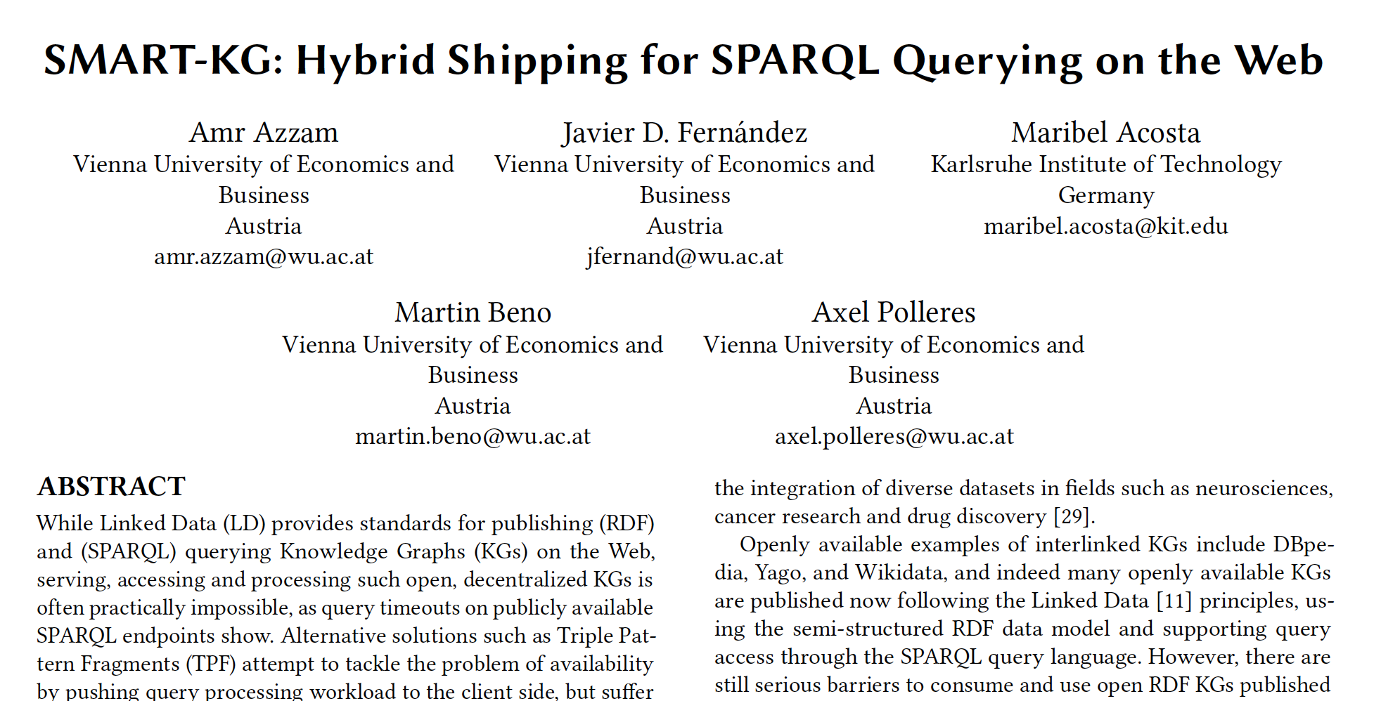
Smart-KG:
Further details, cf. our paper:
predicate-restricted families, i.e. pruning
too rare or
too common
predicates for partitioning.
Example: for DBpedia, a naive partitioning would create +600k partially very large families, which are unfeasible to serve.
partition caching

Slide 34
Experiments:
server, 384 GB RAM
up to 80 clients, 32 RAM
1 GBit/s network (limited to 20Mbit/s per client
WatDiv up to 1B triples, up to 10joins
DBpedia, 12 random BPGs from LSQ

Slide 35
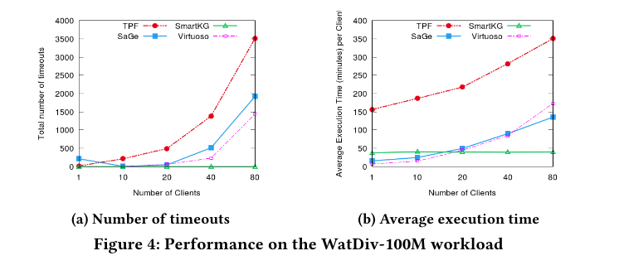
Overall Query Performance
Increasing Number of Clients
100M Watdiv

Slide 36
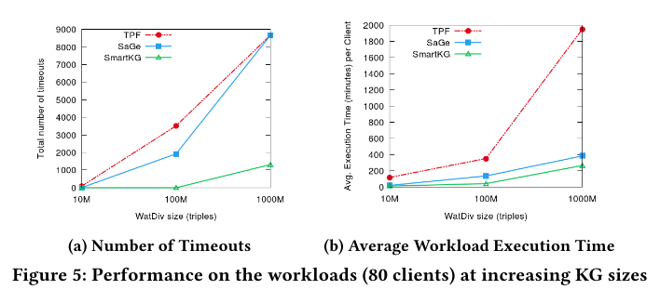
Overall Query Performance
Increasing KG size

Slide 37
Resources Consumption
Server Network & CPU & RAM

Slide 38
Next Step/Extension:
execute star-patterns directly on the server (resources allowed)
… using an extension of TPF called SPF…
or on the client using SmartKG…
… based on comparing COST models for client and server execution, taking into account current server load:
WiseKG (WebConf 2021)

Slide 39
Challenge 3: Scalability of SPARQL endpoints? - It's often too expensive to host Open KGs
Challenge 3.1: serve complex/long running queries to single users
Challenge 3.2: serve many queries to many users concurrently
Summary: HDT helps ☺
more ideas for improvements, e.g.:
- peer-to-peer?
- optimize partitioning (based onquery logs?)

Slide 40
References
Armin Haller, Axel Polleres, Daniil Dobriy, Nicolas Ferranti, Sergio José Rodríguez Méndez: An Analysis of Links in Wikidata. ESWC 2022: 21-38
Axel Polleres, Maulik Rajendra Kamdar, Javier D. Fernández, Tania Tudorache, and Mark A. Musen. A more decentralized vision for linked data. 11(1):101--113, January 2020. Semantic Web Journal (SWJ) 11(1):101-113, 2020.
Armin Haller, Javier D. Fernández, Maulik R. Kamdar, and Axel Polleres. What are links in linked open data? a characterization and evaluation of links between knowledge graphs on the web. ACM Journal of Data and Information Quality (JDIQ), 2(2):1–34, 2020.
Tobias Käfer, Jürgen Umbrich, Aidan Hogan, and Axel Polleres. Towards a dynamic linked data observatory. In WWW2012 Workshop on Linked Data on the Web (LDOW2012), Lyon, France, April 2012.
Javier D. Fernández, Miguel A. Martinez-Prieto, Claudio Gutiérrez, Axel Polleres, and Mario Arias. Binary RDF Representation for Publication and Exchange (HDT). Journal of Web Semantics (JWS), 19(2), 2013.
Ruben Verborgh, Miel Vander Sande, Pieter Colpaert, Sam Coppens, Erik Mannens, Rik Van de Walle: Web-Scale Querying through Linked Data Fragments. LDOW 2014
Ruben Verborgh, Miel Vander Sande, Olaf Hartig, Joachim Van Herwegen, Laurens De Vocht, Ben De Meester, Gerald Haesendonck, Pieter Colpaert: Triple Pattern Fragments: A low-cost knowledge graph interface for the Web. J. Web Semant. 37-38: 184-206 (2016)
O. Hartig and C. B. Aranda. 2016. Bindings-Restricted Triple Pattern Fragments. In ODBASE 2016. 762–779
Amr Azzam, Javier D. Fernández, Maribel Acosta, Martin Beno, and Axel Polleres. SMART-KG: Hybrid shipping for SPARQL querying on the web. In The Web Conference 2020, Taipei,Taiwan, 2020.
Amr Azzam, Christian Aebeloe, Gabriela Montoya, Ilkcan Keles, Axel Polleres, and Katja Hose. WiseKG: Balanced Access to Web Knowledge Graphs. In The Web Conference 2021, pages 1422–--1434, Ljubljana, Slovenia, 2021. ACM / IW3C2.
G. Aluç, O. Hartig, M. Tamer Özsu, and K. Daudjee. 2014. Diversified Stress Testing of RDF Data Management Systems. In ISWC 2014. 197–212.
T. Neumann and G. Moerkotte. 2011. Characteristic sets: Accurate cardinality estimation for RDF queries with multiple joins. In ICDE 2011. 984–994.
T. Minier, H. Skaf-Molli, and P. Molli. 2019. SaGe: Web Preemption for Public SPARQL Query Services. In WWW 2019. 1268–1278.
Muhammad Saleem, Muhammad Intizar Ali, Aidan Hogan, Qaiser Mehmood, and Axel-Cyrille Ngonga Ngomo. 2015. LSQ: the linked SPARQL queries dataset. In Proc. of ISWC. Springer, 261–269.

