Slide 1



Privacy: Standards and Vocabularies for Transparency & Interoperability
Axel Polleres Joint work with: Piero Bonatti, Bert Bos, Stefan Decker, Javier D. Fernández, Sabrina Kirrane, Vassilios Peristeras, Rigo Wenning, Martin Kurze, Ben Whittam Smith & the members of the W3C Data Privacy Vocabularies and Controls CG

Slide 2
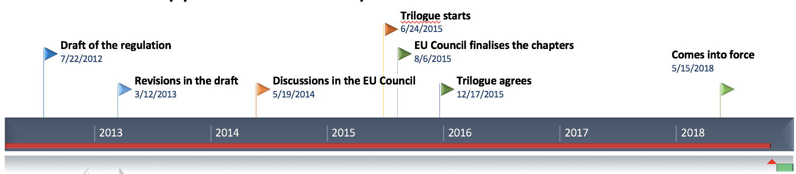

Background…

Slide 3

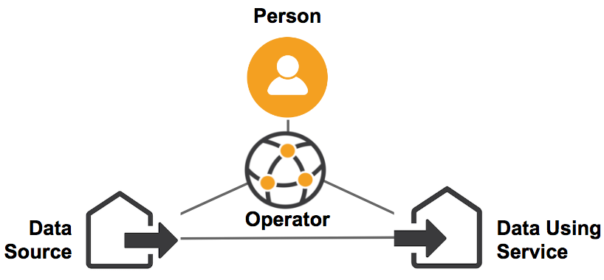
Use Cases for Transparency and Interoperability in Privacy:
Companies: Ensuring Regulatory Compliance for Companies
Regulators: Checking and enforcing GDPR
Data Subjects: Personal Data Markets: from “Data Collection” to “Data Donations”
Different roles have different use cases.

Slide 4
Components of Personal Data Processing
(not exhaustive…)
Rules/Policies
  Consent
  Regulations
Purpose
Processing
Storage
Personal Data (categories, formats)
$
✆
Geo
JSON
Notes:
Not exhaustive, but we have to make a start somewhere.

Slide 5

Regulatory Compliance for Big Companies
GDPR
Many heterogeneous systems that process personal data
Potentially many different places that store and hold consent
How to deal with GDPR data requests at scale?
How to prove to the regulator and to the customer that personal data has been handled in compliance to consent only?
Z
Log
Consent
X
P2
P1
Y
Consent
X
Consent
P3
P4
Y
?
P4
$$⊆$$
P2

Slide 6

Regulatory Compliance for Small Companies
GDPR
No resources to build their own compliance infrastructure
How to deal with GDPR data requests at scale?
How to prove to the regulator and to the customer that personal data has been handled in compliance to consent only?
Log
X
P2
Y
P1
Consent
P4
Y
P3
X
?
P4
$$⊆$$
P2

Slide 7

Semantic Interoperability boils down to:
- What is a common core to address these use cases?
- How do we benefit them all at the same time?
https://www.w3.org/2018/vocabws/report.html

Slide 8
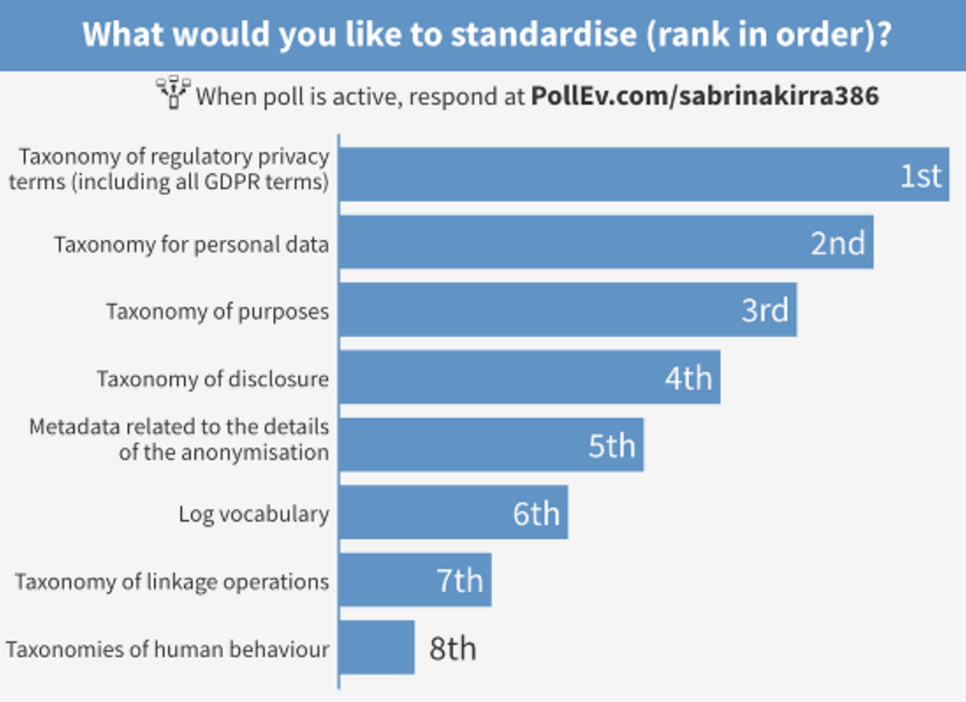
Semantic Interoperability boils down to:
- What is a common core to address these use cases?
- How do we benefit them all at the same time?
Rough workshop outcome / scoping:
Taxonomy of regulatory privacy terms (including all GDPR terms).
Taxonomy for personal data.
Taxonomy of purposes.
Taxonomy of disclosure/processing.
Metadata (e.g. related to processing details of anonymization)
Log vocabulary.
Taxonomy of linkage operations.
Taxonomies of human behavior.

Slide 9
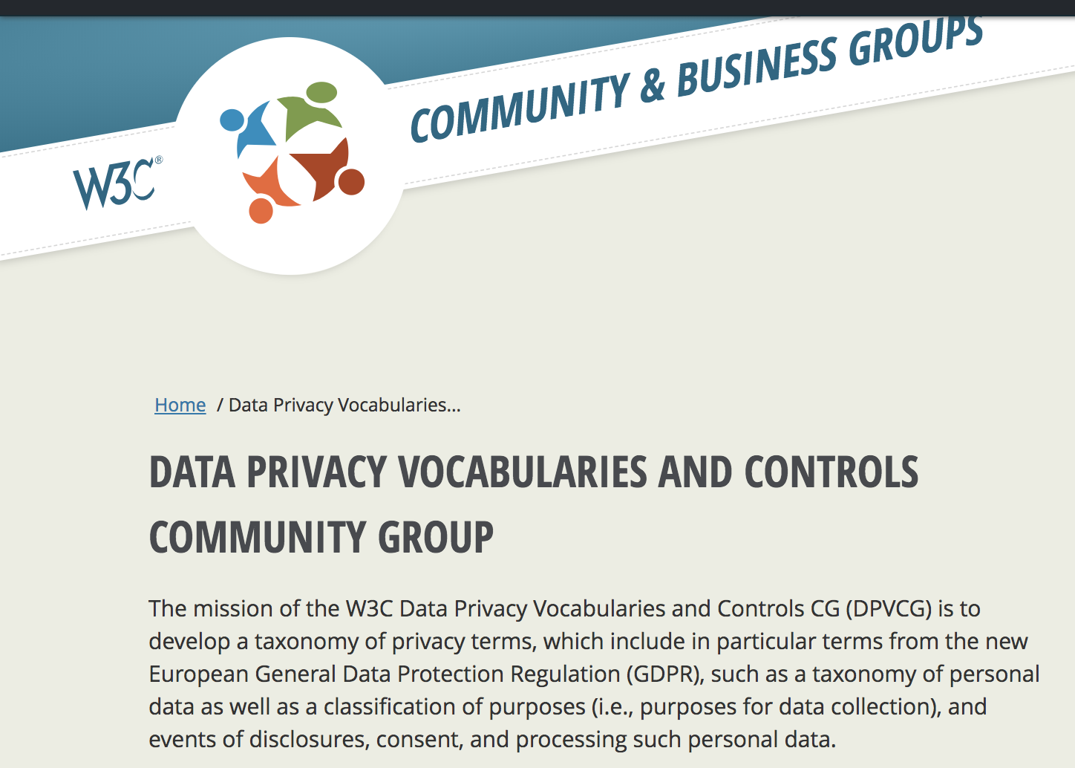
Semantic Interoperability boils down to:
- What is a common core to address these use cases?
- How do we benefit them all at the same time?
→ Foundation of a W3C Community Group (25th May 2018)
→ Collect concrete Use cases
→ Collect Existing Vocabularies
→ Align Core Vocabularies
Taxonomy of regulatory privacy terms (including all GDPR terms).
Taxonomy for personal data.
Taxonomy of purposes.
Taxonomy of disclosure/processing.
Metadata (e.g. related to processing details of anonymization)
Log vocabulary.
Taxonomy of linkage operations.
Taxonomies of human behavior.

Slide 10
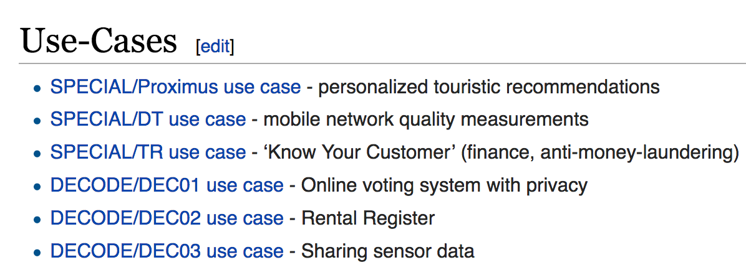
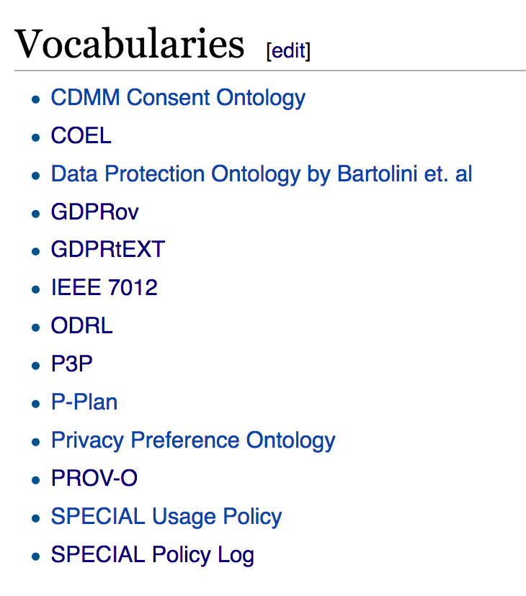
Semantic Interoperability boils down to:
- What is a common core to address these use cases?
- How do we benefit them all at the same time?
→ Foundation of a W3C Community Group (25th May 2018)
→ Collect concrete Use cases
→ Collect Existing Vocabularies
→ Align Core Vocabularies
…
We need your input!
→ Join DPVCG!
https://www.w3.org/community/dpvcg/wiki/Use-Cases,_Requirements,_Vocabularies

Slide 11
Starting Point:
Use Cases/Vocabularies from SPECIAL

Slide 12



Three Distinct Use Cases:
Know-Your-Customer services for the banking industry
Recommendation engine for subscribers
Service quality monitoring
12

Slide 13
One Compliance Solution:
Processing requires PERMISSIONING
Permissions must be compliant with the GDPR
Permissions must be compliant with Consent
i.e., COMPLIANCE is a logical operation
GDPR
P
C
P
13

Slide 14
What to Standardise:
Core Logic
Core Vocabularies
Compliance Services
Against What Criteria:
Completeness and Correctness:
Market adoption
14

Slide 15
SPECIAL‘s view on Core Interoperability Components:
← W3C ODRL/POE
Log/Transparency
SPECIAL Policy Log Vocabulary(SPLOG)
Rules/Policies:
SPECIAL Usage Policy Language (SPL)
  Purposes
  Processing
  Storage
  Data
  Recipients
Log
$
← W3C P3P
✆
← W3C ODRL
SPECIAL namespaces:
@prefix spl: <http://www.specialprivacy.eu/langs/usage-policy#>.
@prefix svpu: <http://www.specialprivacy.eu/vocabs/purposes#>.
@prefix svpr: <http://www.specialprivacy.eu/vocabs/processing#>.
@prefix svd: <http://www.specialprivacy.eu/vocabs/data#>.
@prefix svr: <http://www.specialprivacy.eu/vocabs/recipients#>.
@prefix splog: <http://www.specialprivacy.eu/langs/splog#>.
…
← W3C P3P,
(OASIS COEL?)
← W3C P3P
15

Slide 16
Use Cases/Vocabularies from SPECIAL: Example
The data controller will collect financial and judicial information from public sources and analyse it for “know your customer” purposes. This information will be stored on the controller’s servers and released to specific third parties.
16

Slide 17
Use Cases/Vocabularies from SPECIAL: Example (OWL)
ObjectIntersectionOf(
ObjectSomeValueFrom( spl:hasData
ObjectUnionOf( svd:Financial svd:Judicial ))
ObjectSomeValueFrom( spl:hasProcessing
ObjectUnionOf( tr:Collect-public svpr:Analyze ))
ObjectSomeValueFrom( spl:hasPurpose tr:KYC )
ObjectSomeValueFrom( spl:hasStorage
ObjectIntersectionOf(
ObjectSomeValueFrom(spl:hasLocation spl:ControllerServers) DataSomeValuesFrom( spl:durationInDays
DatatypeRestriction( xsd:integer xsd:mininclusive "0"^^xsd:integer ))
))
ObjectSomeValueFrom( spl:hasRecipient svr:AnyRecipient )
)
tr:KYC
svpu: finmg
tr: Collect-public
svpr: collect
17

Slide 18
Discussion…
How to structure those taxonomies?
What are the important use cases to cover?

Slide 19
Components of Personal Data Processing
(not exhaustive…)
Rules/Policies
  Consent
  Regulations
Purpose
Processing
Storage
Personal Data (categories, formats)
$
✆
Geo
JSON
Notes:
Not exhaustive, but we have to make a start somewhere.

Slide 20
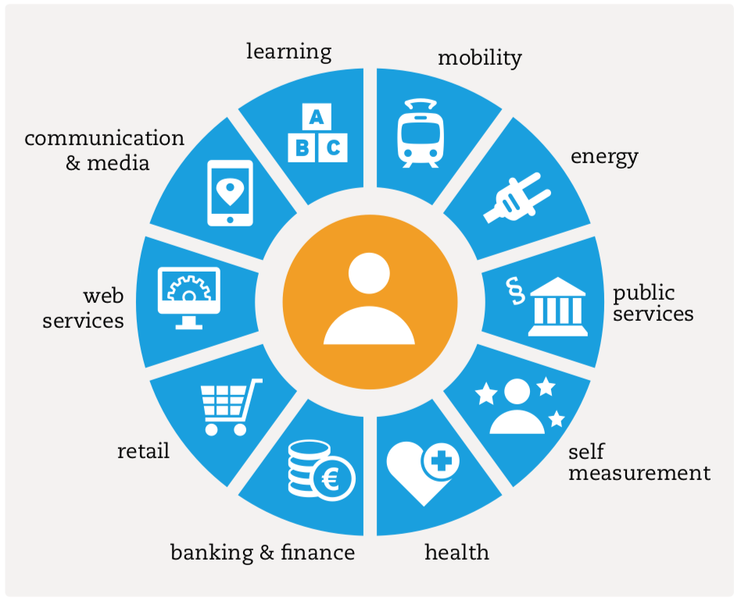
the MyData model
Geo
JSON
Personal Data (categories, formats)
The MyData model could be integrated on the “high level” it presents data as
human-centrically grouped into “areas of interest”
as well as how it’s
processed
and used
Quelle: MyData

Slide 21
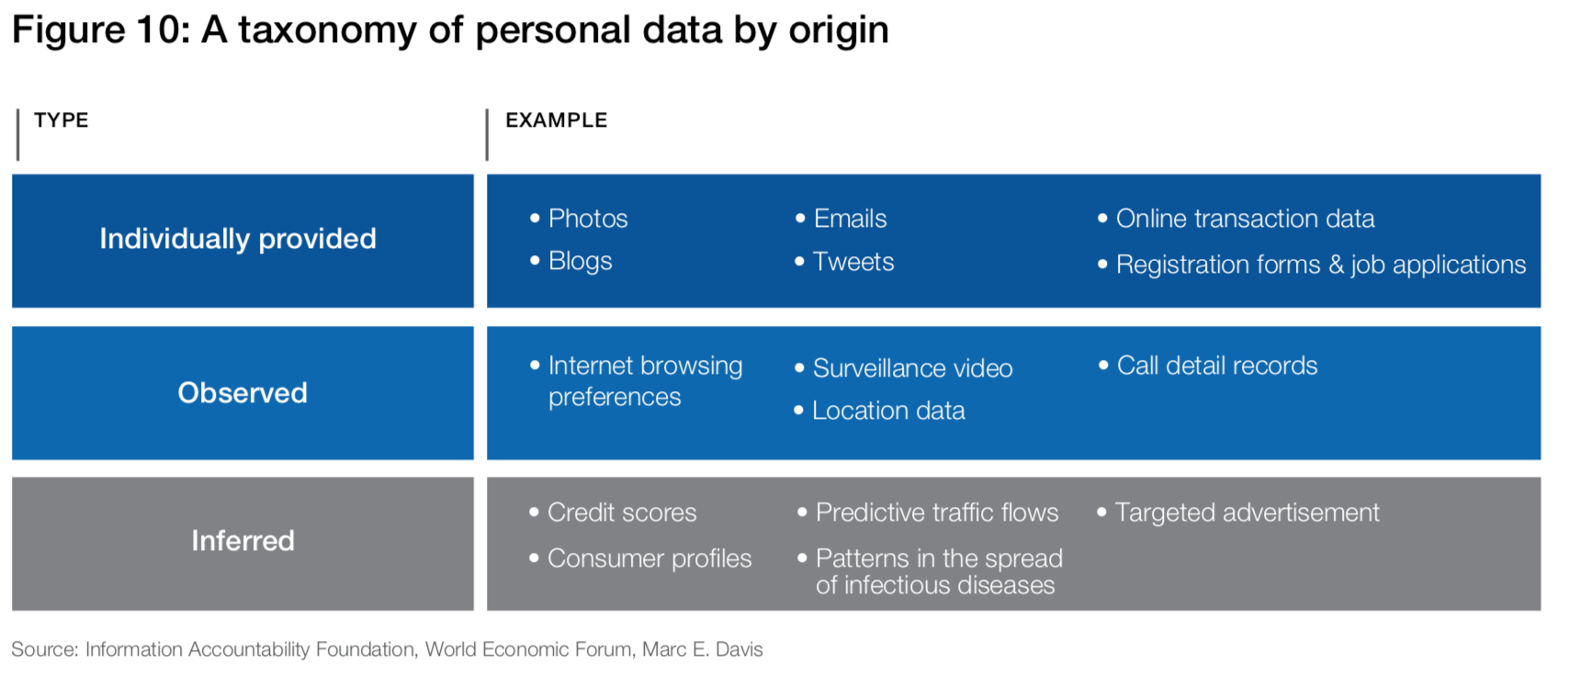
the Worls Economic Forum model
Geo
JSON
Personal Data (categories, formats)
Quelle: MyData

Slide 22
How should we structure our taxonomy?
Geo
JSON
Personal Data (categories, formats)
Which one is more fit for purpose?
Which one covers 80:20 use cases?
vs.
$
How to structure our other taxonomies?
What expressivity do we need (conditionals, etc.)?
✆

Slide 23

Call for Action: Join DPVCG!
More use cases matter!
Existing efforts for interoperability/vocabularies matter!
Joining is easy!
The group is Open to everyone!
Just create a W3C account
https://www.w3.org/community/dpvcg/
Looking forward to discussions…

