Slide 1
Integrating Open Data:
(How) Can Description Logics & Ontological Reasoning Help me?
Axel Polleres
web: http://polleres.net twitter: @AxelPolleres

Slide 2
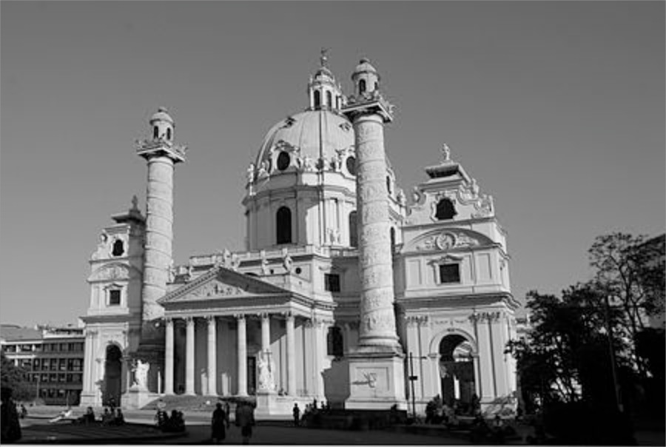
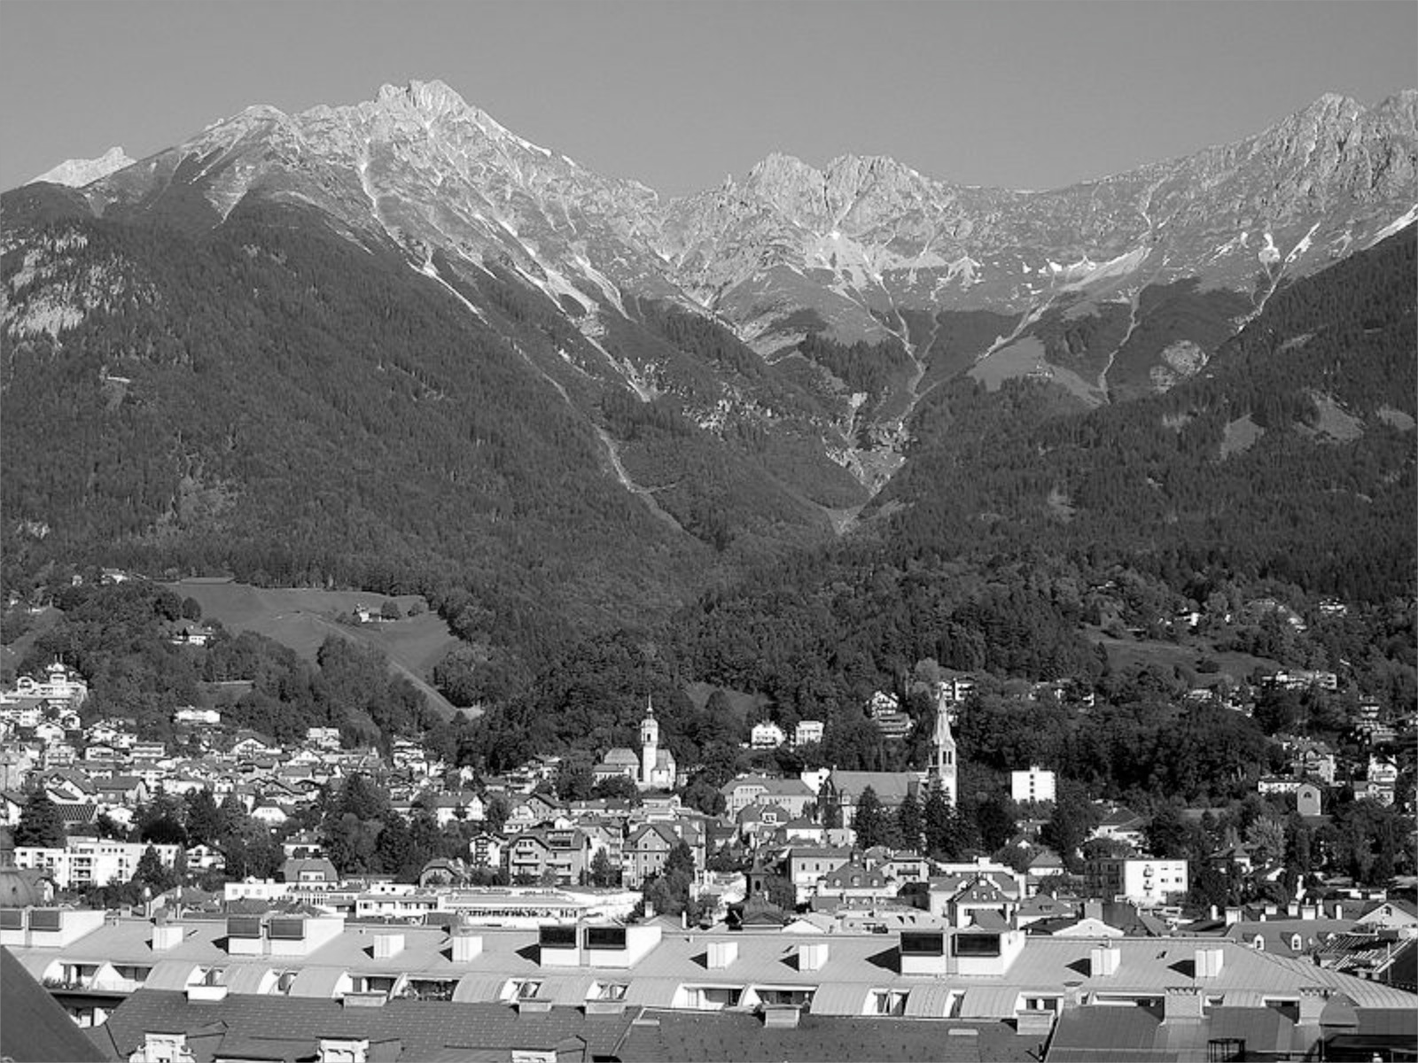
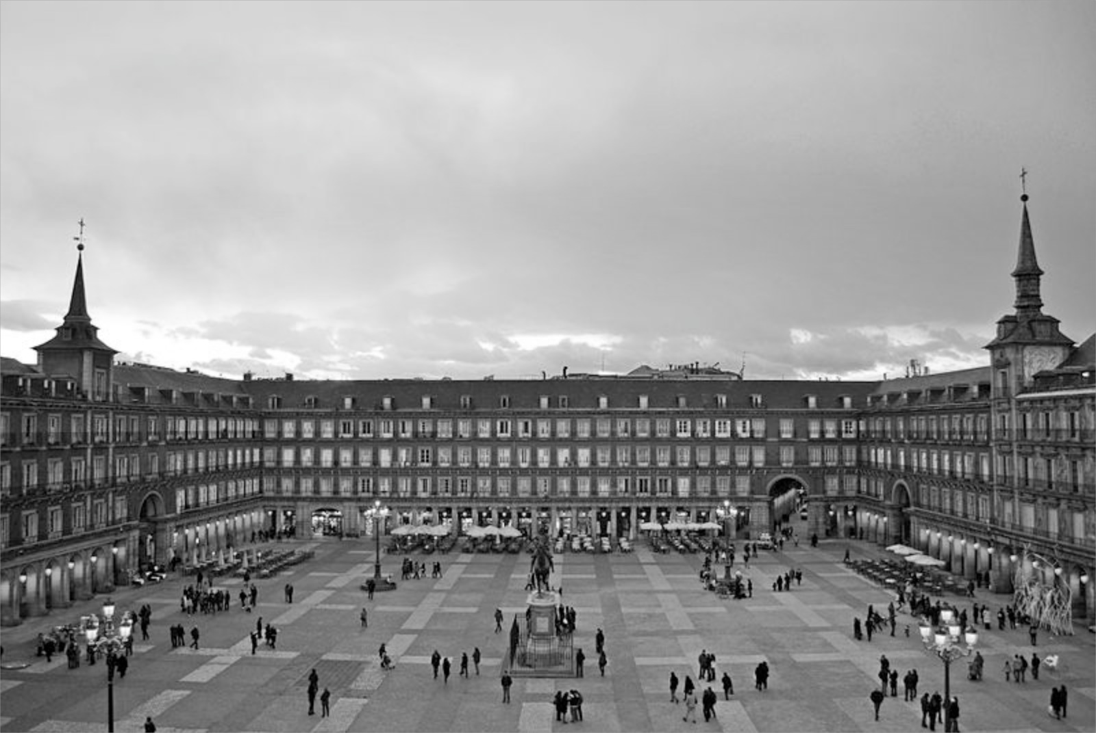

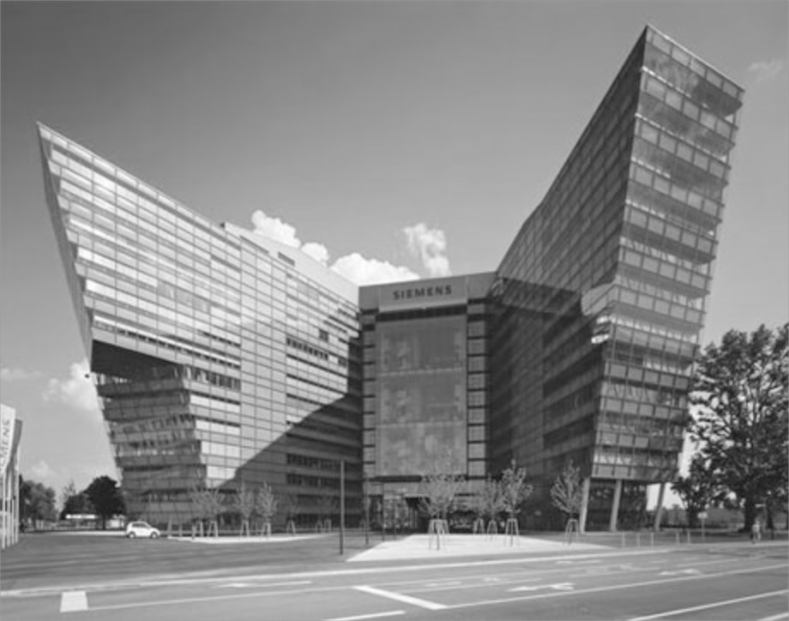

About me...
TU Vienna
Univ. Rey Juan Carlos Madrid
Univ. Innsbruck
DERI, NUIGalway
Siemens AG Österreich
Vienna University of Economics & Business (WU)
Query Languages, Reasoning, Semantic Web, SPARQL, W3C, Answer Set Programming, Logic Programming, KR, AI Planning, Semantic Web Services, Databases, Linked Data... Open Data
Notes:
1:37
(1:15)‏

Slide 3

What is Open Data?
Availability and Access: the data must be available as a whole and at no more than a reasonable reproduction cost, preferably by down-loading over the internet, […] in a convenient and modifiable form.
Reuse and Redistribution: the data must be provided under terms that permit reuse and redistribution including the intermixing with other datasets. The data must be machine-readable
Universal Participation: everyone must be able to use, reuse and redistribute – […] no discrimination against fields of endeavour, persons or groups. For example, no ‘non-commercial’ […]restrictions.
See more at: http://opendefinition.org/okd/
Open Knowledge Foundation
Notes:
Let me start with talking about what open data is for me... Or maybe not for me, actually there is a definition, the opendefinition by OFKN, which gives some framework.

Slide 4











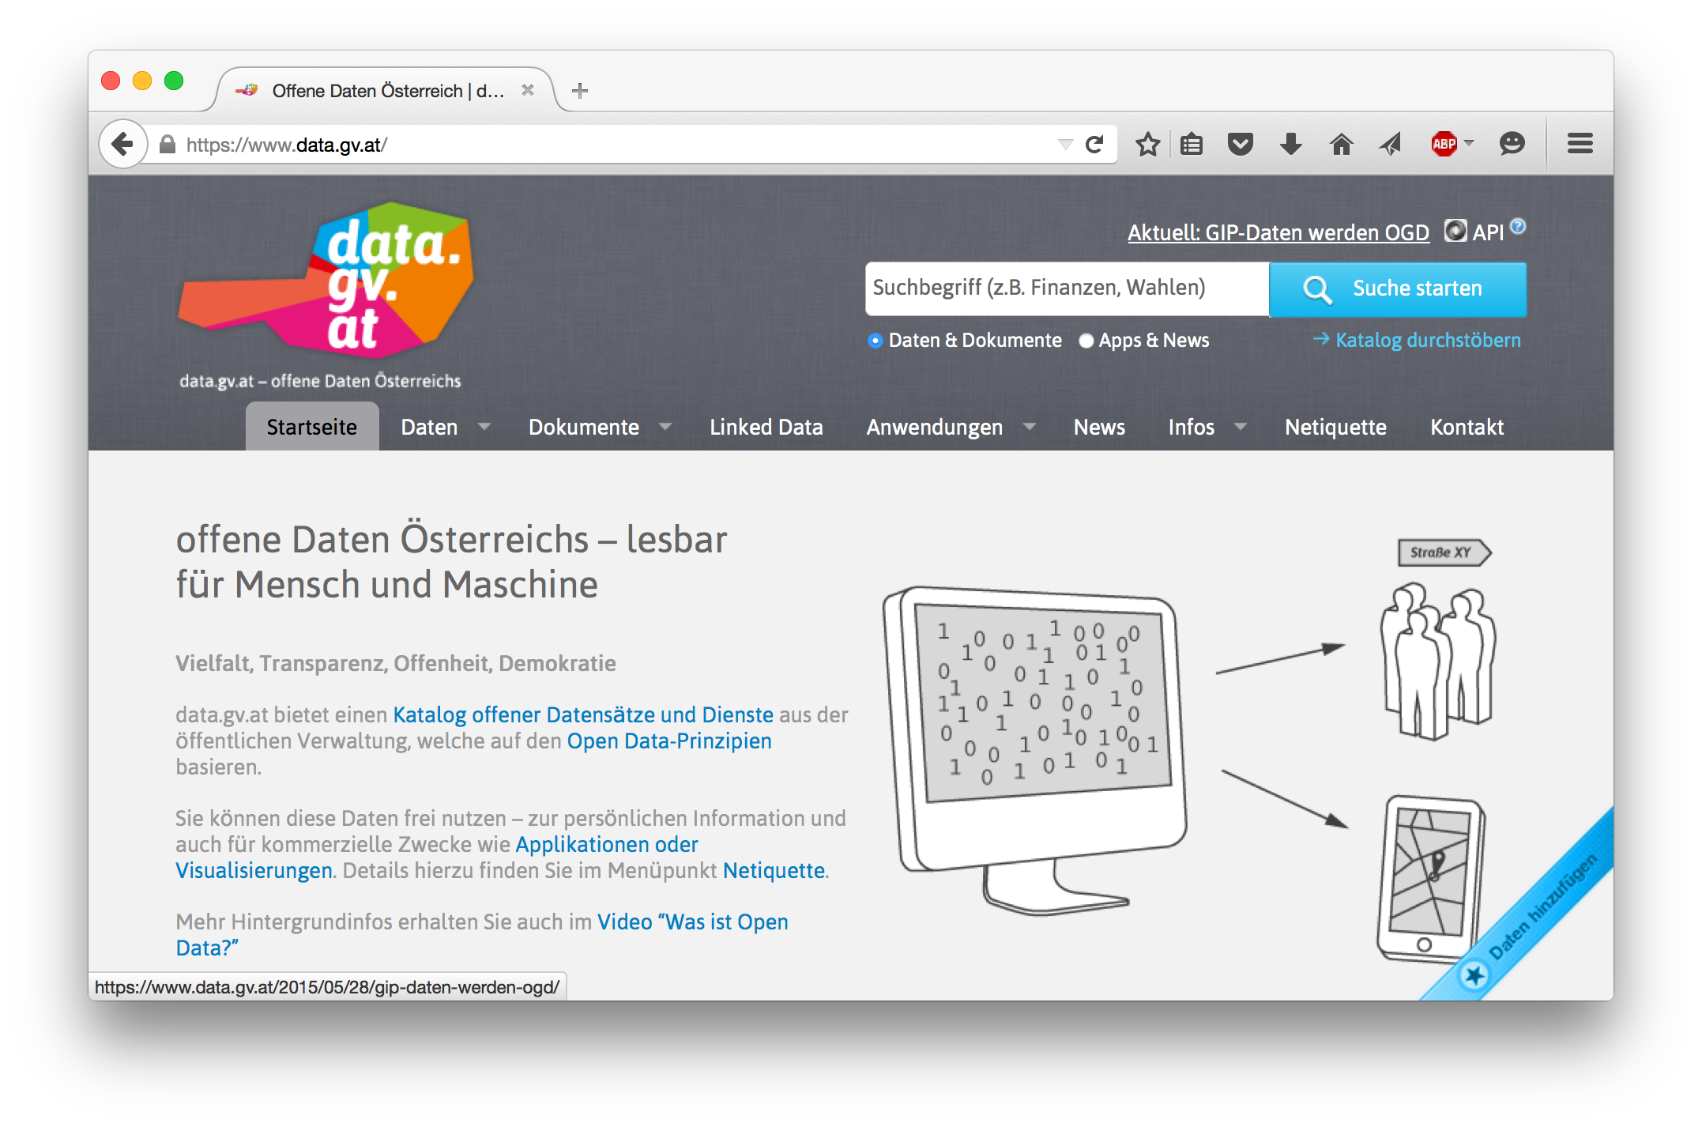
Open Data is a global trend:
    Cities, International Organizations, National and European portals, etc.:
Notes:
4

Slide 5
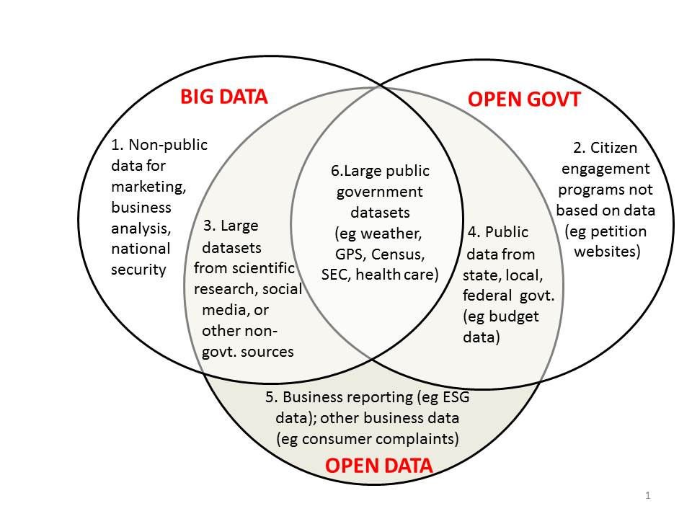
Buzzword Bingo 1/3:
Open Data vs. Big Data
http://www.opendatanow.com/2013/11/new-big-data-vs-open-data-mapping-it-out/

Slide 6

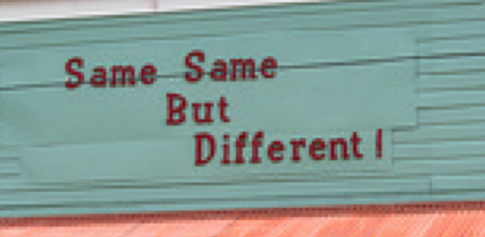

Buzzword Bingo 2/3:
Open Data vs. Big Data
Volume:
  It's growing! (we currently monitor 90 CKAN portals, 512543 resources/ 160069 datasets,
  at the moment (statically) ~1TB only CSV files...
Variety:
  different datasets (from different cities, countries, etc.), only partially comparable, partially not.
  Different metadata to describe datasets
  Different data formats
Velocity:
  Open Data changes regularly (fast and slow)
  New datasets appear, old ones disappear

Slide 7

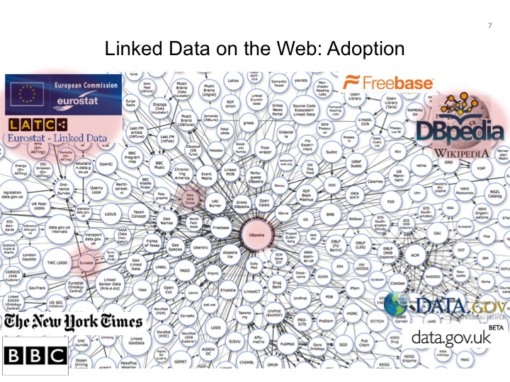
Buzzword Bingo 3/3:
Open Data vs. Linked Data
This talk is NOT about DL Reasoning over Linked Data:
Status: OWLED2013 talk …
LOD is till growing, but OD is growing faster and challenges aren't necessarily the exactly same…
So. let's focus on Open Data in general…
Alternatives in the meantime: (wikidata...)
LD efforts discontinued?!
LOD in OGD growing, but slowly

Slide 8

Now: Can ontological reasoning help me to integrate Open Data?
short answer: yes, but ...
long answer: no, but ...
In more detail:
  Is Open Data useful at all?
  Are ontology languages expressive enough?
  Which ontologies could I use?
  Is there enough data at all?
  How to tackle inconsistencies?
  Where to find the right data?
Notes:
In other words, there are quite some obstacles, and in this talk I'd rather like to talk about these obstacles, and probably only give starting points in how to overcome these from our own experience, tather than answering them fully.

Slide 9
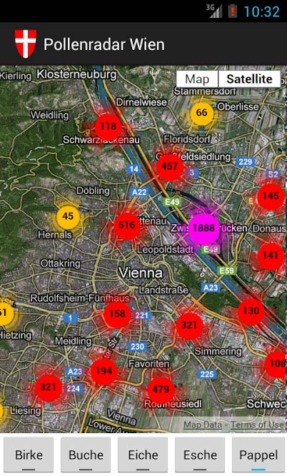
Is Open Data useful at all?
Beyond "single dataset Apps"...
Great stuff, but limited potential...

Slide 10
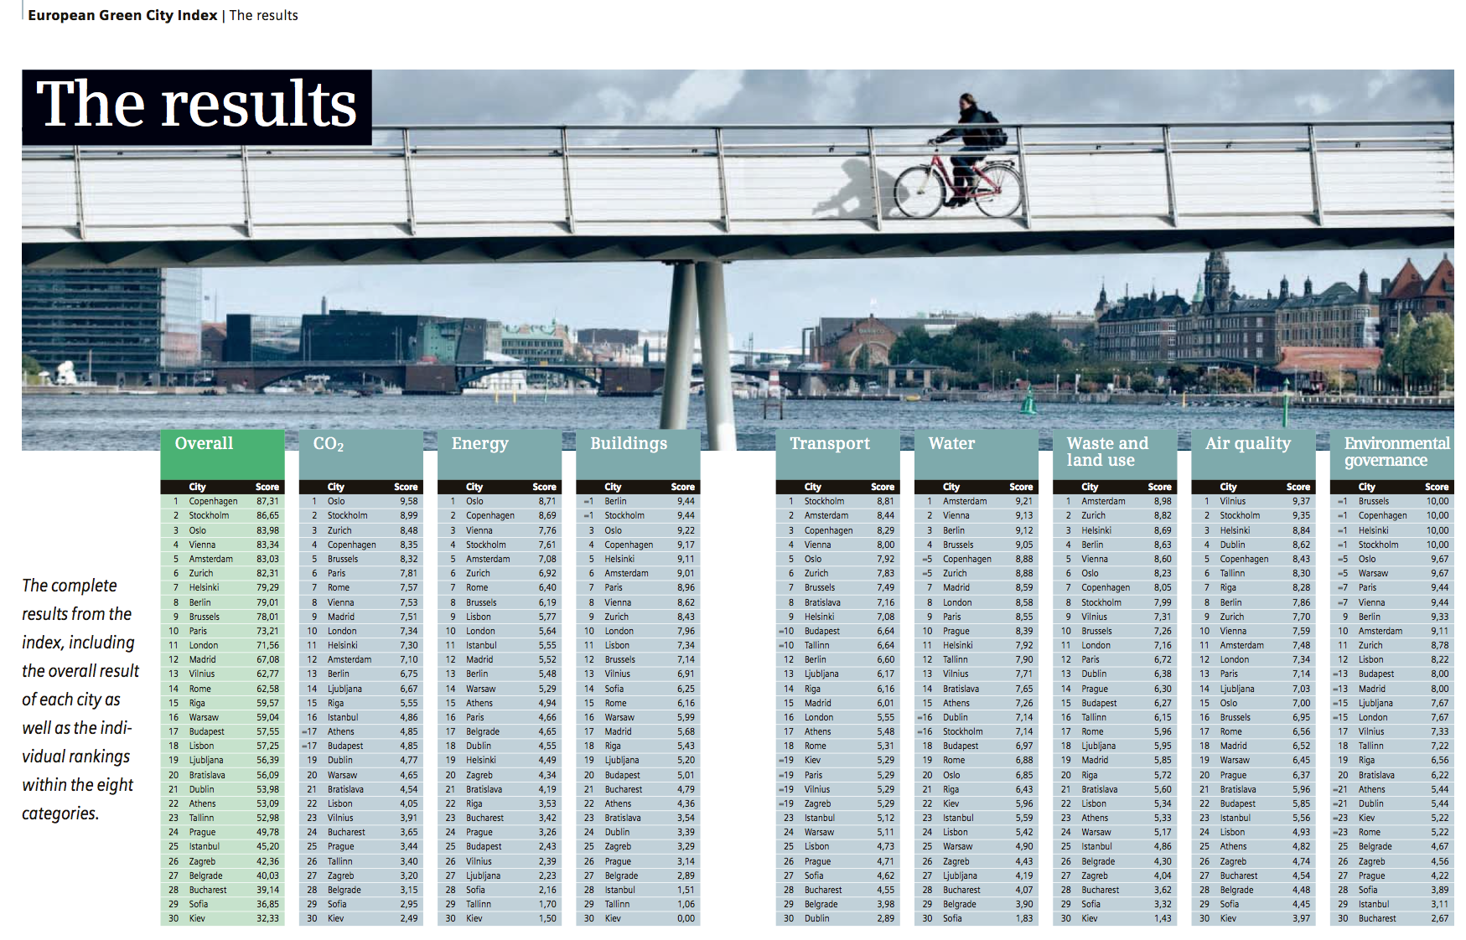
Is Open Data useful at all?
A concrete Open Data Integration use case:

Slide 11
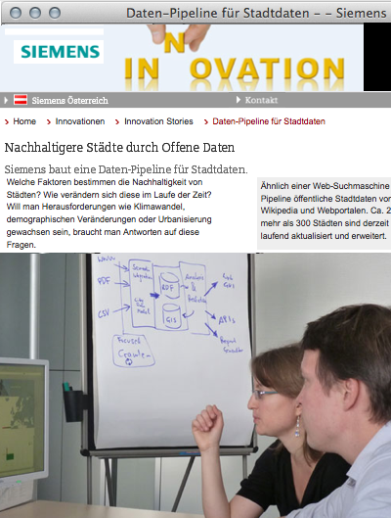
A concrete use case:
The "City Data Pipeline"
Idea – a "classic" Semantic Web use case!
Regularly integrate various relevant Open Data sources (e.g. eurostat, UNData, ...)
Make integrated data available for re-use
(How) can ontologies help me?
  Are ontology languages expressive enough?
  Which ontologies could I (re-)use?
  Is there enough data at all?
  Where to find the right data?
  How to tackle inconsistencies?

Slide 12
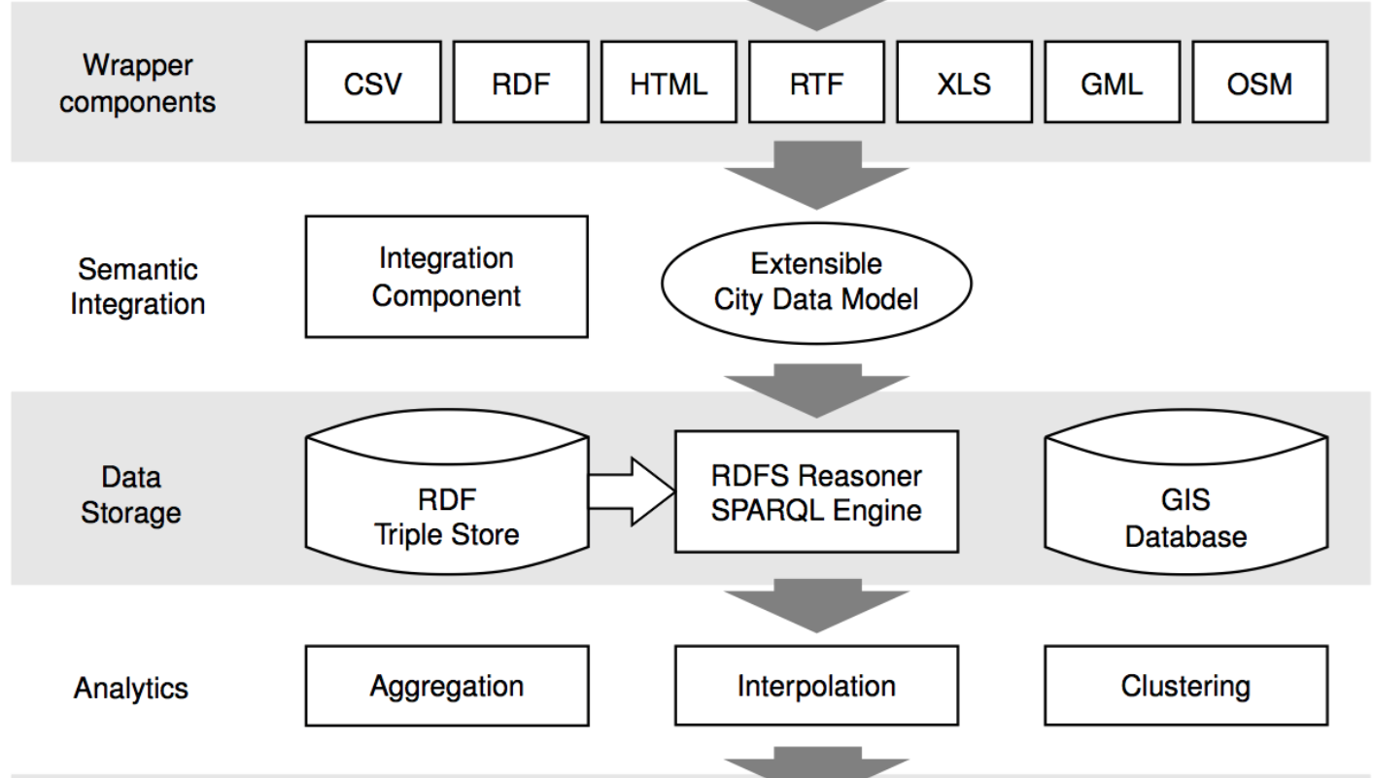


A concrete use case:
The "City Data Pipeline"
That's a standard ETL pipeline, isn't it?

Slide 13
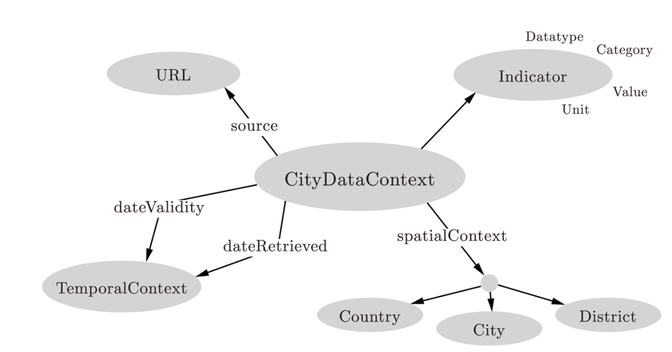
A concrete use case:
The "City Data Pipeline"
City Data Model: extensible ALH(D) ontology:
Indicators, e.g. area in km2, tons CO2/capita
Provenance
But we use and flexible Semantic integration using ontologies and reasoning!
Temporal information
Spatial context

Slide 14

A concrete use case:
The "City Data Pipeline"
City Data Model: extensible ALH(D) ontology:
dbpedia:areakm2
:area
Indicators, e.g. area in km2, tons CO2/capita
Provenance
eurostat:area
:area
Ok, we only need role hierarchies (rdfs:subPropertyOf) here? Are we done?
Temporal information
Spatial context

Slide 15
A concrete use case:
The "City Data Pipeline"
City Data Model: extensible ALH(D) ontology:
dbpedia:areakm2
:area
Indicators, e.g. area in km2, tons CO2/capita
Provenance
eurostat:area
:area
?
:populationDensity = :population/:area
:area = 0,386102 * dbpedia:areaMi2
Temporal information
Spatial context
Hmmm, not quite... Let me come up with a solution...

Slide 16
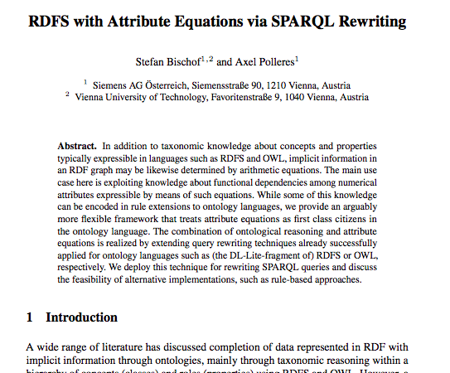
Can equational knowledge co-exist with OWL?
Stefan Bischof, Axel Polleres. ESWC2013

Slide 17
Can equational knowledge co-exist with OWL?
Can equational knowledge co-exist with OWL?
  We need a syntax & define a formal semantics
Syntax:
Semantics:
  Requirements:
    “Fit” with common model-theoretic semantics for OWL and RDFS
    Treat equivalent equations equivalently:
:populationDensity = :population/:area
:area = 0,386102 * dbpedia:areaMi2
:populationDensity :defineByEquation “:population/:area” .
:area :defineByEquation “:areaMi2 * 0,386102 ” .
dbPedia:populationTotal :rdfs:subPropertyOf :population.
:area = 0,386102 * dbpedia:areaMi2
:areaMi2 = 2,589988 * :area

Slide 18


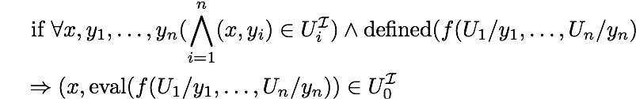
Can equational knowledge co-exist with OWL?
₀
  An Interpretation interprets datatype properties U as binary relations between domain elements and Data-Values (for simple equations rational numbers are sufficient):
  Interpretations of inclusion axioms are as usual, e.g.
    A sub-property axiom sp
    U₁ rdfs:subPropertyOf U₂
    is satisfied in
  NEW: A property equation axiom e
    U₀ :defineByEquation “f(U₁,…U_{n})” .
    is satisfied in
  An interpretation is a model it satisfies
    all inclusion axioms
    all variants of all equation axioms
dbo:populationToal rdfs:subPropertyOf :population .
dbr:Athens dbo:populationTotal 664046.
dbr:Athens :population 664046.
:populationDensity :definedByEquation “:population / :area” .
dbr:Athens :population 664046.
dbr:Athens :area 38.964 .
)
dbr:Athens dbo:populationDensity 17042.55 .

Slide 19
Can equational knowledge co-exist with OWL?
₀
  An Interpretation interpret datatype properties U as binary relations between domain elements and Data-Values (for our simple equations rational numbers are sufficient):
  Interpretations of inclusion axioms are as usual, e.g.
    A sub-property axiom sp
    U₁ rdfs:subPropertyOf U₂
    is satisfied in
  NEW: A property equation axiom e
    U₀ :defineByEquation “f(U1,…U_{n})” .
    is satisfied in
  An interpretation is a model if it satisfies
    all inclusion axioms
    all variants of all equation axioms
:populationDensity :definedByEquation “:population / :area” .
dbr:Athens :population 664046.
dbr:Athens :area 0 .
)
:population :definedByEquation “:populationDensity * :area”.
:area:definedByEquation “:population / :populationDensity” .

Slide 20


Can materialization and/or query rewriting be used?
Rule-based Materialization:
dbr:Athens dbo:population 2.
dbr:Athens dbo:area 3.
dbr:Athens dbo:population 664046.
dbr:Athens dbo:area 38.964 .
dbr:Athens dbo:popDensity 0.66666666.
dbr:Athens dbo:area 3.00000000003.
dbr:Athens dbo:population 1.99999998002.
… potentially infinite values by rounding errors.
Similarly, for ambiguous values (assume 2 population values for Athens)

Slide 21
Can materialization and/or query rewriting be used?
Rewriting? Again consider clausal form of all variants of equations:
dbr:Athens dbo:Athens 664046.
dbr:Athens dbo:area 38.964 .
Finally, the resulting UCQs with assignments can be rewritten back to SPARQL using BIND
  SELECT ?PD WHERE { :Athens dbo:popDensity ?PD}
… infinite expansion even if only 1 equation is considered.
Solution: “blocking” recursive expansion of the same equation for the same value.
  SELECT ?PD WHERE { {:Athens dbo:popDensity ?PD }
  UNION
  { :Athens dbo:population ?P ; dbo:area ?A .
  BIND (?P/?A AS ?PD )}
  }

Slide 22
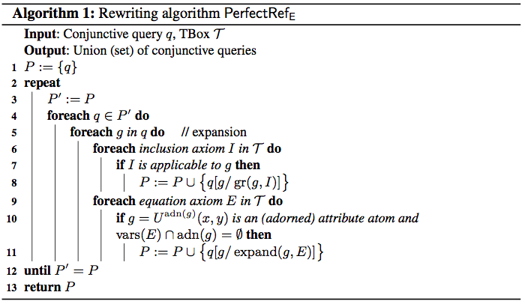
Algorithm:
“Down-stripped” version of PerfectRef [Calvanese, 2007] which handles equations by keeping “adornments” of attributes during rewriting:

Slide 23
Can materialization and/or query rewriting be used?
Rule-based Materialization:
dbr:Athens dbo:population 2.
dbr:Athens dbo:area 3.
Similar blocking possible in some rule systems, e.g. Jena Rules:
[ (?C :area ?A) (?C :population ?P)
notEqual(?A, 0) quotient(?P, ?A, ?PD)
noValue(?C, :populationDensity) -> (?C :populationDensity ?D)]
[ (?C :populationDensity ?PD) (?city :population ?P)
notEqual(?PD, 0) quotient(?P, ?PD, ?A)
noValue(?C, :area) -> (?city :area ?A)]
[ (?C :area ?A) (?C :populationDensity ?P) product(?A, ?PD, ?P)
noValue(?city, :population) -> (?city :population ?P)]
Side remark: Experiments in our ESWC2013 paper favor rewriting approach.

Slide 24
A concrete use case:
The "City Data Pipeline"
City Data Model: extensible ALH(D) ontology:
In more detail:
  Is Open Data useful at all?
  Are ontology languages expressive enough?
  Which ontologies could I use?
  Is there enough data at all?
  How to tackle inconsistencies?
  Where to find the right data?
Dbpedia:areakm2
:area
eurostat:area
:area
Indicators, e.g. area in km2, tons CO2/capita
Provenance
:populationDensity = :population/:area
Ok, so where do I find these equations? Is there an ontology?
:area = 0,386102 * dbpedia:areaMi2
Temporal information
Spatial context

Slide 25
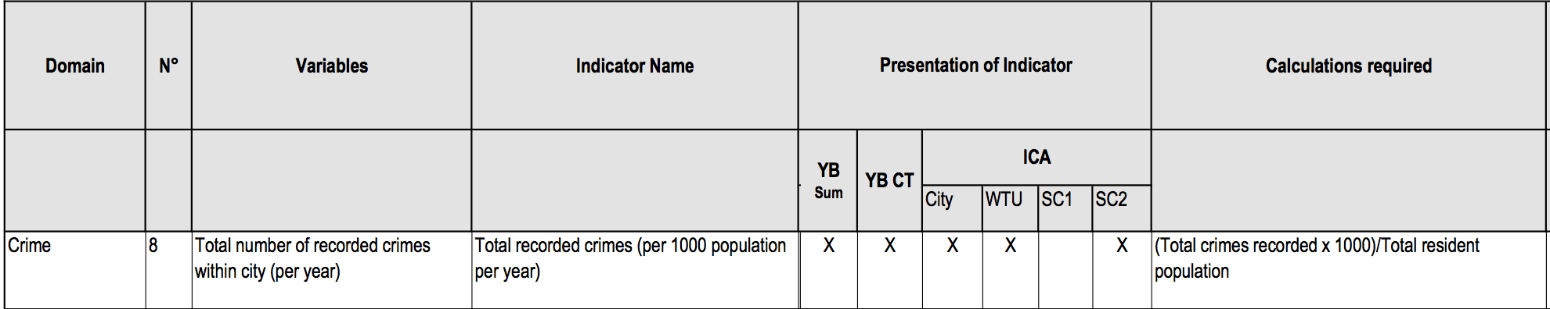
Equational knowledge:
Eurostat/Urbanaudit:
  http://ec.europa.eu/regional_policy/archive/urban2/urban/audit/ftp/vol3.pdf
Notes:
Not available as structured form, but ok, you can let a bachelor student write these down...

Slide 26
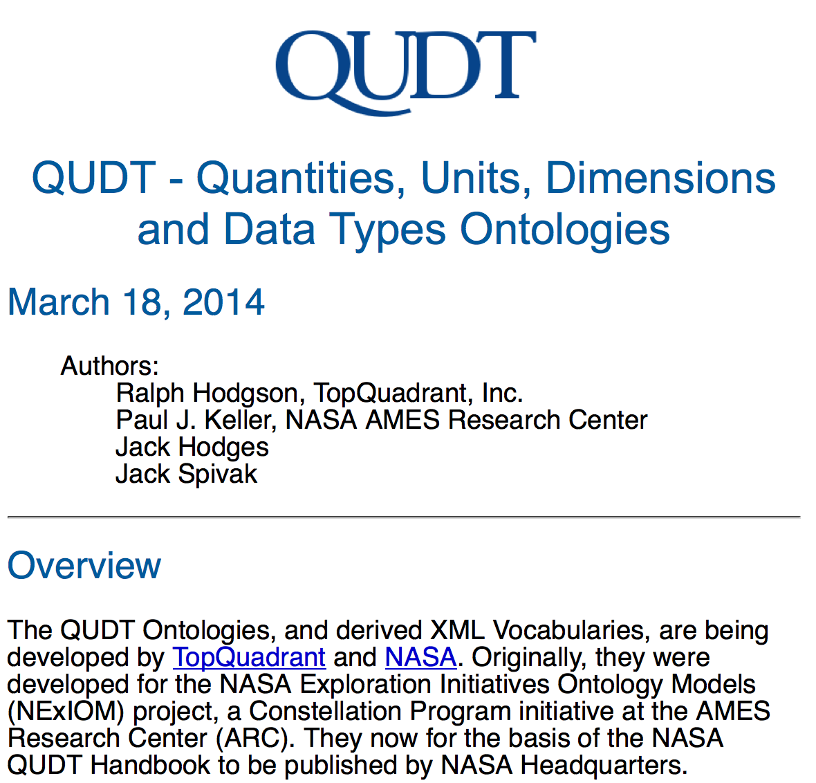
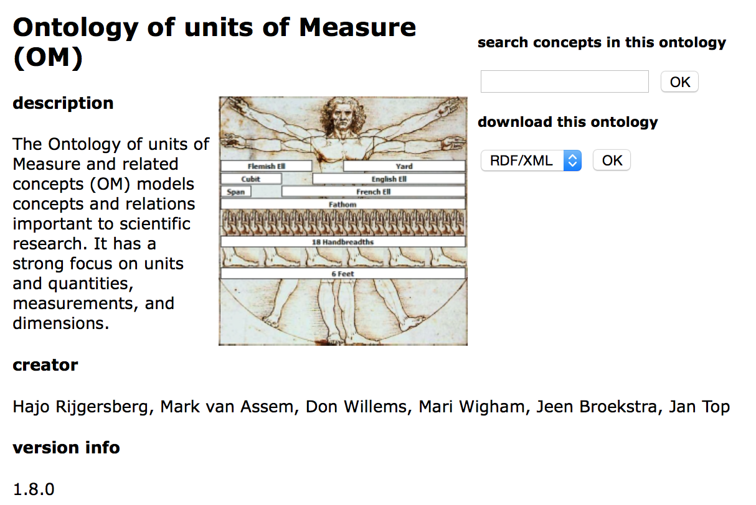
Equational knowledge:
Unit conversion
http://qudt.org/
http://www.wurvoc.org/vocabularies/om-1.8/
Notes:
Not available as structured form, but ok, you can let a bachelor student write these down...

Slide 27
A concrete use case:
The "City Data Pipeline"
City Data Model: extensible ALH(D) ontology:
Dbpedia:areakm2
:area
eurostat:area
:area
Indicators, e.g. area in km2, tons CO2/capita
Provenance
:populationDensity = :population/:area
So, are we done?
:area = 0,386102 * dbpedia:areaMi2
Temporal information
Spatial context

Slide 28
A concrete use case:
The "City Data Pipeline"
In more detail:
  Is Open Data useful at all?
  Are ontology languages expressive enough?
  Which ontologies could I use?
  Is there enough data at all?
  How to tackle inconsistencies?
  Where to find the right data?
City Data Model: extensible ALH(D) ontology:
Hmmm... Still a lot of work to do, e.g. adding aggregates for statistical data (Eurostat, RDF Data Cube Vocabulary) ... cf. [Kämpgen, 2014, PhD Thesis]
Indicators, e.g. area in km2, tons CO2/capita
:avgIncome per country is the
population-weighted average income of all its provinces.
Provenance
Temporal information
But Eurostat data is incomplete... I don't have the avg. income for all provinces or countries in the EU!
Spatial context
Hmmm...
Notes:
Integration and Analysis of Distributed Multidimensional Datasets

Slide 29
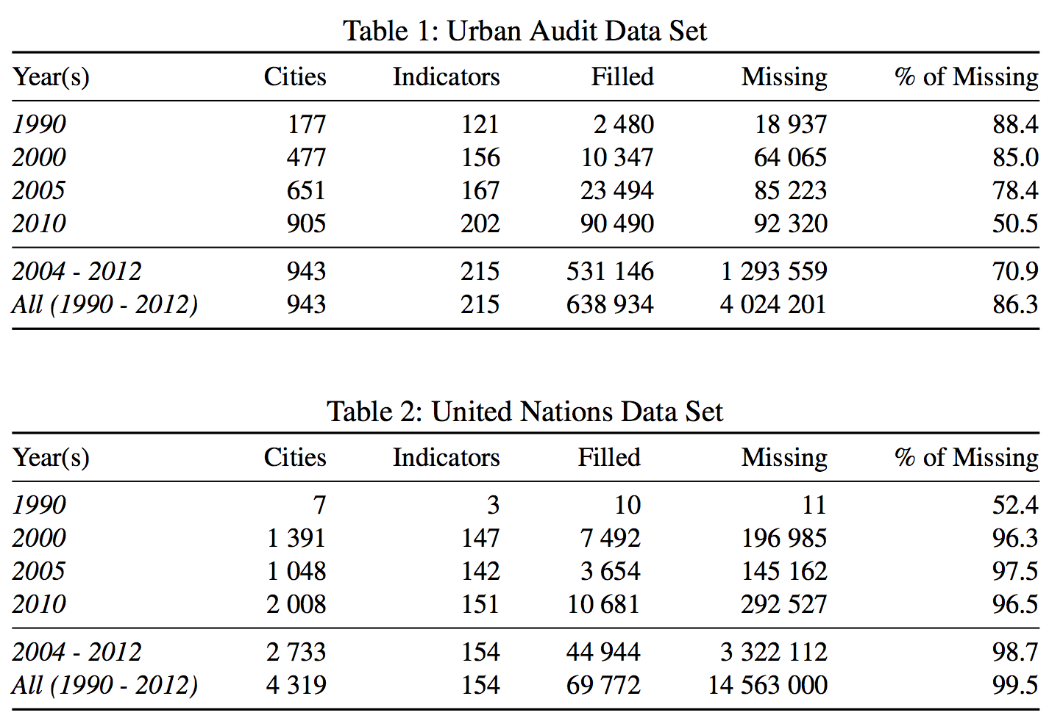
Challenge – Missing values
Found a huge amount of missing values
Two main reasons:
  Incomplete data published by providers (Tables 1+2)
  The combination of different data sets with disjoint cities and indicators (later)

Slide 30
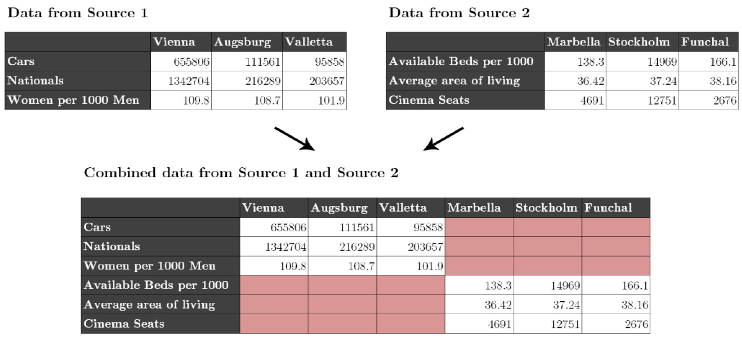
Challenges – Missing values
Individual datasets (e.g. from Eurostat) have missing values
Merging together datasets with different indicators/cities adds sparsity

Slide 31
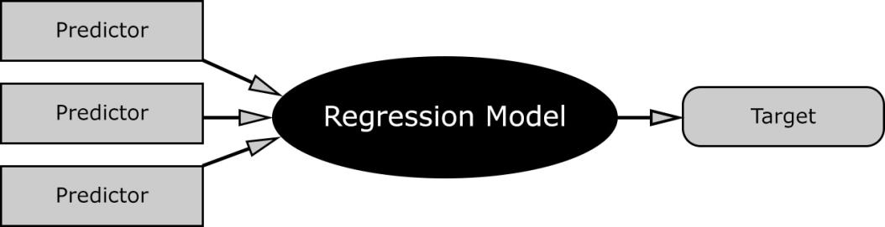
Missing Values – Hybrid approach choose best prediction method per indicator:
Our assumption: every indicator has its own
distribution and relationship to others.
Basket of „standard“ regression methods:
  K-Nearest Neighbour Regression (KNN)
  Multiple Linear Regression (MLR)
  Random Forest Decision Trees (RFD)

Slide 32
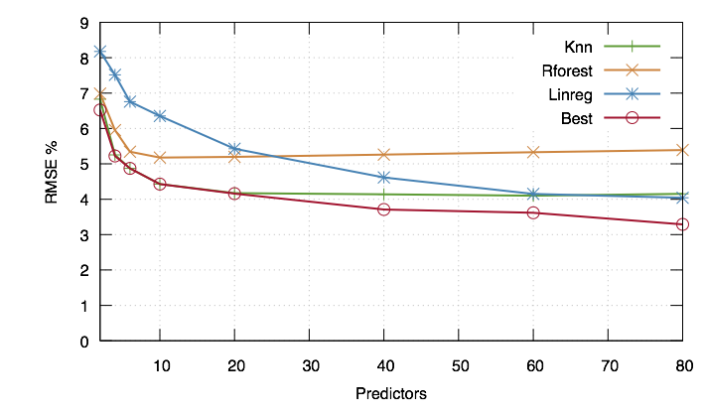
Missing Values – Hybrid approach choose best prediction method per indicator:
Instead of using indicators directly we use Principle Components, built from the indicators
For buidling the PCs, fill in missing data points with neutral values → predict all rows

Slide 33
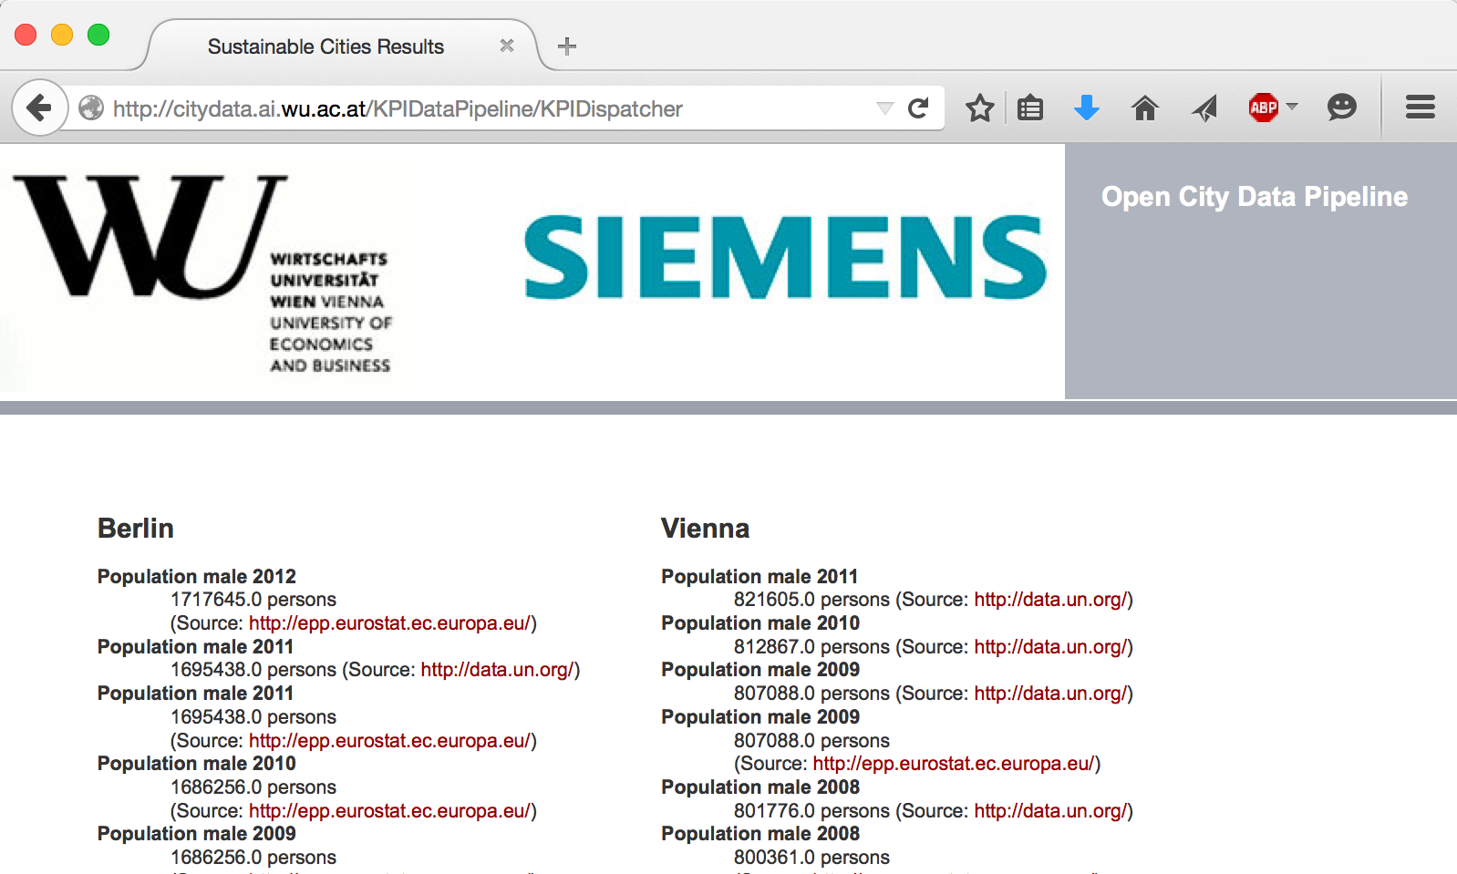

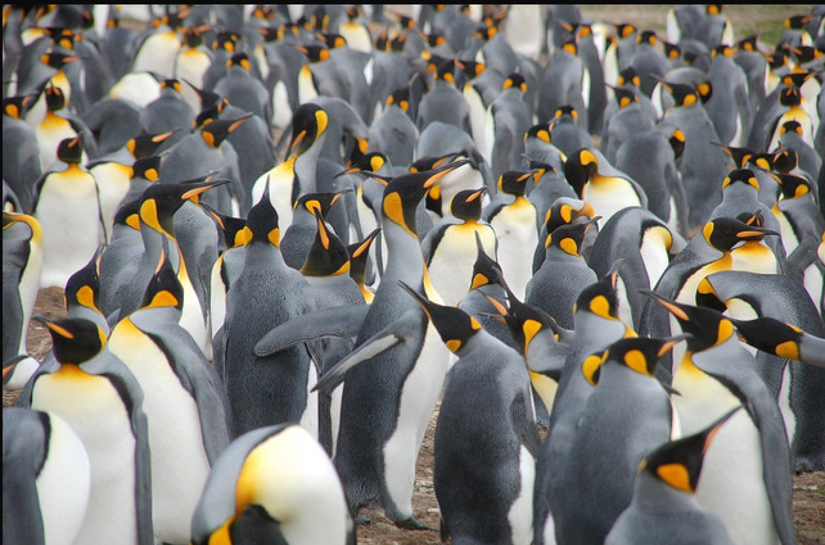
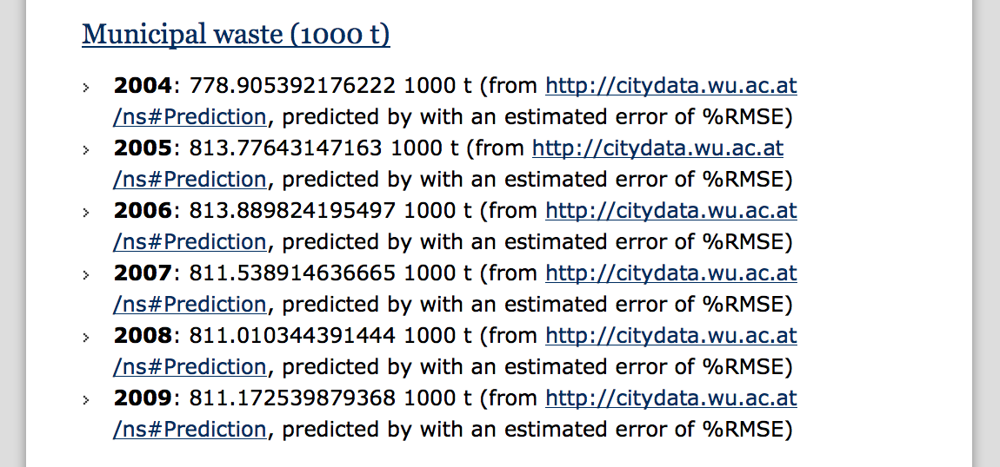
City Data Pipeline
citydata.wu.ac.at
Search for indicators & cities
obtain results incl. sources
Integrated data served as Linked Data
Predicted values AND estimated error (RMSE) for missing data...
...assumption: Predictions get better, the more Open data we integrate...
Open Data: The more, the merrier!

Slide 34
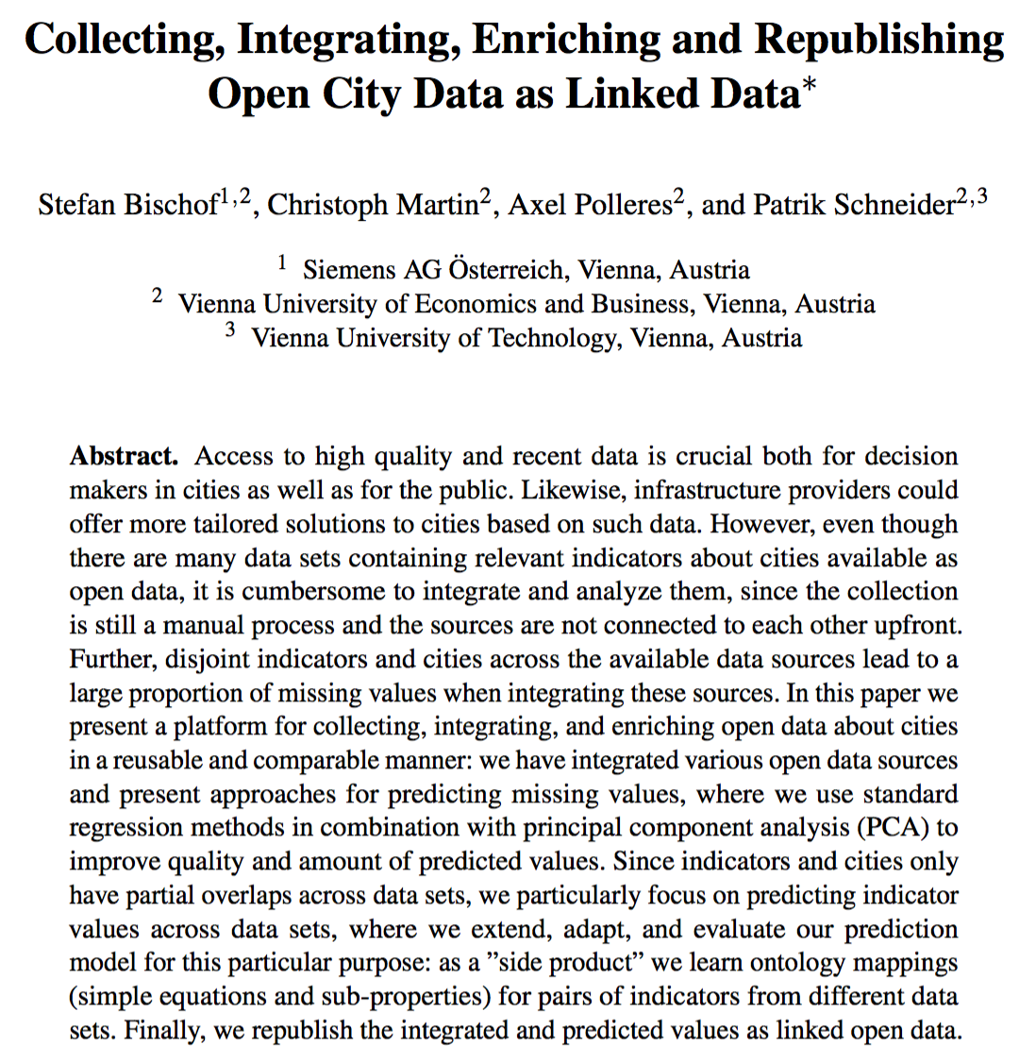
More Details:
Stefan Bischof, Christoph Martin, Axel Polleres, and Patrik Schneider. Collecting, integrating, enriching and republishing open city data as linked data. In Proceedings of the 14th International Semantic Web Conference (ISWC 2015), Bethlehem, Pennsylvania, October 2015. To appear.
So, are we done?

Slide 35
Lesson(s) learnt?
Hmmm, still, lots of open challenges!
Time series analysis is necessary
Open Data is incomparable
Still not great coverage of all available sources
Open Data Quality is an issue
Still unanswered:
  Is Open Data useful at all?
  Are ontology languages expressive enough?
  Is there enough data at all?
  Which ontologies could I use?
  How to tackle inconsistencies?
  Where to find the right data?

Slide 36



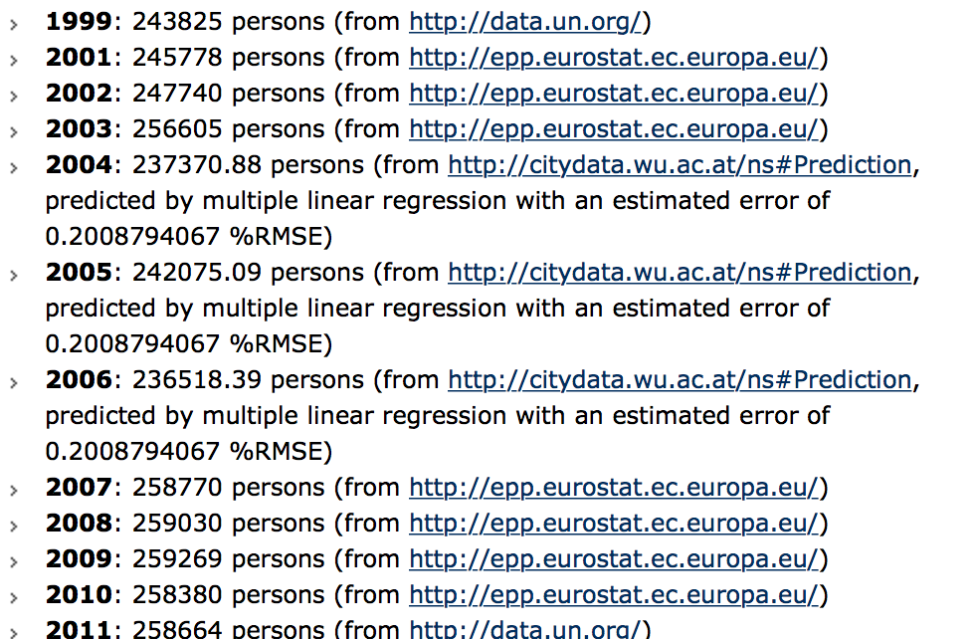
Time series analysis is necessary
  Predictions on time series data are partially very bad at the moment:
  Most of the data we look at is time series data/data changing over time.

Slide 37
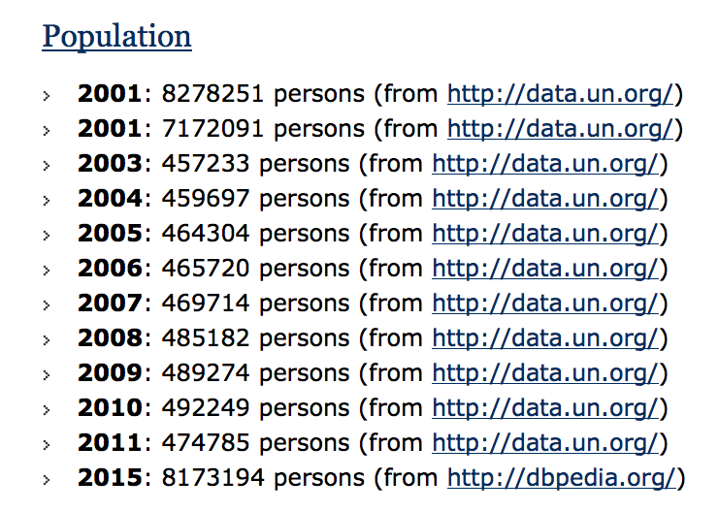
Open Data is incomparable
More surprising maybe, how much obviously weird data you find:
  Inconsistencies across and within datasets

Slide 38

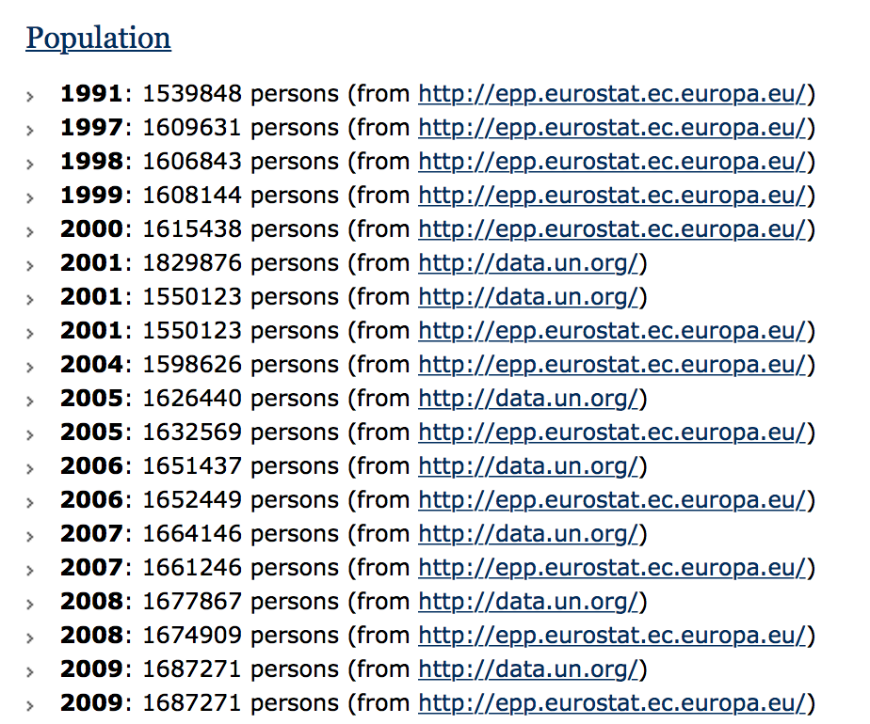
Open Data is incomparable
More surprising maybe, how much obviously weird data you find:
  Inconsistencies across and within datasets
  Still, some datasets match quite well on certain indicators
  (How) can we exploit this?
  → Ontology learning of cross-dataset mappings and linear equations!
Notes:
Ontology learning, what we started looking into now was learning correlations ... Linear equations come "for free" with our completion/prediction method.

Slide 39
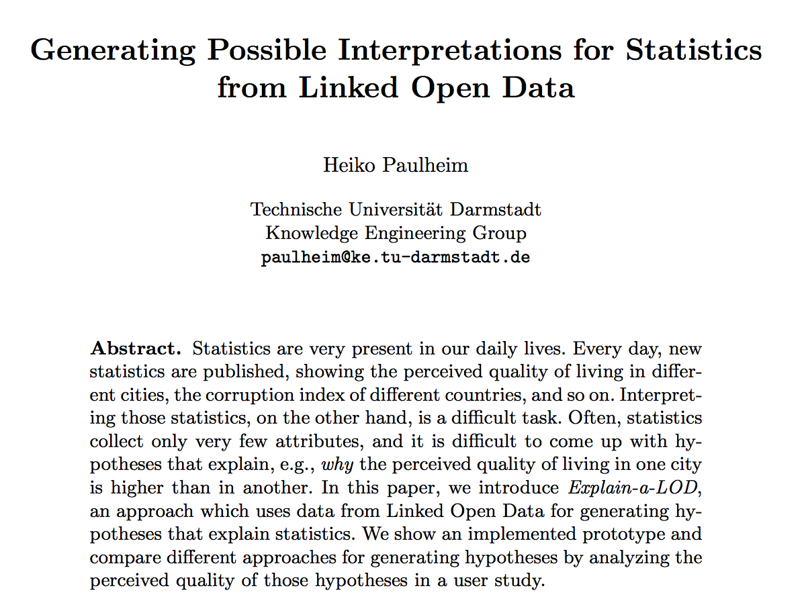
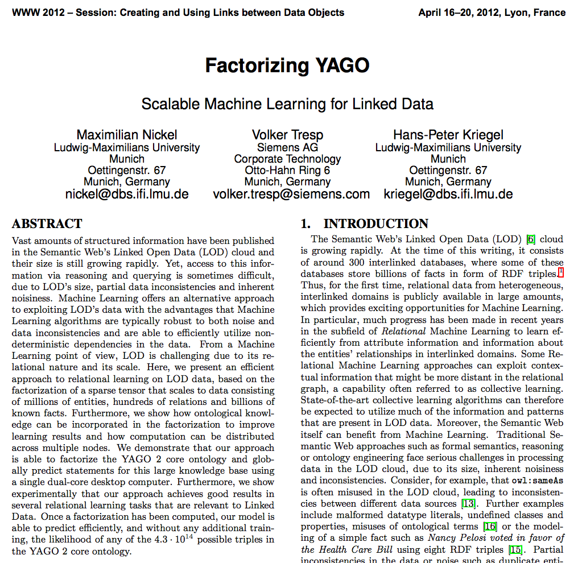
Worthwhile related work to look at... Paulheim, 2012 (ESWC), Nickel et al. 2012 (WWW)

Slide 40
Lesson(s) learnt?
Hmmm, still, lots of open challenges!
Time Series analysis is necessary
Open Data is incomparable
Open Data Quality is an issue
Still unanswered:
  Is Open Data useful at all?
  Are ontology languages expressive enough?
  Is there enough data at all?
  Which ontologies could I use?
  How to tackle inconsistencies?
  Where to find the right data?

Slide 41
Data Quality issues:
Missing
Outdated data
Wrong data
Ambiguous Data
Wrong meta-data
Data source offline/not reachable
Notes:
In the previous challenge, we have "solved" this by pretty much manually integrating a carefully chosen set of data sources, but not used Open Data portals to automatically find the right data sources...

Slide 42
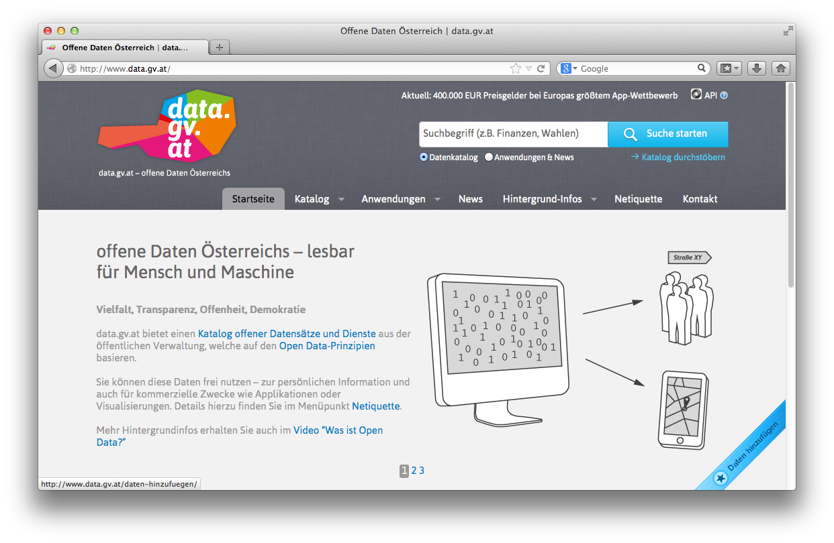
Open Data Portals
CKAN ... http://ckan.org/
almost „de facto“ standard for Open Data Portals
facilitates search, metadata (publisher, format, publication date, license, etc.) for datasets
http://datahub.io/
http://data.gv.at/
machine-processable? ...
... partially

Slide 43
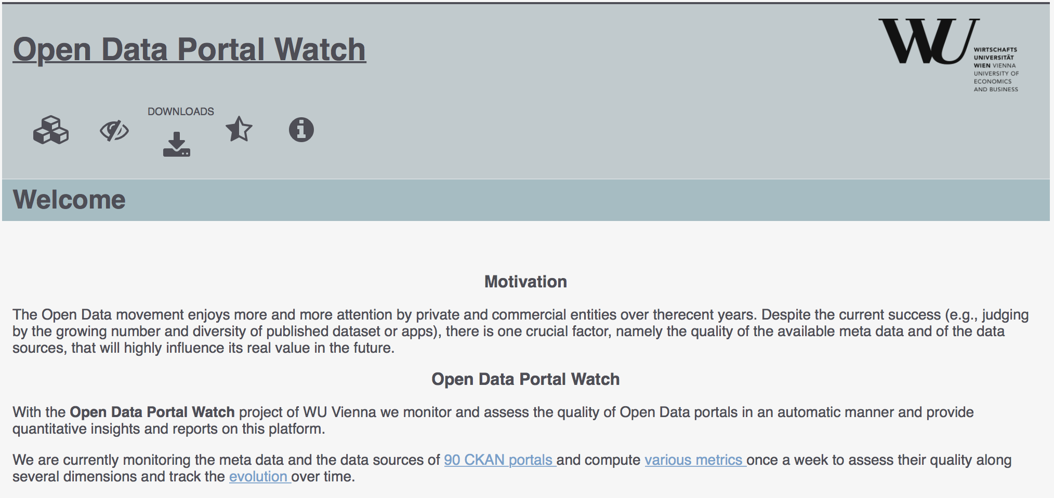
OPEN DATA PORTAL WATCH
… a first step.
http://data.wu.ac.at/portalwatch/
Periodically monitoring a list of Open Data Portals
  90 CKAN powered Open Data Portals
Quality assessment
Evolution tracking
  Meta data
  Data

Slide 44
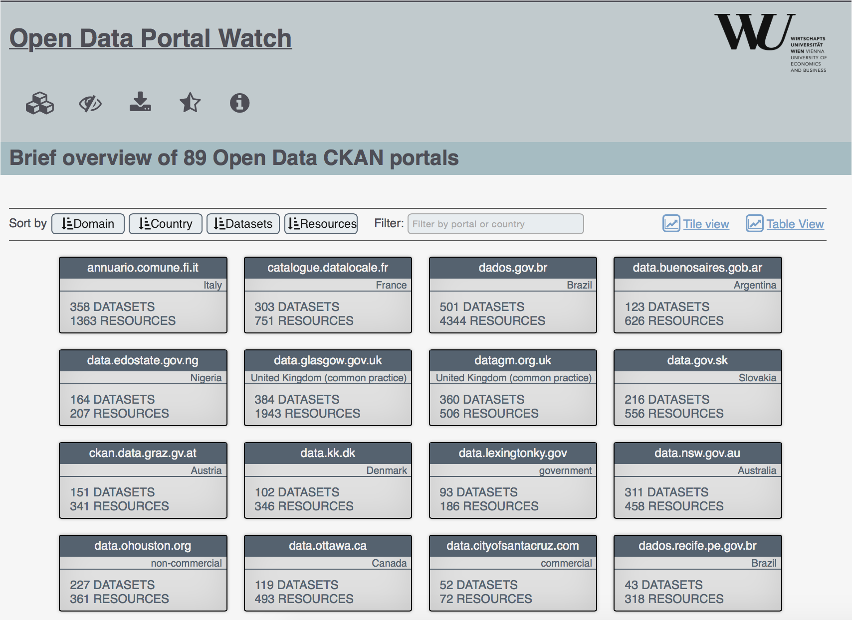
Open Data Portal list

Slide 45
QUALITY DIMENSIONS
DIMENSION | DESCRIPTION
Retrievability | The extent to which meta data and resources can be retrieved.
Usage | The extent to which available meta data keys are used to describe a dataset.
Completeness | The extent to which the used meta data keys are non empty.
Accuracy | The extent to which certain meta data values accurately describe the resources.
Openness | The extent to which licenses and file formats conform to the open definition.
Contactability | The extent to which the data publisher provide contact information.
Objective measures which can be automatically computed in a scalable way

Slide 46
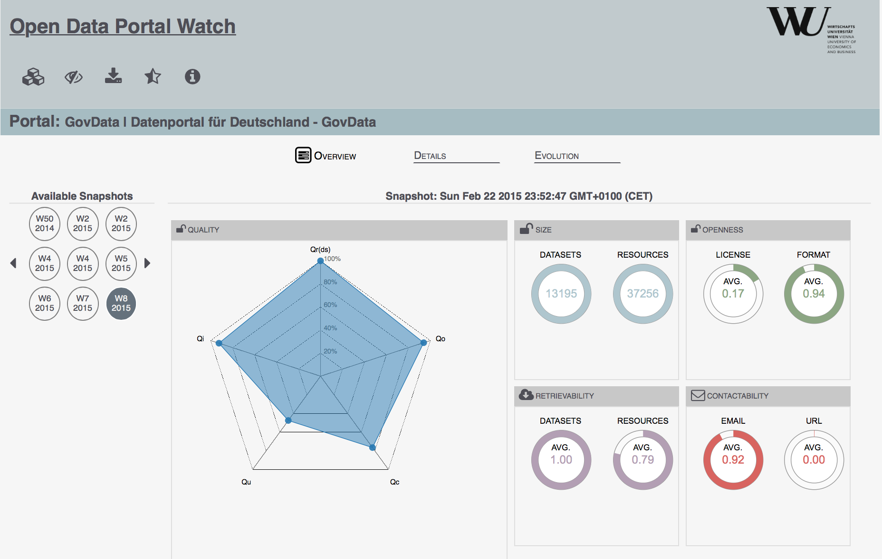
Portal Overview

Slide 47
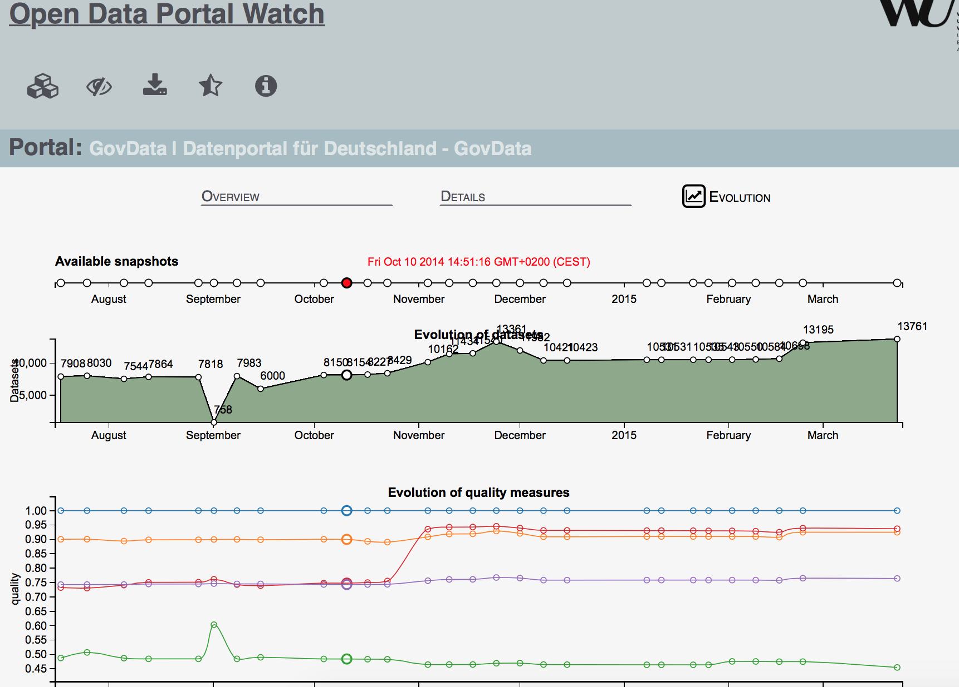
ODP Evolution

Slide 48
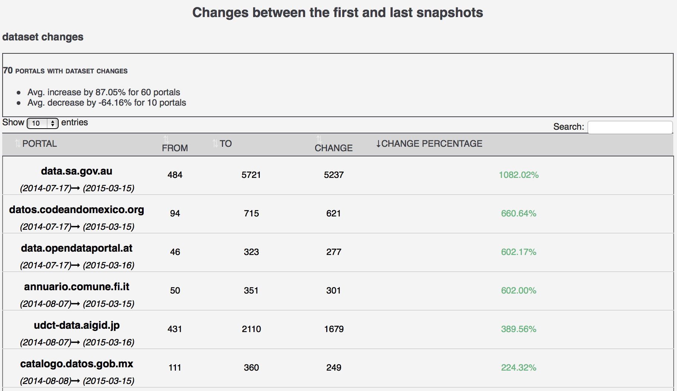
ODP CHANGES

Slide 49
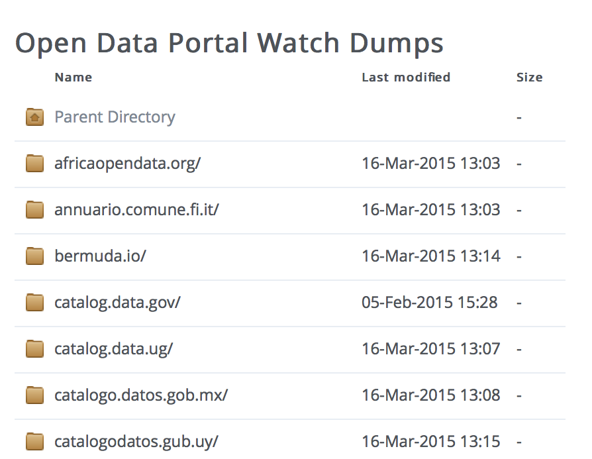
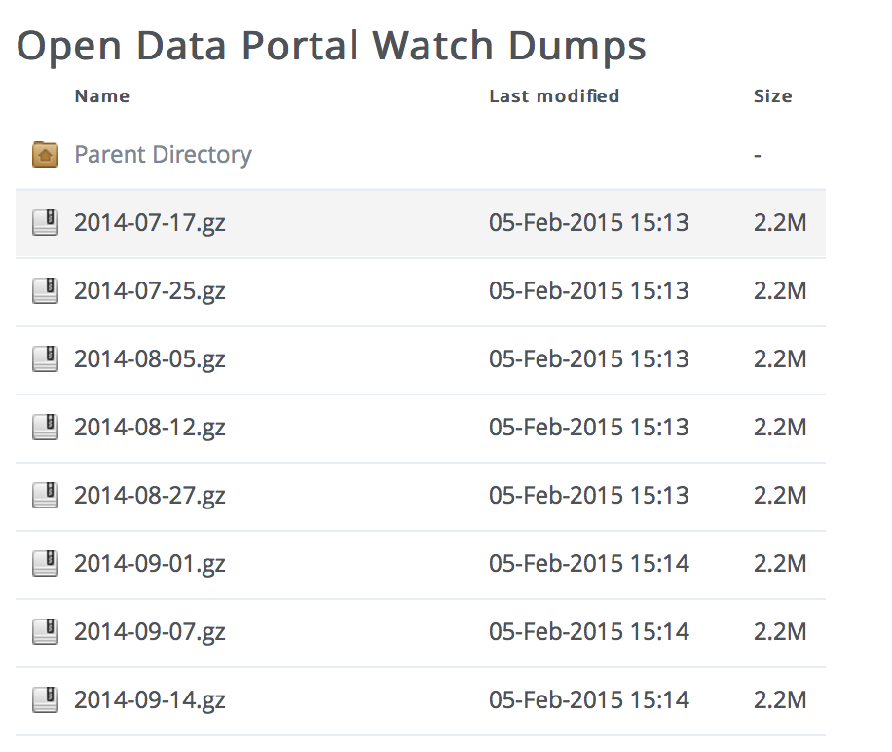
Data Dumps
OPEN DATA PORTAL WATCH provides an archive of Open Data portal crawls (weekly snapshots/dynamic crawling framework):

Slide 50
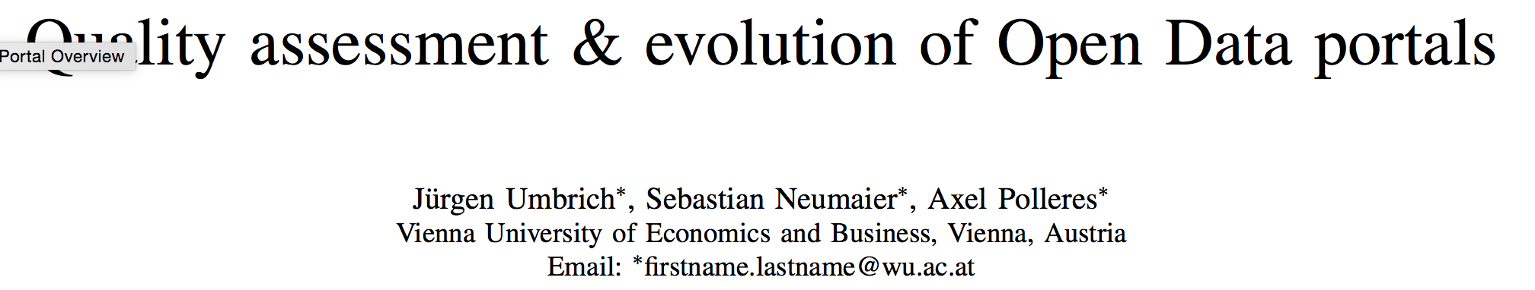

Open Data Portal Watch
Got Best paper award at IEEE OBD-2015, yesterday ☺
http://data.wu.ac.at/portalwatch/
Key findings:
  Significantly varying quality acrosss portals
  Rapid growth for some portals
  Huge variety and range of datasets
  Open Data Portal search is a big problem.

Slide 51
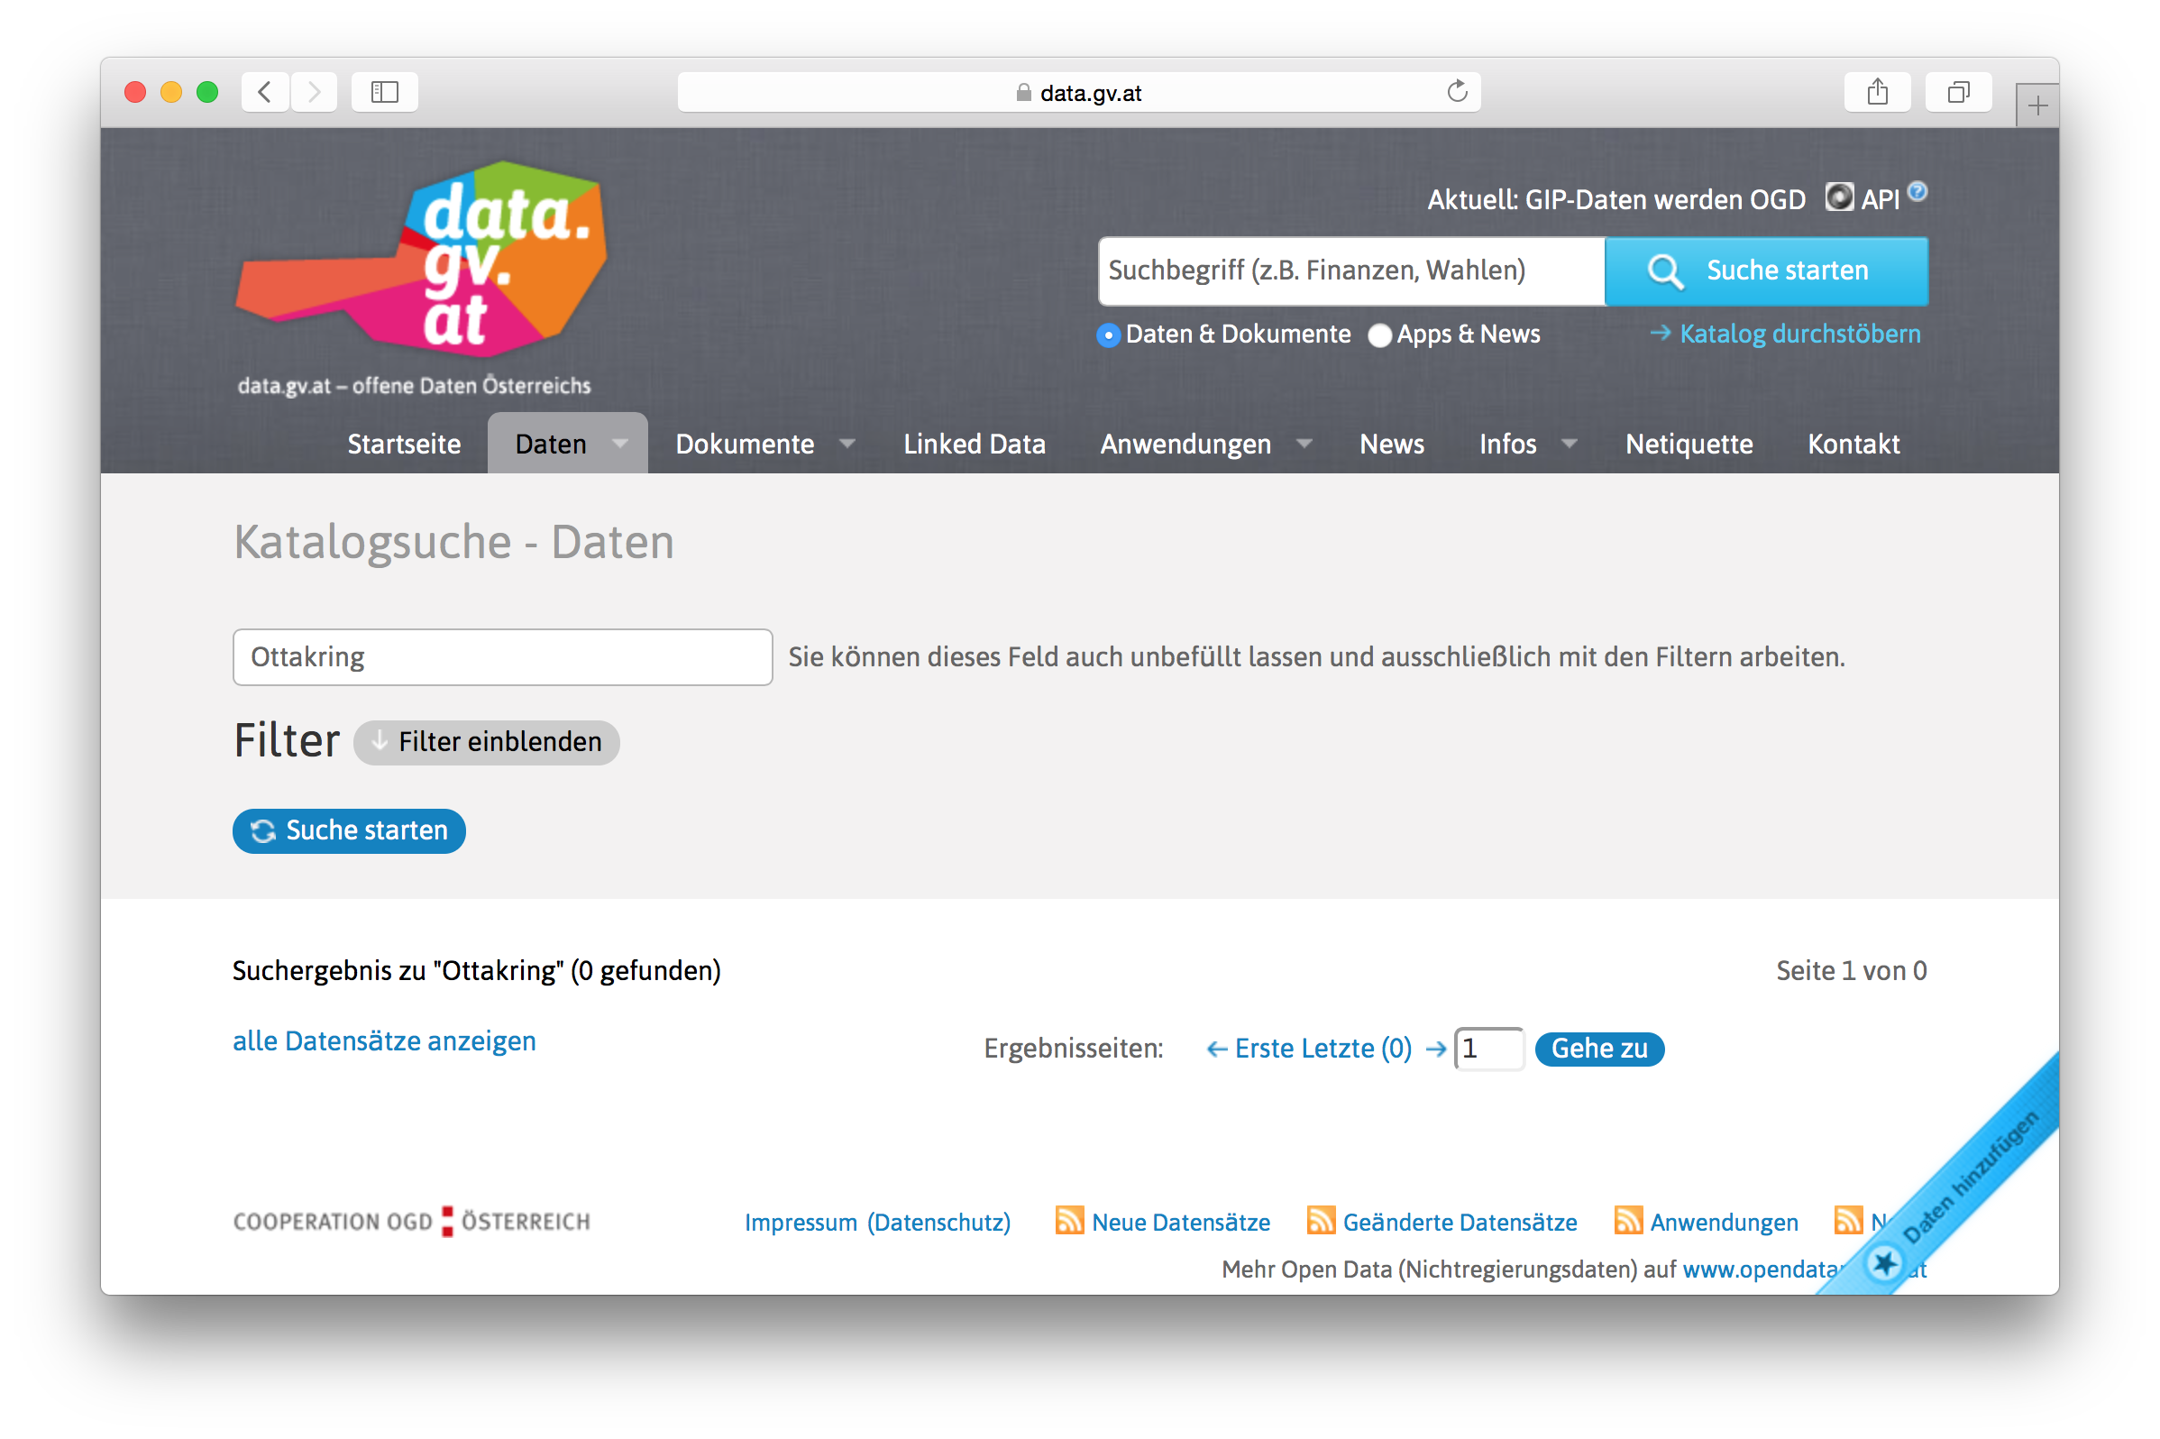
Open Data Portal search is a big problem... Why?

Slide 52
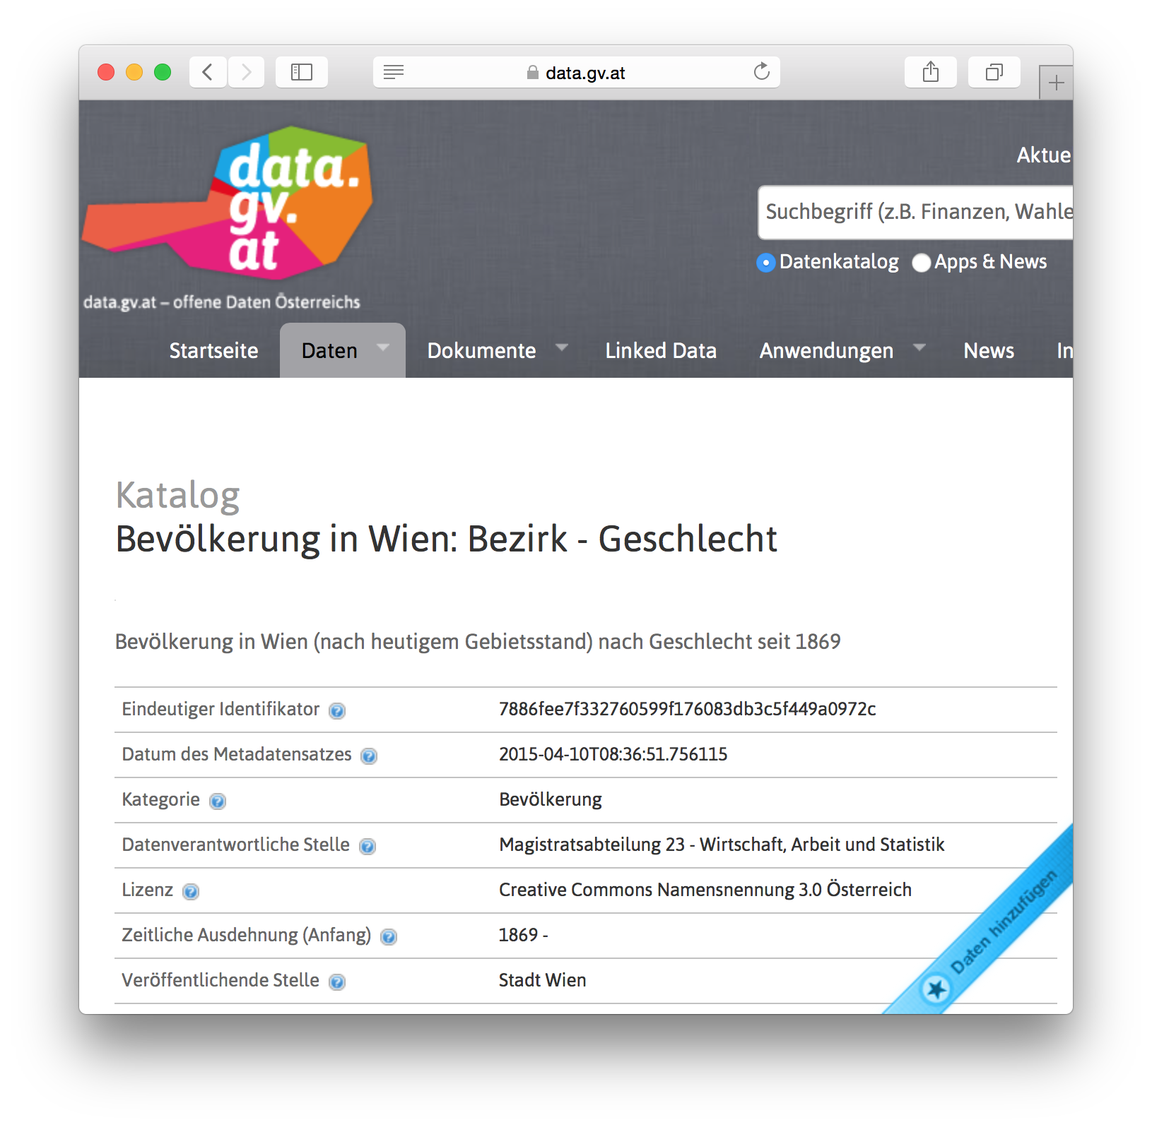
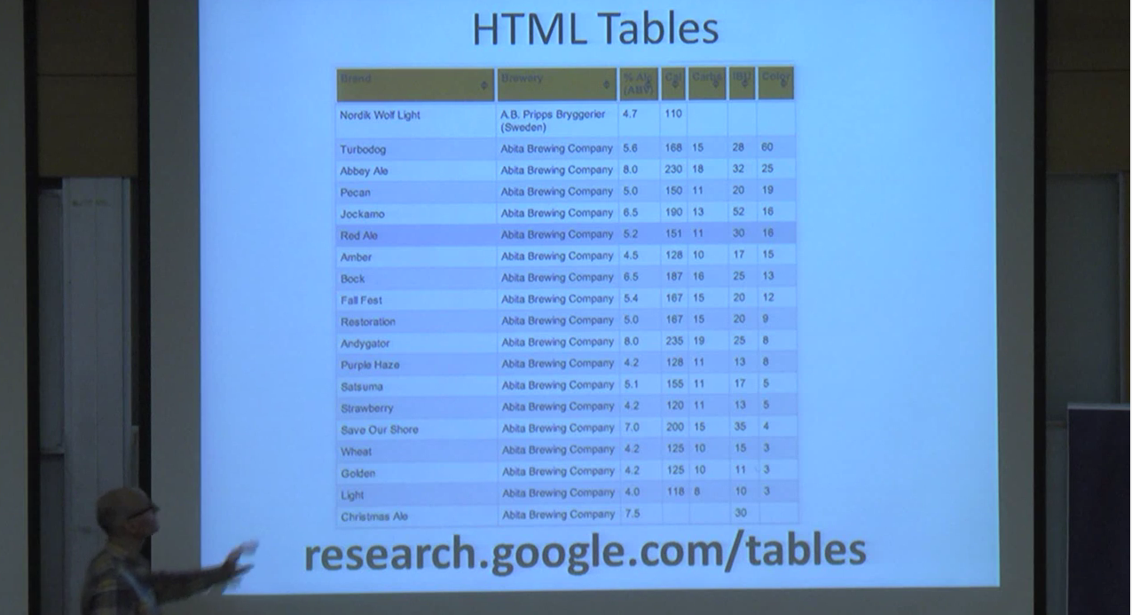
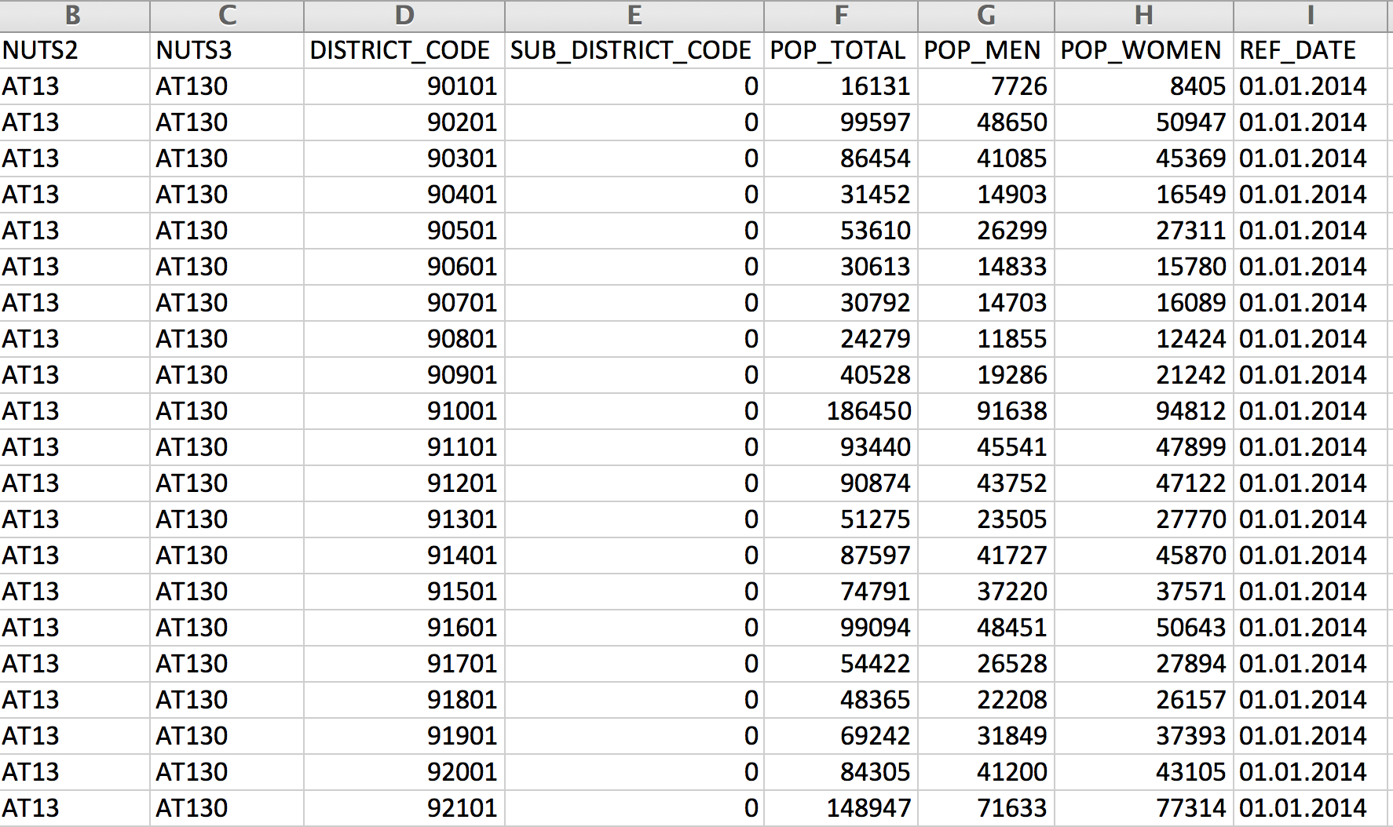
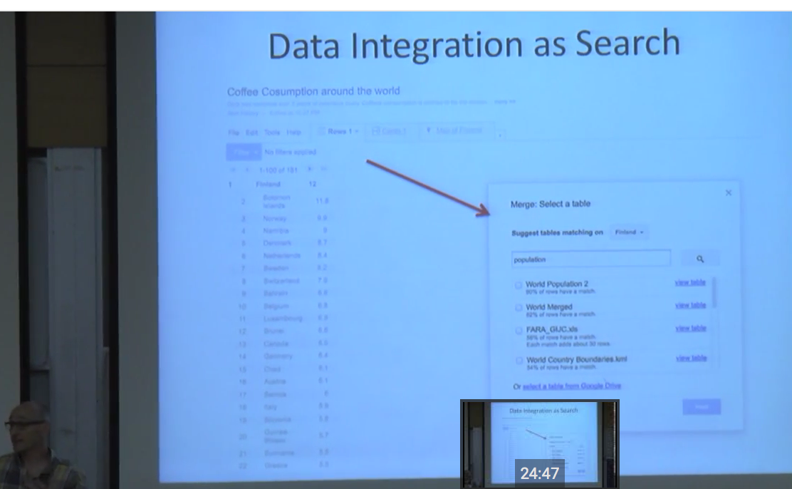
Open Data integration as Search?
https://www.youtube.com/watch?v=kCAymmbYIvc
Structured Data in Web Search by Alon Halevy
vs.
Disclaimer: Won't attempt to compete, but ...
This looks like a slightly different problem...
Can linking to "Open" knowledge graphs help?
(wikidata, dbpedia?) ... Probably.

Slide 53

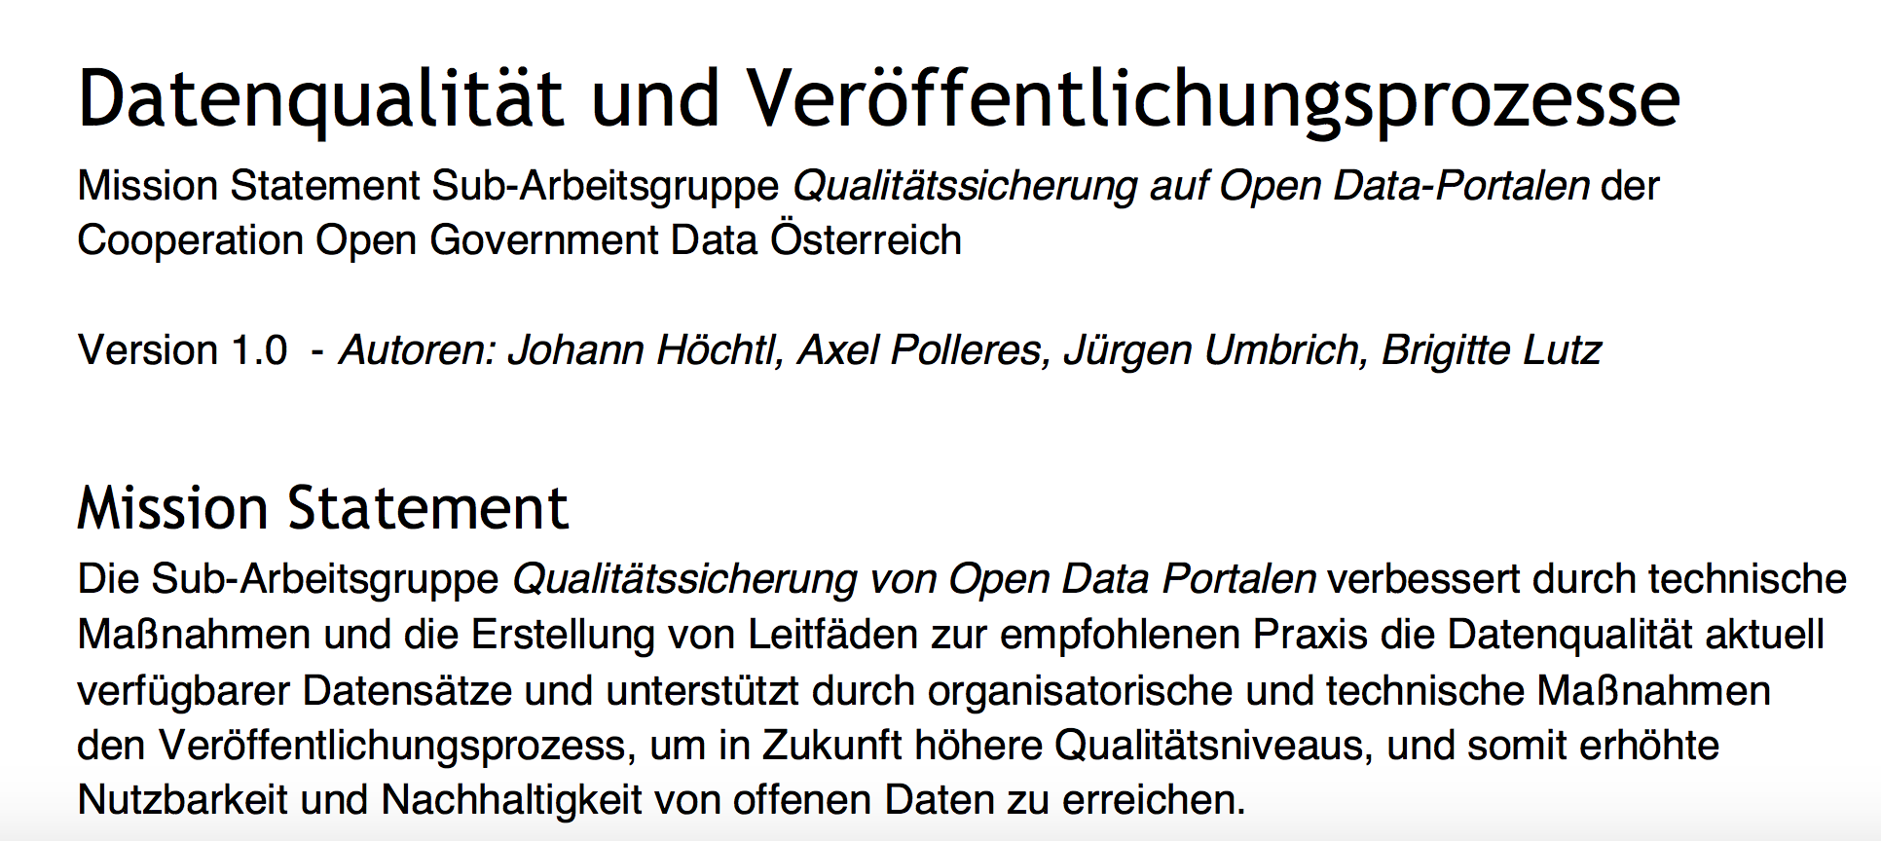
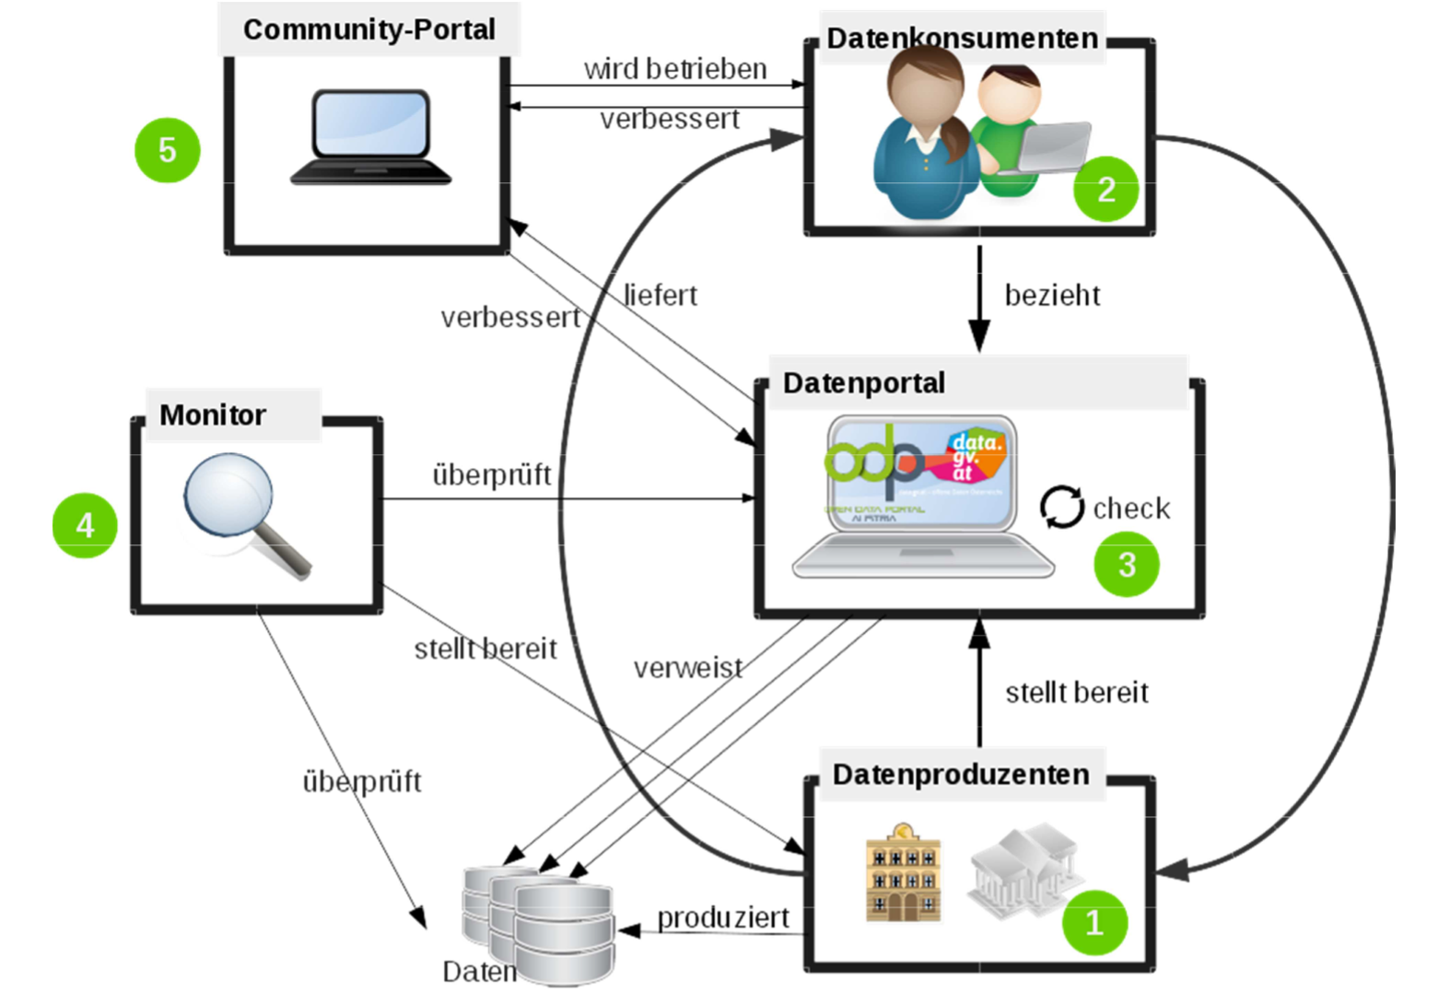

What's next? Research roadmap to make Open Data usage more effective:
Improving Open Data Quality, make OD better searchable...
https://www.data.gv.at/wp-content/uploads/2012/03/Mission-Statement-AG-Qualitaetssicherung-OpenData-Portale.pdf
Upcoming:
ADEQUATe: Analytics & Data
Enrichment to improve the
QUAliTy of Open Data
Project Start: October 2015

Slide 54
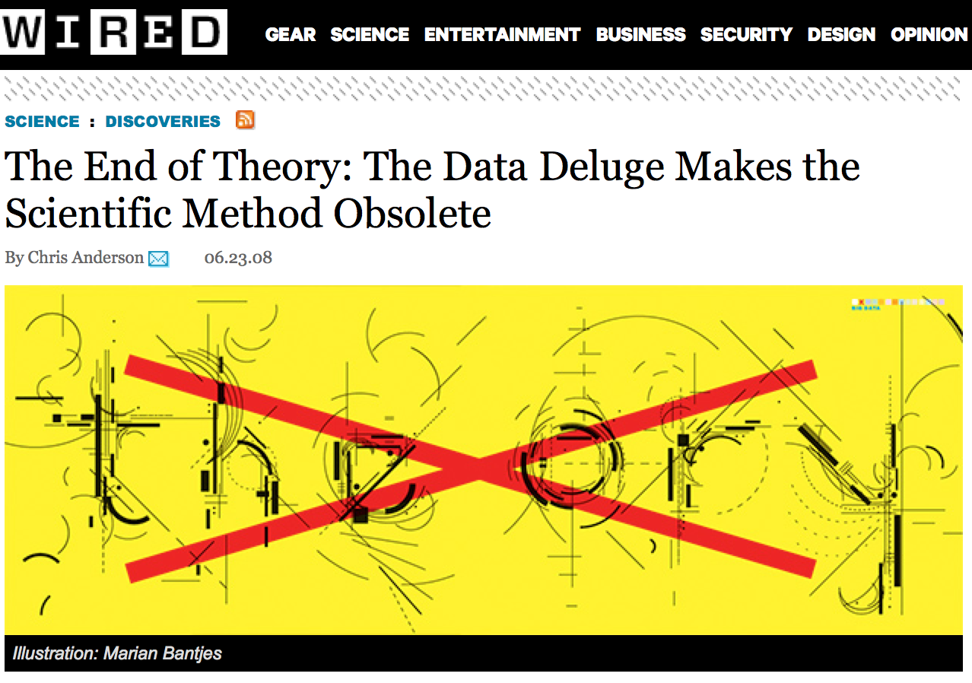
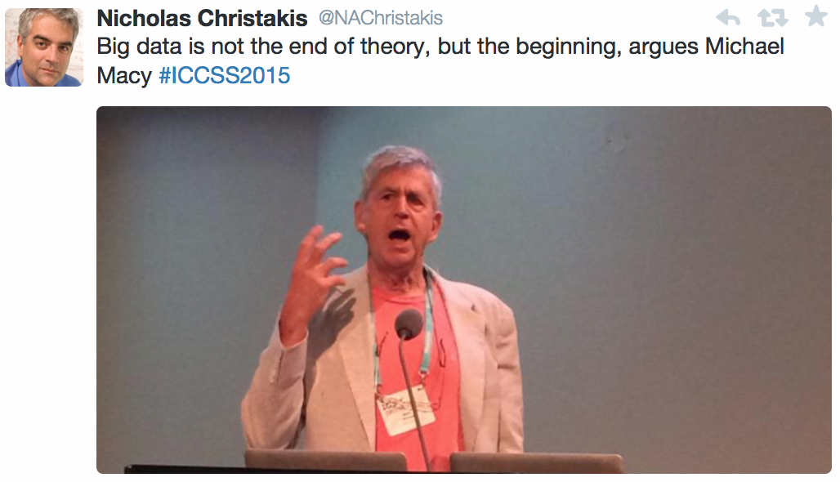
Integrating Open Data:
(How) Can Description Logics Help me?
Expressive ontology languages (plus e.g. equational knowledge) needed
Combination of reasoning about formal background knowledge & statistical methods needed
temporal aspects need to be taken into account, but also provenance
soundness/completeness (KRR) vs. coverage/accuracy (ML)
"NoLD"... not only Linked Data
Beginning
... even the computational social scientists don't buy that:

Slide 55
Integrating Open Data:
(How) Can Description Logics Help me?
Temporal aspects:
On Implementing Temporal Query Answering in DL-Lite (extended abstract) Veronika Thost, Jan Holste, Özgür Özcep (DL2015)
The Complexity of Temporal Description Logics with Rigid Roles and Restricted TBoxes: In Quest of Saving a Troublesome Marriage Víctor Gutiérrez Basulto, Jean Christoph Jung, Thomas Schneider (DL2015)
Temporal Query Answering in EL. Stefan Borgwardt, Veronika Thost (DL2015)
Interval Temporal Description Logics. Alessandro Artale, Roman Kontchakov, Vladislav Ryzhikov, Michael Zakharyaschev (DL2015)
Temporal OBDA with LTL and DL-Lite. Alessandro Artale, Roman Kontchakov, Alisa Kovtunova, Vladislav Ryzhikov, Frank Wolter, Michael Zakharyaschev (DL2014)
Complexity of Temporal Query Abduction in DL-Lite 233-244. Szymon Klarman, Thomas Meyer (DL2014)
Temporalising EL Concepts with Time Intervals 620-632. Jared Leo, Ulrike Sattler, Bijan Parsia (DL2014)
Temporalising OWL 2 QL 17-28 Alessandro Artale, Roman Kontchakov, Frank Wolter, Michael Zakharyaschev (DL2013)
...
Inconsistency handling/
paraconsistent reasoning:
Reasoning Efficiently with Ontologies and Rules in the Presence of Inconsistencies (Extended Abstract) Tobias Kaminski, Matthias Knorr, Joao Leite (DL2015)
Explaining Query Answers under Inconsistency-Tolerant Semantics over Description Logic Knowledge Bases (Extended Abstract) Meghyn Bienvenu, Camille Bourgaux, François Goasdoué (DL2015)
OBDA Using RL Reasoners and Repairing 729-733 Giorgos Stoilos (DL2014)
Querying Inconsistent Description Logic Knowledge Bases under Preferred Repair Semantics 96-99 Camille Bourgaux, Meghyn Bienvenu, François Goasdoué (DL2014)
Bayesian Description Logics 447-458 Ismail Ilkan Ceylan, Rafael Peñaloza (DL2014)
Reasoning about Belief Uncertainty in DL Lite N bool 513-525 Ala Djeddai, Hassina Seridi, Tarek Khadir (DL2014)
Complexity of Inconsistency-Tolerant Query Answering in Datalog+/- 791-803 Thomas Lukasiewicz, Maria Vanina Martinez, Gerardo Simari (DL2013)
…
Numerical Reasoning? Equations?
Closest related work on DLs with concrete domains...
Snorocket 2.0: Concrete Domains and Concurrent Classification 32-38. Alejandro Metke-Jimenez, Michael Lawley (ORE2013)
Concrete domains also supported in HERMIT, Fact++.
Most foundational works 2005 and before...? E.g.: Tableau Algorithm for DLs with Concrete Domains and GCIs – DL2005 Carsten Lutz, Maja Milicic:

Slide 56
Integrating Open Data:
(How) Can Description Logics Help me?
Expressive ontology languages (plus e.g. equational knowledge) needed
combination of reasoning about formal background knowledge & statistical methods needed
temporal aspects need to be taken into account, but also provenance
soundness/completeness (KRR) vs. coverage/accuracy (ML)
"NoLD"... not only Linked Data
Maybe you find our datasets useful:
data.wu.ac.at/portalwatch
citydata.wu.ac.at
Beginning
... even the computational social scientists don't buy that:

