Slide 1
SPARQL1.1 Updates and Entailment - Why the specification is silent about their interaction
Axel Polleres
web: http://polleres.net twitter: @AxelPolleres

Slide 2
Outline
RDF & Linked Data – as a Data abstraction layer of Databases published on the Web
SPARQL - Data – as an abstraction layer of Data services on the Web
Two new features in SPARQL 1.1:
  Entailment regimes
  SPARQL Update
How do they interact?
  Possible Semantics & Examples
Discussion

Slide 3
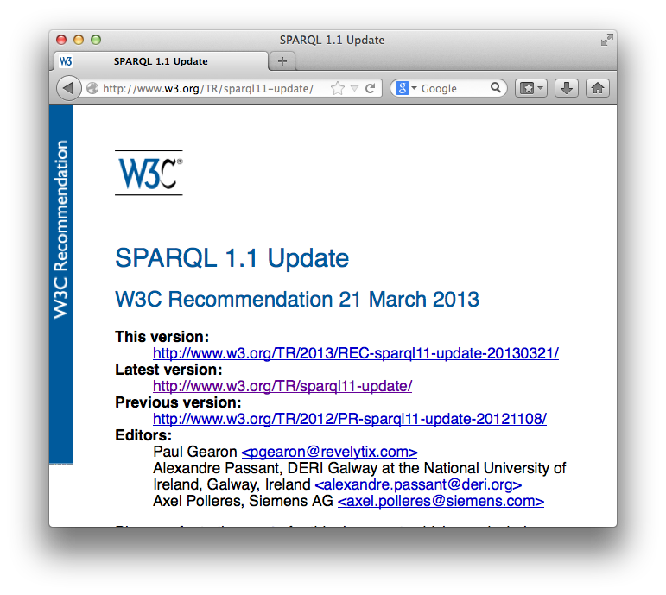
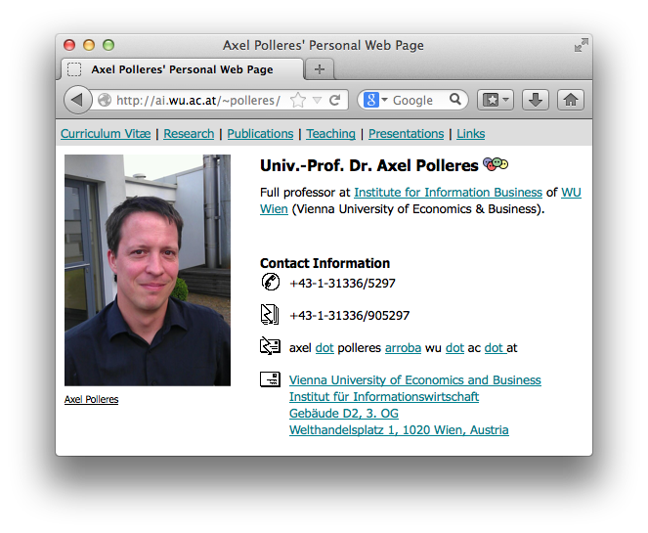
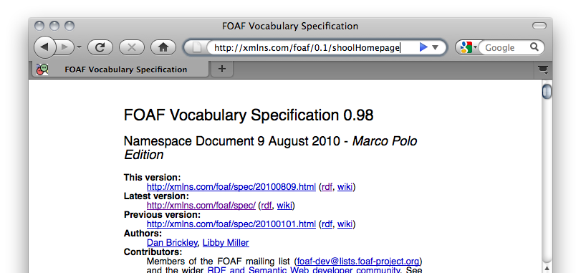

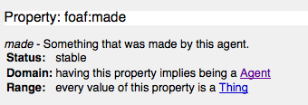
… towards a Web of (Linked) Data
From the HTML Web…
Globally Unique identifiers
Links between Documents (href)
A common protocol
Globally Unique identifiers
Typed Links (=relations) between Entities
A common protocol
URIs
RDF
HTTP
Axel Polleres edited SPARQL1.1 Update spec .
xmlns.com/foaf/0.1/made
polleres.net#me
w3.org/TR/sparql11-update
href
Person
Article
a universal graph-based data format…
(note that e.g. any relational data can be decomposed into such triples)

Slide 4
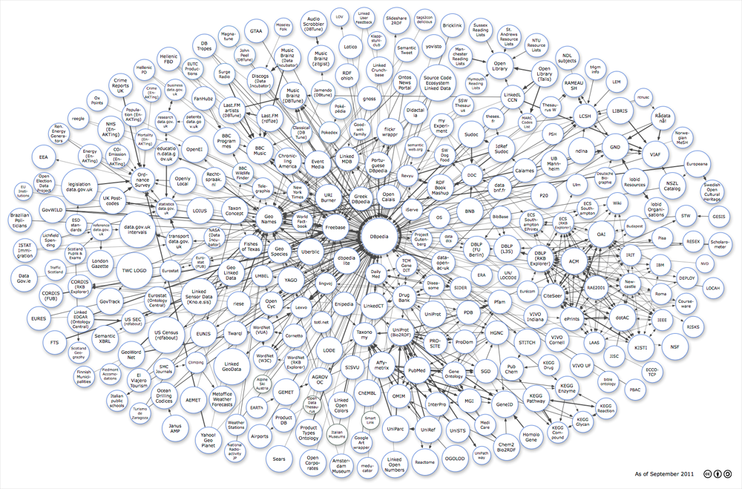








Any data can be represented and Linked using RDF
Image from: http://lod-cloud.net/
4

Slide 5







Linked Data has moved from academia to industry over the last few years…

Slide 6

In the last few years, we have seen many successes, e.g. …
Watson
Knowledge Graph

Slide 7
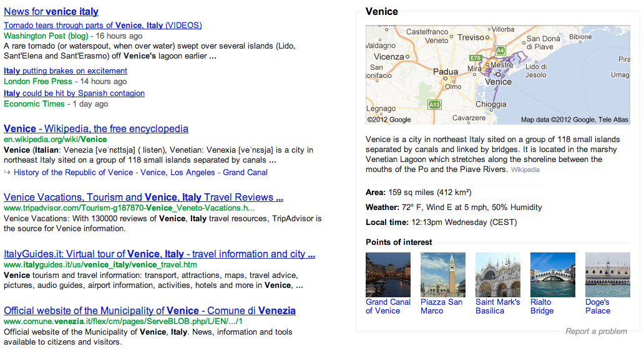
Google Knowledge Graph

Slide 8
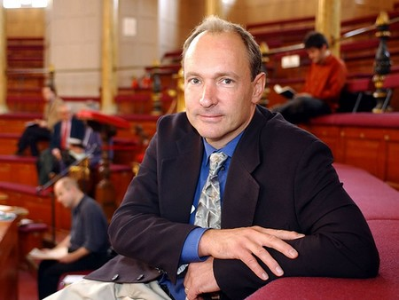


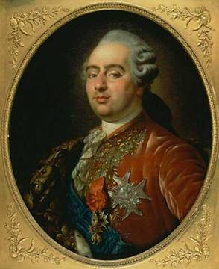
The “Semantic Web” promise…
  “If HTML and the Web made all the online documents look like one huge book, RDF, schema and inference
  languages will make all the data in the world look like one
  huge database” Tim Berners-Lee, 1999
Try the following in google:
“Children of Austrian rulers married to French rulers…?”
Notes:
Te explain what I mean here, let me start with a quote, which at the same time is one of the “big promises” of the Semantic Web and what its technologies shall enable. In 1999 Tim-Berners Lee, the creator of the Web wrote: “If HTML … “ Well, it’s almost 15 years from that now and so it should work by now, shouldn’t it? So let’s try that on google! Unfortunately google doesn’t answer these questions, because google doesn’t allow structured query answering…
For instance, take some market research questions such as the following:
What are the latest news on the new York times about companies with a revenue of over 10b EUR?
Or for my own preparation to this talk, I might have asked myself questions like the following: Who of my peers may have published with colleagues from WU Wien and how do these colleagues look like, such that I recognize them when I stand here in front of you today.

Slide 9
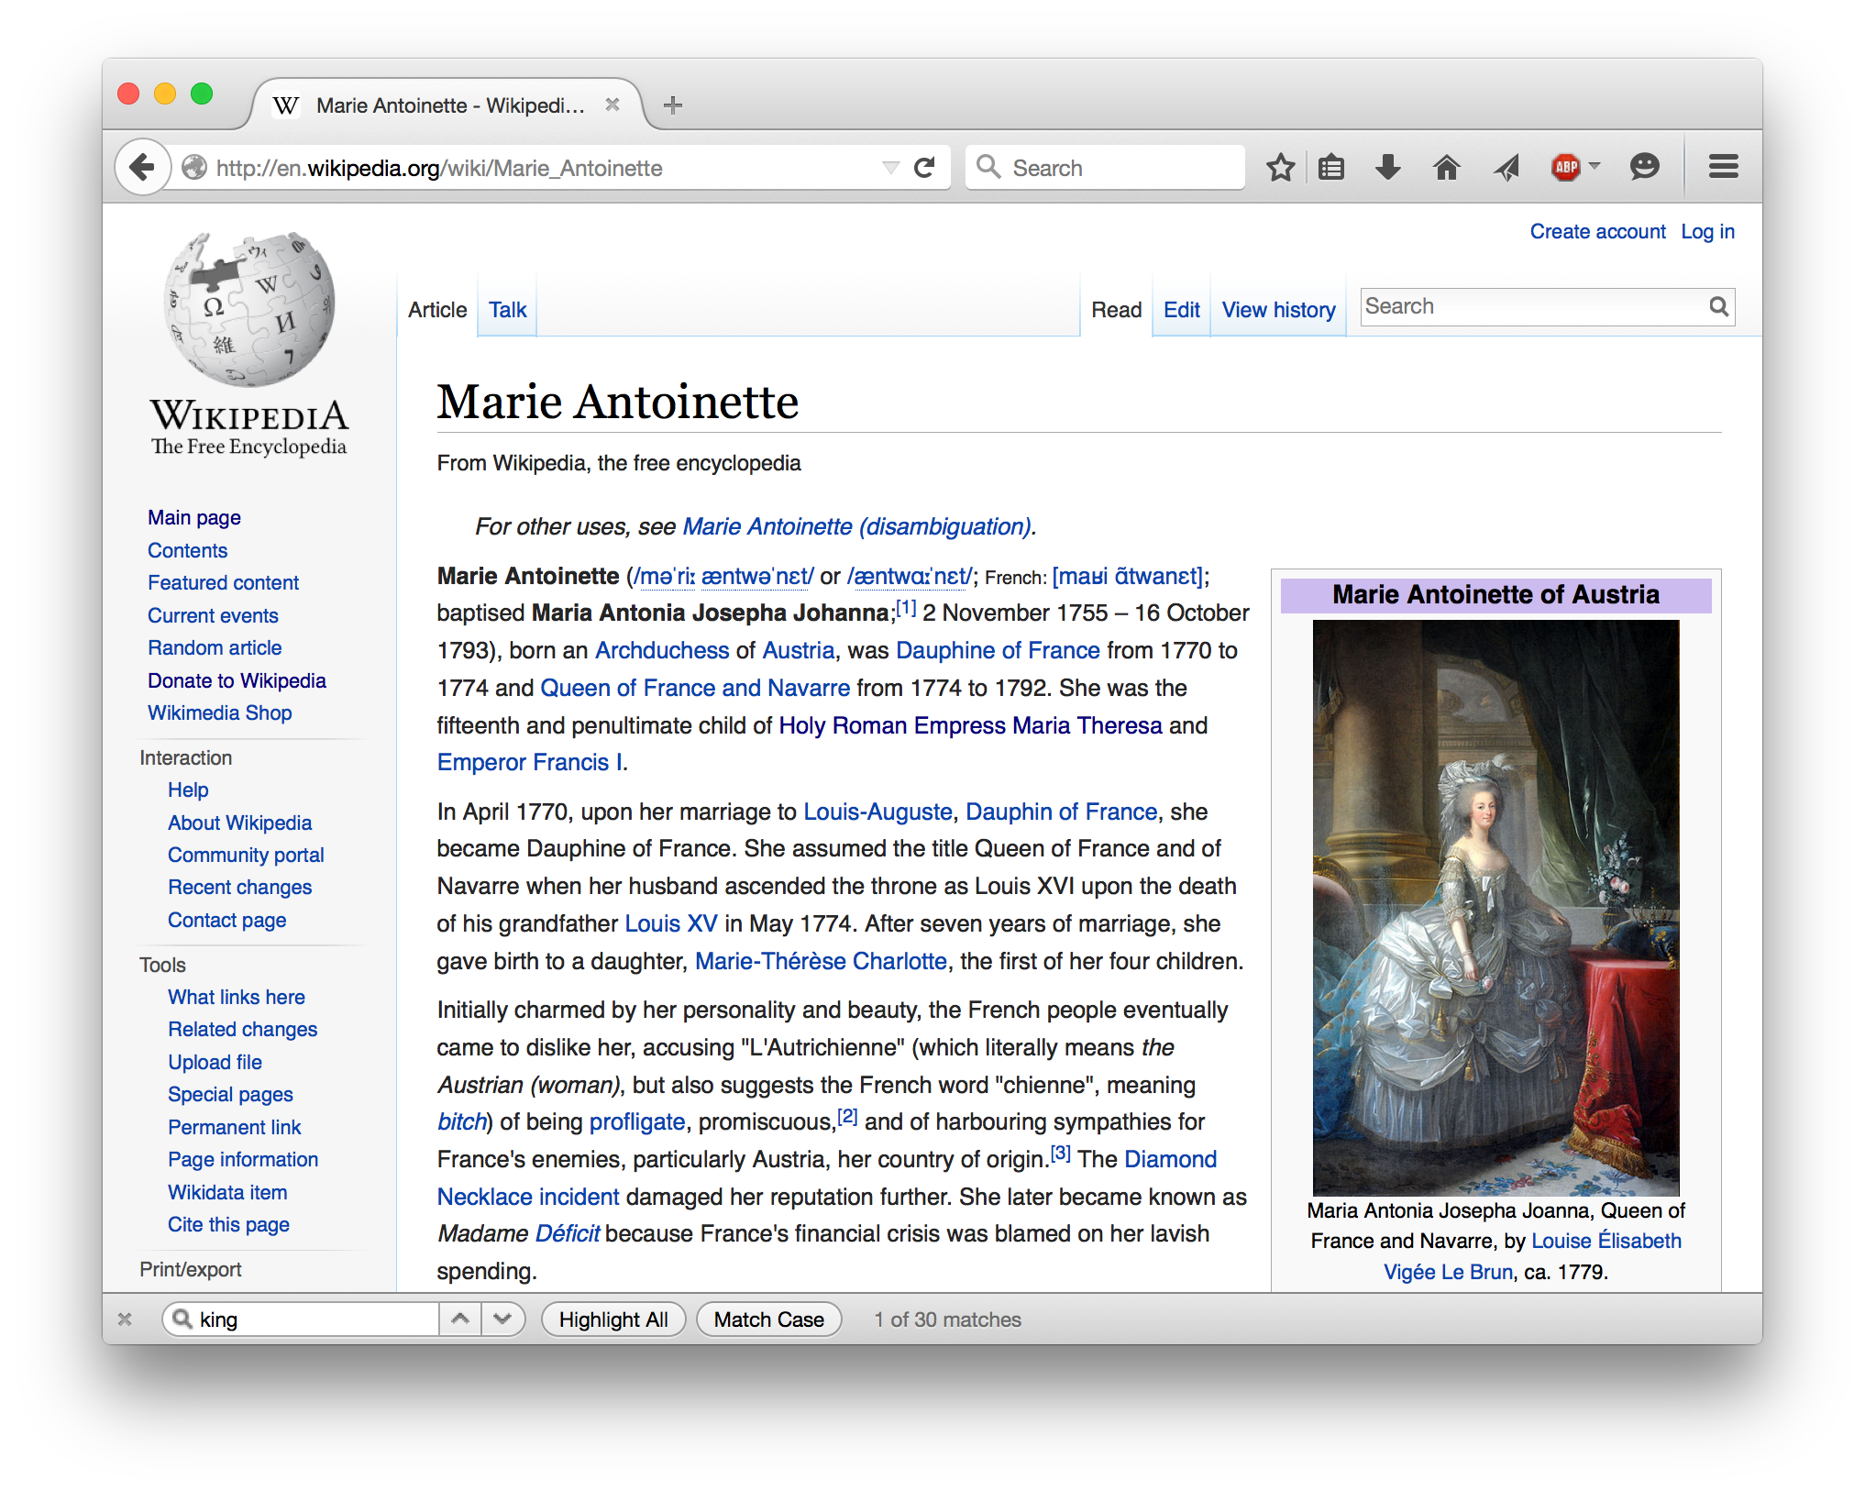
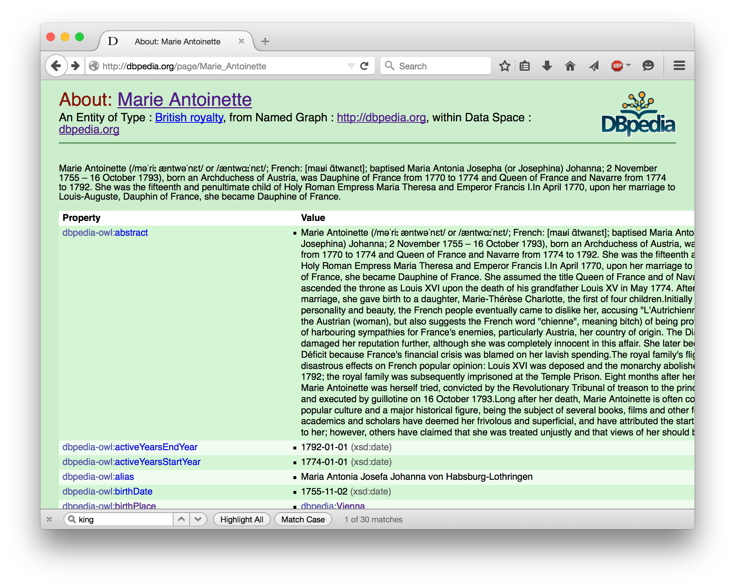
The necessary information is available in RDF – Dbpedia: Wikipedia as a Data Service...
S | P | O
:marie | :hasMother | :maria_t
:marie | :hasSpouse | :louis
:maria_t | a | :RulerOfAustria
:louis | a | :DauphinOfFrance

Slide 10
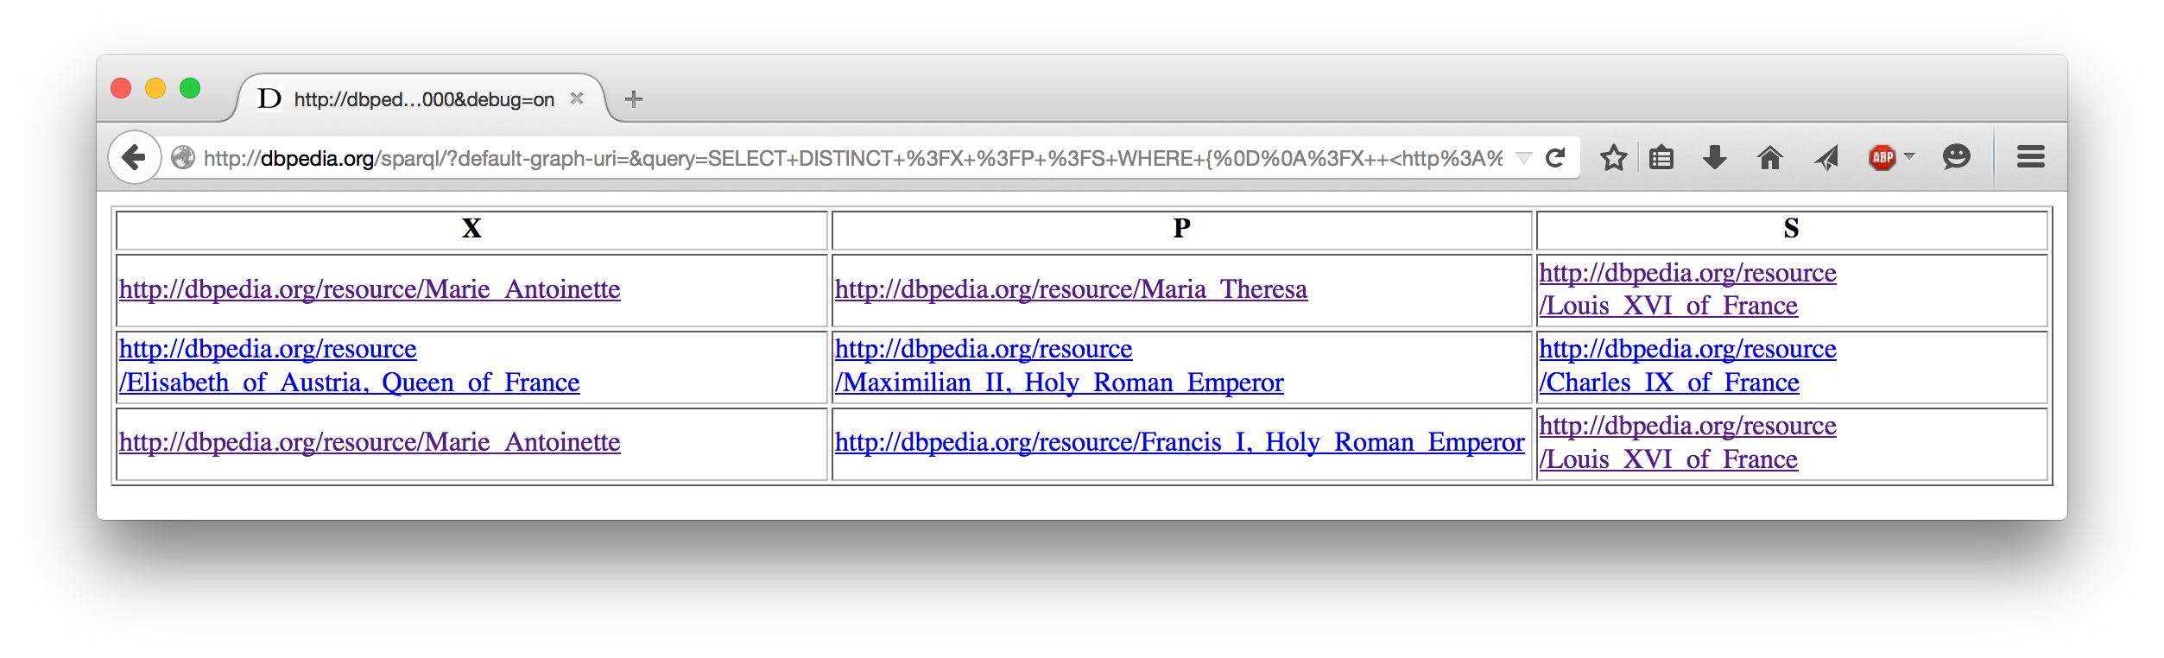
SPARQL: query language for RDF
SPARQL offers a standard protocol/service interface to data offering services!
SPARQL endpoint
→ Query request encoded in a HTTP request
← Query result in various formats (CSV, RDF, JSON, ...)
SELECT ?X ?P ?S WHERE {
?X :hasMother ?P . ?X :hasSpouse ?S .
?P a RulerOfAustria . ?S a :DauphinsOfFrance .
}

Slide 11
SPARQL 1.1
SPARQL 1.0 (2008): SQL "look-and-feel" for RDF and Linked data
SPARQL 1.1 (2013): adding demanded features
Added two new features:
  Use of implicit information: SPARQL 1.1Entailment regimes
  Provide an update interface: SPARQL 1.1 Update

Slide 12
SPARQL1.1 Entailment Regimes:
Make use of ontological meta-information (RDFS and OWL):
SELECT ?X ?P ?S WHERE {
?X :hasMother ?P . ?X :hasSpouse ?S .
?P a RulerOfAustria . ?S a :DauphinsOfFrance .
}
SELECT ?X ?P ?S WHERE {
?X :hasParent ?P . ?X :hasSpouse ?S .
?P a RulerOfAustria . ?S a :RulerOfFrance .
}
S | P | O
:marie | :hasMother | :maria_t
:marie | :hasSpouse | :louis
:maria_t | rdf:type | :RulerOfAustria
:louis | rdf:type | :DauphinOfFrance
S | P | O
:hasMother | rdfs:subPropertyOf | :hasParent
:DauphinOfFrance | rdfs:subClassOf | :RulerOfFrance

Slide 13
How are Entailment Regimes typically implemented in SPARQL engines?

Slide 14
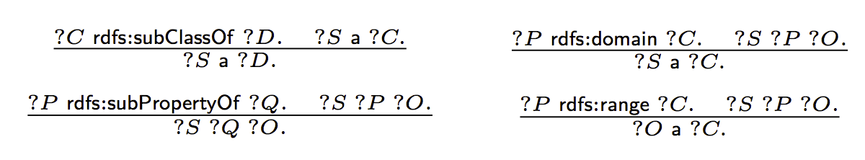
SPARQL Query answering under RDFS Entailment:
S | P | O
:Mother | rdfs:subClassOf | :Parent
:hasMother | rdfs:subPropertyOf | :hasParent
:hasMother | rdfs:range | :Mother
:hasParent | rdfs:domain | :Child
:hasParent | rdfs:range | :Parent
...
...
S | P | O
:marie | :hasMother | :maria_t
:marie | :hasParent | :maria_t
[Munoz et al., ESWC2007] Minimal RDFS (ABox-) Inference Rules
S | P | O
:marie | :hasMother | :maria_t
:marie | a | :Child
:marie | :hasParent | :maria_t
:maria_t | a | :Mother
:maria_t | a | :Parent
materialize(G)

Slide 15
SPARQL Query answering under RDFS Entailment:
SELECT ?Y
WHERE {
{ :marie :hasParent ?Y . }
UNION
{:marie :hasMother ?Y . }
UNION
{:marie :hasFather ?Y . }
[Bischof et al., ISWC2014] Schema-Agnostic Query Rewriting in SPARQL 1.1
S | P | O
:Mother | rdfs:subClassOf | :Parent
:hasMother | rdfs:subPropertyOf | :hasParent
:hasMother | rdfs:range | :Mother
:hasParent | rdfs:domain | :Child
:hasParent | rdfs:range | :Parent
...
DELETE {?S1 a ?D1. ?S2 a ?C2. ?S3 ?Q3 ?O3. ?O4 a ?C4.}
WHERE {
{ ?C1 sc+ ?D1. ?S1 a ?C1. }
UNION { ?P2 dom/sc* ?C2. ?S2 ?P2 ?O2. }
UNION { ?P3 sp+ ?Q3. ?S3 ?P3 ?O3. }
UNION { ?P4 rng/sc* ?C4. ?S4 ?P4 ?O4. }
}
rewrite(q,T)
...
S | P | O
:marie | :hasMother | :maria_t
S | P | O
:marie | :hasMother | :maria_t
:marie | :hasParent | :maria_t
ans(rewrite(q, T), G)
=
ans(q, materialize(G))
Well known:
ans(rewrite(q, T), reduce(G))
=
ans(q, materialize(reduce(G)))
reduce(G)
S | P | O
:marie | :hasMother | :maria_t
:marie | a | :Child
:marie | :hasParent | :maria_t
:maria_t | a | :Mother
:maria_t | a | :Parent
SELECT ?Y
WHERE { :marie :hasParent ?Y . }
materialize(G)

Slide 16
SPARQL 1.1
SPARQL 1.0 (2008): SQL "look-and-feel" for RDF and Linked data
SPARQL 1.1 (2013):
Added two new features:
  Use of implicit information: SPARQL 1.1Entailment regimes
  Provide an update interface: SPARQL 1.1 Update

Slide 17
Data Services on the Web allow updates:
Examples:
INSERT { :marie :hasChild :marie_therese_of_France .}
What do these updates mean in a materialized or reduced store?
DELETE { ?X ?P ?O .}
WHERE { ?X :hasParent :maria_t}
DELETE {?X :hasParent :maria_t .}
INSERT { ?X :hasMother :maria_t. }
WHERE { ?X :hasParent :maria_t}

Slide 18
Status:
Standardization of SPARQL 1.1 Update, and SPARQL 1.1 Entailment Regimes with triple stores implementing those standards (rewriting- or materialization-based)
Query rewriting techniques already explored in the context of DL-Lite and OBDA… do they help us with updates as well?
Emerging need for a more systematic approach of dealing with SPARQL 1.1 Update over ABoxes & TBoxes
Nothing endures but change. - Heraclitus

Slide 19
What's been done already?
What do off-the-shelf triple stores do?
  Entailment typically handled
    at (bulk) loading by materialization , or
    at query time by rewriting
  but not in the context of Updates.
  no “standard” behavior for Delete & Insert upon materialized stores.
  interplay of Entailments and Update left out in the SPARQL 1.1 spec.
What does the literature say?
Approaches in the literature on updates and RDFS (or also DLs) limited to atomic update operations…
  [Gutierrez et al., ESWC2011] ABox deletions in the context of RDFS
  [Calvanese et al., ISWC2010] ABox & TBox insertions in the context of DL-Lite (incl. inconsistency repair)
Also related:
  Deductive DBs: [Gupta et al., SIGMOD93]: DRed (delete and re-derive), applied by [Kotowski et al.2011] and [Urbani et al. 2013] in the contet of RDF/RDFS…
  KB evolution, Belief revision, etc.: Various works in classical AI and philosophy
Particularly, none of these considers the interplay between DELETE, INSERT based on a joint WHERE clause as in SPARQL

Slide 20
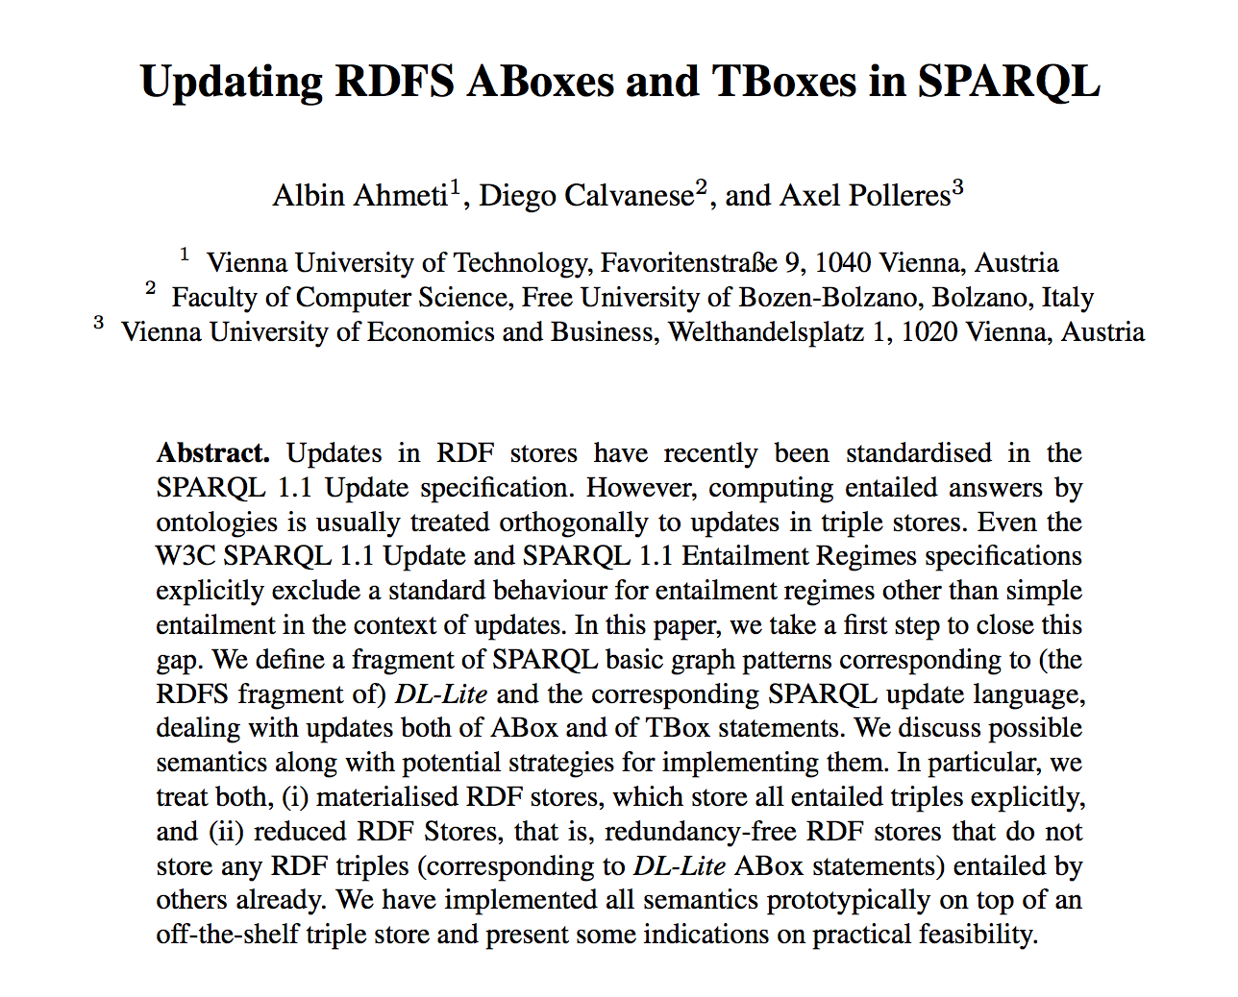
Our initial thoughts on this problem...

Slide 21
Let's start with a minimalistic setting:
Discuss possible update semantics in the context of materialized and reduced stores & RDFS:
  Only ABox updates, TBox fixed
  Use "minimal" RDFS as TBox language (without axiomatic triples, blank nodes) … i.e., DL-Lite_{RDFS}
  Restrict on BGPs to only allow ABox Insert/Deletes
Even in this restricted setting (RDFS) defining a reasonable update semantics under entailments turns out to be challenging!
INSERT {:marie :hasMother ?Y }
WHERE
{:marie :hasParent ?Y }
INSERT {:marie ?Y :foo}
WHERE
{:marie rdf:type ?Y }
Notes:
After this slide, add a slide which shows the Abox RDFS rules. (with a hint to Muñoz et al. Paper), i.e. subclass, subpropertz, domain, range inferences

Slide 22
Baseline semantics
Sem₀^{mat}
  Naïve Update followed by re-materialization

Slide 23
Exploring possible ABox update semantics
Materialized-preserving semantics
  Sem₀^{mat} … baseline semantics
  Sem_{1a}^{mat}
  Sem_{1b}^{mat}
  Sem₂^{mat} … delete incl. causes and rewrite upon inserts
Reduced-preserving semantics
  Sem₀^{red} ... baseline semantics
  Sem₁^{red} … delete incl. causes followed by reduce
}
inspired by DRed: delete (incl. effects) and re-derive new effects upon inserts

Slide 24
  Sem₀^{mat}: Naïve Update followed by re-materialization
DELETE { ?X a :Child . }
INSERT { ?Y a :Mother . }
WHERE { ?X :hasParent ?Y . }
S | P | O
:Mother | rdfs:subClassOf | :Parent
:hasMother | rdfs:subPropertyOf | :hasParent
:hasMother | rdfs:range | :Mother
:hasParent | rdfs:domain | :Child
:hasParent | rdfs:range | :Parent
...
...
DELETE { :marie a :Child . }
INSERT { :maria_t a :Mother . }
?X=:marie
?Y=:maria_t
S | P | O
:marie | :hasMother | :maria_t
:marie | :hasParent | :maria_t
:maria_t | a | :Mother
:maria_t | a | :Parent
S | P | O
:marie | :hasMother | :maria_t
:marie | a | :Child
:marie | :hasParent | :maria_t
:maria_t | a | :Mother
:maria_t | a | :Parent
S | P | O
:marie | :hasMother | :maria_t
:marie | a | :Child
:marie | :hasParent | :maria_t
:maria_t | a | :Mother
:maria_t | a | :Parent
No effect!
materialize(G)

Slide 25
Alternative Materialized-pres. semantics
Sem_{1a}^{mat}
  “Delete and rederive”
1. DELETEs triples incl. Effects
2. INSERT triples
3. Re-materialize
Notes:
delete the instantiations of P_{d} plus “dangling” effects, i.e., effects of deleted triples that after deletion are not implied any longer by any non-deleted triples;
insert the instantiations of P_{i} plus all their effects

Slide 26
  Sem_{1a}^{mat}: Delete and rederive
DELETE { :marie :hasMother :maria_t. }
S | P | O
:Mother | rdfs:subClassOf | :Parent
:hasMother | rdfs:subPropertyOf | :hasParent
:hasMother | rdfs:range | :Mother
:hasParent | rdfs:domain | :Child
:hasParent | rdfs:range | :Parent
...
DELETE { :marie :hasMother :maria_t .
:marie :hasParent :maria_t .
:marie a Child .
:maria_t a Mother.
:maria_t a Parent. }
...
S | P | O
:marie | :hasMother | :maria_t
:marie | a | :Child
:marie | :hasParent | :maria_t
:maria_t | a | :Mother
:maria_t | a | :Parent
S | P | O
S | P | O
May be viewed quite "radical"
materialize(G)

Slide 27
  Sem_{1a}^{mat}: Delete and rederive
DELETE { :marie :hasParent :maria_t. }
S | P | O
:Mother | rdfs:subClassOf | :Parent
:hasMother | rdfs:subPropertyOf | :hasParent
:hasMother | rdfs:range | :Mother
:hasParent | rdfs:domain | :Child
:hasParent | rdfs:range | :Parent
...
DELETE { :marie :hasParent :maria_t .
:marie a Child .
:maria_t a Parent. }
...
S | P | O
:marie | :hasMother | :maria_t
:maria_t | a | :Mother
S | P | O
:marie | :hasMother | :maria_t
:marie | a | :Child
:marie | :hasParent | :maria_t
:maria_t | a | :Mother
:maria_t | a | :Parent
S | P | O
:marie | :hasMother | :maria_t
:marie | a | :Child
:marie | :hasParent | :maria_t
:maria_t | a | :Mother
:maria_t | a | :Parent
Again: no effect!
materialize(G)

Slide 28
Alternative Materialized-pres. semantics
Sem_{1b}^{mat}
  Variant of Sem_{1a}, that makes a distinction between explicit and implicit triples.
  Re-materialization from scratch from

Slide 29
  Sem_{1b}^{mat}: Delete and rederive with separating "explicit" and "implicit" ABox
DELETE { :marie :hasParent :maria_t. }
S | P | O
:Mother | rdfs:subClassOf | :Parent
:hasMother | rdfs:subPropertyOf | :hasParent
:hasMother | rdfs:range | :Mother
:hasParent | rdfs:domain | :Child
:hasParent | rdfs:range | :Parent
...
...
ABox_{expl}
S | P | O
:marie | :hasMother | :maria_t
S | P | O
:marie | :hasMother | :maria_t
:marie | :hasParent | :maria_t
ABox_{impl}
Abox'_{impl}
Again: no effect!
S | P | O
:marie | :hasMother | :maria_t
:marie | a | :Child
:marie | :hasParent | :maria_t
:maria_t | a | :Mother
:maria_t | a | :Parent
S | P | O
:marie | :hasMother | :maria_t
:marie | a | :Child
:marie | :hasParent | :maria_t
:maria_t | a | :Mother
:maria_t | a | :Parent
materialize(G)

Slide 30
Alternative Materialized-pres. semantics
Sem₂^{mat}
  Delete the instantiations of 𝑃_{𝑑} plus all their causes;
  Insert the instantiations of 𝑃_{𝑖} plus all their effects.
Notes:
Say that set of causes in RDFS (if you assume acyclic Tbox) is uniquely determined.

Slide 31
DELETE { ?X a :Child . }
INSERT { ?Y a :Mother . }
WHERE { ?X :hasMother ?Y . }
S | P | O
:Mother | rdfs:subClassOf | :Parent
:hasMother | rdfs:subPropertyOf | :hasParent
:hasMother | rdfs:range | :Mother
:hasParent | rdfs:domain | :Child
:hasParent | rdfs:range | :Parent
...
rewrite(u,T)
DELETE { ?X a :Child. ?X :hasFather ?x1.
?X :hasMother ?x2. ?X :hasParent ?x3. }
INSERT { ?Y a :Mother. ?Y a :Parent. }
WHERE { { ?X :hasMother ?Y. }
{ ?x1 a rdfs:Resource. ?x2 a rdfs:Resource.
?x3 a rdfs:Resource.} }
S | P | O
:marie | :hasMother | :maria_t
:marie | :hasParent | :maria_t
DELETE {:marie a :Child.
:marie :hasFather :maria_t, :marie, :louis … .
:marie :hasMother :maria_t, :marie, :louis … .
:marie :hasParent :maria_t, :marie, :louis … … }
INSERT { :maria_t a :Mother . :maria_t a Parent . }
materialize(G)
S | P | O
:marie | :hasMother | :maria_t
:marie | a | :Child
:marie | :hasParent | :maria_t
:maria_t | a | :Mother
:maria_t | a | :Parent
S | P | O
:maria_t | a | :Mother
:maria_t | a | :Parent
?X=:marie ?Y=:maria_t
?x1=?x2=?x3=*

Slide 32
DELETE {}
INSERT {:marie :hasMother :maria_t;:hasFather :louis}
WHERE {};
S | P | O
:Mother | rdfs:subClassOf | :Parent
:hasMother | rdfs:subPropertyOf | :hasParent
:hasMother | rdfs:range | :Mother
:hasParent | rdfs:domain | :Child
:hasParent | rdfs:range | :Parent
...
DELETE {:marie :hasMother :maria_t;:hasFather :louis }
INSERT{}
WHERE{};
rewrite(u1,T)
rewrite(u2,T)
DELETE {}
INSERT {:marie :hasMother :maria_t;:hasFather :louis,
:hasParent :maria_t, :hasParent :louis.
:marie a :Child . :maria_t a :Mother, :Parent.
:louis a :Father, Parent.} WHERE {};
S:ja | P | O
:marie | a | :Child
:maria_t | a | :Mother
:maria_t | a | :Parent
:marie | :hasParent | :maria_t
:louis | a | :Father
:marie | :hasParent | :louis
DELETE {:marie :hasMother :maria_t;:hasFather :louis }
INSERT {}
WHERE {};
DELETE following INSERT is NOT idempotent!
→ Leaves "Dangling effects"
Notes:
Dangling effects not easy to deal with, some intuition given in the paper, but again we find unintuitive examples in the end...

Slide 33

Baseline semantics
Sem₀^{red}
  Naïve Update followed by re-reduce

Slide 34
  Sem₀^{red}: Naïve Update followed by re-reduce
DELETE { ?X a :Child . }
INSERT { ?Y a :Mother . }
WHERE { ?X :hasMother ?Y . }
S | P | O
:Mother | rdfs:subClassOf | :Parent
:hasMother | rdfs:subPropertyOf | :hasParent
:hasMother | rdfs:range | :Mother
:hasParent | rdfs:domain | :Child
:hasParent | rdfs:range | :Parent
...
DELETE { :marie a :Child . }
INSERT { :maria_t a :Mother . }
?X=:marie
?Y=:maria_t
S | P | O
:marie | :hasMother | :maria_t
:maria_t | a | :Mother
S | P | O
:marie | :hasMother | :maria_t
S | P | O
:marie | :hasMother | :maria_t
No effect!
reduce(G)
Notes:
Maybe add the Abox and reduce operator…

Slide 35

Alternative Reduced-pres. semantics
Sem₁^{red}
  Delete the instantiations of 𝑃_{𝑑} plus all their causes;
  Insert the instantiations of 𝑃_{𝑖}.
  Followed by re-reduce
Notes:
Say that set of causes in RDFS (if you assume acyclic Tbox) is uniquely determined.

Slide 36
  Sem₁^{red}: Re-written Update followed by re-reduce
DELETE { ?X a :Child . }
INSERT { ?Y a :Mother . }
WHERE { ?X :hasMother ?Y . }
S | P | O
:Mother | rdfs:subClassOf | :Parent
:hasMother | rdfs:subPropertyOf | :hasParent
:hasMother | rdfs:range | :Mother
:hasParent | rdfs:domain | :Child
:hasParent | rdfs:range | :Parent
...
rewrite(u,T)
DELETE { ?X a :Child. ?X :hasFather ?x1.
?X :hasMother ?x2. ?X :hasParent ?x3. }
INSERT { ?Y a :Mother. }
WHERE { { ?X :hasMother ?Y. }
{ ?x1 a rdfs:Resource. ?x2 a rdfs:Resource.
?x3 a rdfs:Resource.} }
S | P | O
:maria_t | a | :Mother
S | P | O
:marie | :hasMother | :maria_t
DELETE {joe a :Child. :marie :hasMother :maria_t, :louis, ….
:marie :hasParent :maria_t, :louis, …. … }
INSERT { :maria_t a :Mother. }
reduce(G)
?X=:marie ?Y=:maria_t
?x1=?x2=?x3=*
S | P | O
:maria_t | a | :Mother

Slide 37
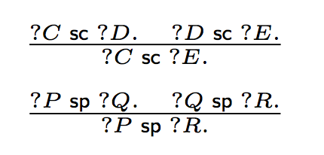
TBox updates
In this setting
  We expand BGPs to take into account TBox Inserts/Deletes – general BGPs
  Tbox inserts are trivial in this setting of RDFS.
  TBox deletions for RDFS are ambiguous (minimal cuts) [Gutierrez et al., ESWC2011]
Opens various degrees of freedom… What if we consider a materialized Tbox?
  We also use two RDFS rules for TBox materialization.
DELETE {:A rdfs:subClassOf ?C . }

Slide 38
Minimal cuts are ambiguous!

Slide 39
Proposed TBox update semantics
DELETE { :A rdfs:subClassOf ?X. }
WHERE
{ :A rdfs:subClassOf ?X .
?X rdfs:subClassOf* :F. }
Outbound cut: Intuition
DELETE { :A rdfs:subClassOf :F. }
Idea: Can be implemented with SPARQL 1.1 property paths

Slide 40
Analogous alternative: Sem_{incut}
Inbound cut: Intuition
DELETE { ?X rdfs:subClassOf :F. }
WHERE
{ :A rdfs:subClassOf* ?X .
?X rdfs:subClassOf :F. }

Slide 41
Prototype & Evaluation
A prototype is available in Java using Jena API implementing the proposed update semantics
  http://dbai.tuwien.ac.at/user/ahmeti/sparqlupdate-rewriter/index.html

Slide 42
Conclusions
A first step to close the gap left by the current standards (SPARQL1.1 Update vs. SPARQL1.1 Entailment Regimes)
We looked into various materialized and reduced preserving semantics
  Seemingly no “one-size fits all” semantics
  Even for RDFS only
  → Bad news adding OWL features makes things probably worse!
  Non-intuitive corner cases in each semantics
  → depends on use case?
SPARQL 1.1 Update, i.e. pairing DELETE and INSERT templates with a common WHERE clause (BGP matching) imposes a non-trivial challenge!

Slide 43
Future work
Open Problems:
Extend with OWL QL/RL features for expressing TBox
  Benefit from a more expressive query language
  Exploit different Query rewriting algorithms? Optimisations
  Imposes new challenges such as dealing with inconsistencies
  Other possible semantics?
  What works in practice for which use case?
  Can we safe the problem from slide 32?
    i.e.: what does "Dangling effect" *actually* mean?
  Complexity?

Slide 44
Backup, what more you find in the paper...

Slide 45

Another alternative
Materialized-pres. semantics
Sem₃^{mat}
  Idea: Combine Sem₁^{mat} and Sem₂^{mat} , i.e.
  Upon deletion: delete causes …
  …plus additionally (recursively) delete “dangling” effects for instantiations of 𝑃_{𝑑}
    i.e. triples that would not be implied any longer by any non-deleted triples after deletion
    No formalization given yet, but let’s check the intuition…

Slide 46
DELETE { marie_t a :Parent. }
S | P | O
:Mother | rdfs:subClassOf | :Parent
:Mother | rdfs:subClassOf | :Female
rewrite(u,T)
Open Question:
Should
:marie_t a :Female.
be deleted?
Might need "bookkeeping"
on which triple was caused by which INSERT?
→ What does "Dangling effect" actually
mean?
Again, various choices...
S | P | O
:marie_t | a | :Mother
S | P | O
:marie | :hasMother | :maria_t
:marie | a | :Child
:marie | :hasParent | :maria_t
:maria_t | a | :Mother
:maria_t | a | :Parent
S | P | O
:marie_t | a | :Mother
:marie_t | a | :Parent
:marie_t | a | :Female
:maria_t | a | :Mother
:maria_t | a | :Parent
materialize(G)
Notes:
If I had :jill :hasParent :maria_t, then :maria_t a Parent would not be included here, because it is derivable.

