Slide 1
Web Standards and Technical Challenges for Publishing and Processing Data on the Web
Axel Polleres
web: http://polleres.net twitter: @AxelPolleres

Slide 2
Outline
Data on the Web...
What is Open Data?
What is Linked (Open) Data?
Why do standards matter?
Challenges in Consuming Open Data

Slide 3
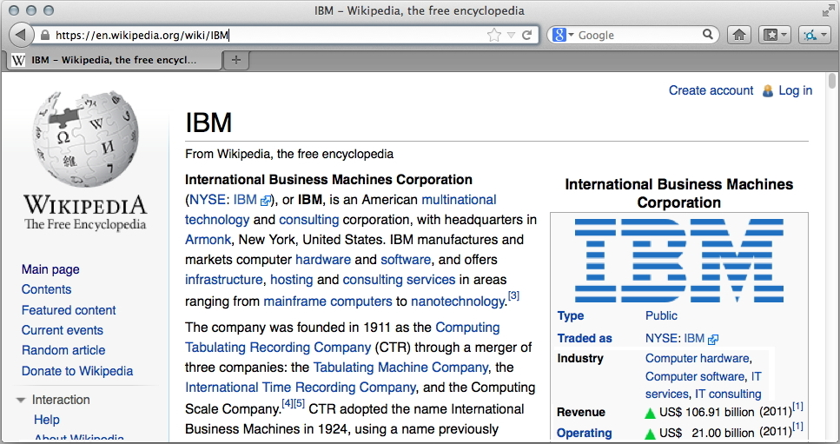
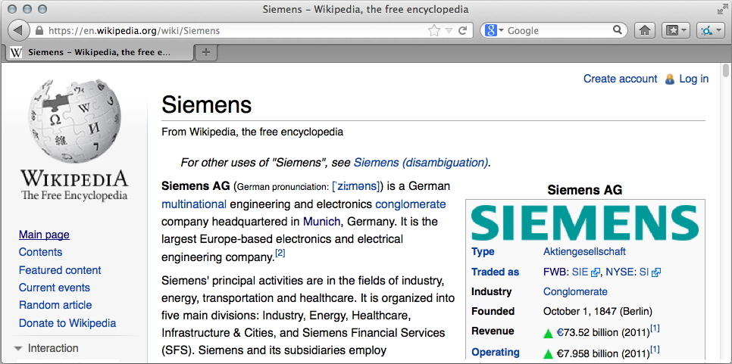
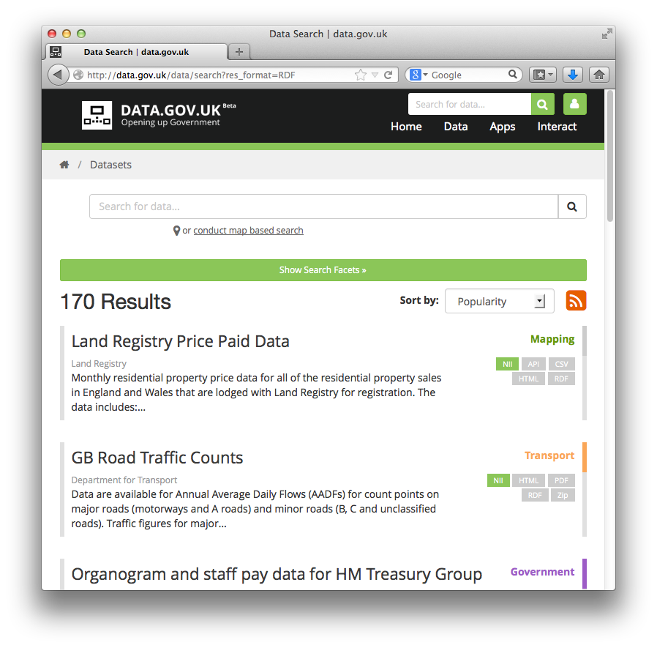
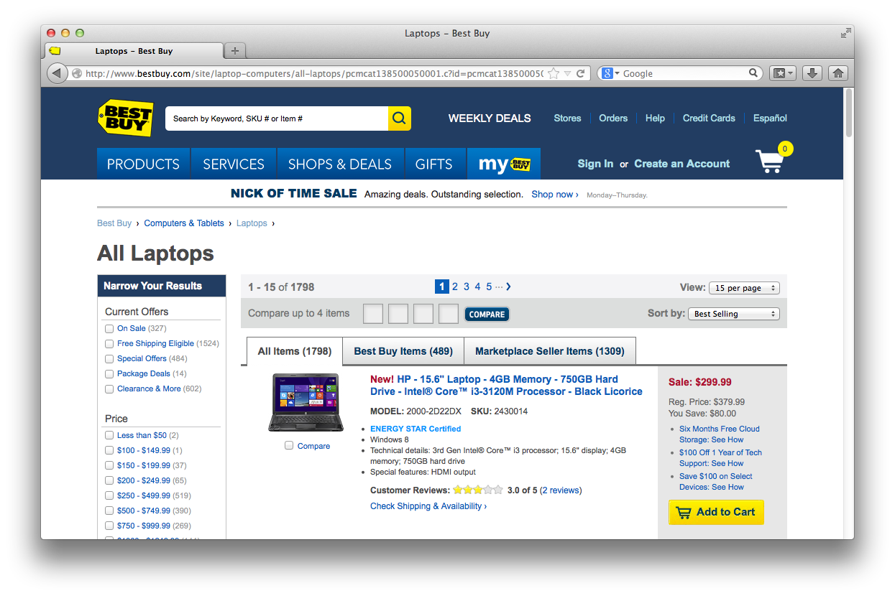
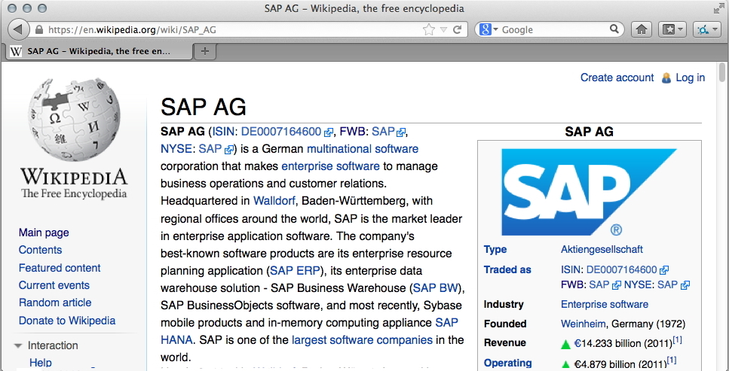
Data on the Web: the Web is not only a place for documents!
Most Web pages are created dynamically... from Data
Data from user-generated content...
Data from public administration...
Data from companies...
In the course of the trend for „Open Data“
a lot of this Data is being published
directly on the Web, but rarely interlinked

Slide 4
What is Open Data?
Availability and Access: the data must be available as a whole and at no more than a reasonable reproduction cost, preferably by downloading over the internet. The data must also be available in a convenient and modifiable form.
Reuse and Redistribution: the data must be provided under terms that permit reuse and redistribution including the intermixing with other datasets. The data must be machine-readable.
Universal Participation: everyone must be able to use, reuse and redistribute – there should be no discrimination against fields of endeavour or against persons or groups. For example, ‘non-commercial’ restrictions that would prevent ‘commercial’ use, or restrictions of use for certain purposes (e.g. only in education), are not allowed.
See more at: http://opendefinition.org/okd/
Open Knowledge Foundation

Slide 5
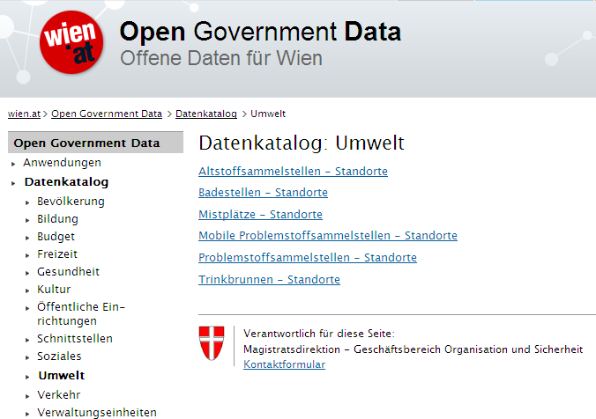
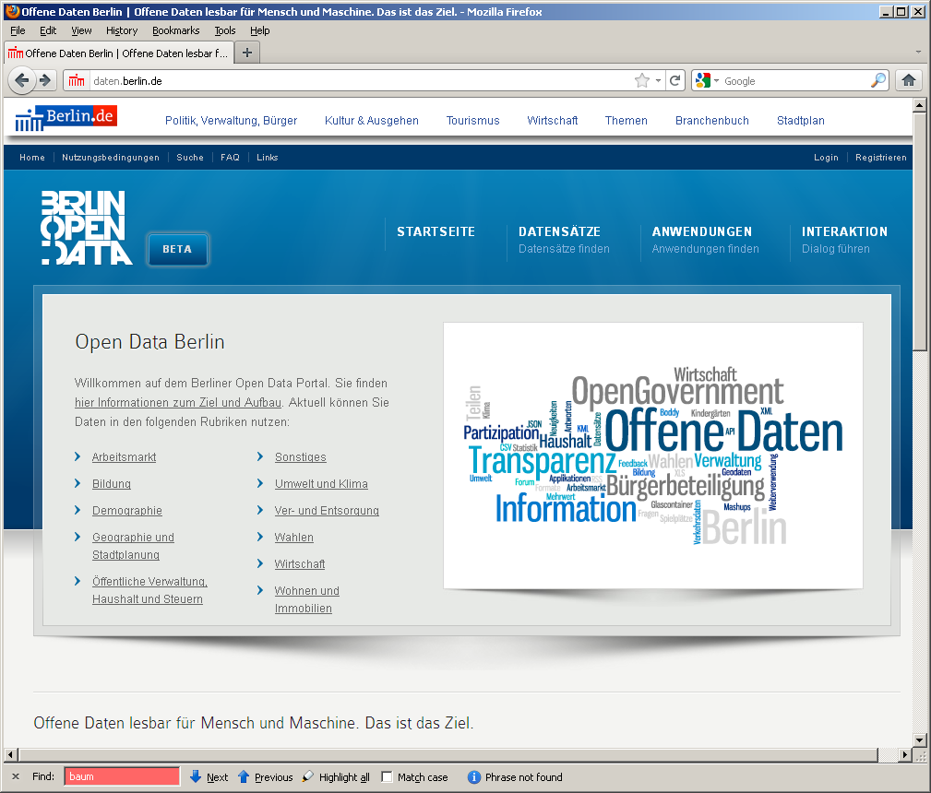
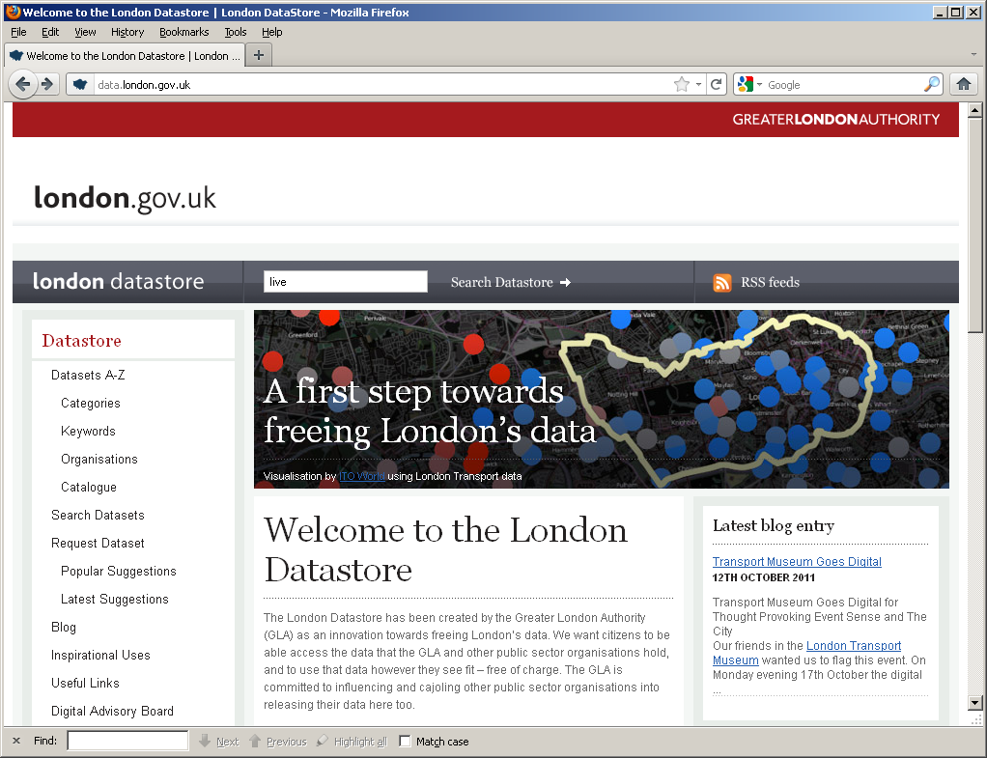
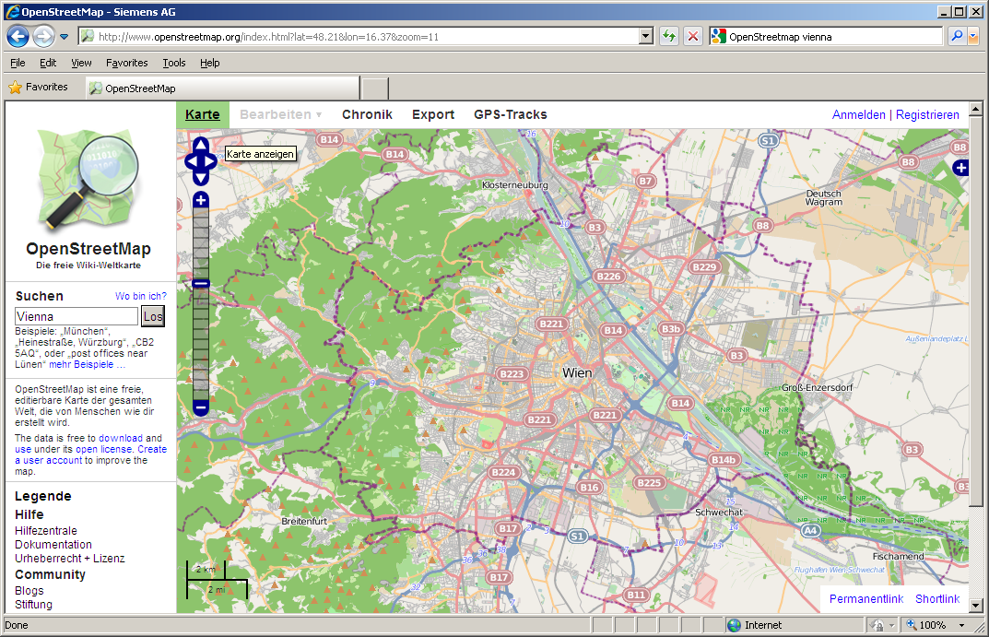
Open Data Trends, Future & Challenges
DIRECTIVE 2007/2/EC INSPIRE
Open Data: Typically very liberal licenses (variants of CC), but still mixed
Many formats, varying quality, harmonization starting
Mostly by online communities or public bodies (cities, communities, governments, UN,…)
Currently focused mostly in SMEs to take advantage of that data
vs. Publicly available data: e.g. NYT is public but not free/not license free
vs. Enterprise (Linked) Data

Slide 6
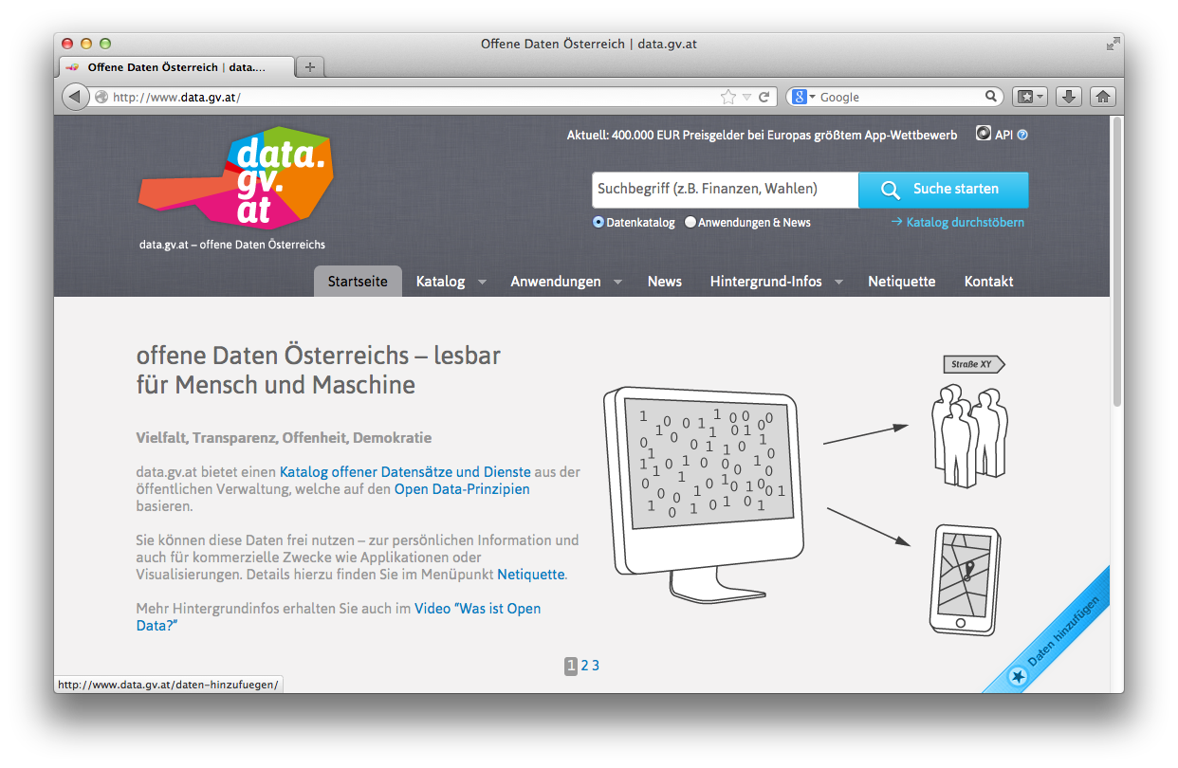
Open Data Portals
CKAN ... http://ckan.org/
almost „de facto“ standard for Open Data Portals
facilitates search, metadata (publisher, format, publication date, license, etc.) for datasets
http://datahub.io/
http://data.gv.at/
machine-processable? ...
... partially

Slide 7
Still... Challenges regarding machine-readability:
... Missing/wrong meta-data
related datasets are not linked
searching for the right dataset is difficult

Slide 8
Standards to the rescue: Towards more machine-processable Data publishing: Linked Data!

Slide 9
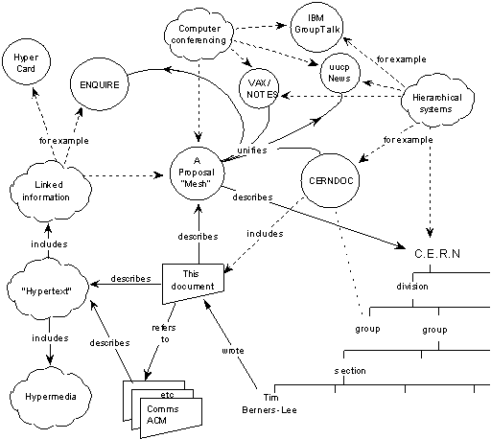
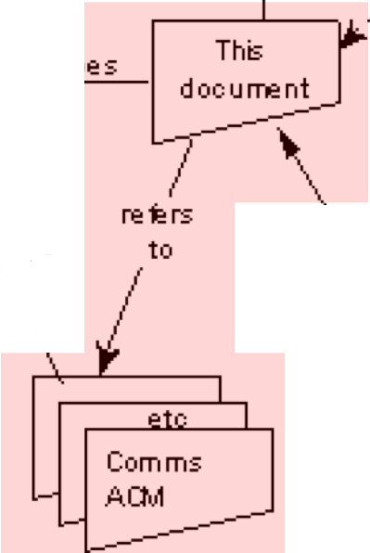
The Web 1989…
Globally Unique identifiers
Links between Documents (href)
A common protocol
URIs
“This proposal concerns the management of general information about accelerators and experiments at CERN
[…] based on a distributed hypertext system. “
HTTP
<p>I work <a href=“http://wu.ac.at”>here</a></p>

Slide 10
A standard format for aWeb of Data…
Globally Unique identifiers
Links between Documents (href)
A common protocol
Globally Unique identifiers
Typed Links between Entities
A common protocol
URIs
RDF
HTTP
xmlns.com/foaf/0.1/wokplaceHomepage
wu.ac.at
<p about="#me">I work <a rel=“foaf:workplaceHomepage” href=“http://wu.ac.at”>here</a></p>
polleres.net#me
<p>I work <a href=“http://wu.ac.at”>here</a></p>
Person
University

Slide 11
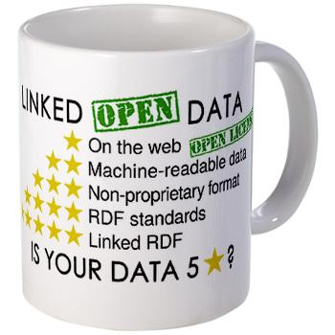
... towards Linked Data
Best practices to publish Data on the Web...
★ Make data/documents available on the Web
★★ Make it available as structured data (e.g., an Excel sheet instead of image scan of a table)
★★★ Use a non-proprietary format (e.g., a CSV file instead of an Excel sheet)
★★★★ Use linked data format (i.e., URIs to identify things, and RDF to represent data)
★★★★★ Link your data to other people’s data to provide context
Source: http://inkdroid.org/journal/2010/06/04/the-5-stars-of-open-linked-data/

Slide 12
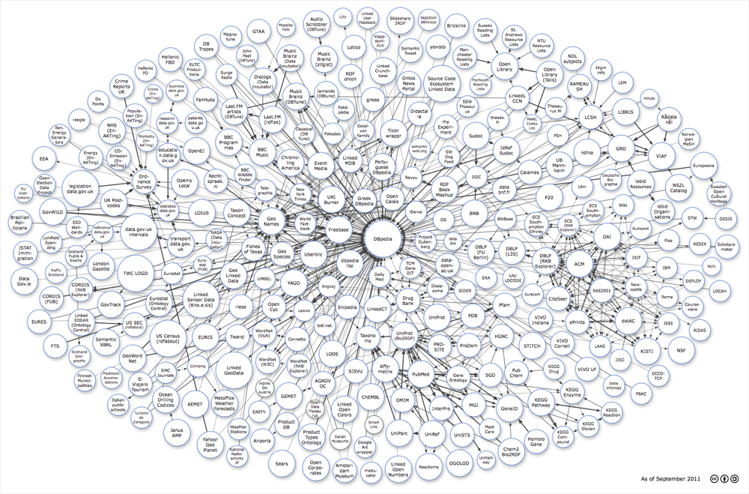
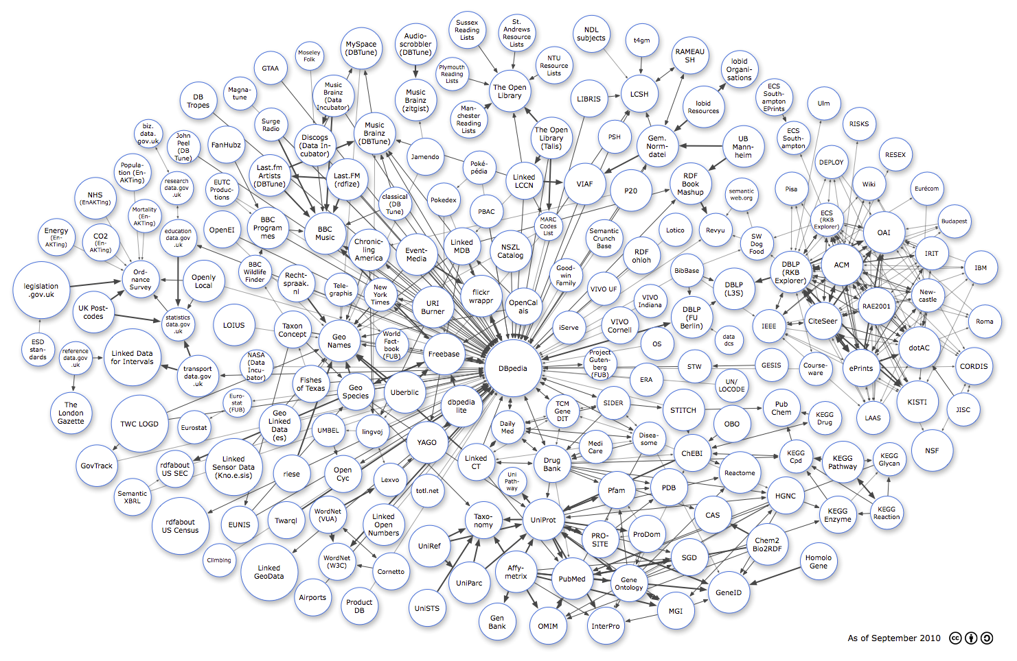
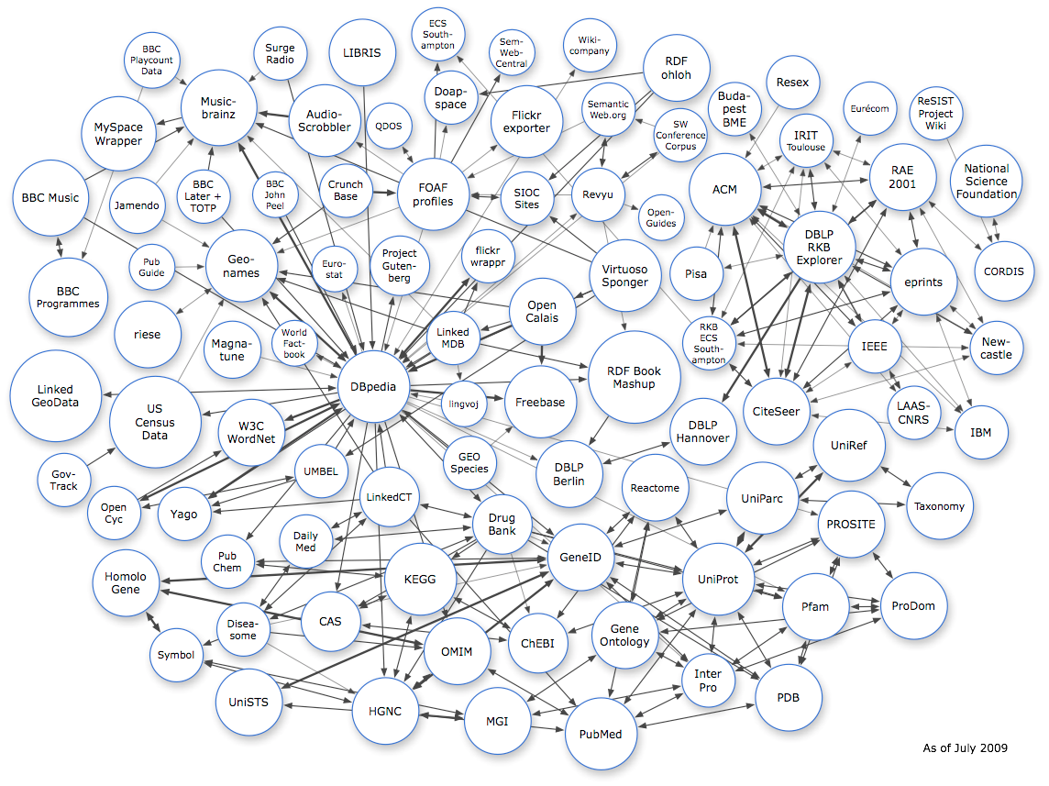
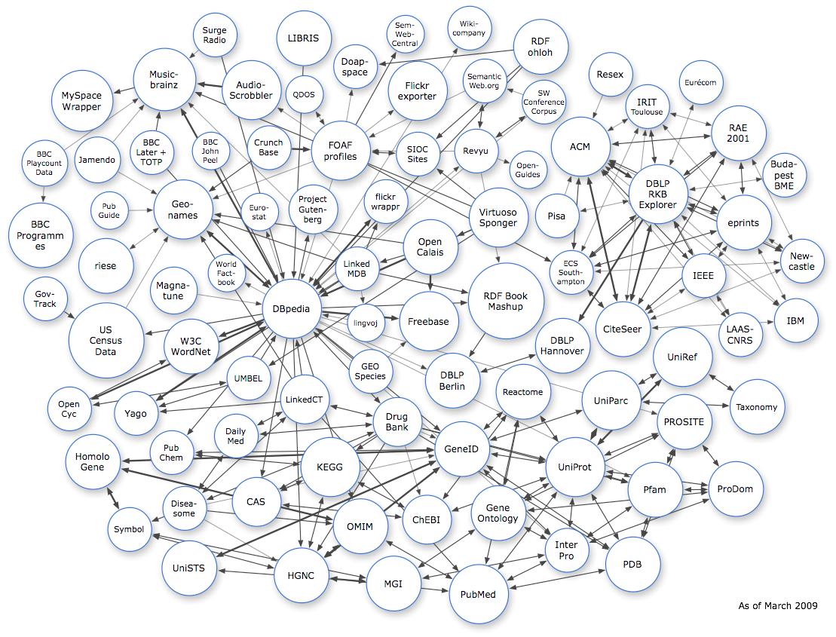
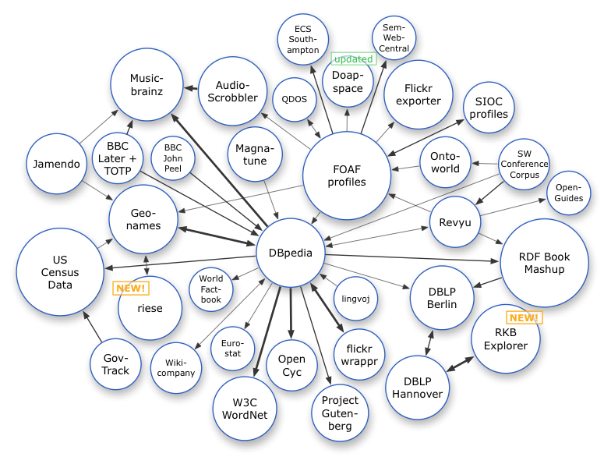
Linked Data on the Web: Adoption
Image from: http://lod-cloud.net/
March 2008
July 2009
March 2009
Sep. 2011
12
Sep. 2010

Slide 13
Linked Data is moving from academia to industry

Slide 14
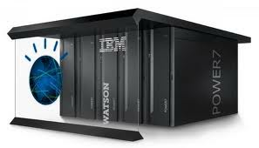
In the last few years, we have seen many successes, e.g. …
Watson
Knowledge Graph

Slide 15
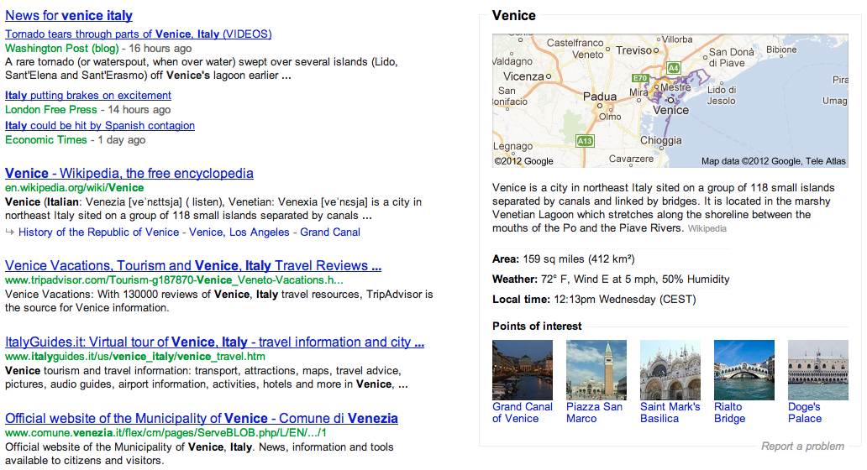
Google Knowledge Graph

Slide 16
Open Data – Status:
Mostly 3-star Open Data...
... RDF and Linked Data are starting to be adopted by Open Government Data.
Some exceptions: US, UK, EU

Slide 17
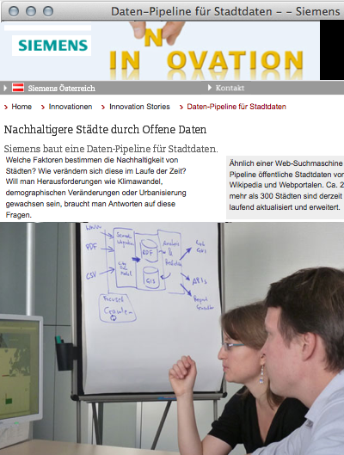
Can Open Data be used by industry?
Use Case: Building an Open City Data Pipeline...

Slide 18
Collected Data vs. Green City Index Data: Overlaps
We identified 20 quantitative raw data indicators that are overlapping between the Siemens’ “Green City Index” and our current Data sources. The picture below visualizes the availability of data for these indicators for the cities of the European GCI:
>65% of raw date could be covered by publically available data that we have collected automatically
Data quality?
Not all indicators are 100% comparable (different scales, units, etc., sources of different quality)
for some indicators (e.g. Population) already less than 2% median error.
The more data we collect, the better the quality!

Slide 19
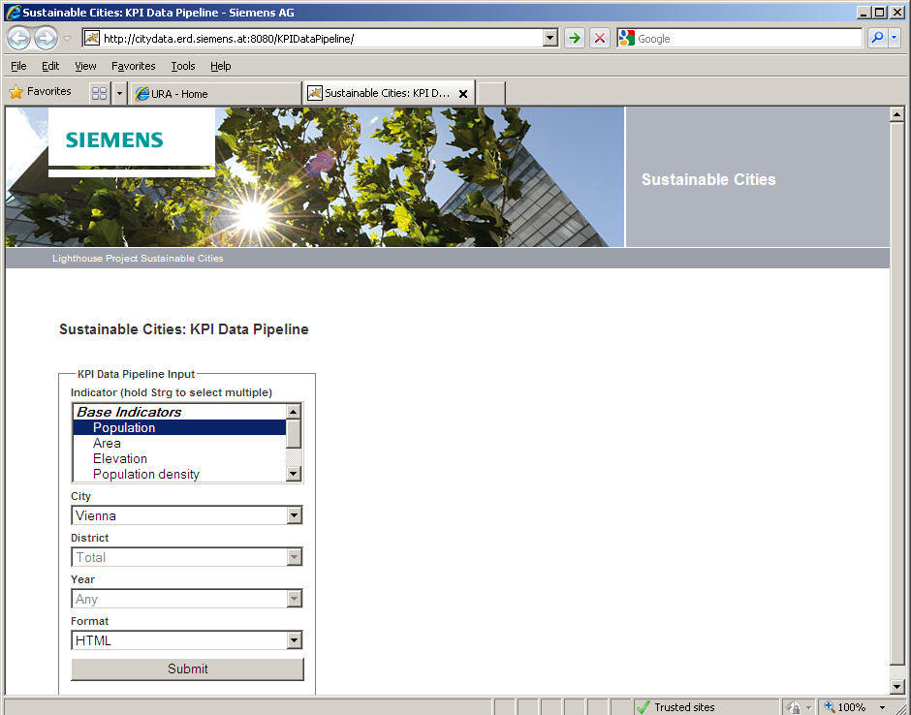
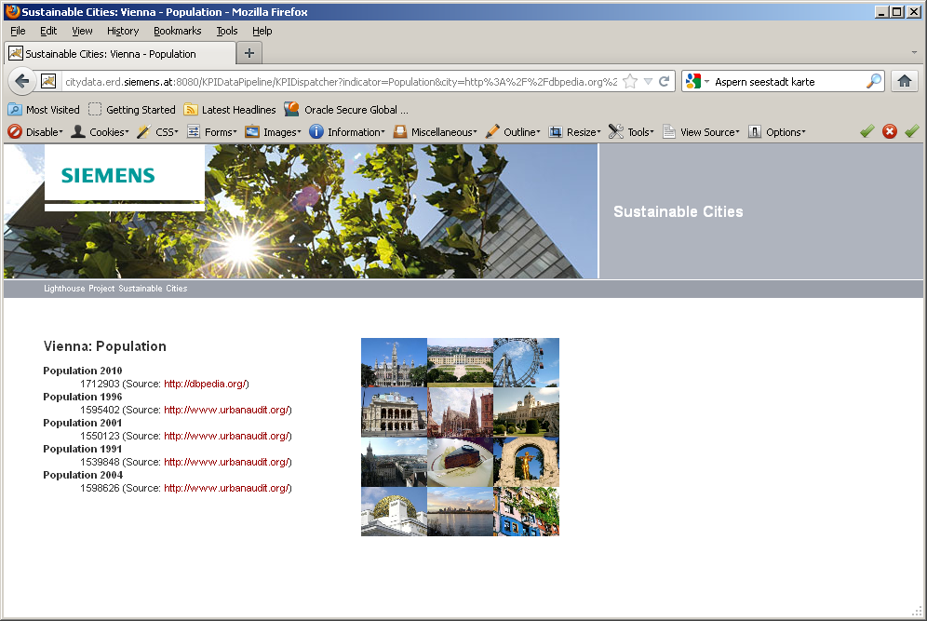
City Data Pipeline: Web Interface
Our Web interface allows to browse data and download complex composed KPIs as Excel sheets (e.g. “Transport related CO2 emissions for Berlin”):
2
Browse available Open Data sources that contain the requested indicators

Slide 20
Challenges & Lessons Learnt – Is Open Data fit for industry?
Incomplete Data: can be partially overcome
By ontological reasoning (RDF & OWL) = formalizing "background knowledge"
By statistical methods and data mining, e.g.Multi-dimensional Matrix Decomposition:
Incomparable Data:
dbpedia:populationTotal
dbpedia:populationCensus
Heterogeneity across Open Government Data efforts:
Different Indicators, Different Temporal and Spatial Granularity
Different Licenses of Open Data: e.g. CC-BY, country specific licences, etc.
Heterogeneous Formats (CSV != CSV) ... Maybe the W3C CSV on the Web WG will solve this issue)
Open Data needs strong standards to be useful
Gaining Knowledge from Open Data has high potential, but still needs research!
Notes:
Goal of this project: Do things before we finish the dabate about the challenges and standards.
Metadata-standards for provenance and PROV might help, RDF1.1 might help, but not readily deployed.
Top-level ontologies needed...
Yesterday at OFK meetup: „We really want high-quality datasets out there.“
To summarize, problems arising from the data:
* 96% of all data entries are missing (or 70% when ignoring the year dimension)
* the data is not missing at random (e.g. smaller cities are less likely to have temperature data)
* (the majority of) indicators are correlated
* there may be multiple values for the same (city, indicator, year) coordinate.
No indicator is truly gaussian/normal distributed (using a negentropy measure [6], area/population indicators are close, while for example augSun is closer to linear)
The multiple input values for that same city x indicator x year
Idea of matrix decomposition is that indicators can be “grouped”
every city is then to some degree a linear combination of these categories
For the current algorithm we used a two-dimensional matrix (no time).
We applied this relatively naively now.
We have heard already in the keynote by Mr Wrobel this morning: that standards are eventually what we need to make Open data more usable comparable and processable
Not only interesting for SMEs

Slide 21
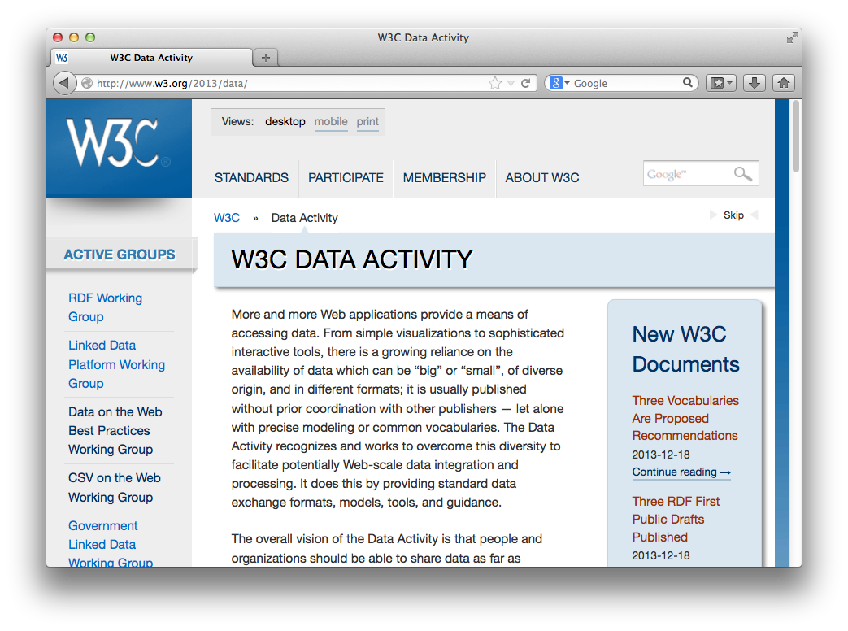
Recent Activities in Standardisation: W3C
W3C Data Activity launched (December 2013!!!)
Data on the Web Best Practices Group
CSV on the Web Group
Provenance WG (PROV)
Government Linked Data
Group
etc. ...
Also just founded
a data quality working group!

Slide 22
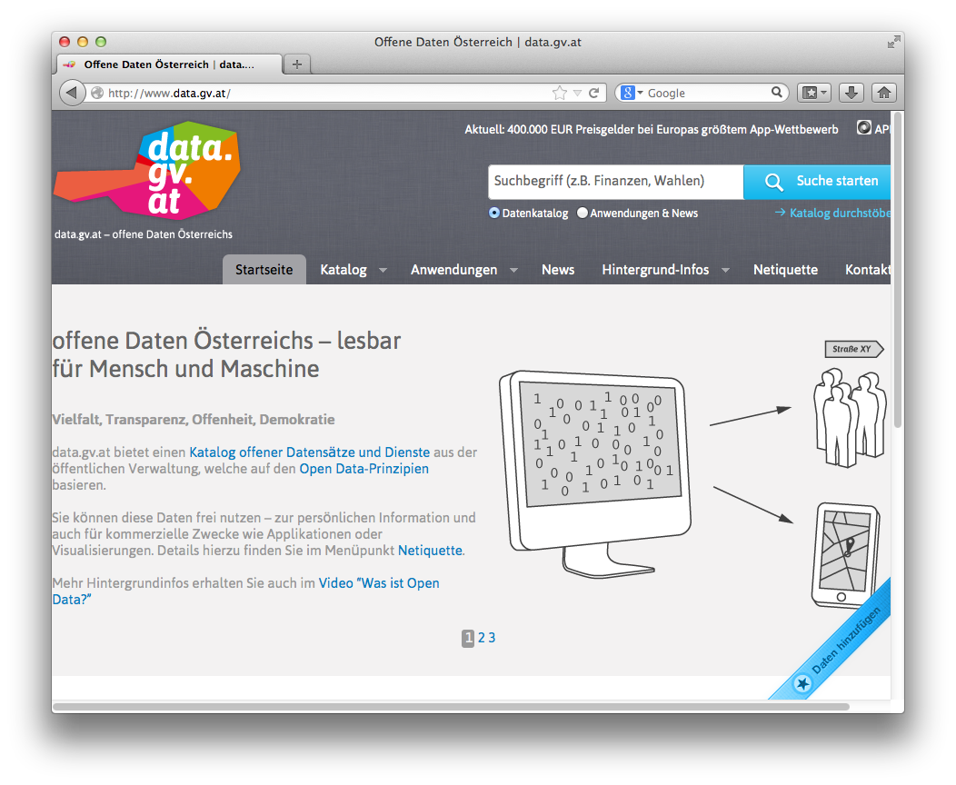
Open Government Data Austria:
Mostly 3-star
Various interesting aspects
Standard meta-data catalog
„grass-roots effort by various
public bodies (as opposed to e.g. UK)
Parallel (non-government)
Open data Platform underway
Unique license
Community meetings („BarCamps“)
E.g. transformation to 4/5-star discussed
The portal just won the UN Public Service Award 2014!

Slide 23
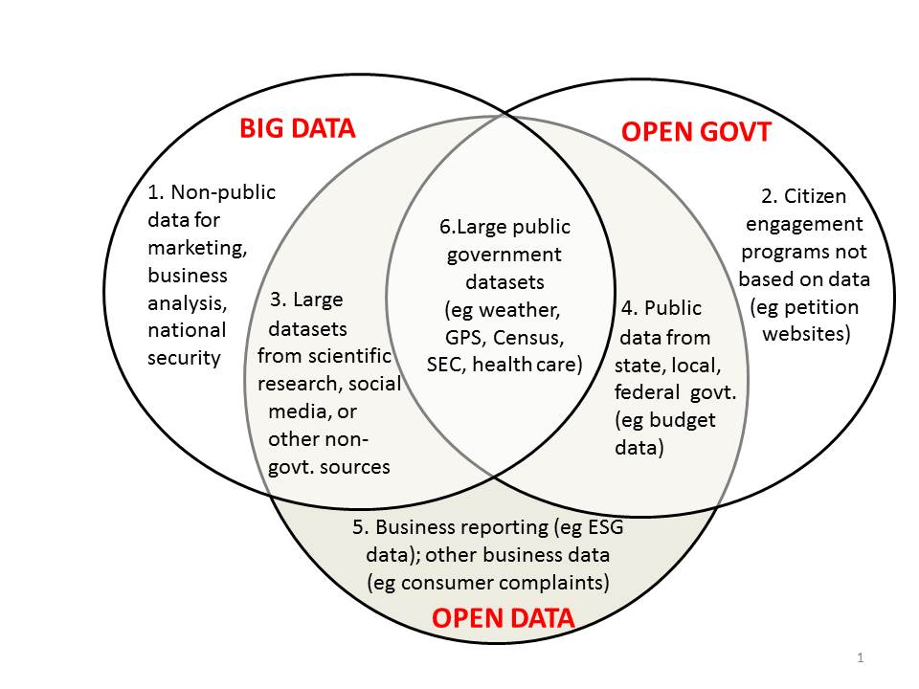
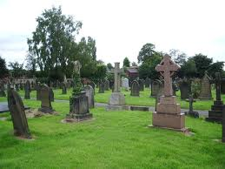
Open Data vs. Big Data
http://www.opendatanow.com/2013/11/new-big-data-vs-open-data-mapping-it-out/
Aggregated Open Data from various , heterogeneous sources and different portals will potentially become "Big Data" over time.
Serving Open Data "at scale" might become a challenge the more Open Data is being used!
We need big data technologies to avoid creating data graveyards

Slide 24
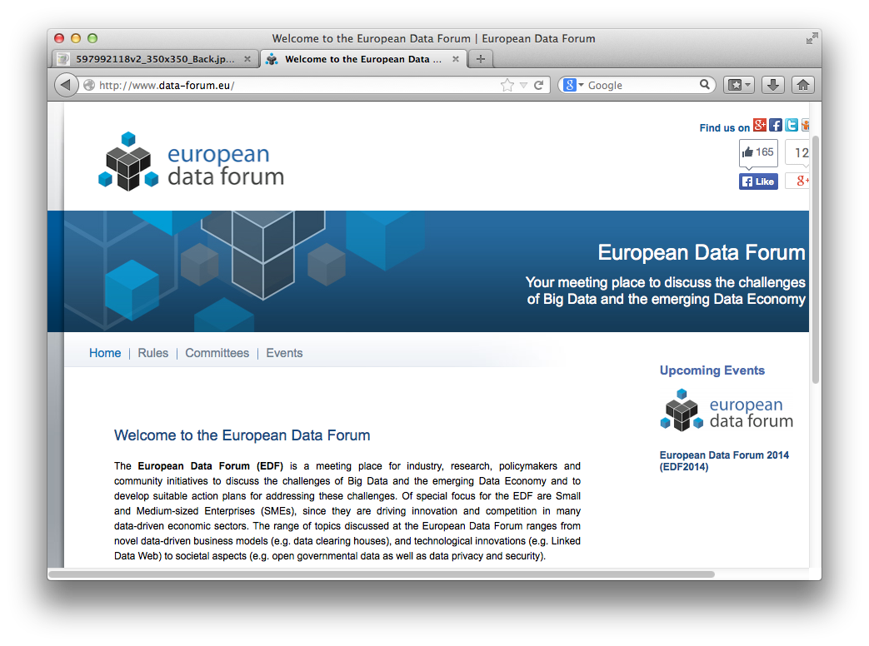
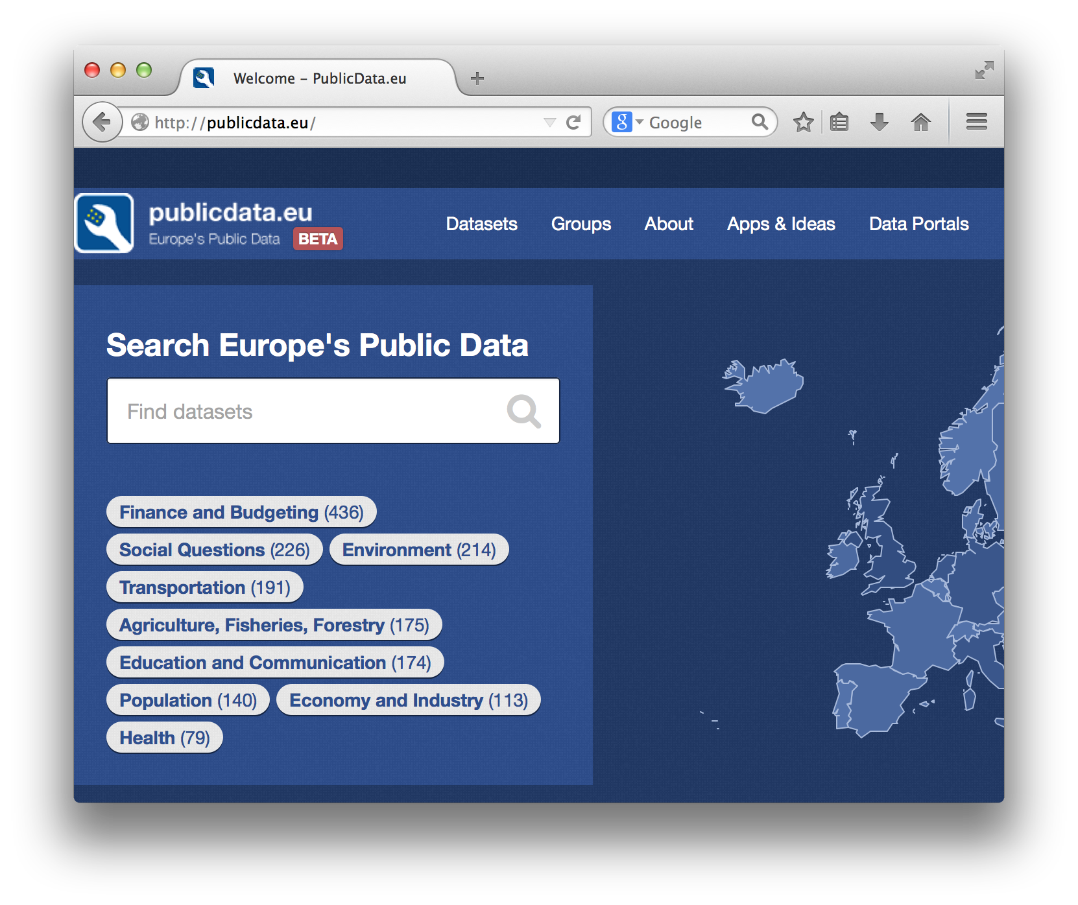
EU is pushing Linked Data Standards

