Slide 1
From SQL to SPARQL Symposium zur Pensionierung Prof. Wolfgang Panny
Axel Polleres
web: http://polleres.net twitter: @AxelPolleres

Slide 2
Hintergrund
~40 Jahre Forschung im Bereich Artif. Intelligence und Abfragesprachen an der WU
Operations Research, Algorithmen, Datenbanken
Logische Inferenz & Expertensysteme
SQL & Relationale Datenbanken in Theorie und Praxis
Aktive Mitarbeit in der Standardisierung von Abfragesprachen (ISO SQL)

Slide 3
Hintergrund
+10 Jahre Forschung im Bereich Semantic Web und Abfragesprachen, seit 2013 an der WU
Logische Programmierung, Deduktive Datenbanken
Logische Inferenz in Ontologien
SPARQL und Erweiterungen (SPARQL++, XSPARQL,...)
Aktive Mitarbeit in der Standardisierung von Abfragesprachen (W3C SPARQL)

Slide 4
Outline: From SQL to SPARQL
Linked Data: A universal Data Format for the Web
From Relational Data to Graph Data on the Web
Querying Linked Data with SQL and SPARQL
A few hints on the relation between those two languages
SPARQL‘s distinct Features and challenges

Slide 5
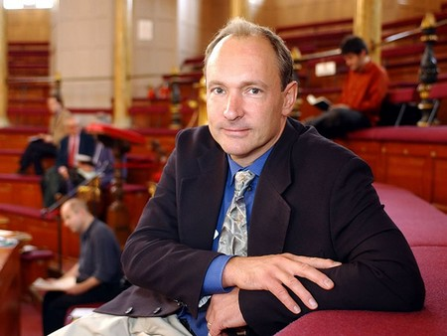
The “Semantic Web” promise…
“If HTML and the Web made all the online documents look like one huge book, RDF, schema and inference
languages will make all the data in the world look like one
huge database” Tim Berners-Lee, 1999
Try the following in google:
“Persons who have published books related to this book
and also have edited W3C specifications”
Notes:
Te explain what I mean here, let me start with a quote, which at the same time is one of the “big promises” of the Semantic Web and what its technologies shall enable. In 1999 Tim-Berners Lee, the creator of the Web wrote: “If HTML … “ Well, it’s almost 15 years from that now and so it should work by now, shouldn’t it? So let’s try that on google! Unfortunately google doesn’t answer these questions, because google doesn’t allow structured query answering…
For instance, take some market research questions such as the following:
What are the latest news on the new York times about companies with a revenue of over 10b EUR?
Or for my own preparation to this talk, I might have asked myself questions like the following: Who of my peers may have published with colleagues from WU Wien and how do these colleagues look like, such that I recognize them when I stand here in front of you today.

Slide 6
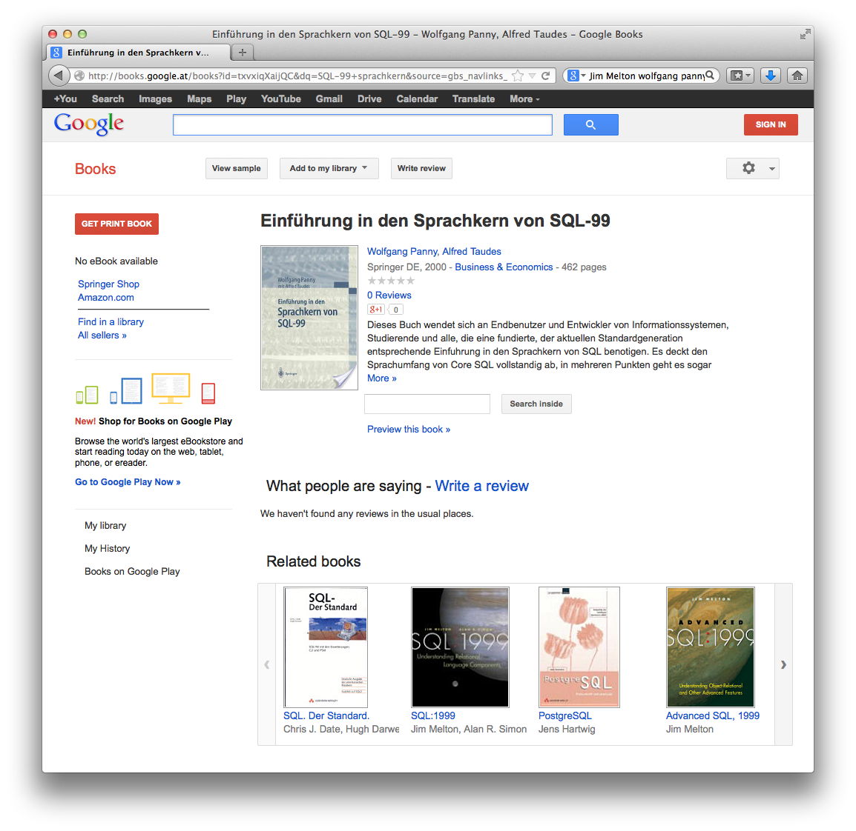
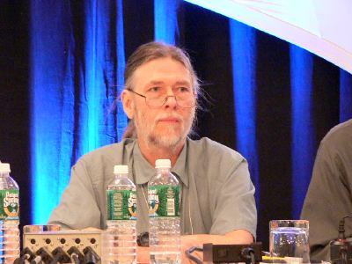
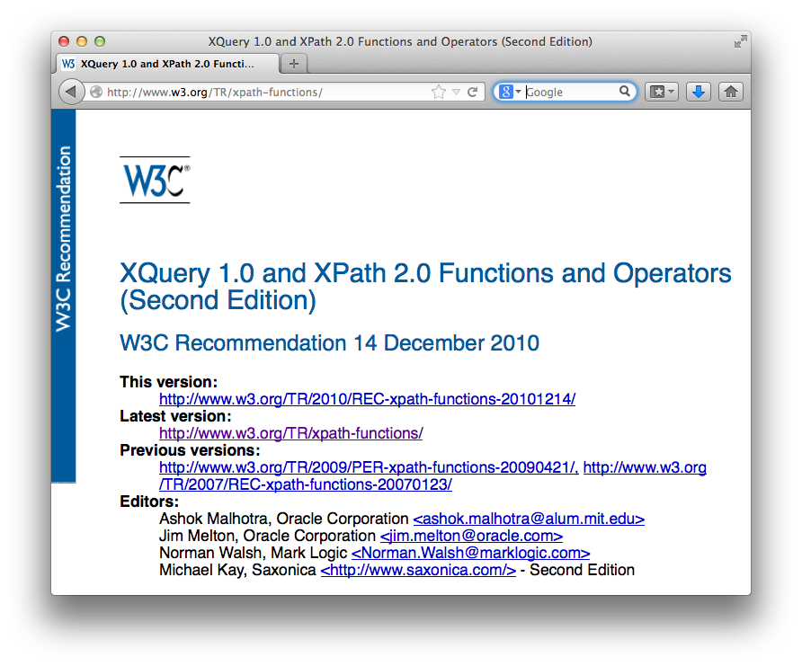
The data is all available on the Web…
Jim Melton, Oracle
Notes:
Likewise for the second question: The data is there, and the answer can be found by following links from my homepage, and my knowledge what these links mean. … There is a link to publications on DBLP, where I find that some of these articles I have coauthored with Stefan Decker, and if I browse further to Stefans publications, I find an article he has co-authored with Gustaf Neumann, with a link to his homepage at WU and a link to his picture. Again, this is actually structured data, all the data in DBLP comes from a Database which is exposed on the Web.

Slide 7
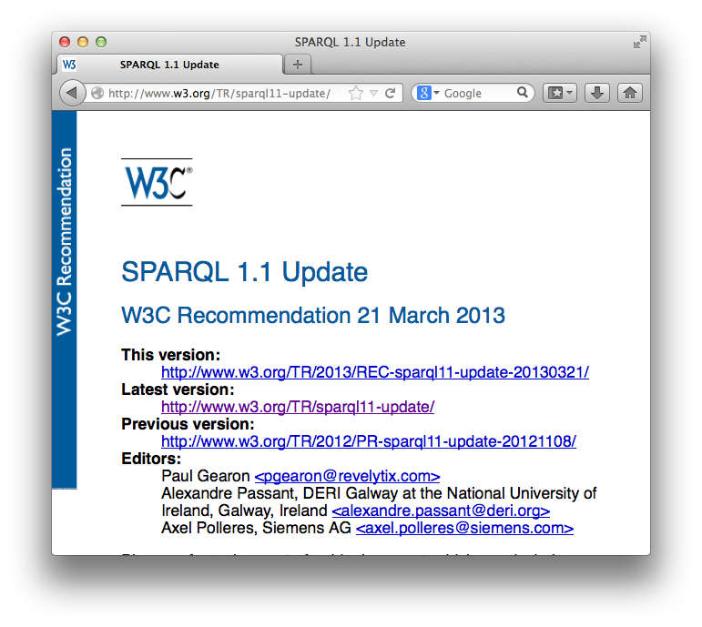
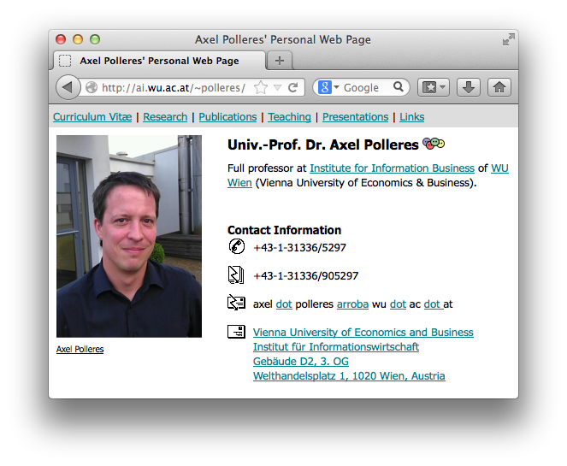
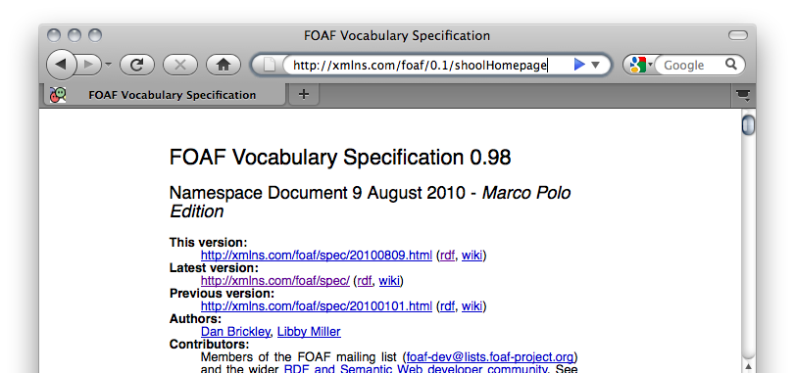
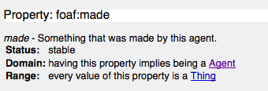
… towards a Web of (Linked) Data
From the HTML Web…
Globally Unique identifiers
Links between Documents (href)
A common protocol
Globally Unique identifiers
Typed Links (=relations) between Entities
A common protocol
URIs
RDF
HTTP
Axel Polleres edited SPARQL1.1 Update spec .
xmlns.com/foaf/0.1/made
polleres.net#me
w3.org/TR/sparql11-update
href
Person
Article
a universal graph-based data format…
(note that e.g. any relational data can be decomposed into such triples)

Slide 8
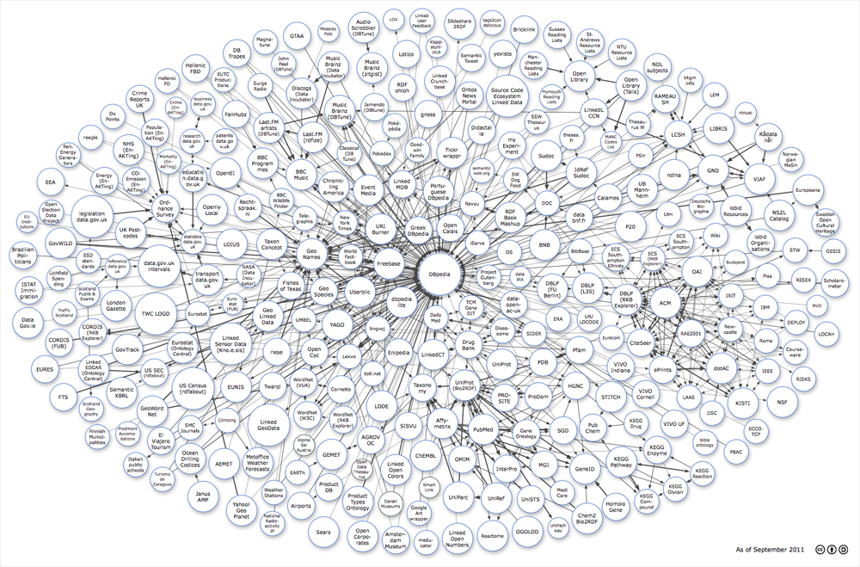
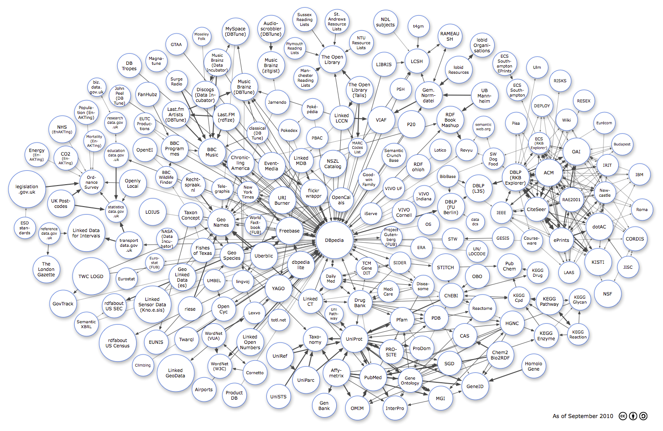
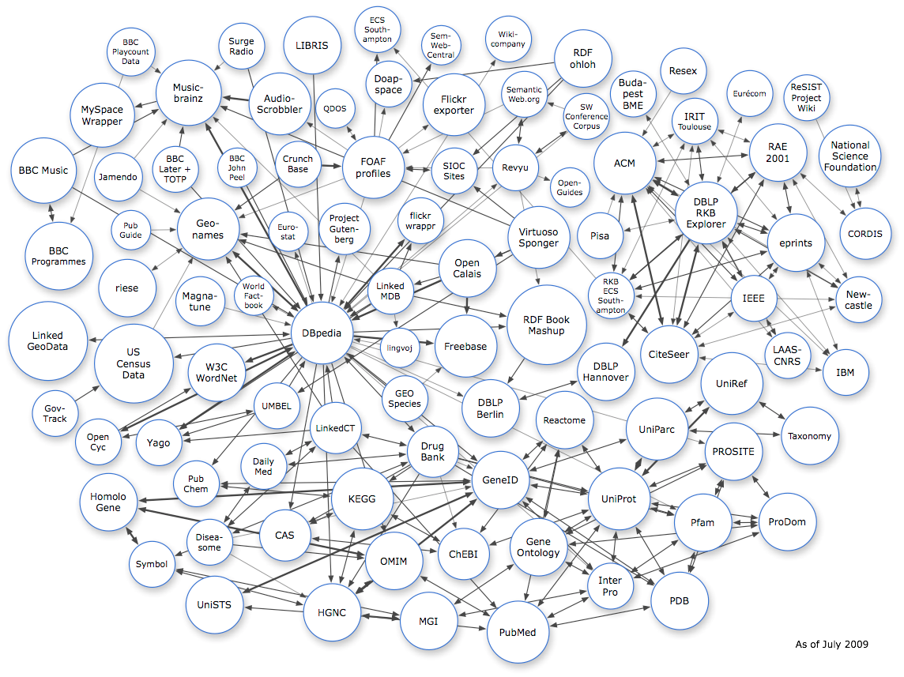
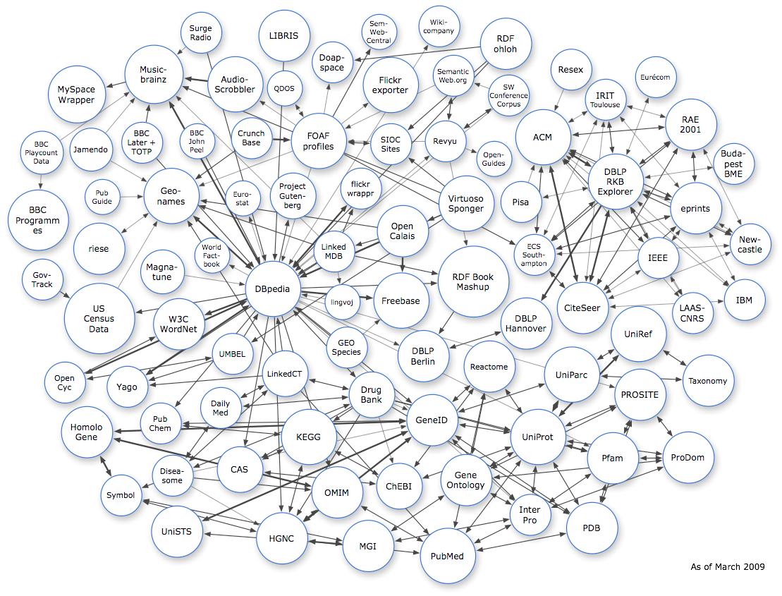
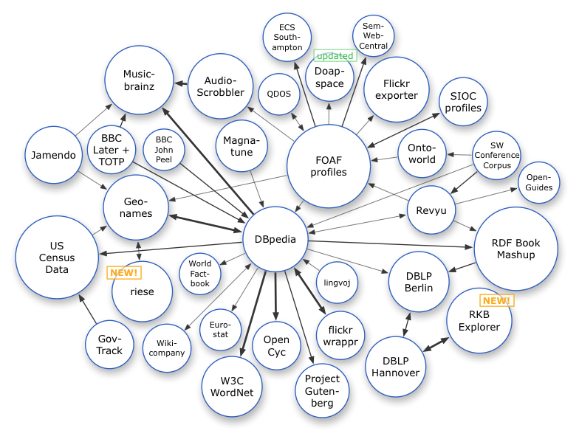
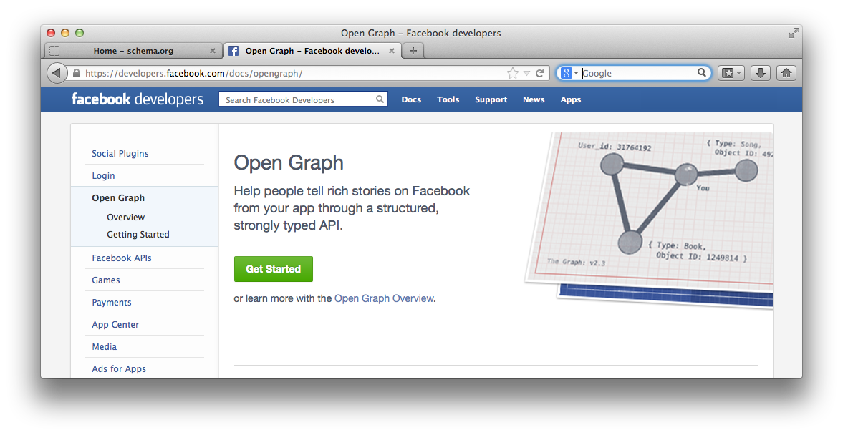
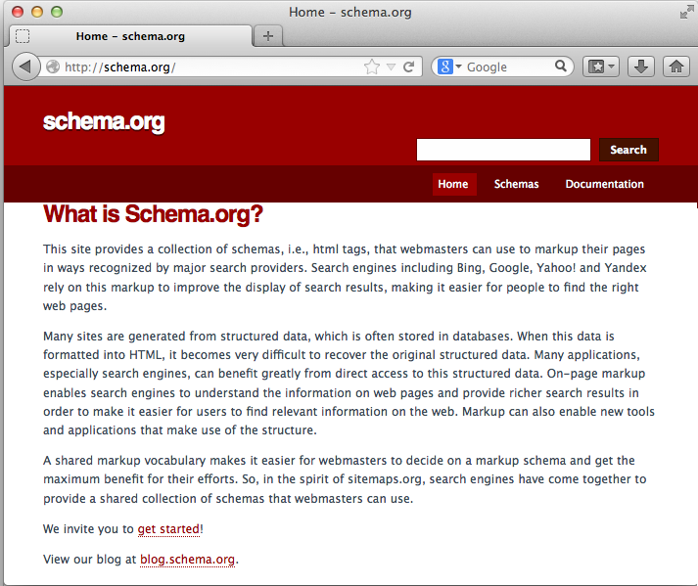
Linked Data on the Web: Adoption
Image from: http://lod-cloud.net/
March 2008
July 2009
March 2009
Sep. 2011
8
Sep. 2010

Slide 9
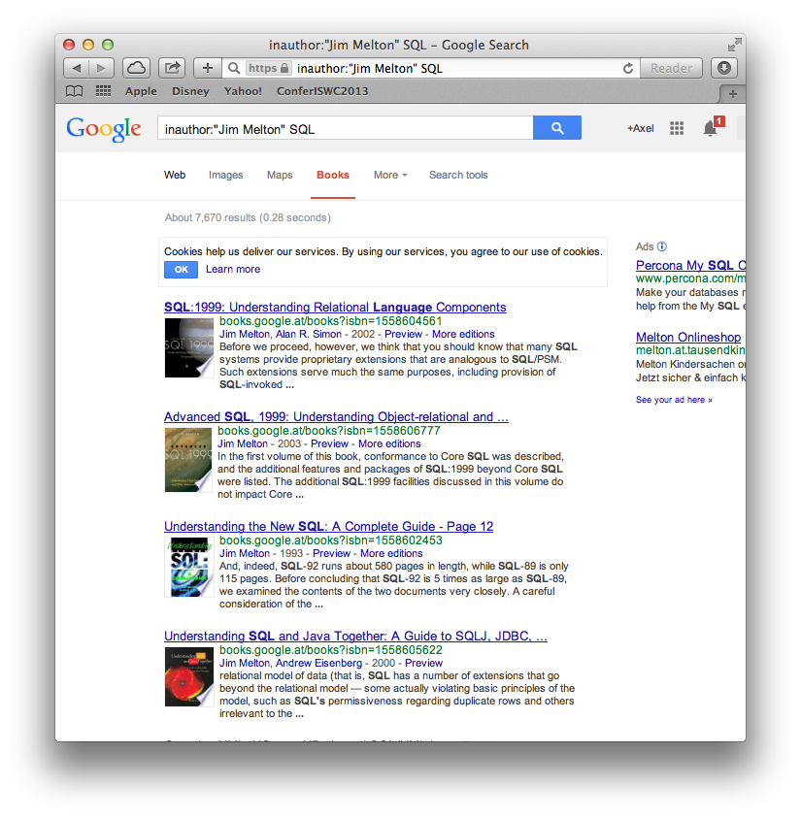
+ Linked Data Principles allow standard
access information on the Web
RDF
polleres.net#me
made
w3.org/TR/sparql11-update
title
SPARQL 1.1 Update
made
Axel Polleres
type
name
W3.org/REC
XQuery 1.0 and XPath 2.0 Functions and Operators
type
title
RDF Store
w3.org/TR/xpath-functions/
made
name
Subject | Predicate | Object
_:b1 | foaf:made | w3.org/TR/xpath-functions/
_:b1 | foaf:name | “Jim Melton”
google.books/Jim Melton | foaf:name | “Jim Melton
google.books/Jim Melton | foaf:made | google.books/SQL-1999
google.books/SQL-99 | rdfs:seeAlso | google.books/SQL-1999
Jim Melton
name
google.books/SQL-1999
made
Notes:
This idea of Linked data allows me, to answer my query for images of colleagues from WU linked to my coauthors just by traversing these typed links published over the Web…
That is, my Web pages says I’ve authored an article mentioned on DBLP, and DBLP mentions that Stefan has co-authored with me and also has co-authored with Gustaf Neumann, finally bringing me to his Webpage and image.
Fortunately, I don’t have to do this manually, but can crawl all this data into an RDF store (that is a new breed of Databases tailored for storing and querying this RDF data) and query this data from that data store in a structured query language

Slide 10
SPARQL
provides a standard query language
Query:
?Book1
made
?P
made
?Doc2
seeAlso
google.books/SQL-99
title
type
?T
w3c:REC
PREFIX g: <google.books/>
...
SELECT ?P ?T WHERE
{g:SQL-99 rdfs:seeAlso ?Book1 .
?P foaf:made ?Book1 .
?P foaf:made ?Doc2 .
?Doc2 rdf:type w3c:REC ;
cd:title ?T . }
RDF Store
Subject | Predicate | Object
W3c:editor1 | foaf:made | w3.org/TR/xpath-functions/
W3c:editor1 | foaf:name | “Jim Melton”
google.books/Jim Melton | foaf:name | “Jim Melton
google.books/Jim Melton | foaf:made | google.books/SQL-1999
google.books/SQL-99 | rdfs:seeAlso | google.books/SQL-1999
10
SPARQL
= SQL look-and–feel for Linked Data
Notes:
… this standard query language for RDF is SPARQL, which I have also contributed to as chair of the respective W3C working. You see this language looks very similar to SQL, and allows you to write down the triple “patterns” matching answers you’re looking for very much like a “graph template”… With these ingredients structured queries over Linked data should be possible!

Slide 11
Could be done in SQL, couldn’t it?
Yes, [Angles&Gutierrez, 2008] show that SPARQL1.0 has the same expressivity as non-recursive Datalog with Negation, i.e. Relational Algebra, i.e. within SQL-99)
But: … syntax gets quite blown up
… lots of self-joins…
encodings into SQL usually use different schemata e.g. property tables.
Specialized triple stores perform better than encodings on top of SQL DBs in practice
Plus: peculiarities that make this encoding non-trivial
e.g. the semantics of outer-joins in SPARQL (OPTIONAL)
cf. SPARQL1.1 Tutorial at http://polleres.net/presentations/20101019SPARQL1.1Tutorial.pptx
PREFIX g: <google.books/>
...
SELECT T2.Subject T5.Object
FROM triples T1, triples T2, triples T3, triples T4, triples T5
WHERE
{ T1.Subject = g:SQL-99 AND
T1.Predicate = rdfs:seeAlso AND
T1.Object = T2.Object AND
T2.Subject = T3.Subject AND
T2.Predicate = foaf:made …
triples
Subject | Predicate | Object
W3c:editor1 | foaf:made | w3.org/TR/xpath-functions/
W3c:editor1 | foaf:name | “Jim Melton”
google.books/Jim Melton | foaf:name | “Jim Melton
google.books/Jim Melton | foaf:made | google.books/SQL-1999
google.books/SQL-99 | rdfs:seeAlso | google.books/SQL-1999
11
Notes:
… this standard query language for RDF is SPARQL, which I have also contributed to as chair of the respective W3C working. You see this language looks very similar to SQL, and allows you to write down the triple “patterns” matching answers you’re looking for very much like a “graph template”… With these ingredients structured queries over Linked data should be possible!

Slide 12
SPARQL1.1
Adds some interesting new features that differ from SQL!
SPARQL1.1 Query: Property Paths, Aggregates, Subqueries, ...
SPARQL1.1 Federation
SPARQL1.1 Update
SPARQL1.1 Entailment Regimes
Still leaves some challenges open

Slide 13
SPARQL1.1 Query: Property Paths, Aggregates, Subqueries, ...
New features in the query language make SPARQL a „real“ graph query language, property paths (aka regular path queries):
„List all previous versions of the SPARQL Query Language specification“
PREFIX g: <google.books/>
...
SELECT ?X ?T WHERE
{ ?Rec rdf:type w3c:REC; dc:title “SPARQL 1.1 Query Language”
w3c:prevVersion* ?X. }
sparql11
prevVersion
prevVersion
prevVersion
sparql11
PR-sparql11
PR-sparql11
CR-sparql11
CR-sparql11
WD-sparql11
WD-sparql11
type
title
SPARQL 1.1 Query Language
w3c:REC

Slide 14
SPARQL1.1 Query: Property Paths, Aggregates, Subqueries, ...
New features in the query language make SPARQL a „real“ graph query language, property paths (aka regular path queries):
„E.g. List all previous versions of the SPARQL Query Language specification“
PREFIX g: <google.books/>
...
SELECT ?X ?T WHERE
{ ?Rec rdf:type w3c:REC; dc:title “SPARQL 1.1 Query Language”
w3c:prevVersion* ?X. }
RDF specific issues in terms of the „right“ semantics:
Count multiple paths or not?
V1
prevVersion
prevVersion
How to deal with cycles?
This problem does not occur in relational or tree-based models!
sparql11
V3
V2
prevVersion
prevVersion
prevVersion
V4
Academia provided useful input here: [Arenas+,2012], [Losemann&Mrtens,2012]

Slide 15
SPARQL1.1 Federation
Remote subqueries to delegate parts of a query to another SPARQL server:
„Famous people on wikipedia who have the same birthdays as my friends“
Problem in practice:
result limits in public
endpoints
(incomplete results)
Needs control flow to „incect“ bindings into remote calls.
PREFIX g: <google.books/>
SELECT ?P
FROM <mycContacts.rdf>
WHERE
{ polleres.net#me :knows ?X .
?X :birthday ?D
SERVICE <http://dbpedia.org/sparql>
{ ?P :birthday ?D }
}
Remote SPARQL endpoint: dbpedia.org
Local RDF Store
SPARQL Protocol
A solution to this problem: combining XQuery and SPARQL - XSPARQL [JODS,2013],

Slide 16
SPARQL1.1 Federation
Remote subqueries to delegate parts of a query to another SPARQL server:
„Famous people on wikipedia who have the same birthdays as my friends“
PREFIX g: <google.books/>
for ?D from <mycContacts.rdf>
where{ polleres.net#me :knows ?X .
?X :birthday ?D }
return { for ?P from endpoint <http://dbpedia.org/sparql>
where { ?P :birthday ?D }
return ?P }
A solution to this problem: combining XQuery and SPARQL - XSPARQL [JODS,2013],

Slide 17
SPARQL1.1 Update
SPARQL1.1 adds a Data Manipulation Language:
„Change the title of the SPARQL1.1 specification“.
INSERT { <sparql11> dc:title “SPARQL 1.1 Abfragesprache” }
DELETE { <sparql11> dc:title “SPARQL 1.1 Query Language” }
Note the difference to SQL...
... would not work for RDF, because in RDF several titles are possible:
Updates even more tricky when combined with implied triples by Ontologies (RDF Schema, OWL), cf. [OrdRing,2013]
UPDATE specs SET title = “SPARQL 1.1 Abfragesprache”
WHERE id = sparql11
sparql11
SPARQL 1.1 Abfragesprache
title
title
SPARQL 1.1 Query Language

Slide 18
Take-home message:
SPARQL is not too far form SQL
even SPARQL1.1 is translatable to SQL (or variants of Datalog, cf. [JANCL,2013])
although not straightforwardly, many special purpuoe implementations
... but adds some distinct features important for querying Web-&Graph-data
... plus syntax more „friendly“ to these use cases
... imposes different challenges than in normal relational setting in terms of optimizations for implementers
The availability of a standard query language will be a key enabler to the further success of Linked Data!

Slide 19
References
[Losemann&Martens,2012] Katja Losemann, Wim Martens: The complexity of evaluating path expressions in SPARQL. PODS 2012: 101-112
[Arenas+,2012] Marcelo Arenas, Sebastián Conca, Jorge Pérez: Counting beyond a Yottabyte, or how SPARQL 1.1 property paths will prevent adoption of the standard. WWW 2012: 629-638
Own publications:
[JODS,2013] Stefan Bischof, Stefan Decker, Thomas Krennwallner, Nuno Lopes, and Axel Polleres. Mapping between RDF and XML with XSPARQL. Journal on Data Semantics, 1(3):147-185, 2012.
[JANCL,2013] Axel Polleres and Johannes Wallner. On the relation between sparql1.1 and answer set programming. Journal of Applied Non-Classical Logics (JANCL), 23(1-2):159-212, 2013
[OrdRing,2013] Albin Ahmeti, Axel Polleres. SPARQL update under RDFS entailment in fully materialized and redundancy-free triple stores. 2nd Int‘l Workshop on Ordering and Reasoning (OrdRing 2013), October 2013.

