Slide 1
Dynamic querying of mass-storage RDF data with rule-based entailment regimes
Giovambattista Ianni, Thomas Krennwallner, Alessandra Martello, and Axel Polleres
Uniasdsd
Universitá Della Calabria
Notes:
1

Slide 2
What this paper is about
… we define two small, but useful language extensions of SPARQL for “dynamic inferencing and querying”
… we show its feasibility in an deductive DB-based implementation, the GiaBATA system.
… we demonstrate that we can achieve decent query response times by well-known optimization techniques.
2

Slide 3
Motivation
Why “dynamic inferencing and querying”?
Is the same data to be queried always with the same ontologies?
If my query engine supports inference, do we always want to use the same entailment regime?
Likely answer: “No”… the Semantic Web should be a solution to – as Ora Lassila formulated it – those problems and situations that we are yet to define
Unfortunately, not much support here from current RDF stores and SPARQL engines…
Can we fix it?
3

Slide 4
Example: Query the same data with different ontologies?
<Bob.rdf>
Query: Find bob’s nicknames?
1
2
3
4
5
:bob foaf:name "Robert";
foaf:nick "Bob";
foaf:icqChatId "Bob123";
foaf:holdsAccount <facebook.com/BobTheBuilder> .
<facebook.com/BobTheBuilder> sioc:name "Bob the Builder".
SELECT ?nick
FROM <Bob.rdf>
WHERE {:bob foaf:nick ?nick}
?nick
“Bob”
4

Slide 5
Example: Query the same data with different ontologies?
<Bob.rdf>
Query: Find bob’s nicknames?
Hmm, foaf.rdf says:
1
2
3
4
5
:bob foaf:name "Robert";
foaf:nick "Bob";
foaf:icqChatId "Bob123";
foaf:holdsAccount <facebook.com/BobTheBuilder>
<facebook.com/BobTheBuilder> sioc:name "Bob the Builder".
SELECT ?nick
FROM <Bob.rdf>
WHERE {:bob foaf:nick ?nick}
?nick
“Bob”
foaf:icqChatId rdfs:subPropertyOf foaf:nick
5

Slide 6
Example: Query the same data with different ontologies?
<Bob.rdf>
Query: Find bob’s nicknames?
Hmm, foaf.rdf says:
1
2
3
4
5
:bob foaf:name "Robert";
foaf:nick "Bob";
foaf:icqChatId "Bob123";
foaf:holdsAccount <facebook.com/BobTheBuilder>
<facebook.com/BobTheBuilder> sioc:name "Bob the Builder".
SELECT ?nick
FROM <Bob.rdf>
FROM <foaf.rdf>
WHERE {:bob foaf:nick ?nick}
?nick
“Bob”
foaf:icqChatId rdfs:subPropertyOf foaf:nick
Still, only one result in most SPARQL engines: missing: Inference rules
6

Slide 7
Example: Query the same data with different ontologies?
<Bob.rdf>
Query: Find bob’s nicknames?
Hmm, foaf.rdf says:
1
2
3
4
5
:bob foaf:name "Robert";
foaf:nick "Bob";
foaf:icqChatId "Bob123";
foaf:holdsAccount <facebook.com/BobTheBuilder>
<facebook.com/BobTheBuilder> sioc:name "Bob the Builder".
SELECT ?nick
FROM <Bob.rdf>
FROM <foaf.rdf>
WHERE {:bob foaf:nick ?nick}
?nick
“Bob”
foaf:icqChatId rdfs:subPropertyOf foaf:nick
“Bob123”
Fortunately, several engines support RDFS inference:, e.g. ARQ, Sesame:
{?s ?q ?o } <= {?s ?p ?o . ?p rdfs:subPropertyOf ?q}
7

Slide 8
Example: Query the same data with different entailment rules?
<Bob.rdf>
Query: Find bob’s nicknames?
Say, we want to add a mapping to SIOC, using OWL2
1
2
3
4
5
:bob foaf:name "Robert";
foaf:nick "Bob";
foaf:icqChatId "Bob123";
foaf:holdsAccount <facebook.com/BobTheBuilder>
<facebook.com/BobTheBuilder> sioc:name "Bob the Builder".
SELECT ?nick
FROM <Bob.rdf>
FROM <myVersionOfFoaf.rdf>
WHERE {:bob foaf:nick ?nick}
?nick
“Bob”
foaf:nick :propertyChainAxiom (foaf:holdsAccount, sioc:name ) .
“Bob123”
Nothing happens, not covered by RDFS rules
8

Slide 9
Example: Query the same data with different entailment rules?
<Bob.rdf>
Query: Find bob’s nicknames?
Say, we want to add a mapping to SIOC, using OWL2
1
2
3
4
5
:bob foaf:name "Robert";
foaf:nick "Bob";
foaf:icqChatId "Bob123";
foaf:holdsAccount <facebook.com/BobTheBuilder>
<facebook.com/BobTheBuilder> sioc:name "Bob the Builder".
SELECT ?nick
FROM <Bob.rdf>
FROM <myVersionOfFoaf.rdf>
WHERE {:bob foaf:nick ?nick}
?nick
“Bob”
foaf:nick :propertyChainAxiom (foaf:holdsAccount sioc:name) .
“Bob123”
Different set of inference Rules (OWL2RL) can cover that:
“Bob the
Builder”
{?s ?p ?o } <= {?s ?q [?r ?o].
?p :propertyChainAxiom (?q ?r) .}
9

Slide 10
Problems
Current implementations are not tailored for that kind of dynamic querying:
Most assume reasoning done once and for all (at loading)‏
→ Inference rules can’t be changed on-the-spot,
Most assume fixed dataset
On top of that, inferences in SPARQL often limited to the Default Graph
… Let’s look at the last problem first…
10

Slide 11
Example: Querying Named Graphs
Dataset in SPARQL (D,N) consists of
D … Default Graph (merge of FROM clauses, or given implicitly in the store)‏
N … Set of named graphs, identified by a IRI
Ontology is merged into default graph
SELECT ?nick
FROM <Bob.rdf>
FROM <myVersionOfFoaf.rdf>
WHERE {:bob foaf:nick ?nick}
D = myVersionOfFoaf.rdf Bob.rdf
N = {}
?nick
“Bob”
“Bob123”
“Bob the
Builder”
11

Slide 12
Example: Querying Named Graphs
Dataset in SPARQL (D,N) consists of
D … Default Graph (merge of FROM clauses, or given implicitly in the store)‏
N … Set of named graphs, identified by a IRI
SELECT ?nick ?g
FROM NAMED <Bob.rdf>
FROM <myVersionOfFoaf.rdf>
WHERE { GRAPH ?g {:bob foaf:nick ?nick }}
D = myVersionOfFoaf.rdf
N = { Bob.rdf }
?nick
?g
“Bob”
Bob.rdf
☹
Looses all inferences:
No means to “merge” ontology into a named graph!
12

Slide 13
Can we fix it? Yes we can!
Two extensions to SPARQL to handle these issues:
Extended Datasets / USING ONTOLOGY
USING RULESET
13

Slide 14
Extended Dataset/USING ONTOLOGY
Definition:
A graph collection G is a set of RDF graphs.
An extended RDF dataset D is a pair (G0,{⟨u1,G1⟩,...,⟨un,Gn⟩})‏
Enables merge arbitrary graphs into named graphs…
USING ONTOLOGY <O>
is simply a shortcut for merging <O> into any graph in the dataset.
SELECT ?nick ?g
FROM NAMED <Bob> ( <Bob.rdf> <myVersionOfFoaf.rdf> )
WHERE {GRAPH ?g { :bob foaf:nick ?nick }}
SELECT ?nick ?g
FROM NAMED <Bob> ( <Bob.rdf> <myVersionOfFoaf.rdf> )
FROM NAMED <Alice> ( <Alice.rdf> <myVersionOfFoaf.rdf> )
…
WHERE {GRAPH ?g { :bob foaf:nick ?nick }}
SELECT ?nick ?g
USING ONTOLOGY <myVersionOfFoaf.rdf>
FROM NAMED <Bob.rdf>
FROM NAMED <Alice.rdf>
WHERE {GRAPH ?g { :bob foaf:nick ?nick }}
14

Slide 15
USING RULESET
Additionally, we allow to explicitly name the ruleset that should be used for inference:
USING RULESET <R>
SELECT ?nick ?g
USING RULESET <rdfs.dlh>
USING ONTOLOGY <myVersionOfFoaf.rdf>
FROM NAMED <Bob.rdf>
WHERE {GRAPH ?g { :bob foaf:nick ?nick }}
SELECT ?nick ?g
USING RULESET <owl2rl.dlh>
USING ONTOLOGY <myVersionOfFoaf.rdf>
FROM NAMED <Bob.rdf>
WHERE {GRAPH ?g { :bob foaf:nick ?nick }}
?nick
?nick
?g
?g
Fixed!
“Bob”
Bob.rdf
“Bob”
Bob.rdf
“Bob123”
“Bob123”
Bob.rdf
Bob.rdf
“Bob the Builder”
Bob.rdf
15

Slide 16
Different Entailment Regimes
USING RULESET
Which rules we allow?
In principle: “safe” N3-style rules, i.e. no blank nodes in rule heads, e.g. USING RULESET rdfs
Paper defines extended BGP matching w.r.t such rulesets.
Internally, our system allows a more expressive language (dlvhex)‏
Other accepted syntaxes being worked in (RIF)‏
?P rdfs:subPropertyOf ?R. <= ?P rdfs:subPropertyOf ?Q. ?Q rdfs:subPropertyOf ?R.
?S ?Q ?O <= ?P rdfs:subPropertyOf ?Q. ?S ?P ?O .
?C rdfs:subClassOf ?E <= ?C rdfs:subClassOf ?D . ?D rdfs:subClassOf ?E .
?S rdf:type ?D. <= ?C rdfs:subClassOf ?D . ?S rdf:type ?C .
?S rdf:type ?C. <= ?P rdfs:domain ?C . ?S ?P ?O .
?O rdf:type ?C. <= ?P rdfs:range ?C . ?S ?P ?O .
16

Slide 17
How to implement this?
GiaBATA system:
SPARQL → dlvhex (logic program)‏
Ruleset → dlvhex (logic program)
Deductive Database techniques:
Datalog engine (dlvhex)‏
Postgres SQL Database underneath (dlv-db)‏
RDF storable in different schemas in RDB
Magic sets, storage
→ SQL
17

Slide 18
SPARQL → dlvhex (logic program)‏
Based on [Polleres ,WWW2007]
Non-recursive Datalog with negation and built-ins:
18

Slide 19
Ruleset → dlvhex (logic program)‏
Straighforward, just translates rules in a way “compatible” with the SPARQL translation:
{?s ?q ?o } <= {?s ?p ?o . ?p rdfs:subPropertyOf ?q}
19

Slide 20
SPARQL+Rules → SQL
Done by dlv-DB, cf. [Terracina, et al. TPLP 8(2),2008]
All non-recursive parts are pushed to the Database
All recursive parts handled by semi-naïve evaluation
(more efficient than WITH RECURSIVE views in SQL, where necessary, intermediate results temporarily materialized into the DB)‏
Some necessary optimisations to make this reasonably performant:
FILTER expression evaluation is pushed to SQL (3-valued semantics of SPARQL Filters is handled natively in SQL)‏
No miracles… but magic: Magic set optimisations for focused fwd-chaining evaluation.
Join-reordering, not yet implemented, but we did some manual reordering to optimize the query plan in the experiments.
20

Slide 21
What do we mean by “reasonably performant”
Experiments
Let’s compare with ARQ, Allegro, Sesame
21

Slide 22
Experiments Settings
Test setup
Dataset (LUBM1, LUBM5, LUBM10, LUBM30)‏
Intel P4 3GHz machine, 1.5GB RAM under Linux 2.6.24.
Compared Systems:
AllegroGraph 3.2 (native persistence mechanism)‏
ARQ 2.6 (connected to PostgreSQL 8.3)‏
GiaBATA (connected to PostgreSQL 8.3)‏
Sesame 2.3 (native store persistence support)‏
Experiments are enough for comparing performance trends, so we didn’t consider at this stage larger instances of LUBM.
LUBM test setup

Slide 23
Time Measures
Loading time
elapsed time needed for storing the dataset to the system.
Including the time spent in processing of ontology and source files (parsing, storing, indexing, possibly reasoning).
Query time
elapsed time for querying (opening the dataset, executing the query, getting the results, closing the dataset.
Evaluation time (overall loading + query time )‏
in our setting inferred information depends on the entailment regime, on the dataset at hand, per query
dynamic querying of RDFS moves inference from the pre-materialization-at-loading to the query step
We set a 120min query timeout limit to all test runs.

Slide 24
Query Examples
Query 1 (without inference)‏
{?X rdf:type GraduateStudent ;
takesCourse <http://www.Department0.University0.edu/GraduateCourse0> }
large input and high selectivity, no inference
Query 4 (with inference)‏
{?X rdf:type Professor‏;
worksFor <http://www.Department0.University0.edu>; ‏
name ?Y1;
emailAddress ?Y2;‏
telephone ?X ?Y3 }‏
small input and high selectivity, reasoning over subclasses:
Class Professor has a wide hierarchy, it queries about multiple properties of a single class.

Slide 25
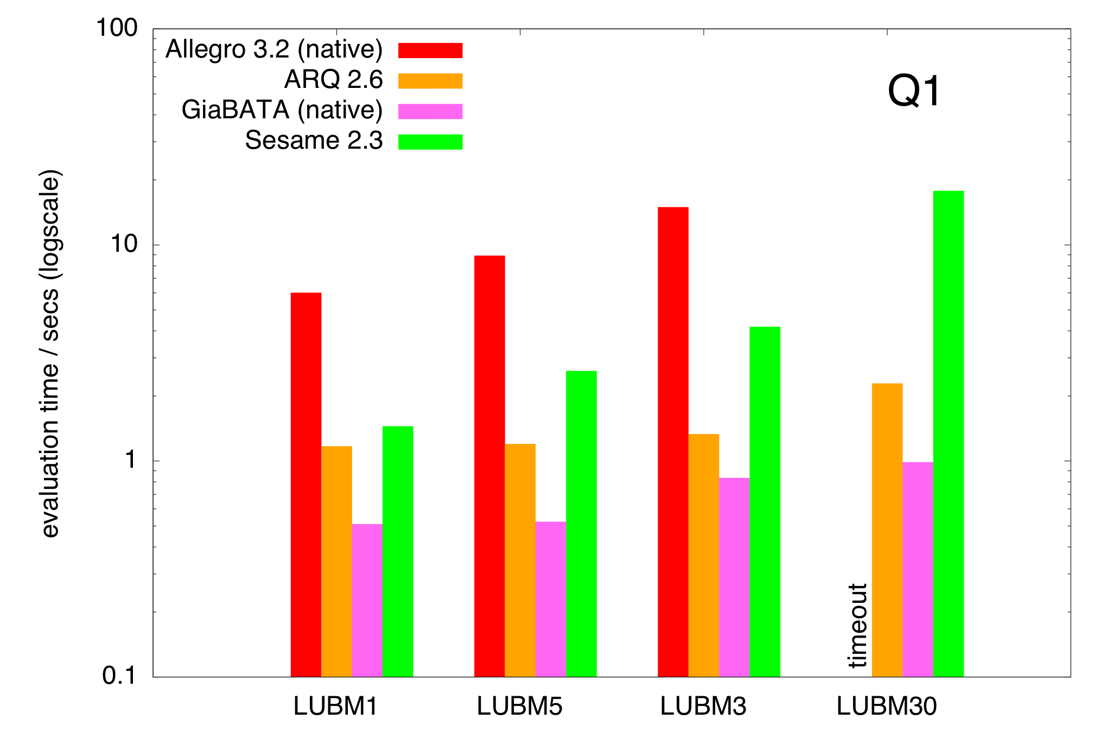
What do we mean by “reasonably performant”
Experiments
Let’s compare query time with ARQ, Allegro, Sesame - performance
Notes:
Q1, just to check, seems our SQL reqeiting is not too bad… Q4: Interesting Allegro (ordered is almost constant/linear, sesame)

Slide 26
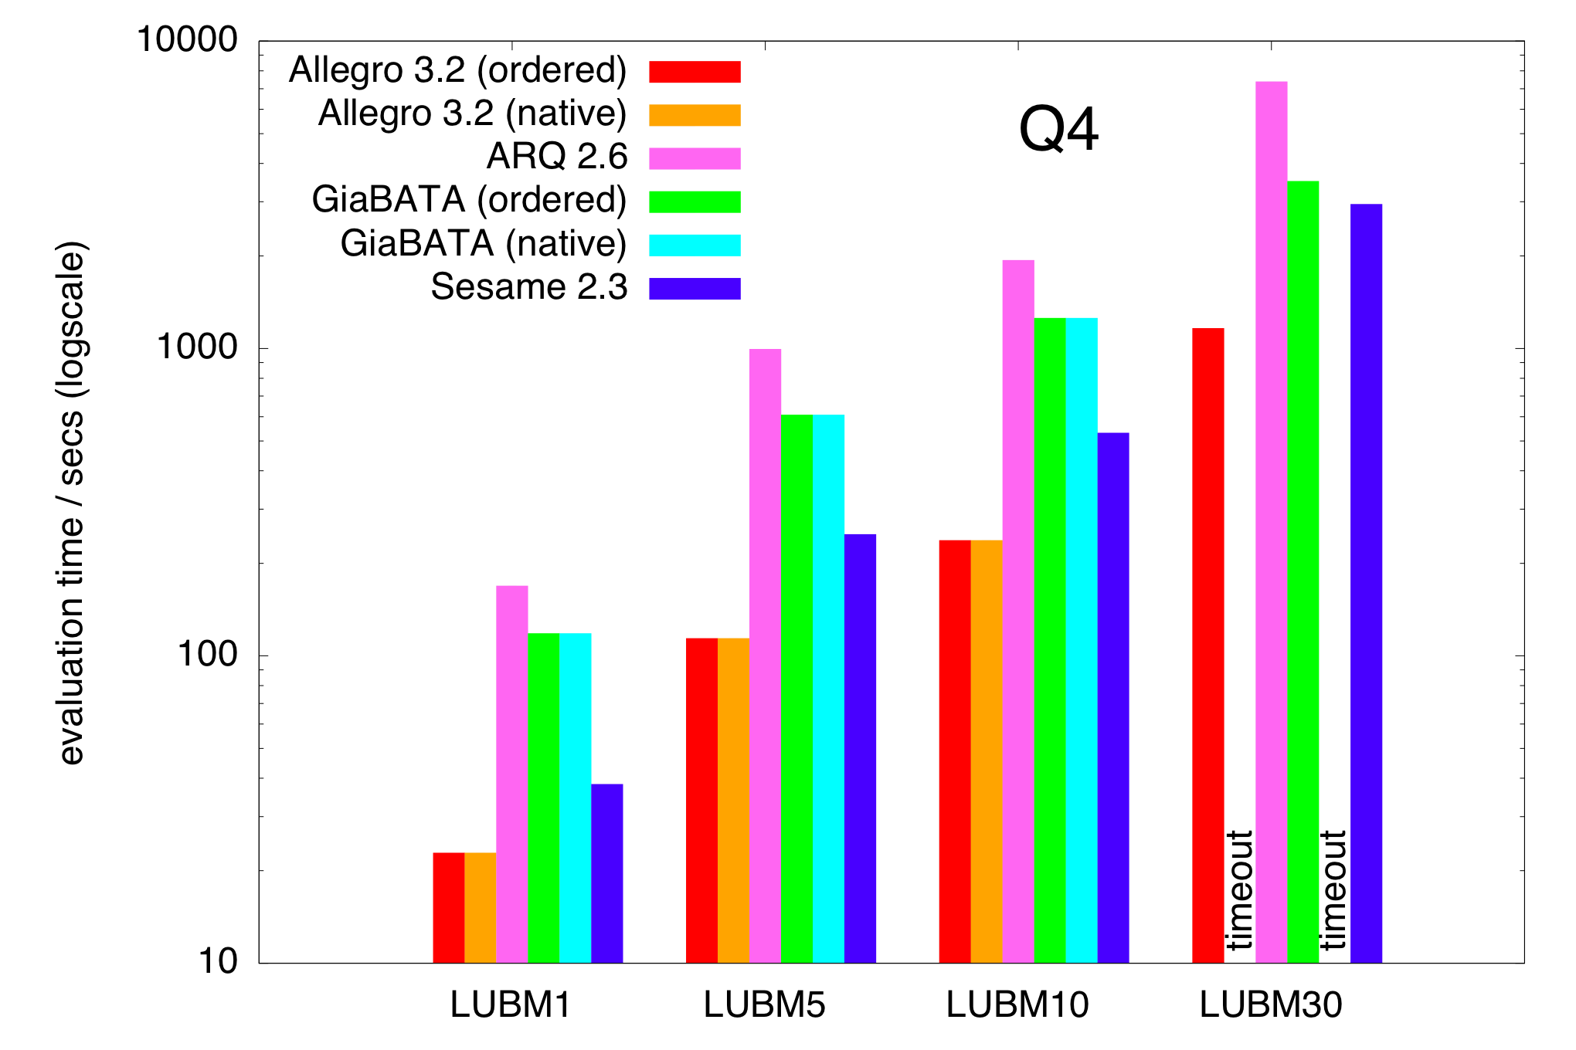
Q4: query time
Taking loading time into account different picture:
Trend looks promising…
Notes:
Allegro ordered is query manually ordered…

Slide 27
System Comparison (1)‏
RDBMS Support
all systems allow persistent storage on RDBMS.
AllegroGraph is itself a database, but it offers the ability to back up its operations to a relational database
INFERENCE/QUERYING STRATEGY
both reasoning and query evaluation are usually performed in main memory, with exception of ours
all, except AllegroGraph and ours, adopt a persistent materialization approach of the whole closure for inferring data.
So, AllegroGraph has some Dynamic inferencing support, but no means to change the dataset on the fly after loading.
www.franz.com/agraph/allegrograph/dynamic-materialization.lhtml
Notes:
We can do some pre-oprimisation, e.g. magic sets that we do now, etc.

Slide 28
System Comparison (2)‏
RDFS/OWL SUPPORT
all cover RDFS (actually, disregarding axiomatic triples) and partial or non-standard OWL fragments.
RULESET FORMAT
Custom (none yet support e.g. RIF)
External reasoner integration (beyond rules)
Sesame via Sesame Sail Interface;
ARQ interface with external DL reasoner (Pellet, Racer, FaCT);
AllegroGraph support integration with RacerPro;
GiaBATA via external atoms of dlvhex‏

Slide 29
What we did:
… defined two extensions of SPARQL for “dynamic inferencing and querying”
… showed feasibility in an deductive DB-based implementation, the GiaBATA system.
… demonstrated that we can achieve reasonable query response times by well-known optimization techniques.
29

Slide 30
Conclusion/Outlook
There is no one-size-fits all solution to querying semtantic data → dynamic querying/inference is often needed
May be viewed similar in spirit to “hypothetical datalog”:
add/delete clauses hypothetically…
… we didn’t yet consider the delete part
More experiments: on multiple/sequential queries in production, ie. compare one-time loading vs reloading/rematerialising per query.
We need more/better optimisations, if we really want to do dynamic inference on larger scale, e.g. no caching yet. not taking into account data graph structure/statistics
30

Slide 31
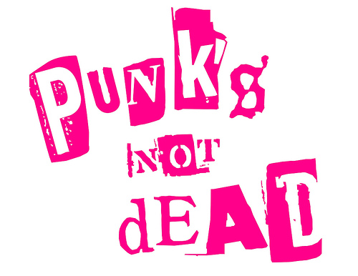
Conclusion/Outlook

